Slide 1
GCSE Science: Marking and improving student outcomes in AO2-focussed questions
Jane Bryant
Spring 2019

Slide 2
Welcome

Slide 3
This meeting will be recorded
Exam boards have an Ofqual requirement to record event audio.
Recordings are kept for the lifetime of the specification and not shared as an accompaniment to session resources.
The recording will begin now.

Slide 4
Outline for the session
Mark schemes and how we apply them
AO2-focused questions in GCSE sciences
Exercise using student work
Using exam questions to improve student performance
Assessing AO2 at different levels of demand
Notes:
Outline of the whole session.
First, I’d like to find a little more about you: where you come from, your experience
Include questions that usually use in first slide of Inset Online presentations?
The first section – Mark schemes and how we apply them – is generic to all three presentations.
General headings for the AO2 section onwards should be adaptable to both Maths and Practical Skills.

Slide 5
Mark schemes and how we apply them
What is the mark scheme for?
Our GCSE Science mark schemes
Points-based mark schemes
Levels of response mark schemes
Notes:
Before going into detail on how we assess different skills, want to give some information on how we mark our questions. The following section covers some general, but very important information on using our mark schemes.
By understanding and applying the principles given here, teachers should be able to mark papers easily and consistently when using out papers as mocks for their students.

Slide 6
What is the mark scheme for?
To evaluate the evidence from each student fairly
To reward positive achievement
To differentiate purely on evidence of subject knowledge, understanding and skills
To fully and consistently reflect the agreed interpretation of command words
To fully reflect the purpose of each assessment
To credit appropriate responses that reflect the different ways in which learners may demonstrate what they know, understand and can do
Notes:
Loads of good information in Fair Access by Design – Ofqual document Pages 37 to 39 deal with the mark scheme. The notes below are taken from this document.
Mark schemes
Mark schemes that are valid and use clear language will support both accurate marking and equal opportunities.
Mark schemes should be designed so that they can be easily and consistently applied by all assessors. In addition, teachers and learners may have access to assessed work and the associated
mark scheme. It is therefore important that mark schemes show clearly what, where and how marks are awarded.
Assessments should be designed to reward positive achievement. They should differentiate between learners purely on evidence of subject knowledge, understanding and skills. The degree of
flexibility of a mark scheme will reflect the nature of the subject and what is being assessed. Equally valid responses presented in different forms should achieve the same marks.
Mark schemes should credit appropriate responses that reflect the diverse background of learners and the different ways in which they may demonstrate what they know, understand
and can do. Some types of task present particular challenges. Synoptic questions, for example, need to take account of the many valid ways in which learners may answer the question.
Some multi-part questions may explicitly be designed to test a sequence of logical thought. Generally, however, mark schemes should not allow a wrong answer on one part of a question to
make later marks harder or impossible to earn.
Each of the following points considers an aspect of the design of mark schemes.
Awarding bodies should:
a) ensure that the purpose of each assessment is fully reflected in the associated mark scheme
b) ensure that the mark scheme rewards a variety of appropriate responses
c) design mark schemes that are sufficiently flexible to allow alternative response modes, where these are necessary
d) aim to make mark schemes as clear and legible as the tasks to which they relate
e) ensure that marks awarded reflect fully and consistently the agreed interpretation of command words.

Slide 7
Our GCSE Science mark schemes
The ‘Information to examiners’ section:
general guidance on the parts of the mark scheme
explicit guidance on what parts of the mark scheme mean and how they should be applied
marking levels of response questions
exactly the same for all GCSE Sciences.
Detailed mark scheme for each question:
specific guidance on what is/is not acceptable
points or levels of response marked.
Notes:
This whole ‘Information to examiners’ section is given in the Handout
This section is very important and needs to be flagged up.
Worth talking through some of the sections in the handout to show what examiners need to keep in mind – and to flag to teachers how they should be using the MS when marking mocks
For example:
Emboldening and underlining
application of list principle
Calculations
Ecf – what it does, and more importantly does not mean
use of brackets
allow, ignore, do not accept
When setting questions, the senior examiners consider very carefully which is the most appropriate and fairest way to mark the answers: are we looking for a fixed number of points to be made (often in a certain order)? If so, the question is most appropriately points marked.
However, for very open questions, because there are almost as many ways of structuring an answer as there are students, the fairest way of marking them is to use a levels of response mark scheme. This looks at the quality of the answer as a whole, taking into account the levels descriptors based on the command words and the indicative content, and doesn’t tie students to answering in a particular way.
The primary use of our mark schemes is to ensure that our examiners fully understand and can apply the marking criteria consistently from student 1 to student several thousand. However, we also publish them after every series so that teachers can use them along with the papers for mocks, end of section tests or whatever and know that this is the actual mark scheme used so if they apply it correctly they will be able to get some indication of how these students are doing.

Slide 8
Points-based mark schemes
Marks given for each correct point a student gives
Explicitly define correct (and incorrect) answers
Emphasis is on the correctness of the response, not the quality
Usually used for lower-tariff questions (<10 marks)
If well-written are very reliable
Notes:
Type of mark scheme used is crucial to its validity. Need to really think which is most appropriate to appropriately reward students for what they know and can do.
Because points-based mark schemes are very prescriptive you need a really good think about all the possible responses – correct and incorrect – that the question is likely to elicit in order to write a good mark scheme.
Should be 1 mark for every correct point.
If there are more points than marks available will reduce discrimination. Because may unduly reward some students and unduly penalise others.
If there are more marks than points available will be wasting marks on the paper.
Example points-based MS in Handout – talk through briefly. Have inclulded both a prose and a calculation mark scheme.

Slide 9
Levels of response mark schemes
Used for open questions where there are a variety of ways for students to arrive at a mark
Reward the overall quality of the answer
Divide performance into chunks of marks (levels) on a continuum
Describe the performance at each level
Generic level descriptors linked to specific command words
Same descriptors apply to all GCSE sciences
Section of indicative content specific to each question
Notes:
In GCSE Science we use LOR for questions that we class as ‘Extended response’ and these can be worth 4 or 6 marks.
What if you are writing an item that assesses both knowledge and skills? Which is the best MS to use?
A levels mark scheme is often the better approach as it can be a better discriminator in student performance
Working with colleagues from other subjects that have really clear and strong LOR mark schemes, and our Educational Research (CERP) division, we have developed generic level descriptors to use when marking levels-marked questions. These descriptors are linked to specific command words. The descriptors are common across all the GCSE sciences, to ensure consistency of approach across all the specifications. You can see what these are in the supporting booklet
This consistency helps with both constructing and marking these types of question. It also helps to remove ‘hurdles’ that can wrongfully prevent students accessing higher levels.
There is then a section of indicative content is not an exhaustive list of marking points, and students will not have to cover every point in the indicative content to achieve full marks. This idea can be quite difficult to get over – often hear the question ‘well, how much of the indicative content does a student need to get into Level 2? Etc.
We feel that this approach, looking at the overall quality of the answer, and not getting hung up too much on punctuation and spelling, is fairer than the old QWC approach. Of course, a student who produces an answer that rambles, uses only vague terminology and is so badly structured that the examiner cannot follow what the student is talking about, is likely to not achieve high marks, so the QWC element is still there to an extent, but it is incorporated into the whole holistic approach.

Slide 10
AO2-focused questions in GCSE sciences
What is AO2?
Regulatory requirements
How do we assess AO2?
Common issues with AO2 questions in Summer 2018

Slide 11
What is AO2?
AO2 is the skill of being able to apply knowledge and understanding to provide meaning and explanation to observed phenomena
It involves making links between theory and data to make sense of observations
This skill is a fundamental part of science
It is not an ‘add on’ but something scientists do all the time
Notes:
However, application of knowledge to situations is something that students often struggle with.

Slide 12
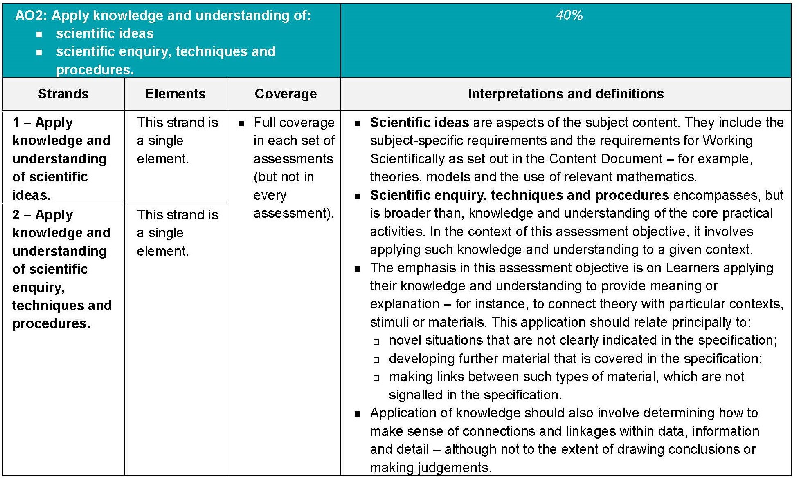
Regulatory requirements for AO2
GCSE Subject Level Guidance for Single Science (Biology, Chemistry, Physics)
Notes:
Should be familiar to you at this stage – we’ve been talking about this since before the specs were accredited.
As you can see, this splits AO2 into two ‘Strands’ – application of scientific ideas and application of scientific enquiry, techniques and procedures.
Requirement on coverage of the two strands in assessments is vague – ‘Full coverage in each set of assessments (but not in every assessment)
What does ‘Full coverage’ mean? Basically it means that over the whole set of assessments for a specification we have to ensure that AO2/1 and AO2/2 are covered, but there is no guidance on how much of each strand is to be covered in each assessment. It is very unlikely to be an exact 50/50 split – more likely to be slightly more AO2/1 than AO2/2 because of the amount of content but exact amounts will vary series on series.
It also means that the Assessment Objectives are not level of demand specific – we have to assess all AOs (including the different strands and elements) at all levels of demand – from Grade 1 up to Grade 9.
The right hand column includes some interpretation from Ofqual on what constitutes each strand: you can see that we need to cover application of the subject content in Section 3 of the specification, the Working Scientifically criteria, the Apparatus and Techniques criteria and mathematical skills.
Still ensure that there is full coverage – eg breakdown in Summer 2018 Trilogy papers:
Foundation tier: 102 AO2/1 and 69 AO2/2 (60:40)
Higher Tier: 93 AO2/1 and 77 AO2/2 (55:45)
In Synergy papers the balance was:
Foundation Tier 86 AO2/1 and 82 AO2/2 (52:48)
Higher Tier 73 AO2/1 and 91 AO2/2 (45:55)

Slide 13
Unpicking the strands
Strand 1
Includes application of subject-specific content and aspects of Working Scientifically (WS) 1 and 3 (‘theories, models and relevant mathematics’).
Strand 2
Includes application of practical skills gained through doing the required practical activities: WS2, Apparatus and Techniques Skills, aspects of WS3 and WS4.
Notes:
What are the differences between AO2/1 and AO2/2? Some aspects are very clear cut, some less so.
I don’t think it really matters to teachers to go down to this level of detail – it’s regulatory requirements – so really only need to know what is AO2 overall. This slide is really only to explain what the two different strands are. As the previous slide said, we have to ensure full coverage over each set of assessments, and cover all levels of demand
AO2/1 is likely to be WS 1 or WS 3
Some maths will be AO2/1 – for example straightforward calculations given data, or when students have to do a calculation based on applying an equation to a theoretical question.
Some mathematical procedures fall under AO2/2, because students are applying their knowledge/skills in a context to data obtained from a practical situation – eg plotting a graph from experimental data
Examiners for all three subjects apply in the same way – so a graph plotting exercise in Biology will be AO2/2, and so will one in Chemistry or Physics
So what do we need to assess? All these things for practical work.
knowledge and understanding of the Apparatus and Techniques criteria
experimental skills and strategies (WS2)
collecting, presenting, analysing and evaluating data (WS3)
knowledge and understanding of scientific terminology (WS4).
WS2 deals especially with experimental skills – hypotheses, planning, taking and recording measurements, safe working, sampling techniques and evaluating methods. Questions that target WS2 are often AO2 or AO1.
WS3 is all the analysis and evaluation skills – presenting data appropriately (so graph plotting), analysing and evaluating data, identifying patterns and drawing conclusions, coming up with explanations relating data to hypotheses. Questions aimed at WS3 are more often AO2 and AO3, and very often include maths skills.

Slide 14
Contexts and making links
We must assess the application of knowledge and understanding gained by doing the required practicals, primarily in a context that is not given in the specification
Students need to develop further material that is given in the specification
Students need to be able to make links between material in the specification, which are not signalled in the specification
Notes:
Note: ‘encompasses, but is broader than, k&U of the core practical activities’
What does this mean?
We must assess application of K&U gained by doing the RPAs in a given context, and this context should primarily be unfamiliar to students – see definition on previous slide
These rules mean that students need to be taught to expect to see based on methods or experiments they have not done (or based on practical that is covered in the other half of the specification, or on a variant of a practical they may have carried out). The point of these questions is to assess their ability to apply knowledge and skills. Any information needed to answer the question will be given.
We also have to get students to apply the knowledge and understanding of the content in situations they might not have come across either – that’s the second bullet point.
And students need to be able to make links between bits of content – for example in linking an observation with an explanation – and that’s something that they have to do: we do not signpost it.

Slide 15
What do we assess as AO2?
Most maths skills: calculations, using equations or formulae, plotting, interpreting and using graphs
Applying knowledge from an area of the specification to a context (which might not be a familiar one)
Understanding the use of models and theories
Practical skills such as reading scales or taking measurements
Understanding of variables, errors, uncertainties
Using scientific vocabulary and terminology
Using/interpreting specialist diagrams
Notes:
We have to assess all this at all levels of demand – from Grade 1 up to Grade 9. There is no AO2 that is tier specific
Graph work: plotting graphs from data, drawing lines of best fit, reading points off a graph, drawing tangents to a curve, explaining why a particular type of graph is chosen, analysing data/a pattern/trend on a graph
Sometimes a question involving data is AO3 rather than AO2, even if they’re manipulating data – all about the ‘analysis and evaluation’ – comes under the last bullet point on slide 12
Can always tell from the question which AO is being assessed – but do need to analyse what the question is asking you to do. Although it is easier once you see the mark scheme, students don’t need to know what AO the question is assessing.
You can find examples of all of these in this summer’s examinations – all papers. Most easily identified by first looking at the mark scheme, where the AOs are identified. Can then look at the individual questions

Slide 16
Common issues with AO2 in Summer 2018
Confusion in using practical terminology
Basic maths skills
Choosing appropriate scales for graphs
Basic graph plotting
Lines of best fit
Interpreting graphical data
Applying knowledge and skills in an unfamiliar context
Linking ideas across the specification
Notes:
Full details for every paper are given in the Examiners reports – on SKM
BP 1 – example confusing ‘control’ and ‘control variable’, or inappropriate usage - examples accurate and precise, valid, fair test (which is generally too vague to be creditable)
BP 2 – example calculating a percentage
BP 3 – the graph paper given in the question allows for quite large axes usually
BP 4 – inaccuracy of plotting – dots instead of crosses (which are clearer and can be more accurately placed), not plotting all the points – especially the origin if given in a table of data, risks not gaining all the plotting marks
Sometimes incorrect graph plotted (eg bar chart instead of line graph)
BP 5 – Students often unable to interpret data given in a graph to describe trends and relationships. Using graphs is a skill that students should use in as many different contexts as possible. They may need to be able to describe a graph or draw a conclusion from it.
BP 6 – common problem - lobf is not always a straight line through the origin – in science is often a curve but many students attempt to draw a straight line. Dot-to-dot not acceptable if told to draw a lobf. Line drawing often very inaccurate: more than one line, not smooth, fuzzy.
BP 7 - Some students have clearly learned ‘standard’ answers but these need to be adapted to fit the context asked about.
BP 8 - Very few responses seen where students were ‘thinking outside the box’ in terms of bringing in knowledge from other parts of the specification to enhance their answers – eg thinking about respiration, decay and oxygen levels in biology. We do have to ask questions that require this without pointing out to students that this is what they need to do. Teachers need to start thinking a bit more about how different areas of the spec can be related – rather than a silo.

Slide 17
Using AO2 questions to improve performance
Marking student responses
Using exam questions to improve student performance
Adapting AO2 questions for different levels of demand
Notes:
For this presentation examples will concentrate on Graphing skills, Applying knowledge in an unfamiliar context and using/interpreting specialist diagrams – other aspects of maths and practical skills are covered in Julian’s and Elise’s presentations
Will probably only have time to look at one example to mark, but there are many more in the support booklet. Intended for you to take and discuss with colleagues. Show how student did/did not gain marks.
With each one there is the mark scheme and examiner commentary as to marks.
For each question, you will find more information in the examiner reports (available on SKM) on how students performed.

Slide 18
Exercise: Marking student responses
Mark the responses for examples 1, 2 and 3 using the mark schemes
Discuss your marks with other delegates:
do you agree with each other?
if these responses were indicative of your students’ responses, how could you support them during Year 11, Year 10 and KS3?
Feedback with the group
Notes:
Examples 1 and 2 are the same question, as both of these examples are very representative of what we were seeing.
Example 3 is a high-demand question requiring students to apply their knowledge of equilibria in an unfamiliar context
Commentaries and marks given are provided in the support booklet.
There are further examples in the Support booklet, for you to take away and use as basis for discussions in school.

Slide 19
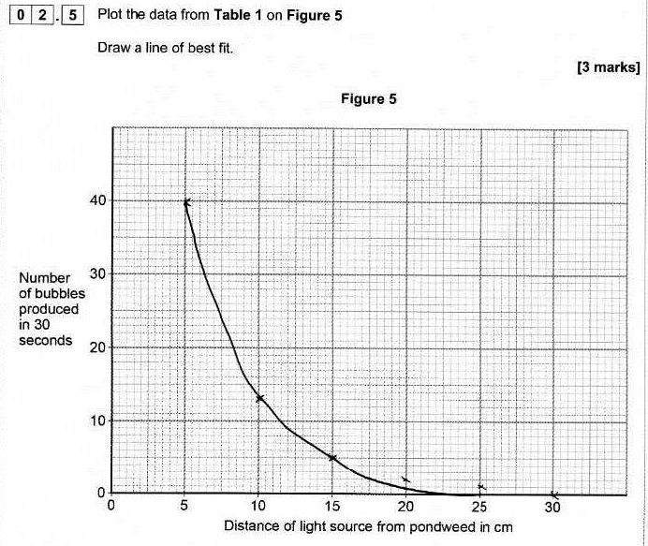
Example 1
Notes:
Example 1 – assesses student ability to plot 6 data points accurately and draw an appropriate smooth curve of best fit.
The student has correctly plotted all the points from the table of data, within the tolerance allowed in the mark scheme, although the crosses could have been clearer.
They have attempted to draw a curved line of best fit, but it has not been drawn through all the points and is not a smooth enough curve. So the mark for lobf cannot be awarded.
Total 2 marks.

Slide 20
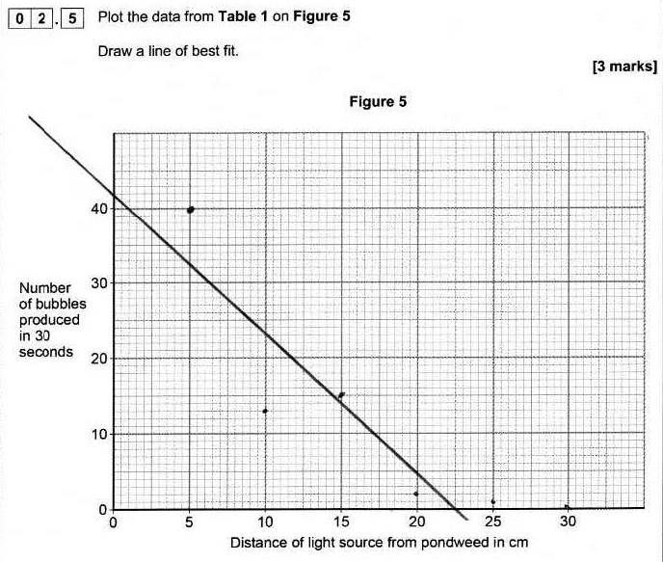
Example 2
Notes:
Example 2 – same question as Example 1
The student has plotted four of the five points correctly, within the tolerance allowed, so gains 1 mark for the plotting.
The line of best fit is incorrect, so the marks for this cannot be awarded.
Total 1 mark.

Slide 21
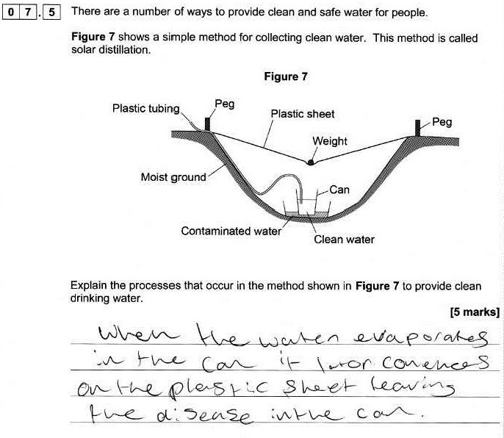
Example 3
Notes:
This is a high-demand question requiring students to link their knowledge and understanding of the water cycle to the context of a method of purifying water to create potable water. It is taken from Combined Science: Synergy.
Although the student has not clearly indicated how the process works with the equipment shown, there is a basic understanding of the principles involved. They have recognised that the water will evaporate and condense on the plastic sheet, so gain marking points 2 and 3. There is nothing else of any merit in this answer, however.

Slide 22
Using exam questions to improve performance
Use as examples in the classroom
Look at key points in the response that gain marks
Discuss mark scheme requirements with students
Students mark their own or each other’s work
Group discussions on how a response could be improved to gain more marks
Notes:
Further examples of student responses in AO2 questions are given in the Support booklet, along with marks and commentaries. You can use these as marking exercises with your colleagues.
Let’s now look at a couple of examples and discuss how you might use them (or similar – there are lots of examples in the summer papers) to improve student performance
Consider how you could use these – and other examples from this summer’s exams – to help students to focus in future series.
Don’t have to use whole papers – by looking at the AOs identified in the mark scheme you can use individual questions to target particular AOs and skills – in this case the infinite variety that is AO2!

Slide 23
Factors that contribute to level of demand
Content being assessed
Command word
Amount of cueing
Type of question
Amount/complexity of data
Context
Notes:
As I said earlier, AOs are not demand specific and we have to assess all AOs (including the different strands and elements) at all levels of demand – from Grade 1 up to Grade 9.
Let’s consider some of the factors that are used to determine the level of demand of a question.
First: What levels of demand do we use in AQA GCSE Science papers:
Low (grades 1-3)
Standard (grades 4-5)
High (grades 6-9)
The content being assessed might be a factor – some parts of the specification are Higher tier only – which means they’ll only ever be assessed at grades 4-5 or 6+ and never at Low demand. Remember HT only means assessed on the Higher tier paper – not just high demand, so could expect to see some of this content assessed at grades 4-5. Won’t be on the Foundation tier paper, however.
Is it content that covers intrinsically difficult concepts? How can we devise questions that assess K&U of these concepts at grades 1-3?
Is it covering very familiar content, or a very familiar context
Within that, what else will make a question more/less difficult?
Command word used – for example, Describe will likely be of a lower level of demand than Explain – see examples 7 and 8, which both ask students to use the information given in a graph. Although we do ask high demand ‘Describe’ questions and low demand ‘explain’ ones – in these cases, what we would look for in the mark scheme might be more simple or require less linking of ideas at lower levels that at higher – look at some examples in the mark schemes.
Amount of cueing given
Eg in graph drawing – bullet points reminding what needs to do – lower level of demand. Helps students to focus. At High demand this cueing is not there or minimal as expected to know what to do when told to plot data
In a diagram, might use a very standard diagram, with some labels added for low demand – but might make it less obvious for higher levels
Type of question:
Is the question completely open? Often making it a closed question (eg sentence completion – with or without words to choose – or multiple choice) will lower the demand of the question.
Long answer/short answer (of course, we have to assess extended response at all levels – even grades 1-3)
Number of responses needed
Amount of data given to plot
Detail of data (eg whole numbers rather than decimal points)
Higher demand may include irrelevant data, eg
Scales chosen – more straightforward scales make plotting less demanding
Giving the first couple of points or bars already plotted clues in to what is required, lowering level of demand
Scales given on graph – or student to choose and plot for themselves
Asking for lobf: a simple straight line through all the data will be of lower demand than with data that doesn’t fit closely to a line but still on a straight line – anomalous points? Curves
Example 14 shows some of the principles above in action – although not all the questions are AO2 – but then, not all items in a whole question are likely to be.

Slide 24
Adapting questions to levels of demand
Look at example 9
This question is targeted at high demand (grades 6-9)
What makes it high demand?
What skills is it assessing?
How could it be adapted to assess the same skills at:
standard demand?
low demand?
Notes:
Just looking at one example from the booklet here – but again there are many others you could use – not just in the booklet but in the Sumer 2018 papers and SAMs 1 and 2. I’ve put a few comments at the end of the booklet where you might want to start thinking about adapting questions.
Example 14 in the booklet
Use the mark scheme to find some questions that are targeted at AO2. Might want to include as part of a whole question covering a particular area of the specification, or as stand-alone questions (especially if working on graphing skills).

Slide 25
How did we do?
Please rate this session on the Sched Conference app.
Using the postcards provided, please write:
one thing you enjoyed about our session or will take away for your teaching
one thing you feel could be improved.
Please hand your postcard in as you leave.

Slide 26
Thank you

