Slide 1
GCSE Science: AQA & ITE: Support for your first years in teaching
Peter Rupkus
Spring 2019

Slide 2
Welcome

Slide 3
This meeting will be recorded
Exam boards have an Ofqual requirement to record event audio.
Recordings are kept for the lifetime of the specification and not shared as an accompaniment to session resources.
The recording will begin now.

Slide 4
Session overview
Structure of secondary assessment in England
What is a specification?
Our Science papers and mark schemes
Recent reform of qualifications
Progress/Attainment 8
Overview of awarding
Our resources

Slide 5
Structure of secondary assessment in England

Slide 6
Secondary assessment in England
“The Office of Qualifications and Examinations Regulation (Ofqual) regulates qualifications, examinations and assessments in England.”
Independent of government and reports directly to Parliament.
In October 2018, there were over 150 awarding organisations recognised by Ofqual.
Which awarding organisations are involved with GCSE Science in England?
Notes:
Accountancy/Management
Ballet
Canoeing
Beauty Therapy
Equestrian
First Aid
Dance
Sign Language
Prince’s Trust
RHS
Swim England
Gemmological Association
Farriers
Spectacle makers

Slide 7
GCSE Awarding Organisations in England
AQA
Edexcel
Eduqas
OCR
Notes:
AOs are independent of each other and operate in a competitive environment
Previously lots of small regional exam boards…merged
However specs are not as different as you may think
Main differentiator is support
Talk about franchising - Scotland SQA – NI – CCEA – Wales - WJEC

Slide 8
Joint Council for Qualifications (JCQ)
Umbrella organisation for all four English Awarding Organisations.
Determines the general rules and regulations which are applied to the conduct of all assessments.

Slide 9
Regulation
Department for Education (DfE)
“…is responsible for children’s services and education, including higher and further education policy, apprenticeships and wider skills in England.”
Overall responsibility for setting national policy with regard to education:
national curriculum (KS1-4)
types of qualifications (GCSE’s, A-levels, Tech Awards etc) including subjects.
Notes:
Examiners who provide CPD meetings
Teachers that set live assessments

Slide 10
Regulation
Ofqual
Set criteria for qualifications (eg types and duration of assessment).
Regulates the day-to-day activity of the Awarding Organisations:
awarding and standards
malpractice
ensuring that what we are telling centres is fair and equitable
conflicts of interest (eg examiners who write text books/teachers that write assessments).
Notes:
Examiners who provide CPD meetings
Teachers that set live assessments

Slide 11
DfE subject content
Subject content is the minimum content that must be in a subject specification; for GCSE science this:
considers overlaps with Science PoS (KS1-4)
provides continuity and progression to AS/A-level.
Subject content is owned by the DfE.
New DfE subject content for GCSE and A-level Science was produced in consultation with Ofqual, all four AOs and key stakeholders (ASE, RSB, RSC, IOP etc).
Version 3.0
Notes:
Also mention public consultation DfE operates and the role that teachers can play in this.
Try to give a feel for timescales in creation of Subject Content and specs. Ofqual received 2012 letter for A-level (first taught in 2015) and 2013 letter for GCSE (technically first taught 2016 for two year GCSE)

Slide 12
DfE subject content
If any organisation wishes to produce a GCSE or A-level Science qualification which is recognised for performance table points, they must:
use the DfE subject content
be accredited by Ofqual (subject level guidance).
Version 3.0
Notes:
Also mention public consultation DfE operates and the role that teachers can play in this.
Try to give a feel for timescales in creation of Subject Content and specs. Ofqual received 2012 letter for A-level (first taught in 2015) and 2013 letter for GCSE (technically first taught 2016 for two year GCSE)

Slide 13
What is a specification?

Slide 14
What is a specification?
Each Awarding Organisation creates its own unique subject specification.
Specifications for a subject must be based on the DfE subject content.

Slide 15
What is a specification?
The specification outlines:
details of the assessments
subject content to be taught
administration relating to the specification.
Ofqual:
accredit the specification for teaching in England
regulate the operation of the specification.

Slide 16
Assessments
GCSE Biology
GCSE Chemistry
GCSE Physics
GCSE Combined Science: Trilogy
GCSE Combined Science: Synergy
Notes:
Information in booklet
GCSE Biology/Chemistry/Physics: Topics are not in a teaching order although from the last round of meetings vast majority of biologists were going to start on Cells and chemists on atomic structure , Physics were less in agreement and no real consensus
All have 2 papers, 100 marks topics covered on each paper is stated , there are a range of question types which we will show later
GCSE Combined Science: Trilogy: Both combined courses are the same standard and are good preparation for A level DfE expectation that the majority of students will do combined
Trilogy - Traditional science approach
Co teachable with separate science
Always for flexible movement up and down between the separates and combined
Required practical's sub set of the separate course
Practical questions will be on both papers and are embedded in questions as items
Will be a foundation level only SOW to support the issue of engaging some of our learners
GCSE Combined Science: Synergy: Divides science content in to two halves - life and environment and physical sciences so pupils can see links between areas
Allows sharing teaching between two teachers –
Fewer exams but longer
Same standard and content as other combined – just a different way of approaching combined science

Slide 17
Our specification
This is what must be taught This is for exemplification
Notes:
This is for the separates and Trilogy only - Synergy's layout is three column and everything is examinable, unlike here.
Reminder that what will be assessed is in the specification, explain the role of the additional information
The resources (including text books) will support the specification
Text books are produced by independent publishers and not the Aos

Slide 18
Our specification
For teaching purposes:
the specification is the definitive document
all content will be covered over a set period of time
assessments are based on the content of the specification only.
Notes:
IF they only take away one message – make sure it’s those three bullet points!!
Reminder that what will be assessed is in the specification, explain the role of the additional information
The resources (including text books) will support the specification
Text books are produced by independent publishers and not the AOs

Slide 19
Our Science papers and mark schemes

Slide 20
Key points for successful assessment design
Good mark schemes are at the heart of the validity of the assessment and the reliability of marking.
When writing questions it is important to consider how to avoid mark compression, for example by ensuring questions are distinct and by encouraging examiners to use the full mark range.
Avoid double jeopardy (ie students must know the answer to one question in order to answer the next).
Notes:
Explain what mark compression is Mark compression: a poor spread of marks across the mark range which makes discriminating between students difficult. This happens for a number of reasons.
Questions being too easy or too difficult
Students not able to discern the level of detail required in their response – common in ‘explain’ type questions
Low maximum marks, makes it difficult to spread students adequately across the mark range
Questions which are not sufficiently distinct, means more able students do not see the opportunity to gain access to the full mark allocation
Examiners not being willing to use the full range of marks available, especially in essay style questions
A poor spread of marks – this makes grade boundaries difficult to set and potentially be very close together

Slide 21
Key points for successful assessment design
Question content must be mapped to the specification.
Questions should be perfectly aligned with their mark schemes.
Students should be able to access all available marks.
Notes:
Explain what mark compression is Mark compression: a poor spread of marks across the mark range which makes discriminating between students difficult. This happens for a number of reasons.
Questions being too easy or too difficult
Students not able to discern the level of detail required in their response – common in ‘explain’ type questions
Low maximum marks, makes it difficult to spread students adequately across the mark range
Questions which are not sufficiently distinct, means more able students do not see the opportunity to gain access to the full mark allocation
Examiners not being willing to use the full range of marks available, especially in essay style questions
A poor spread of marks – this makes grade boundaries difficult to set and potentially be very close together

Slide 22
GCSE Science Assessment Objectives
 | Description | %
AO1 | Demonstrate knowledge and understanding of: scientific ideas; scientific techniques and procedures. | 40
AO2 | Apply knowledge and understanding of: scientific ideas; scientific enquiry; techniques and procedures. | 40
AO3 | Analyse information and ideas to: interpret and evaluate; make judgements and draw conclusions; develop and improve experimental procedures. | 20
22
Copyright © AQA and its licensors. All rights reserved.
Notes:
Explain what AOs are, why are they important.
How they are used to create assessment (eg in 20% NEA, 18% AO3, 2% AO2) so same practical will have to be assessed in exams.
All AOs use the same AOs to create their assessments …differences come in the interpretation of the AOs

Slide 23
Our Science papers and mark schemes
Making questions clear
Command words
Avoiding repetition or unnecessary information
Answer line prompts
Use of bold

Slide 24
Our Science papers and mark schemes
Our exams explained
Ramping of demand
Question scaffolding
Multiple choice
Calculations
Extended response

Slide 25
Recent reforms of qualifications

Slide 26
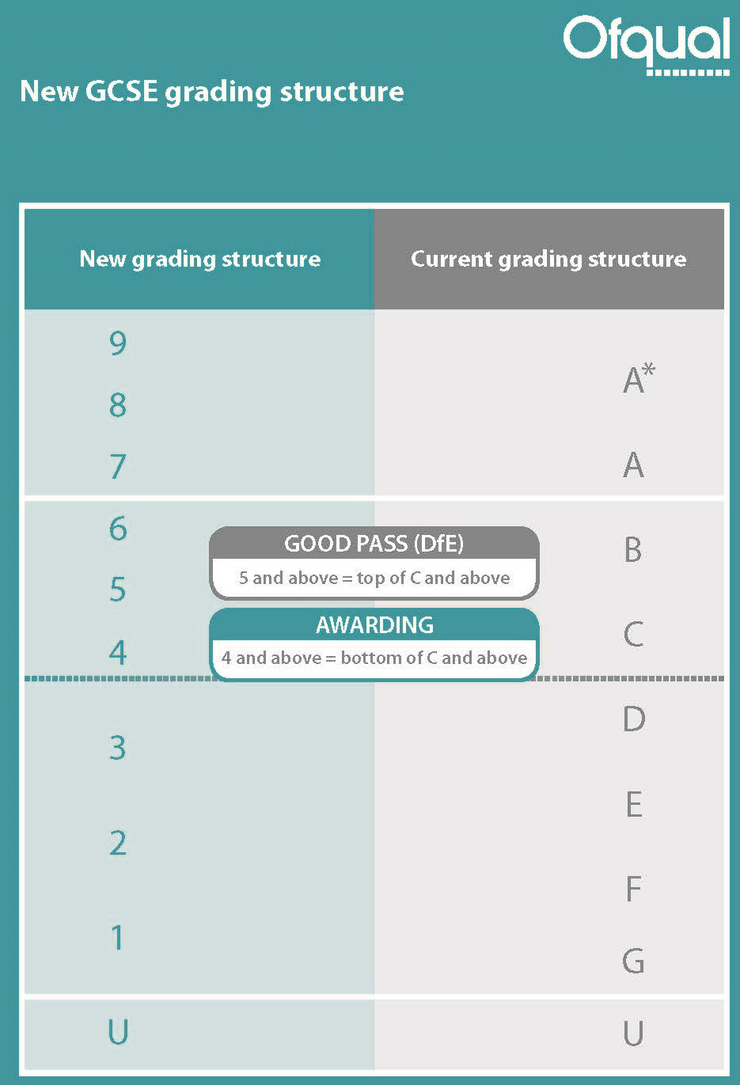
New GCSE Grading
Grade 4 equivalent to bottom of a C; grade 7 equivalent to an A
Grade 5 around the top third of a C and bottom third of a B
Bottom of grade1 aligned with bottom of a G
New Foundation tier: grades 1–5 available
New Higher tier: grades 4–9 available with a few marks for a grade 3 as a safety net

Slide 27
New GCSE Grading
No mixed tiering in the combined science papers
Can enter for different tier for each of the separate sciences but must be the same tier for each of the two papers within the award

Slide 28
Grading in Combined Science
Sequential numbering on a 1–17 point scale
Total mark on all papers combined determines both grades
Individual grades not dependant on individual paper/subject performance
Notes:
Students get two grades for Combined Science – for the award as a whole. Means that won’t be able to separate out grades for each subject within the papers . However, marks for individual papers will be available on ERA so will be able to do some analysis
Will be calculated on the overall marks for the specification
Grades will be either two numbers the same, or two adjacent numbers – so only 1 number apart. you couldn’t get a 9-1
In schools we are recommending they don’t go down the granular route for reporting interim progress as to difficult. In formative topic tests they might want to record biology marks, chemistry and physics separatly as this will show if there is one area they are not doing well in so they can put some intervention into this science discipline as all the sciences will be added together for the final award.
Teacher need to rely on their professional experience as to where students are along with the interim tests and our end of year 10 exam and analysis which we will be supplying on SKM

Slide 29
Grading in Combined Science
Either two numbers the same:
9-9, 8-8, 7-7, 6-6, 5-5, 4-4, 3-3, 2-2, 1-1
or one number different:
9-8, 8-7, 7-6, 6-5, 5-4, 4-3, 3-2, 2-1
No zero, so no 1-0 or 1-U
No other grades available
Notes:
Students get two grades for Combined Science – for the award as a whole. Means that won’t be able to separate out grades for each subject within the papers . However, marks for individual papers will be available on ERA so will be able to do some analysis
Will be calculated on the overall marks for the specification
Grades will be either two numbers the same, or two adjacent numbers – so only 1 number apart. you couldn’t get a 9-1
In schools we are recommending they don’t go down the granular route for reporting interim progress as to difficult. In formative topic tests they might want to record biology marks, chemistry and physics separately as this will show if there is one area they are not doing well in so they can put some intervention into this science discipline as all the sciences will be added together for the final award.
Teacher need to rely on their professional experience as to where students are along with the interim tests and our end of year 10 exam and analysis which we will be supplying on SKM

Slide 30
Points from summer 2018 awards
Ofqual extended the ‘security’ grade boundary on Combined Science Higher tier from a half width 4−3 to a full width 4−3 and a full width 3−3.
Unclassified (U) was still used.
Ofqual has only introduced this as a special measure as they felt tier of entry wasn’t down to the student and some students had been incorrectly entered.
Applied to all awarding bodies.
Single Science grade 3 extended from half range to a full width boundary.

Slide 31
Secondary school accountability measures
What counts towards a schools’ league table performance?
Notes:
What role does AQA have with school accountability measures?
AQA does not set accountability measures – however our qualifications are used to determine the performance of schools and even individual teachers.

Slide 32
Secondary school accountability measures
Percentage of pupils achieving a grade 5 or above in English and maths
Percentage of students staying in education or going into employment after key stage 4 (pupil destinations).
Percentage of pupils entering the English Baccalaureate (Ebacc)
English Baccalaureate Average Point Score (EBacc APS)
Attainment across the same eight qualifications (Attainment 8)
Progress across eight qualifications (Progress 8)

Slide 33
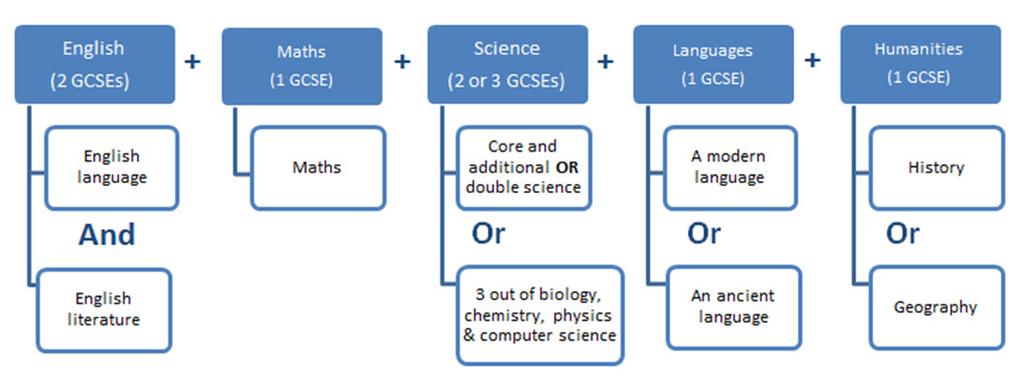
What is the EBacc?
To enter the EBacc, pupils must take at least seven or eight GCSE qualifications across five subject ‘pillars’:

Slide 34
What is Attainment 8?
Notes:
Schools don’t have to do 8, if you can achieve better score with high grades in fewer subjects rather than lower grade in 8. For example English + Maths + 3 other subjects would count. Students don’t have to take 8 quals BUT they score 0 points for any unfilled slots.
Always divide by 10 (English and maths double count) no matter how many quals taken
If a qualification does not fall into one of these buckets, it is not counted in the attainment 8 (or progress 8) measure.
2014 tables: http://www.education.gov.uk/schools/performance/secondary_14/Capping_guide_2014.pdf
In the open group of subjects, any GCSE can count, or any of the high-value, approved vocational and academic qualifications
2016 https://www.gov.uk/government/uploads/system/uploads/attachment_data/file/381337/2016_KS4_list.pdf
2017 https://www.gov.uk/government/uploads/system/uploads/attachment_data/file/448760/Technical_Awards_2017_list_July_2015.pdf

Slide 35
Attainment 8 − Bucket 1 (maths and English slots)
Maths: Double-weighted slot; only EBacc maths qualifications can count.
English: Double-weighted slot; only if student has taken both English Language and English Literature.
Best score from language or literature is double-weighted; the second best score of literature and language can be counted in the 'open' group of subjects if it is one of the student's highest scores in this group.

Slide 36
Attainment 8 − Bucket 2 (Ebacc slots)
The three highest point scores from any of the EBacc qualifications in Science subjects, Computer Science, History, Geography and Languages.
English Literature and English Language cannot be included in the EBacc group of subjects.
No stipulation about the types of Ebacc subjects which can count (eg could all be Science or Languages).
Combined Science can take up two slots (the only double award that can do so).

Slide 37
Attainment 8 − Bucket 3 (‘Open’ slots)
From 2017, approved non-GCSE qualifications are those categorised as Technical Awards.
Contains the three highest point scores in any three other subjects, including English Language or Literature (if not counted in the English slot), further GCSE qualifications (including EBacc subjects) or any other non-GCSE qualifications on the DfE approved list.
If a student has not taken the maximum number of qualifications that count in each group then they will receive a point score of zero where a slot is empty.

Slide 38
What is Progress 8?
An Attainment 8 score is dependant on ability of the cohort.
Progress 8 is the main headline measure/the only measure used for floor standards from 2016.
A measure of students' progress in 8 key subjects between KS2 and KS4 (same 8 subjects as used for Attainment 8).
The average of all students' progress will create the school's result.

Slide 39
What is Progress 8?
It shows whether students have performed to expectation (based on prior performance using a value added method, using KS2 English and maths results as a baseline).
Benchmarks school against the average performance of a school with the same intake − students’ results at the end of KS4 are compared to the actual achievements of other students with the same prior attainment.

Slide 40
The awarding process

Slide 41
What exactly is awarding?
Awarding is the process by which the grade boundary marks are determined at subject level.
We do this in a way that ensures the standard will be comparable with previous series and with that of other awarding organisations.
Making the grades − a guide to awarding

Slide 42
Getting the right grade – assessments
Every answer in a written exam paper is marked by us.
Papers are either traditionally marked (the examiner sees a full script) or electronically marked (the examiner marks single questions).
We employ over 23,000 examiners during the summer period.
We mark over 2,000,000 scripts each year.
Marking starts in late April and must be completed by 7 August.

Slide 43
Getting the right grade – awarding
Every year an awarding committee meet to determine the grade boundaries for a qualification.
The determination is based on statistical evidence and examiner judgement.
Statistics are collected across all awarding organisations for a subject; this ensures that the subject outcomes are comparable.

Slide 44
Getting the right grade – awarding
Decisions are made on key boundaries:
GCSE: A, C and F/7, 4 and 1
GCE: A and E.
Written exam marks can fluctuate year on year; this allows us to deal with differences in demand of the written assessment.

Slide 45
How is a grade boundary decided?
The ‘statistical’ element
Our Centre for Education Research and Compliance (CERP) use a range of statistics to make predictions which suggest the most appropriate statistically recommended grade boundaries. These are based on how comparable students have performed in previous series, KS2 data and matched data.

Slide 46
How is a grade boundary decided?
The ‘judgemental’ element
The awarding meeting uses a balance of judgemental and statistical evidence to make recommendations. The committee will look at a range of scripts for each ‘judgemental grade boundary’ (7, 4 and 1 for GCSE).

Slide 47
Resources

Slide 48
Resources
Visit our website for a range of Science resources, including:
Specifications
Past papers
Schemes of work
Practical Handbooks
Notes:
Link back to subject content and the fact that teachers should be collecting resources from wherever

Slide 49
Become an examiner/moderator
Compliments your teaching
Boost your career/CV while increasing your personal development
Clearer understanding of our mark schemes and assessment process
Inspire your teaching
Network with fellow professionals
Raise your student’s attainment
Earn extra income with all the convenience of home working
Notes:
One full year’s teaching required before you can apply

Slide 50
Any questions?

Slide 51
How did we do?
Please rate this session on the Sched Conference app.
Using the postcards provided, please write:
one thing you enjoyed about our session or will take away for your teaching
one thing you feel could be improved.
Please hand your postcard in as you leave.

Slide 52
Thank you

