Slide 1
Progression from KS3 to Higher Education: Curriculum pathways in science
Catherine Witter
Spring 2019

Slide 2
Welcome

Slide 3
This meeting will be recorded
Exam boards have an Ofqual requirement to record event audio.
Recordings are kept for the lifetime of the specification and not shared as an accompaniment to session resources.
The recording will begin now.

Slide 4
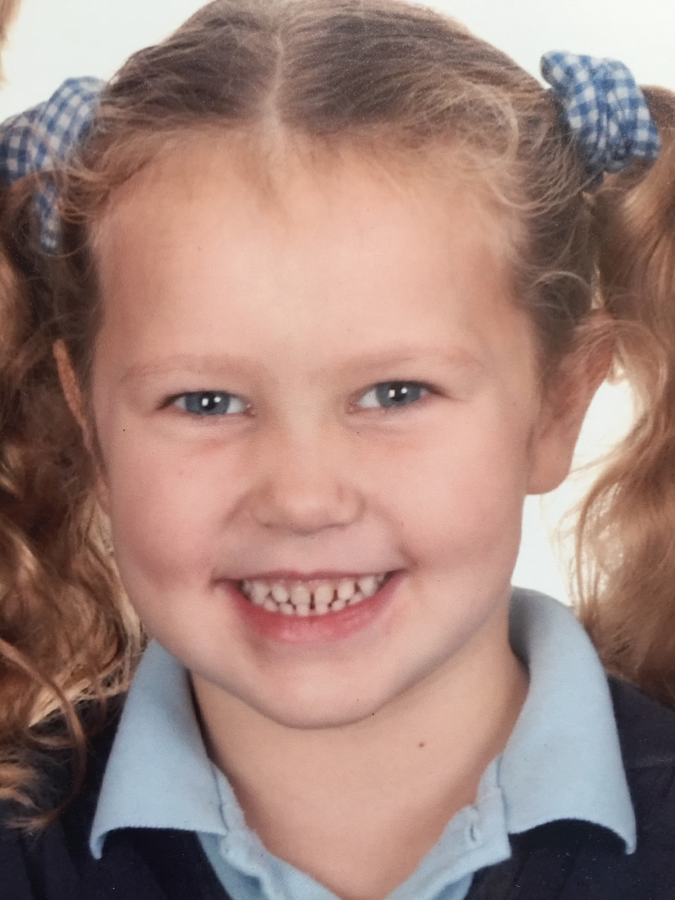
Year 1
“I really want to be a scientist
when I grow up Mummy!”

Slide 5
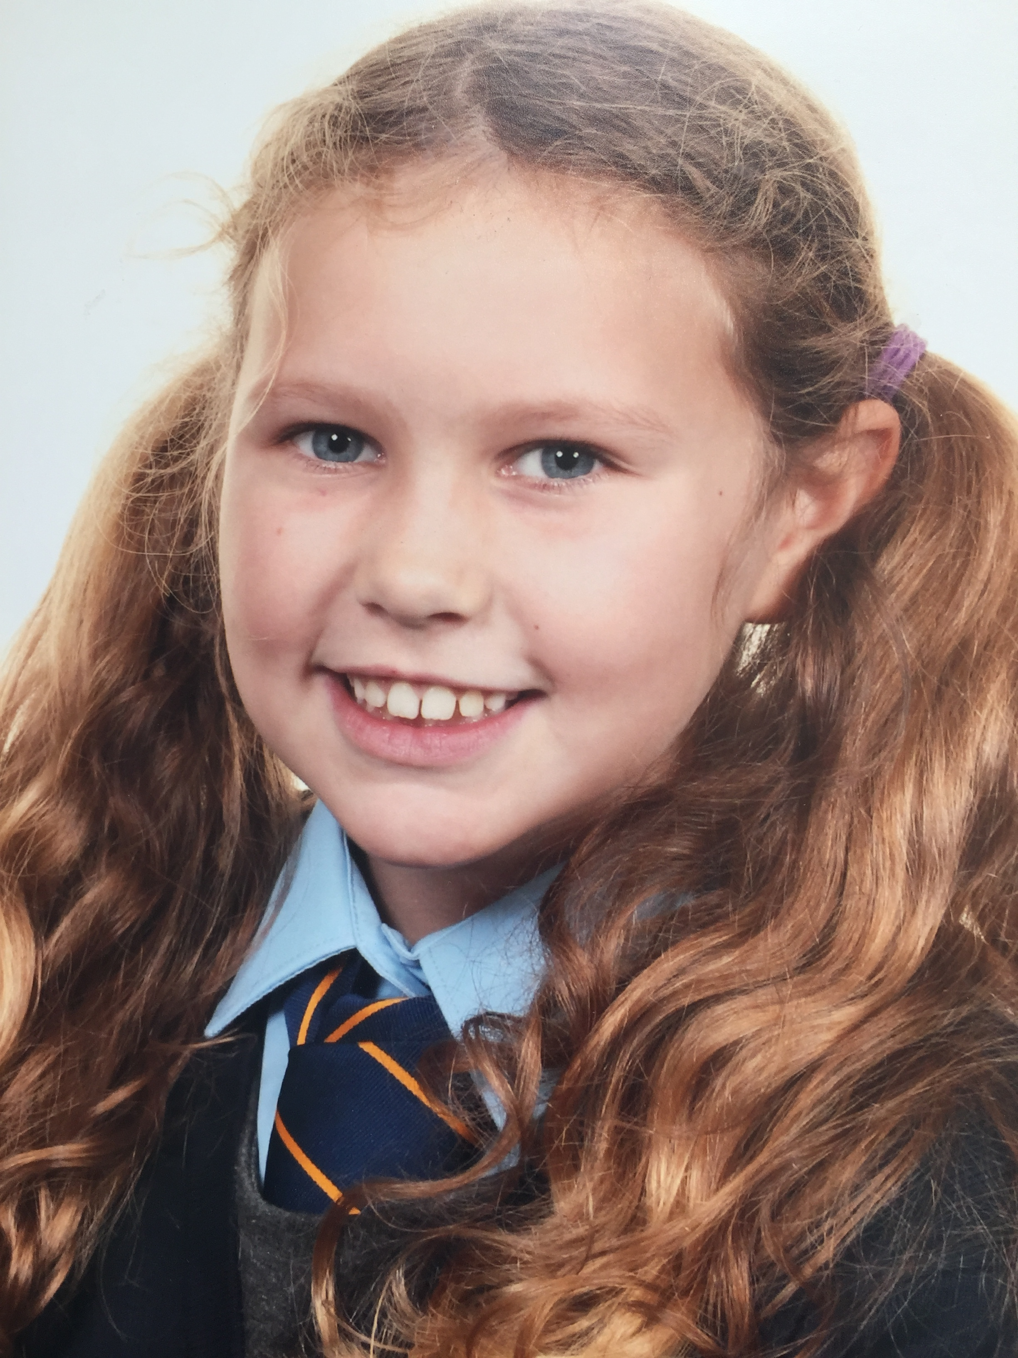
Year 4
“I think I want to be a doctor
when I’m older like Auntie Gillian. She is really clever and so I have to try my best.”

Slide 6
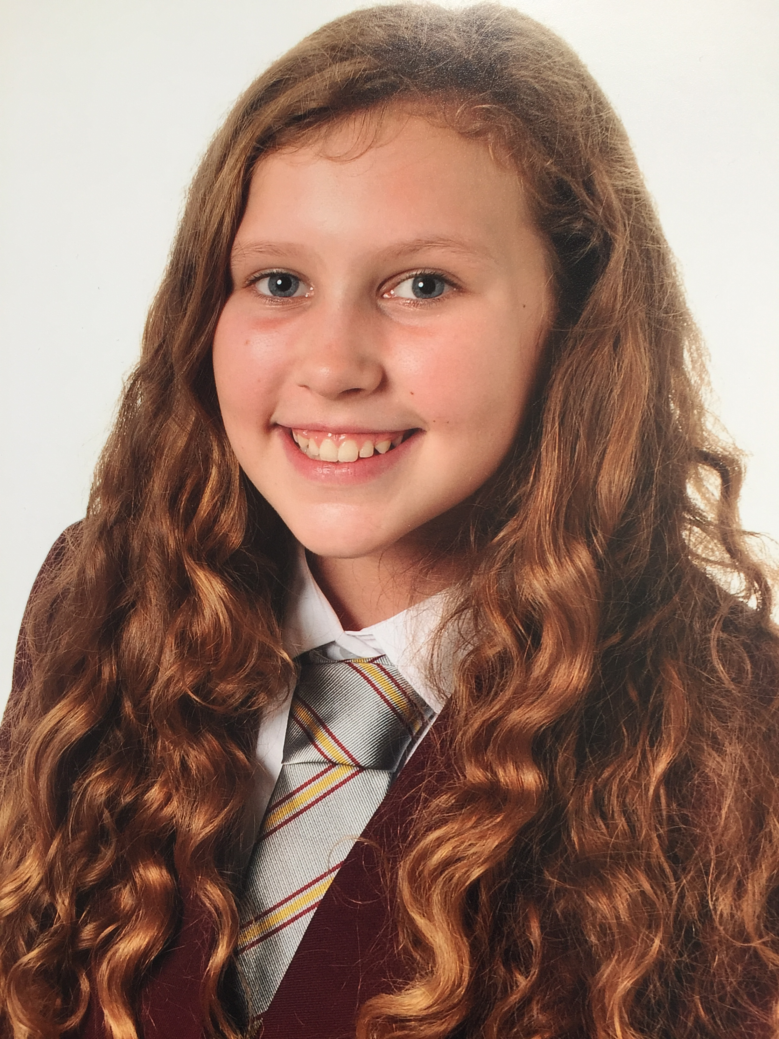
Year 7
“I’m in top set for Science and I
really enjoy it but it’s not easy.
My teachers have told me that
I am doing ok and to keep
trying hard.”

Slide 7
Discussion
What knowledge and skills does Eithne need to be a successful scientist?
What potential barriers will she face as she moves through Year 7-13 and beyond?

Slide 8
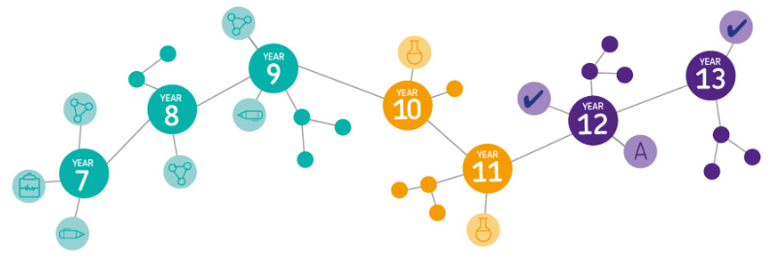
After primary school
What choices are available in science for young people today after primary school?

Slide 9
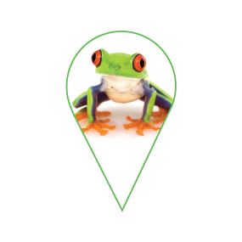
Options − our qualifications
Progression to Biology, Chemistry and Physics A-levels, Applied General Science
GCSE Combined Science: Synergy
Life and environmental sciences
Physical sciences
GCSE Combined Science: Trilogy
Biology
Chemistry
Physics
GCSE
Biology
GCSE
Chemistry
GCSE
Physics
ELC Science single
ELC Science double
Key stage 3 science syllabus, with progress tests

Slide 10
GCSE: What did we learn from summer 2018?
The first summer series since reform went very well.
Considering that this was the largest change to GCSE Science since GCSE was introduced in 1987, the majority of schools had understood the changes, accessed the support available to them and supported their students accordingly.

Slide 11
GCSE: What did we learn from summer 2018?
ELC provided effective support for many students who also entered Combined Science Foundation tier − current research on-going.
There is more practical work in GCSE than previously − the required practicals are understood to be a way to ensure coverage of the Apparatus and Technique statements, not a bolt on activity.

Slide 12
But…
The relative changes to grades and the tiering structure were not universally understood, and parents and students had little understanding.
GCSE provision is very mixed, with a lack of Science teachers in some schools and wide variations in teaching hours (120 GLH per GCSE expectation) − some have more than this, most have less.
Science curriculum models may not always focus on learning in favour of being assessment driven.

Slide 13
Successes
Writing to the end of the paper
Full range of marks covered
Good grade discrimination
Performance at different levels of demand
Performance on common questions
Basic maths skills were good
Recall of equations

Slide 14
Areas of challenge
Reading and understanding the question
Understanding command words − describe, explain compare, evaluate
Writing coherent responses
Precise use of subject specific language
Synoptic linking of ideas particularly on Higher tier
Application of knowledge particular if set in unfamiliar context
Low demand − some gaps in basic knowledge

Slide 15
Areas of challenge
Required practicals
Students didn’t fully understand:
why they had carried out each step in the practical
why they had taken specific measurements
what the data they collected showed.

Slide 16
Areas of challenge
Working Scientifically
Safety aspect that are appropriate at GCSE level repeatable or its significance term ‘fair’ is always inadequate unless suitably qualified.
Maths skills set in context of science and complex calculations including unit conversion.

Slide 17
Discussion
What does this tell us about the knowledge and skills that students in England need to secure before they start their GCSE Science qualifications?
How does this compare with our initial discussions earlier?
What rich questions might Science teachers be asking now as they evaluate their departmental policies and schemes of learning and assessment?

Slide 18
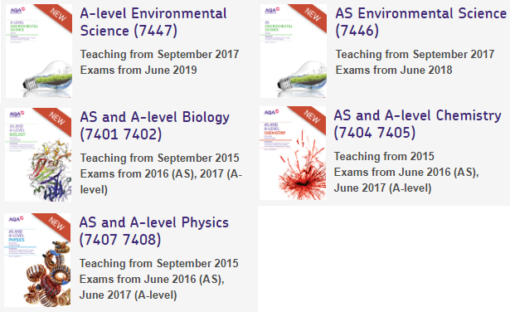
What are her Sixth Form qualification choices?

Slide 19
How our papers are written
Our examiners have to write questions against specific:
Assessment Objectives (AO1, AO2 and AO3)
Maths content
Practical skills content
At GCSE each examination paper will have items of different levels of demand, allowing different tiers of entry. There will also be some items that require an extended response.

Slide 20
A-level: What did we learn from summer 2018?
Almost identical themes were coming through as at GCSE
Students found applying knowledge to an unfamiliar context (AO2) and analysing or evaluating (AO3) difficult.
Some students found items related to practical work challenging, even when there was a connection to a required practical.
Items that required application of maths skills, particularly the use of statistical analysis, were often poorly attempted.

Slide 21
Things to consider
As the themes for our feedback events were very similar for both GCSE and A-level Sciences last autumn, it might be useful to think about:
how an examination specification, mark scheme and insight report can be used to greatest effect
how schools can operate to best support outcomes:
curriculum time
use of setting
deployment of science teachers
collaborative working between departments
style and frequency of assessment.
How the wider science community and government can support schools and colleges (teacher training and retention, CPD, funding, careers education)

Slide 22
Things to consider
how the wider science community and government can support schools and colleges (teacher training and retention, CPD, funding, careers education).

Slide 23
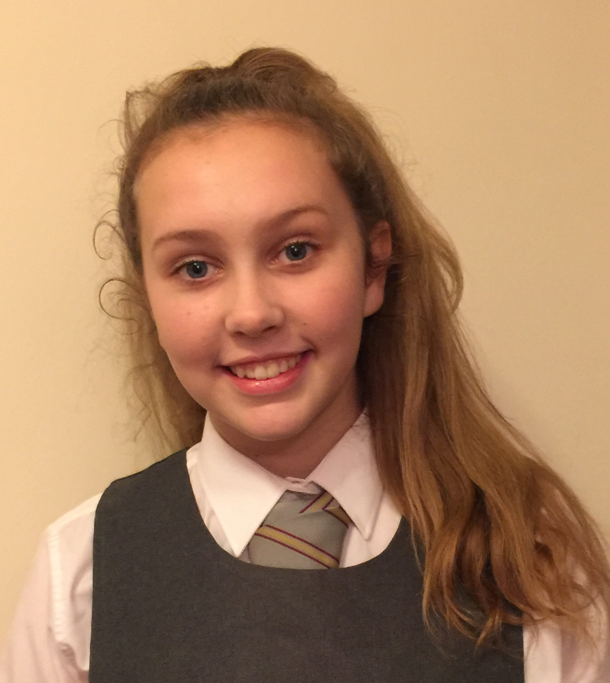
Year 9 – the future “feels bright” for Eithne
“I’m still in top set for Science and I am enjoying it. I know I need to be able to do Maths and I get lots of homework. I do practical work to help me to understand what I am learning. It’s getting harder though Mum.”

Slide 24
Discussion
What might Eithne’s next steps to becoming a successful scientist look like?

Slide 25
How can we help Eithne succeed?
If Eithne is going to realise her dream to be a scientist we need to be mindful of her journey...
… and plan to the best of our ability in schools and colleges.
We are working with a number of universities over the next few years to understand what knowledge and skills undergraduates require to be successful; this will help steer our next generations of qualifications to be as effective as they can be for generations to come.

Slide 26
How did we do?
Please rate this session on the Sched Conference app.
Using the postcards provided, please write:
one thing you enjoyed about our session or will take away for your teaching
one thing you feel could be improved.
Please hand your postcard in as you leave.

Slide 27
Thank you

