Slide 1
Marking and improving student outcomes in Maths-related questions
Julian Clarke
Spring 2019

Slide 2
Outline for the session
Mark schemes and how we apply them
Maths-related questions in GCSE sciences
Exercise using student work
Using exam questions to improve student performance
Assessing Maths skills at different levels of demand
Notes:
Outline of the whole session.
First, I’d like to find a little more about you: where you come from, your experience
Include questions that usually use in first slide of Inset Online presentations?
The first section – Mark schemes and how we apply them – is generic to all three presentations.
General headings for the AO2 section onwards should be adaptable to both Maths and Practical Skills.

Slide 3
Mark schemes and how we apply them
What is the mark scheme for?
Our GCSE Science mark schemes
Points-based mark schemes
Levels of response mark schemes
Notes:
Before going into detail on how we assess different skills, want to give some information on how we mark our questions. The following section covers some general, but very important information on using our mark schemes.
By understanding and applying the principles given here, teachers should be able to mark papers easily and consistently when using out papers as mocks for their students.

Slide 4
What is the mark scheme for?
To evaluate the evidence from each student fairly
To reward positive achievement
To differentiate purely on evidence of subject knowledge, understanding and skills
To fully and consistently reflect the agreed interpretation of command words
To fully reflect the purpose of each assessment
To credit appropriate responses that reflect the different ways in which learners may demonstrate what they know, understand and can do
Notes:
Loads of good information in Fair Access by Design – Ofqual document Pages 37 to 39 deal with the mark scheme. The notes below are taken from this document.
Mark schemes
Mark schemes that are valid and use clear language will support both accurate marking and equal opportunities.
Mark schemes should be designed so that they can be easily and consistently applied by all assessors. In addition, teachers and learners may have access to assessed work and the associated
mark scheme. It is therefore important that mark schemes show clearly what, where and how marks are awarded.
Assessments should be designed to reward positive achievement. They should differentiate between learners purely on evidence of subject knowledge, understanding and skills. The degree of
flexibility of a mark scheme will reflect the nature of the subject and what is being assessed. Equally valid responses presented in different forms should achieve the same marks.
Mark schemes should credit appropriate responses that reflect the diverse background of learners and the different ways in which they may demonstrate what they know, understand
and can do. Some types of task present particular challenges. Synoptic questions, for example, need to take account of the many valid ways in which learners may answer the question.
Some multi-part questions may explicitly be designed to test a sequence of logical thought. Generally, however, mark schemes should not allow a wrong answer on one part of a question to
make later marks harder or impossible to earn.
Each of the following points considers an aspect of the design of mark schemes.
Awarding bodies should:
a) ensure that the purpose of each assessment is fully reflected in the associated mark scheme
b) ensure that the mark scheme rewards a variety of appropriate responses
c) design mark schemes that are sufficiently flexible to allow alternative response modes, where these are necessary
d) aim to make mark schemes as clear and legible as the tasks to which they relate
e) ensure that marks awarded reflect fully and consistently the agreed interpretation of command words.

Slide 5
Our GCSE Science mark schemes
The ‘Information to examiners’ section:
general guidance on the parts of the mark scheme
explicit guidance on what parts of the mark scheme mean and how they should be applied
marking levels of response questions
exactly the same for all GCSE Sciences.
Detailed mark scheme for each question:
specific guidance on what is/is not acceptable
points or levels of response marked.
Notes:
This whole ‘Information to examiners’ section is given in the Handout
This section is very important and needs to be flagged up.
Worth talking through some of the sections in the handout to show what examiners need to keep in mind – and to flag to teachers how they should be using the MS when marking mocks
For example:
Emboldening and underlining
application of list principle
Calculations
Ecf – what it does, and more importantly does not mean
use of brackets
allow, ignore, do not accept
When setting questions, the senior examiners consider very carefully which is the most appropriate and fairest way to mark the answers: are we looking for a fixed number of points to be made (often in a certain order)? If so, the question is most appropriately points marked.
However, for very open questions, because there are almost as many ways of structuring an answer as there are students, the fairest way of marking them is to use a levels of response mark scheme. This looks at the quality of the answer as a whole, taking into account the levels descriptors based on the command words and the indicative content, and doesn’t tie students to answering in a particular way.
The primary use of our mark schemes is to ensure that our examiners fully understand and can apply the marking criteria consistently from student 1 to student several thousand. However, we also publish them after every series so that teachers can use them along with the papers for mocks, end of section tests or whatever and know that this is the actual mark scheme used so if they apply it correctly they will be able to get some indication of how these students are doing.

Slide 6
Points-based mark schemes
Marks given for each correct point a student gives
Explicitly define correct (and incorrect) answers
Emphasis is on the correctness of the response, not the quality
Usually used for lower-tariff questions (<10 marks)
If well-written are very reliable
Notes:
Type of mark scheme used is crucial to its validity. Need to really think which is most appropriate to appropriately reward students for what they know and can do.
Because points-based mark schemes are very prescriptive you need a really good think about all the possible responses – correct and incorrect – that the question is likely to elicit in order to write a good mark scheme.
Should be 1 mark for every correct point.
If there are more points than marks available will reduce discrimination. Because may unduly reward some students and unduly penalise others.
If there are more marks than points available will be wasting marks on the paper.
Example points-based MS in Handout – talk through briefly. Have inclulded both a prose and a calculation mark scheme.

Slide 7
Levels of response mark schemes
Used for open questions where there is a variety of ways for students to arrive at a mark
Reward the overall quality of the answer
Divide performance into chunks of marks (levels) on a continuum
Describe the performance at each level
Generic level descriptors linked to specific command words
Same descriptors apply to all GCSE sciences
Section of indicative content specific to each question
Notes:
In GCSE Science we use LOR for questions that we class as ‘Extended response’ and these can be worth 4 or 6 marks.
What if you are writing an item that assesses both knowledge and skills? Which is the best MS to use?
A levels mark scheme is often the better approach as it can be a better discriminator in student performance
Working with colleagues from other subjects that have really clear and strong LOR mark schemes, and our Educational Research (CERP) division, we have developed generic level descriptors to use when marking levels-marked questions. These descriptors are linked to specific command words. The descriptors are common across all the GCSE sciences, to ensure consistency of approach across all the specifications. You can see what these are in the supporting booklet
This consistency helps with both constructing and marking these types of question. It also helps to remove ‘hurdles’ that can wrongfully prevent students accessing higher levels.
There is then a section of indicative content is not an exhaustive list of marking points, and students will not have to cover every point in the indicative content to achieve full marks. This idea can be quite difficult to get over – often hear the question ‘well, how much of the indicative content does a student need to get into Level 2? Etc.
We feel that this approach, looking at the overall quality of the answer, and not getting hung up too much on punctuation and spelling, is fairer than the old QWC approach. Of course, a student who produces an answer that rambles, uses only vague terminology and is so badly structured that the examiner cannot follow what the student is talking about, is likely to not achieve high marks, so the QWC element is still there to an extent, but it is incorporated into the whole holistic approach.

Slide 8
Maths-related questions in GCSE Sciences
What is Maths in the context of Science GCSE?
Regulatory requirements
How do we assess Maths skills?
Common issues with Maths-related questions in Summer 2018

Slide 9
What is Maths in the context of GCSE Science?
Assessment of mathematical skills
“The Content Document sets out the mathematical skills which must form part of each GCSE Qualification in Combined Science (the ‘Mathematical Skills’) in the ‘Use of Mathematics’ sections and individual content statements for biology, chemistry and physics, the mathematical forms of Working Scientifically and the appendices addressing different aspects of the mathematical requirements.”
Extract from Ofqual: GCSE Subject Level Conditions and Requirements for Combined Science

Slide 10
Regulatory requirements
On page 6 of the content document it is states:
“The mathematics [outlined in the Content document] should be at levels up to, but not beyond, the requirements specified in GCSE mathematics for the appropriate tier.”

Slide 11
Regulatory requirements
In designing and setting the assessments for each GCSE Qualification in Combined Science which it makes available, or proposes to make available, an Awarding Organisation must ensure that, taking the assessments for that qualification together:
the number of marks used to credit the relevant mathematical skills is no less than 20% of the total marks for the qualification
those marks are allocated to questions and tasks related to biology, chemistry and physics in a ratio of 1:2:3

Slide 12
Regulatory requirements
the questions and tasks used to target Mathematical Skills are at a Level of Demand which:
is appropriate to the subject
will allow effective differentiation between a range of attainments by Learners in relation to the subject content being assessed
in respect of assessments for the foundation tier, is not lower than that which is expected of Learners at Key Stage 3 as outlined in the ‘Mathematics programmes of study: key stage 3,’ document reference DFE-00179-2013

Slide 13
Regulatory requirements
in respect of assessments for the higher tier, is not lower than that of questions and tasks in assessments for the foundation tier in a GCSE Qualification in Mathematics.
Mathematical Skills are assessed at an appropriate range of Levels of Demand in each set of assessments and over the lifetime of the qualification.

Slide 14
Content Document requirements

Slide 15
What do we assess as Maths-related skills?
Any of the aspects listed on the previous slide.
Notes:
We have to assess all this at all levels of demand – from Grade 1 up to Grade 9
Graph work: plotting graphs from data, drawing lines of best fit, reading points off a graph, drawing tangents to a curve, explaining why a particular type of graph is chosen, analysing data/a pattern/trend on a graph

Slide 16
Common issues with Maths-related questions in Summer 2018
Basic maths skills
Graphs and data manipulation
Applying mathematical skills in an unfamiliar context
Significant figures and decimal places
Standard form and large numbers
Lack of working, calculator errors
Calculating percentages and percentage increases and percentage decreases
Substitution into and re-arrangement of equations

Slide 17
Graph skills
Graphs should be plotted and drawn with a sharp pencil choosing an appropriate scale which uses most of the paper − use crosses rather than dots (this is easier for the examiner to see), check the scale of the axis when reading values and plot all data points given.
Students need to make use of the data provided, either in a table or in a chart or graph, to answer the question which has been asked.

Slide 18
Using Maths related questions to improve performance
Marking student responses
Using exam questions to improve student performance

Slide 19
Exercise: Marking student responses
Mark the responses for examples 1, 2and 3 using the mark schemes
Discuss your marks with other delegates:
do you agree with each other?
if these responses were indicative of your students’ responses, how could you support them during Year 11, Year 10 and KS3?
Feedback with the group
Notes:
Examples 1 and 2 are the same question, as both of these examples are very representative of what we were seeing.
Example 3 is a high-demand question requiring students to apply their knowledge of equilibria in an unfamiliar context
Commentaries and marks given are provided in the support booklet.
There are further examples in the Support booklet, for you to take away and use as basis for discussions in school.

Slide 20
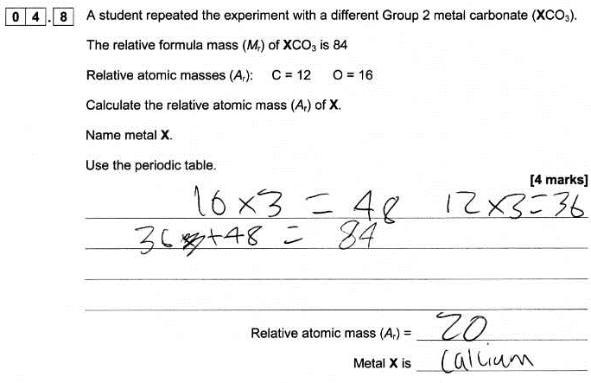
Example 1
Notes:
Example 1 – Trilogy Chemistry paper 1F, standard demand Q4.8 – 1 mark example

Slide 21
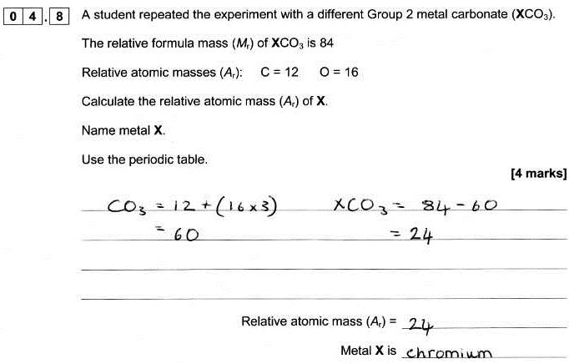
Example 2
Notes:
Example 2 – same question as Example 1 – 3 mark example

Slide 22
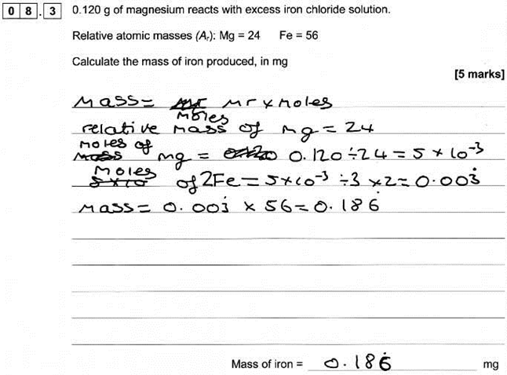
Example 3

Slide 23
Using exam questions to improve performance
Use as examples in the classroom
Look at key points in the response that gain marks
Discuss mark scheme requirements with students
Students mark their own or each other’s work
Group discussions on how a response could be improved to gain more marks
Notes:
Further examples of student responses in maths related questions are given in the Support booklet, along with marks and commentaries. You can use these as marking exercises with your colleagues.
Let’s now look at a couple of examples and discuss how you might use them (or similar – there are lots of examples in the summer papers) to improve student performance
Consider how you could use these – and other examples from this summer’s exams – to help students to focus in future series.
Don’t have to use whole papers – by looking at the AOs identified in the mark scheme you can use individual questions to target particular AOs and skills

Slide 24
Factors that contribute to level of demand
Content being assessed
Command word
Amount of cueing
Type of question
Amount/complexity of data
Context

Slide 25
How did we do?
Please rate this session on the Sched Conference app.
Using the postcards provided, please write:
one thing you enjoyed about our session or will take away for your teaching
one thing you feel could be improved.
Please hand your postcard in as you leave.

Slide 26
Get in touch
T: 01483 477756
E: gcsescience@aqa.org.uk

Slide 27
Thank you

