Slide 1
GCSE Science: Awarding and outcomes explored
Julian Clarke
Spring 2019

Slide 2
Welcome

Slide 3
Outline for the session
This session will provide an update on the process by which GCSE and A-level grades are awarded by AQA and will include consideration of the arrangements for awarding for the first cohort examined against the new GCSE Science specifications.
Key messages from the A-level and GCSE Science exams in 2018 will also be considered.
Notes:
Outline of the whole session.
First, I’d like to find a little more about you: where you come from, your experience
Include questions that usually use in first slide of Inset Online presentations?
The first section – Mark schemes and how we apply them – is generic to all three presentations.
General headings for the AO2 section onwards should be adaptable to both Maths and Practical Skills.

Slide 4
GCSE Science 2018 – an overview
No more Core and Additional − Combined Double Award or individual Biology, Chemistry and Physics
Increased entry for individual sciences (up 18–23%), mostly from IGCSE but also Further Additional Science
Lower grade boundaries, especially grade 4 on Higher tier due to number of marks targeted at each grade
Outcomes were in line with our Year 10 tests
Challenges around application in unfamiliar contexts
Notes:
Entries into individual sciences have increased – 22.8% in biology, 19.2% in chemistry, 17.6% in physics – we think this has largely come from IGCSE entries
Likely to reflect individual sciences as only route to 3 science GCSEs (no more Further Additional)
Lower grade boundaries (combined and individual sciences) – to be expected due to comparable outcomes – sawtooth effect plus increase in demand
Plus removal of Core Science and Y10 entry
Plus (esp at grade 4 on H tier) due to targeting of questions (e.g. AQA targets ~40% of Qs on H tier at grades 4-5)
Outcomes in line with Y10 tests – in particular challenges around AO2 in Y10 tests were reflected in students’ final performance
Estimated c30,000 students were moved from H to F as a result of Y10 tests performance

Slide 5
Provisional GCSE results summer 2018 (all UK candidates)
GCSE | Total entries | Grade 1 | Grade 4 | Grade 7 | Grade 9
Combined Science (Double Award) | 371,324 (NA) | 98.2 (98.1) | 54.8 (55.3) | 7.4 (7.6) | 0.8 (NA)
Biology | 165,245 (143,340) | 99.1 (99.9) | 89.2 (90.4) | 41.5 (42.2) | 12.0 (NA)
Chemistry | 158,410 (141,867) | 99.3 (99.9) | 89.7 (89.9) | 43.1 (42.4) | 12.6 (NA)
Physics | 156,720 (141,977) | 99.3 (99.9) | 90.6 (90.8) | 42.5 (41.9) | 12.2 (NA)
Joint Council for Qualifications
Notes:
371324 students entered Combined Science Double Award nationally, each making 2 entries.

Slide 6
Our provisional GCSE results Summer 2018
GCSE | Total entries | Grade 1 | Grade 4 | Grade 7 | Grade 9
Combined Science Trilogy [National] | 284,212 [371,324] | 98.4 [98.2] | 55.2 [54.8] | 7.6 [7.4] | 0.9 [0.8]
Biology [National] | 129,521 [165,245] | 99.2 [99.1] | 89.3 [89.2] | 41.7 [41.5] | 12.1 [12.0]
Chemistry [National] | 124,584 [158,410] | 99.4 [99.3] | 90 [89.7] | 43.6 [43.1] | 12.8 [12.6]
Physics [National] | 123,628 [156,720] | 99.3 [99.3] | 90.6 [90.6] | 42.9 [42.5] | 12.4 [12.2]

Slide 7
Grade by gender
Cumulative percentages
Joint Council for Qualifications
GCSE |  | Grade 1 | Grade 4 | Grade 7 | Grade 9
Combined Science | Male Female | 97.8 98.7 | 52.1 57.5 | 6.4 8.4 | 0.7 1.0
Biology | Male Female | 99.0 99.2 | 88.7 89.7 | 39.3 43.6 | 10.8 13.1
Chemistry | Male Female | 99.1 99.5 | 89.1 90.4 | 42.3 43.9 | 12.3 12.8
Physics | Male Female | 99.3 99.3 | 91.0 90.2 | 45.3 39.6 | 13.9 10.5

Slide 8
GCSE entry patterns 2018
GCSE | Total entries | Foundation (%) | Higher (%)
Combined Trilogy | 285,671 (NA) | 58 (NA) | 42 (NA)
Combined Synergy | 5,898 (NA) | 73 (NA) | 27 (NA)
Biology | 130,020 (84,976) | 13 (7) | 87 (93)
Chemistry | 124,785 (83,870) | 11 (8) | 89 (92)
Physics | 123,820 (84,598) | 12 (7) | 88 (93)

Slide 9
Security breach – 1 school
Combined Science Trilogy: Chemistry Paper 1 of Foundation tier only
Marks given to every student, so grade boundaries are higher than they would have been
When using the 2018 papers as a mock, use the special ‘Mock notional grade boundaries’ provided on eAQA – supporting guidance has been provided

Slide 10
Provisional GCE results summer 2018
 | Entries | Grade E | Grade C | Grade A
AS Biology | 21,850 (38,744) | 83.6 (84.4) | 50.4 (52.1) | 17.2 (18.0)
A-level Biology | 63,819 (61,908) | 96.6 (96.8) | 69.8 (70.8) | 25.9 (26.2)
AS Chemistry | 18,084 (32,909) | 83.7 (84.2) | 53.9 (53.7) | 20.1 (20.7)
A-level Chemistry | 54,134 (52,331) | 96.6 (97.0) | 74.3 (75.6) | 31.1 (31.7)
AS Physics | 13,007 (25,331) | 83.7 (83.8) | 53.4 (55.0) | 22.1 (22.6)
A-level Physics | 37,806 (36,578) | 95.8 (95.8) | 70.1 (69.7) | 29.6 (29.2)
Joint Council for Qualifications

Slide 11
How we award grades
Making the grades − a guide to awarding

Slide 12
How do students get an examination grade?
A qualification is a way of demonstrating that someone has achieved a certain level of learning.
It is based on a specification which sets out the skills, understanding and knowledge that students are expected to have gained by the end of their course.
Ofqual ensure the specification and assessment materials meet the National criteria; during the development of the specification, we collaborate with teachers and subject associations.

Slide 13
How do students get an examination grade?
Question papers must test how well a students can demonstrate that they have acquired the knowledge, understanding and skills set out in the specification.

Slide 14
Assessment focusing on skills
Greater amount of content
But assessment generally doesn’t focus on knowledge
Some exceptions, eg formula recall
Limit on knowledge in isolation
Use the knowledge:
knowledge plus understanding
applying in context
supporting evaluation and analysis.
Notes:
More content – so more knowledge to be learned
Some exceptions e.g. more recall of formulae needed in sciences – need to find ways to ensure students can get the basics they need and learn key points and facts without getting bogged down in detail or demotivated
Knowledge in isolation – basically factual recall – varies by subject but most have a limit – often 15%
Assessments generally need you to do something with the knowledge using understanding, or applying it in a context, or using it to support an argument
Hard to overstate importance of this – where schools haven’t done as well as they expected, this is usually the reason
We can see it coming down the track – e.g. average performance on Y10 science tests was poor because students couldn’t apply their knowledge in unfamiliar contexts
Schools that develop this skillset should do well at GCSE
Look at AOs then other features/skills

Slide 15
Assessment focusing on skills
Focus on Assessment Objectives and how they’re reflected in questions and mark schemes
Plus extended response, synopticity, mathematical skills, SPAG etc
Notes:
More content – so more knowledge to be learned
Some exceptions e.g. more recall of formulae needed in sciences – need to find ways to ensure students can get the basics they need and learn key points and facts without getting bogged down in detail or demotivated
Knowledge in isolation – basically factual recall – varies by subject but most have a limit – often 15%
Assessments generally need you to do something with the knowledge using understanding, or applying it in a context, or using it to support an argument
Hard to overstate importance of this – where schools haven’t done as well as they expected, this is usually the reason
We can see it coming down the track – e.g. average performance on Y10 science tests was poor because students couldn’t apply their knowledge in unfamiliar contexts
Schools that develop this skillset should do well at GCSE
Look at AOs then other features/skills

Slide 16
Assessment Objectives

Slide 17
AO1

Slide 18
AO2

Slide 19
AO3

Slide 20
How do students get an examination grade?
It is impossible to test the entire specification in one set of exams so we select which areas to focus on in a particular paper, making sure that all areas of the specification are covered over a five year period.
The question paper, mark scheme and marking guidance are all written at the same time by an exam committee led by a chair of examiners for a subject, under whom chief examiners lead the development of the papers for a specification often with a lead assessment writer – almost all of whom are teachers.

Slide 21
How do students get an examination grade?
There is also an assessment developer, whose role is to check that every aspect of Ofqual’s requirements are met.
All papers are checked, scrutinised and revised many times to remove errors and ensure the right level of challenge and completion in the provided time. They are then proof read before being re-scrutinised before being signed off after 18 months of work

Slide 22
Our examining process
Look at the 16 cards describing the stages in the examining process.
Some of the cards have been numbered to show their place in the sequence of steps that take place to provide reliable marks are achieved by students.
Number those cards which do not have a number to create the sequence in which you think the steps take place.
Notes:
For numbering activity suggest that delegates might want to work with the person next to them.

Slide 23
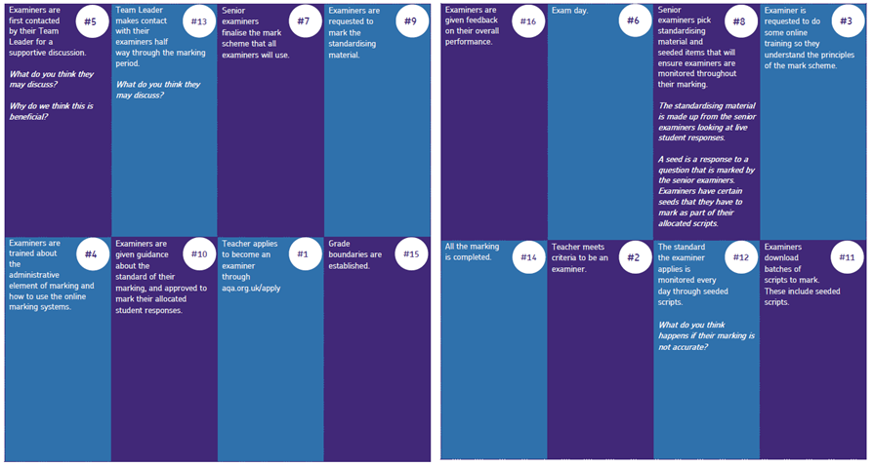
Activity: Examiner journey

Slide 24
How do students get an examination grade?
Marking
After the student has sat the paper, it is first marked and then graded.
We mark more than 7 million scripts each year and provide GCSE and A-level grades to more than 2 million students each year.
Examiners practice using the mark scheme at standardisation meetings (online or less frequently face to face).

Slide 25
How do students get an examination grade?
Marking
The scripts are marked by the examiner team, with rigorous checking procedures to ensure examiners are consistent, fair and meet the required standard; if the examiner is not marking correctly, the scripts are removed from them and marked by another examiner.
The rigorous processes involved ensure that all scripts are marked fairly.

Slide 26
How do students get an examination grade?
Awarding
Whilst boards try to set papers with consistent levels of difficulty, in practice there is variation. To avoid penalising students who sit a more difficult paper in one year compared to another, grade boundaries are set for each paper.

Slide 27
How do students get an examination grade?
Awarding
Awarding is the process by which grade boundaries are identified – it is a lengthy process! Senior examiners look at scripts from last year and compare these with a sample from the current year. They set the boundary so as to maintain the standard of difficulty between papers set in different years. They also use statistics to guide their judgement – how this group of students performed previously and thus what they might be expected to achieve.

Slide 28
How do students get an examination grade?
Awarding
The grade boundaries (minimum marks required to achieve a given grade) are then applied to the marked scripts.
Students performing to the same level should get the same grade regardless of the year of their examination.

Slide 29
Grade descriptors and grade boundaries
H
9
6
Assessment structure of the summer 2018 series Trilogy, Synergy and Separate sciences
15% of marks assess practical skills – all papers
Combined Science, 20% of marks assess maths skills – covering all 3 levels of demand
B-10%, C-20%, P-30%
No QWC marks
Higher demand
60%
F
5
4
5
4
40%
Standard demand
30% common marks
40%
3
1
60%
Lower demand
29

Slide 30
Grade boundaries (use with caution!)
Level of demand (low, standard and high) is a useful indicator of the target grade range of questions but a student’s attainment is based on performance across the papers and the whole mark allocation.
Individual performance can vary hugely depending on the topic and skill area.

Slide 31
Grade boundaries (use with caution)
 |  | Mark ratio | 5-5 | 5-4 | 4-4
Foundation tier (420) Low (60%): Standard (40%) |  | 252 :168 | 253 | 235 | 218
Higher tier (420) Standard (40%): High (60%) |  | 168 : 252 | 136 | 117 | 98
Biology (200) | F H | 120 :80 | 121 |  | 107
 |  | 80 : 120 | 69 |  | 53
Chemistry (200) | F H | 120 : 80 | 127 |  | 109
 |  | 80 : 120 | 72 |  | 52
Physics (200) | F H | 120 : 80 | 123 |  | 107
 |  | 80 :120 | 68 |  | 51

Slide 32
9-1 tiers and awarding
Basis of Numerical Grade 1st year | New Grade |  | Basis of Numerical Grade 2nd year
 | H | F
Tailored approach | 9 |  | Comparable outcomes
 | 8
Comparable outcome – legacy grade A | 7 |  | Comparable outcomes
 | 6
 | 5 | 5
Comparable outcome – legacy grade C | 4 | 4 | Comparable outcomes
 | (3) | 3
 |  | 2
Comparable outcome – legacy grade G |  | 1 | Comparable outcomes
 | U | U
Notes:
This table shows how the grades were set in the 1st year and how that differs from year 2 onwards.

Slide 33
How is a grade boundary decided?
The ‘statistical’ element
Our Centre for Education Research and Compliance (CERP) use a range of statistics to make predictions which suggest the most appropriate statistically recommended grade boundaries. These are based on how comparable students have performed in previous series, KS2 data and matched data.

Slide 34
How is a grade boundary decided?
The ‘judgemental’ element
The awarding meeting use a balance of judgemental and statistical evidence to make recommendations. The committee will look at a range of scripts for each ‘judgemental grade boundary’ (7, 4 and 1 for GCSE).
Making the grades − a guide to awarding

Slide 35
What exactly is awarding?
Awarding is the process by which the grade boundary marks are determined at subject level.
We do this in a way that ensures the standard will be comparable with previous series and with that of other awarding organisations.
Making the grades − a guide to awarding

Slide 36
Awarding and the allocation of grade boundaries
The first award of all new GCSEs is based primarily on statistical predictions with examiner judgement playing a secondary role.
The grade standard established in the first award will be carried forward in the second and subsequent years; where the cohort has the same level of prior attainment, broadly the same proportion of students will achieve a grade 4 and above as currently achieve a C and above; grade 7 and above as currently achieve an A and above; grade 1 and above as currently achieve a grade G and above.

Slide 37
Awarding and the allocation of grade boundaries
All other grade boundaries will be set arithmetically, as previously. For example, the boundaries at grades 5 and 6 will be set based on the difference in marks between grades 4 and 7; grade 5 will be set at one third of the difference in marks, and grade 6 at two thirds the difference in marks.
The process of comparable outcomes works on the basis that if the cohort hasn’t changed much, we wouldn’t expect the proportion of each grade to change much either; this ensures that outcomes are fair, even if the specification or assessment tools are changed.

Slide 38
Comparable outcomes
Awarding and comparable outcomes
In brief:
a statistical approach to predict the likely percentage of students achieving each grade
predicted outcome is contextualised by the prior attainment profile of the cohort (either KS2 for GCSE or GCSE for A-level)
based on the relationship between the prior attainment of students and their subsequent outcomes in a reference year, against which the performance of the current cohort is compares.

Slide 39
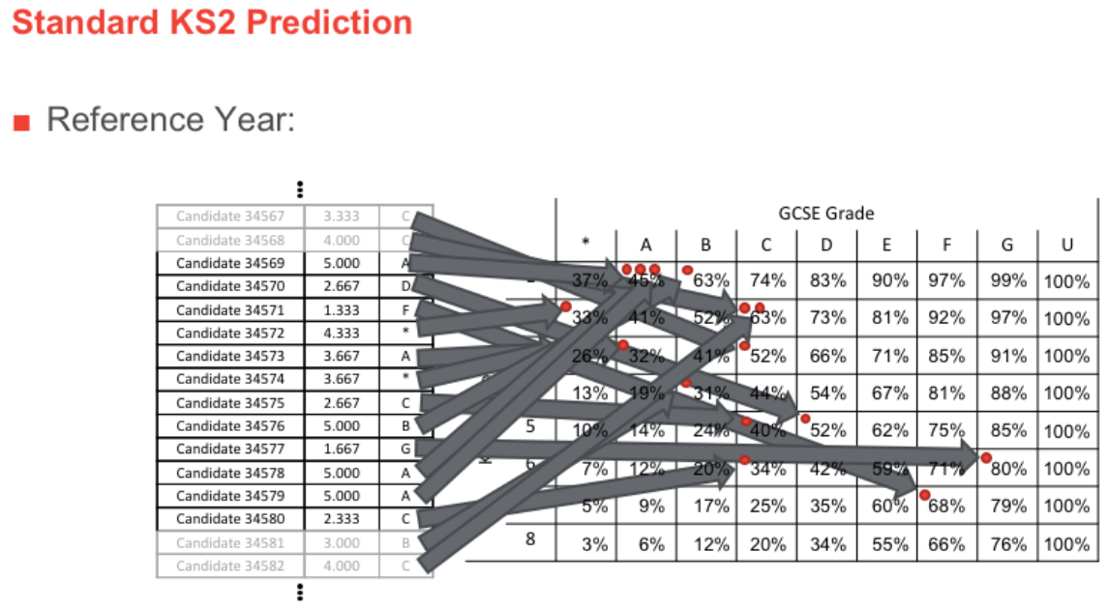
Ofqual extract - 1

Slide 40
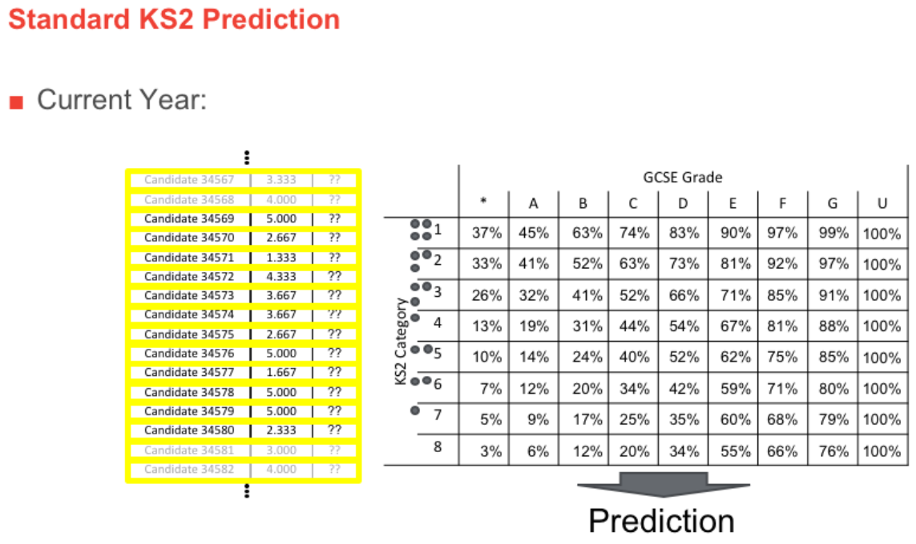
Ofqual extract - 2

Slide 41
Awarding grades 8 and 9 in 2018
The tailored approach:
The proportion of grade 9s awarded in each subject will vary depending on the overall proportion of grades 7 and above awarded within the subject.
A formula was used to achieve these outcomes; based on data from previous exam series the formula is:
Percentage of those achieving at least a grade 7 who will be awarded a grade 9 = 7% + 0.5 × (percentage of students awarded grade 7 and above)

Slide 42
Awarding grades 8 and 9 in 2018
Grade 8 will be awarded arithmetically so that the grade boundary is equally spaced in terms of marks from the grade 7 and 9 boundaries.

Slide 43
Notes:
Simply use the slide to
Re emphasise grading 7,4,1 - rest is arithmetic.
What the 9 will be – it will be set statistically. Grade 8 boundary set arithmetically.
For combined science – judgemental boundaries will be 1-1, and 4-4 for foundation and 4-4 and 7-7 for higher – grade 9-9 will be set using formula provided by Ofqual (is this true?). We’re still waiting to hear from the DfE over the standard they want to carry forward for the combined science in 2018 (core or Additional? Combination of the two seems most likely but yet to have any confirmation). Once it’s confirmed we will let centres know ASAP – we can’t award without knowing the standard we need to carry forward!

Slide 44
Findings from 2018 – GCSE
Please look at the relevant examiner reports on the our website

Slide 45
Our Insight reports
GCSE Insight reports: 2018 results at a glance
Replace the Executive Summaries
Highlight key points for each paper
Headlines only
Detailed information in Reports on the Exam

Slide 46
What did we learn?
With the exception of a breach which was beyond our control, the Summer series went very well.
Considering that this was the largest change to GCSE Science since GCSE was introduced in 1987, the majority of schools had understood the changes, accessed the support available to them and supported their students accordingly.
Tier of entries policies are varied, including ‘aspirational’ entries which did not benefit students.

Slide 47
What did we learn?
ELC provided effective support for many students who also entered Combined Science Foundation tier – current research on-going.
There is more practical work in GCSE than previously – the required practicals are understood to be a way to ensure coverage of the Apparatus and Technique statements; they are not a bolt on activity.

Slide 48
But
The relative changes to grades and the tiering structure were not universally understood and parents and students had little understanding.
Some examination officers/invigilators were confused by the range of examinations available and may need additional support regarding tier of entry and specification.
More than 30,000 candidates changed from Higher to Foundation tier during the last 6 weeks prior to the April 21st deadline.

Slide 49
But
GCSE provision is very mixed, with a lack of Science teachers in some schools and wide variations in teaching hours (120 GLH per GCSE expectation) – some have more than this but most have less.

Slide 50
Successes
In general, appropriate tier entered
Writing to the end of the paper
Full range of marks covered
Discrimination
Performance at different levels of demand
Performance on common questions
Basic maths skills were good
Recall of equations

Slide 51
Areas of challenge
Reading and understanding the question
Understanding command words − describe, explain compare, evaluate
Writing coherent responses
Precise use of subject specific language
Synoptic linking of ideas particularly on Higher tier
Application of knowledge particular if set in unfamiliar context
Low demand − some gaps in basic knowledge

Slide 52
Areas of challenge
Required practicals not understood
Some maths skills
Maths skills set in context of science
Complex calculations including unit conversion
Graphs should be plotted and drawn with a sharp pencil choosing an appropriate scale which uses most of the paper − use crosses rather than dots (this is easier for the examiner to see), check the scale of the axis when reading values and plot all data points given

Slide 53
Areas of challenge
Required practicals
Students didn’t fully understand:
why they had carried out each step in the practical
why they had taken specific measurements
what the data they collected showed unfamiliar with the food tests
Distribution of plants RP was either answered really well or really badly

Slide 54
Areas of challenge
Working scientifically
Safety aspect that are appropriate at GCSE level repeatable or its significance term ‘fair’ is always inadequate unless suitably qualified
If using chemical formulae instead of the words need to be correct; H²O is incorrect
Look at scales and magnification used in diagrams

Slide 55
What can we take from this?
Need to teach the required practicals with reference to working scientifically and the scientific content related to it
Maths − understanding of powers of ten and converting a fraction into standard form
Looking at the ways maths questions are written for a GCSE Maths and a maths question in Science
Consider content emphasis for foundation tier (getting the basics right)

Slide 56
What can we take from this?
More practice with rearranging correctly
Looking at values and thinking which equations link these values
Breaking steps down and clearly showing intermediary values
Having to do unit conversions in examples in class
Thinking about what science knowledge they need to know

Slide 57
Some reminders for GCSE in 2019

Slide 58
Command words
Knowledge
State, give, name, what, which, identify, define (recall), describe (recall)
Understanding
Explain, define (explain), describe (explain), why, suggest, what does ___ mean, give a cause/advantage/disadvantage/reason/problem
Application
How, use, show, demonstrate, illustrate
Notes:
These are not hard and fast rules so need to be careful about how you use them with students
Key point is to really work out what it is the question wants you to do (i.e. what the mark scheme will reward) and then make sure you do that
Application – will typically be about the context – harder to identify by a specific command word but usually quite obvious and straightforward to get right (ie less interpretation of what the question wants!)

Slide 59
Command words
Analysis
Analyse, determine, explain, why, distinguish, appraise, examine
Evaluation
Evaluate, assess, justify, compare, discuss, do you agree, contrast, judge
Notes:
These are not hard and fast rules so need to be careful about how you use them with students
Key point is to really work out what it is the question wants you to do (i.e. what the mark scheme will reward) and then make sure you do that
Application – will typically be about the context – harder to identify by a specific command word but usually quite obvious and straightforward to get right (ie less interpretation of what the question wants!)

Slide 60
Extended response
“The assessments for a GCSE…must…include questions or tasks which allow Learners to…provide extended responses”
“An ‘extended response’ is evidence generated by a Learner which is of sufficient length to allow that Learner to demonstrate the ability to construct and develop a sustained line of reasoning which is coherent, relevant, substantiated and logically structured”
Ofqual GCSE (9 to 1) Qualification Level Conditions and Requirements
Notes:
QWC requirement has gone – extended response has arrived – it is different (and very specific)
Need to teach the technique to answer these open-ended questions
Key is sustained line of reasoning – mark schemes are required to explicitly reward this (or penalise its absence) so ensuring students can do this is essential
Techniques such as Point Evidence Explanation might help for students who will struggle most with this
Many students might benefit from being clear about their line of reasoning before they start to write – brainstorming/essay planning become even more important
But be sure to be using the right skills and answering the questions – think about AOs and command words
Evaluate questions are probably the hardest so simple approaches might be good e.g. identify the two sides of the argument, make one then the other, then say which you think is best and why
It SHOULD be clear which are the extended response questions – but it might not always be

Slide 61
Extended response
Focus on technique
Sustained line of reasoning is key
Tactics – PEE, brainstorming/essay planning
Answer the question – don’t lose focus on AO/command word
It should be clear which questions require extended responses
Notes:
QWC requirement has gone – extended response has arrived – it is different (and very specific)
Need to teach the technique to answer these open-ended questions
Key is sustained line of reasoning – mark schemes are required to explicitly reward this (or penalise its absence) so ensuring students can do this is essential
Techniques such as Point Evidence Explanation might help for students who will struggle most with this
Many students might benefit from being clear about their line of reasoning before they start to write – brainstorming/essay planning become even more important
But be sure to be using the right skills and answering the questions – think about AOs and command words
Evaluate questions are probably the hardest so simple approaches might be good e.g. identify the two sides of the argument, make one then the other, then say which you think is best and why
It SHOULD be clear which are the extended response questions – but it might not always be

Slide 62
Tiering in Science for 2019
You know your students best
Remember new Foundation tier goes up to grade 5 (previous grade B) and Higher tier starts at grade 4 (previous grade C)
Look at performance on common questions on sample papers
Previous B/C boundary a better guide than C/D
Grade 4/5 candidates may have challenging experience of Higher tier
Change tier of entry for free up to 21st April (date tbc)
Supporting you in making tiering decisions foryour students
Notes:
New F tier goes to 5 so there is a higher grade available than current C
H tier starts at 4 so higher demand than now – even allowed grade 3 is higher demand than old grade D
Common Qs are the best guide (at least 20% of questions are common to both tiers) – if students can’t answer many of these, they are unlikely to have a good experience of H tier

Slide 63
Using exam questions to improve performance
Use as examples in the classroom
Look at key points in the response that gain marks
Discuss mark scheme requirements with students
Students mark their own or each other’s work
Group discussions on how a response could be improved to gain more marks
Notes:
Further examples of student responses in maths related questions are given in the Support booklet, along with marks and commentaries. You can use these as marking exercises with your colleagues.
Let’s now look at a couple of examples and discuss how you might use them (or similar – there are lots of examples in the summer papers) to improve student performance
Consider how you could use these – and other examples from this summer’s exams – to help students to focus in future series.
Don’t have to use whole papers – by looking at the AOs identified in the mark scheme you can use individual questions to target particular AOs and skills

Slide 64
Factors that contribute to level of demand
Content being assessed
Command word
Amount of cueing
Type of question
Amount/complexity of data
Context
Notes:
As I said earlier, AOs are not demand specific and we have to assess all AOs (including the different strands and elements) at all levels of demand – from Grade 1 up to Grade 9.
Let’s consider some of the factors that are used to determine the level of demand of a question.
First: What levels of demand do we use in AQA GCSE Science papers:
Low (grades 1-3)
Standard (grades 4-5)
High (grades 6-9)
The content being assessed might be a factor – some parts of the specification are Higher tier only – which means they’ll only ever be assessed at grades 4-5 or 6+ and never at Low demand. Remember HT only means assessed on the Higher tier paper – not just high demand, so could expect to see some of this content assessed at grades 4-5. Won’t be on the Foundation tier paper, however.
Is it content that covers intrinsically difficult concepts? How can we devise questions that assess K&U of these concepts at grades 1-3?
Is it covering very familiar content, or a very familiar context
Within that, what else will make a question more/less difficult?
Command word used – for example, Describe will likely be of a lower level of demand than Explain – see examples 7 and 8, which both ask students to use the information given in a graph. Although we do ask high demand ‘Describe’ questions and low demand ‘explain’ ones – in these cases, what we would look for in the mark scheme might be more simple or require less linking of ideas at lower levels that at higher – look at some examples in the mark schemes.
Amount of cueing given
Eg in graph drawing – bullet points reminding what needs to do – lower level of demand. Helps students to focus. At High demand this cueing is not there or minimal as expected to know what to do when told to plot data
In a diagram, might use a very standard diagram, with some labels added for low demand – but might make it less obvious for higher levels
Type of question:
Is the question completely open? Often making it a closed question (eg sentence completion – with or without words to choose – or multiple choice) will lower the demand of the question.
Long answer/short answer (of course, we have to assess extended response at all levels – even grades 1-3)
Number of responses needed
Amount of data given to plot
Detail of data (eg whole numbers rather than decimal points)
Higher demand may include irrelevant data, eg
Scales chosen – more straightforward scales make plotting less demanding
Giving the first couple of points or bars already plotted clues in to what is required, lowering level of demand
Scales given on graph – or student to choose and plot for themselves
Asking for lobf: a simple straight line through all the data will be of lower demand than with data that doesn’t fit closely to a line but still on a straight line – anomalous points? Curves
Example 14 shows some of the principles above in action – although not all the questions are AO2 – but then, not all items in a whole question are likely to be.

Slide 65
Support
Regular updates via the website including ‘Insight reports’ in ‘Assess’ section of specification web pages
Secure key materials via e-AQA website including Enhanced Result Analysis (to pupil level); secure papers and resources
Telephone and email helplines
Termly local hub groups
Various CPD events (costed)

Slide 66
Unit award scheme
Remember ‘Record of achievement’ folders?
Certification against any criteria is available through our UAS – students meeting criteria, set by teachers, or from a pool, get a certificate
Works well alongside Entry Level Certificate and is being explored in a wider context – such as the STEM award materials

Slide 67
Research – work with us
How much teaching time do you get for GCSE in each year?
How many teachers are there in the department who are not Science graduates? (out of how many FTE?)
How many GCSE students were taught by supply teachers for more than one week?
How much time do students spend on practical work on average in a week?
Who makes the decision about tier of entry? What is your entry policy based on?
To help us with this, please provide your email address, school/college name and the data you have to hand.

Slide 68
How did we do?
Please rate this session on the Sched Conference app.
Using the postcards provided, please write:
one thing you enjoyed about our session or will take away for your teaching
one thing you feel could be improved.
Please hand your postcard in as you leave.

Slide 69
Thank you

