Slide 1
ASE Annual Conference: Top 10 questions people ask us
Julian Clarke
Spring 2020

Slide 2
Welcome

Slide 3
This meeting will be recorded
Exam boards have an Ofqual requirement to record event audio.
Recordings are kept for the lifetime of the specification and not shared as an accompaniment to session resources.
The recording will begin now.

Slide 4
Outline of the session
When people contact us
How people can reach us
Who we are contacted by
What people ask us
The top 10 queries we receive
How you can find answers when the office is closed
Notes:
Need to tidy these contents so they are a bit more friendly

Slide 5
When do people contact us?
Peaks with mock exams and the exam series
Can see the Christmas and Summer school holidays
Notes:
This data shows cases escalated to science curriculum. Most queries received by the business will likely be admin related to exam papers or entries
Queries tend to peak around November to February as we get questions related to using our papers as mock exams
Our biggest period is always the exam series in the Summer, when we receive the most queries – this data saw a big peak in queries from students over the summer period.
You can definitely see the school holidays in the troughs.
A-level queries rise more because of student queries during exam time, also they tend to be more complex queries about the subject detail so more likely to get escalated to the curriculum team

Slide 6
How people reach us
By email at gcsescience@aqa.org.uk or alevelscience@aqa.org.uk
By telephone on 01483 477 756
By post to any of the offices on our website
We are on Twitter
Notes:
Email - Complex queries are best dealt with by email – sometimes they require a bit of thought or we need to talk to our senior examiners
The vast majority of queries escalated to us are by email.
Senior examiners cannot be contacted by telephone – we get a lot of teachers asking for a ‘quick chat’, but the G4 condition from Ofqual about confidentiality of the exams means this is not possible
The last postal query I received was a letter from a parent about a school trip to CERN (???) and one before was a hand written pile of notes from somebody who wanted to show that Einstein was wrong about E=mc²
We get more social media traffic than in previous years, but the large number of students active here mean queries from teachers can be harder to pick out. Queries from teachers are therefore best received by email.
- We do monitor social media around exam time – it can be entertaining

Slide 7
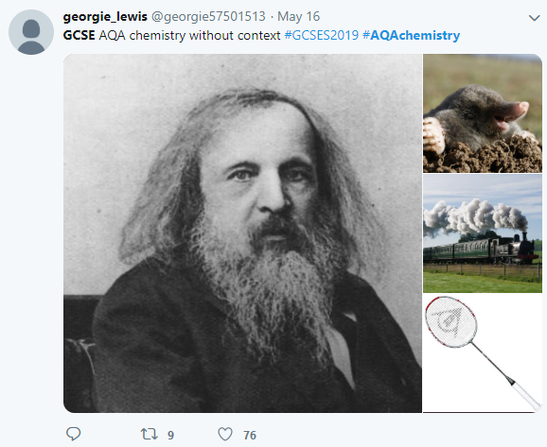
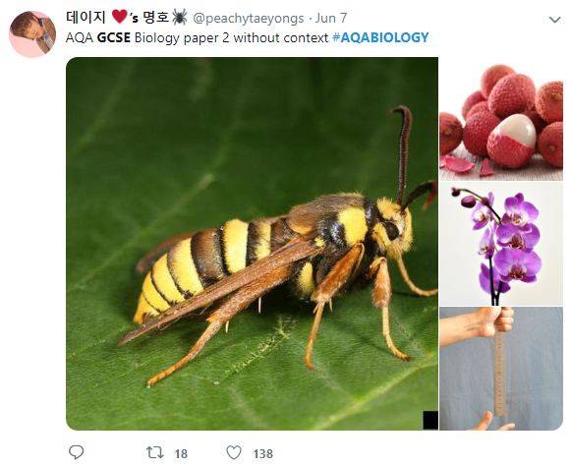
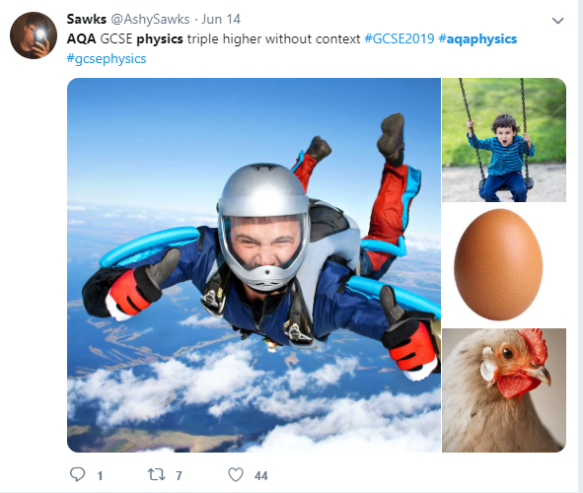
Social media
We monitor traffic, especially during exam season:
Notes:
Examples of AQA papers without the contexts, which ironically are the contexts.
We do keep an eye on social media, partly to see how the question papers are received, but also to identify potential malpractice. Some of the student comments are quite entertaining! – see next slide
On a serious note AQA have taken action as a result of child welfare concerns identified during monitoring social media, so it does have a serious role to play

Slide 8
Social media – student perceptions
Notes:
This tweet is from students saying not to say how easy the paper was otherwise AQA would increase the grade boundaries – they obviously don’t understand how awarding works!

Slide 9
Query word cloud
Notes:
We took all of our queries (these are from 2017-18 actually) and generated a word cloud where the more times we saw a word, the larger it appears in the cloud
It’s nice to see ‘students’ appear quite prominently here
Some of the hot topics of the period were:
‘energy’ – IOP and energy stores (on right side in purple)
‘uncertainty’ – understanding how it differs at A-level (see practical handbook) and GCSE (see subject vocab definition for clarification) (on top left in green)
For 2018-19 ‘electrospray’ was the most common topic query, mostly due to queries from students
Error actually includes queries about uncertainty and errors in practical, so not as bad as it might appear!

Slide 10
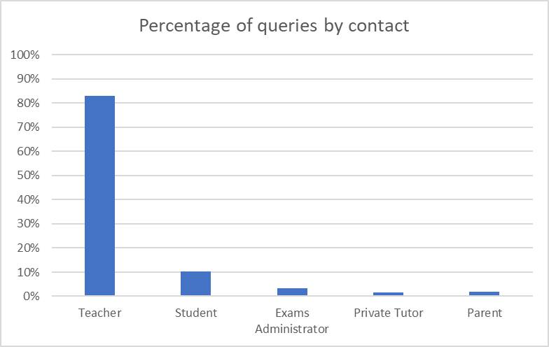
Who contacts us?
Queries about our specifications and assessments in 2018-19:
Most queries received are from teachers, but 10% are from students.
Notes:
This is data about queries received by Curriculum Science in the academic year 2018-19
Teacher 83%
Student 10%
Exams Administrator 3%
Private Tutor 1%
Parent 2%
The vast majority of queries are from teachers as we would expect, but we also get an increasing number of queries from students.
We will look at what these queries are in the next few slides.

Slide 11
What do students ask us?
Most questions are about A-level.
Questions about whether X answer would receive credit.
Queries about electrospray and the A-level Chemistry specification were popular last year.
Sometimes questions are clearly about homework!
Others ask for help explaining our UK qualifications to overseas universities.
Notes:
10% of escalated queries are from students, almost always about A-level
Point 2 (credit) – we use expert examiners who will seek to award credit for answers with correct science that answer the question, even if the science is beyond the spec content. We get lots of these queries from students using past papers to revise or who ask us about exams they have just sat
teachers are the experts in delivering their courses, we don’t want to undermine their relationship with the students and we try to ensure we have capacity to help with teachers as the priority. There are about 600,000 students per year group, so it would be problematic if they all started calling exam boards!
We encourage students to raise their concerns with their school, and to ask the teachers to raise them with us if they feel they are genuine
We sometimes get questions from students who are beginning to read beyond the spec and question some of the detail at A-level, but don’t quite understand enough of the topic to see why the A-level content is by necessity a bit of a simplification eg nuclear physics (GCE) or monoclonal antibodies (GCSE)
We always help with overseas universities. Often they don’t understand how UK GCSEs and A-levels map to their domestic qualifications, so we can produce headed letters to outline this for them. Our qualifications are gateways to further study, including those who seek to do that elsewhere in the world.

Slide 12
What categories of query do we receive?
Most questions are about the specification content and our assessments.
‘Practicals’ is the next most common.
Notes:
Specification content – do I need to teach this? What does this bit mean? Could you give me some example questions about this bit?
Assessments – is this an acceptable answer? Which bit of the spec does this cover? This context seems unusual etc
Expect this pattern to change as teaching of the new specifications is becoming more settled at GCSE and teachers are generally working out all the bits that are new compared with the last specifications.
Practicals – mostly about checking alternative methods are okay. Reminder of technician service?

Slide 13
Top 10 questions
Notes:
These are in no particular order
Spec content queries
Extend of knowledge (eg what could students be assessed on) and answers to hypothetical questions
Maths skills
Queries about mark schemes – would X get credit or what about Y answer. We can’t mark students’ mock exams for you!
What’s the AQA definition of X term? Eg

Slide 14
Question 1
Answer X isn’t on the mark scheme, would it get the mark?
Mark schemes show typical answers we might expect.
We will accept words that mean the same as those in the mark scheme, except where we underline the term – that specific word must be used for the mark.
Notes:
Mark schemes show the kind of answers we would expect to see, based on the spec content
Phraseology will be based on that used in the spec, but it doesn’t mean alternative correct ways to say the same thing won’t be credited, eg talking about energy stores. If the student doesn’t use ‘store’ they can still get the marks if it is clear to the examiner what the student has written
Example of underlining – if we needed to see kinetic energy we would write kinetic energy, so students writing just ‘energy’ or ‘potential energy’ for example would not get the mark

Slide 15
Question 1
Answer X isn’t on the mark scheme, would it get the mark?
Our examiners are subject experts and will look to credit correct science that answers the question, even if it is beyond the level of the course.
The front of each mark scheme has guidance to examiners, which covers most of the common questions about marking.
Notes:
Mark schemes show the kind of answers we would expect to see, based on the spec content
Phraseology will be based on that used in the spec, but it doesn’t mean alternative correct ways to say the same thing won’t be credited, eg talking about energy stores. If the student doesn’t use ‘store’ they can still get the marks if it is clear to the examiner what the student has written
Example of underlining – if we needed to see kinetic energy we would write kinetic energy, so students writing just ‘energy’ or ‘potential energy’ for example would not get the mark

Slide 16
Question 2
GCSE Required Practicals – do I have to do the method in the practical handbook?
No. These are example methods intended to cover the investigations and the apparatus and techniques of the specification.
You can use any method you wish that covers the apparatus and techniques.
Students can practise the techniques outside of the required practicals, to help build their confidence.
Notes:
If a question asks for a method, students should receive credit for any valid alternative method that answers the question
Could point to the hub materials:
Summer 2019 – using ISA questions and data sheets
Autumn 2017 – practical assessment and AO2 questions

Slide 17
Question 3
GCSE Required Practicals – can I use a demo or show a video?
Science is a practical subject!
15% of the marks are on the practicals, so those who don’t do them will be at a disadvantage.
Students should, therefore, be experiencing the practicals themselves.
Notes:
We could ask questions on any aspect of the required practicals, or present contexts based on the RPs
Videos on youtube often don’t cover the working scientifically skills or ask things like ‘how could you improve the accuracy?’ which is the kind of thing students are likely to see questions on rather than AO1 recall of methods

Slide 18
Question 3
GCSE Required Practicals – can I use a demo or show a video?
The head of centre must sign a declaration that students have completed the required practical activities in the specification.
Videos often don’t embed working scientifically, so are of limited use for revision.
Notes:
We could ask questions on any aspect of the required practicals, or present contexts based on the RPs
Videos on youtube often don’t cover the working scientifically skills or ask things like ‘how could you improve the accuracy?’ which is the kind of thing students are likely to see questions on rather than AO1 recall of methods

Slide 19
Question 4
What is the official definition of X?
Really, a lot of the time, the asker is looking for an AO1 definition.
Our questions assess topics at AO1, AO2 and AO3, so are not always about straight recall.
Notes:
We get a lot of questions where people ask, if students were asked about spec area Y, what would the model answer be?
We assess knowledge, understanding and application of content – wording of question can make slight difference to the answer you would expect, so there is no one model answer for all hypothetical questions on that topic.
Not really feasible to do this and often times the questions are not AQA style, ie we wouldn’t ask about that topic in the same way
Look at the past paper questions to get a feel for the depth with which we assess the spec statements
Also a point that specs are designed as they are to avoid too many statements being counted as AO1 in isolation when they are assessed. This allows other AOs to more easily cover the spec points. Means that there might be statements that students should be able to describe a phenomenon but not an example description.
Examples:
Will AQA accept ‘giant structures of positive ions arranged in a regular pattern’ for describing a metallic structure?
If a question asks for an elimination mechanism of a halogenoalkane reacting with NaOH and displayed formulae are not specified in the question, will candidates will lose marks for explicitly drawing the C-H bond in a skeletal structure?
Will 'high to low water potential' always be accepted as an alternate answer for osmosis questions?
Do students need to be taught the following and if so, what are the definitions that we approve:
Isotopic mass
Relative atomic mass
(the idea that AQA approve scientific definitions is odd!)
Please could you provide me with model explanations for em induction in the generator, microphone and transformer.

Slide 20
Question 4
What is the official definition of X?
Look at past papers to get a feel for the depth with which we assess the specifications.
Always happy to clarify specification points.
Notes:
We get a lot of questions where people ask, if students were asked about spec area Y, what would the model answer be?
We assess knowledge, understanding and application of content – wording of question can make slight difference to the answer you would expect, so there is no one model answer for all hypothetical questions on that topic.
Not really feasible to do this and often times the questions are not AQA style, ie we wouldn’t ask about that topic in the same way
Look at the past paper questions to get a feel for the depth with which we assess the spec statements
Also a point that specs are designed as they are to avoid too many statements being counted as AO1 in isolation when they are assessed. This allows other AOs to more easily cover the spec points. Means that there might be statements that students should be able to describe a phenomenon but not an example description.
Examples:
Will AQA accept ‘giant structures of positive ions arranged in a regular pattern’ for describing a metallic structure?
If a question asks for an elimination mechanism of a halogenoalkane reacting with NaOH and displayed formulae are not specified in the question, will candidates will lose marks for explicitly drawing the C-H bond in a skeletal structure?
Will 'high to low water potential' always be accepted as an alternate answer for osmosis questions?
Do students need to be taught the following and if so, what are the definitions that we approve:
Isotopic mass
Relative atomic mass
(the idea that AQA approve scientific definitions is odd!)
Please could you provide me with model explanations for em induction in the generator, microphone and transformer.

Slide 21
Question 5
To what level do we need to cover uncertainty for GCSE?
Working scientifically expectation:
Subject vocabulary:
Notes:
This question mainly seems to come from schools that have been teaching the A-level specifications, because there is a clearly greater expectation at A-level, which you can find in the practical handbooks.
Don’t expect A-level detail! This is a GCSE qualification for 16 year old children, not people completing a PhD!
Only need to know about resolution of measurements and a simple means to calculate uncertainty
We are not expecting a treatment at the level of the A-level science specifications, so understanding of the distinction between measurement/reading is not required.
For resolution, we give a definition here, which is based on the ASE Language of Measurement guide: http://filestore.aqa.org.uk/resources/science/AQA-SCIENCE-GCSE-SUBJECT-VOCAB.PDF

Slide 22
Question 5
At this level, students could use one of these approaches to find the uncertainty about the mean:
+/- half the range
+/- the difference between the mean and the value farthest from the mean.
Examples of this are in 2018 and 2019 past papers – look in all sciences, as working scientifically is common to all our GCSE Science specifications.
Notes:
Based on subject vocab booklet here: http://filestore.aqa.org.uk/resources/science/AQA-SCIENCE-GCSE-SUBJECT-VOCAB.PDF
It’s worth looking at the other science papers for ideas of working scientifically questions you could borrow for your subject area

Slide 23
Question 6
How do we ensure comparability of demand between Combined Science and the Separate Sciences?
Checkpoints throughout development of question papers
Senior Examiners scrutinise level of demand, demand of Assessment Objectives, overall demand of the paper
Notes:
Sometimes separate papers might look more accessible but this is because they have 100 marks compared with 70 for combined.
This means 40% standard demand is 40 marks on separates, but 28 on a Trilogy paper
There are more questions at standard demand, but there are also more questions at high demand due to the greater length of the paper

Slide 24
Question 6
How do we ensure comparability of demand between Combined Science and the Separate Sciences?
Balance levels of demand as follows:
Foundation Tier 60% low demand, 40% standard demand
Higher Tier 40% standard demand, 60% high demand.
These percentages are the same for Combined Science and the Separate Sciences.
Notes:
Sometimes separate papers might look more accessible but this is because they have 100 marks compared with 70 for combined.
This means 40% standard demand is 40 marks on separates, but 28 on a Trilogy paper
There are more questions at standard demand, but there are also more questions at high demand due to the greater length of the paper

Slide 25
Question 7
Why do some topics look like they have different demand on Trilogy than on the Separate Sciences?
Required to cover the whole specification content at all levels of demand and AOs during lifetime
Don’t always assess the same topics with the same AO, level of demand or command word
Notes:
We are required by Ofqual to examine all of the content at all levels of demand and covering all assessment objectives over the lifetime of the specification.
The separate and combined science specifications are examined separately: we do not have common papers or questions and do not intentionally cover these points at the same time in Trilogy and Biology. Partly this is because the separate science content is best incorporated within the combined content, rather than being treated separately from it, which you cannot do if you use identical questions in both combined science and the separate sciences.
Examples are
Magnification (standard demand on biology but high demand on Trilogy Biology as it included recall of equation and a unit conversion)

Slide 26
Question 7
Why do some topics look like they have different demand on Trilogy than on the Separate Sciences?
Within a series you might see a difference.
Over the lifetime of the specifications you should see even coverage.
Notes:
We are required by Ofqual to examine all of the content at all levels of demand and covering all assessment objectives over the lifetime of the specification.
The separate and combined science specifications are examined separately: we do not have common papers or questions and do not intentionally cover these points at the same time in Trilogy and Biology. Partly this is because the separate science content is best incorporated within the combined content, rather than being treated separately from it, which you cannot do if you use identical questions in both combined science and the separate sciences.
Examples are
Magnification (standard demand on biology but high demand on Trilogy Biology as it included recall of equation and a unit conversion)

Slide 27
Question 8
Should grade 5 students sit exams at Foundation Tier or Higher Tier?
Grade boundaries for, eg, a grade 4 are lower on Higher Tier.
But the demand of questions is much greater, so it’s harder to achieve the marks.
Notes:
To get a 5-5 on H tier, you need to get 73% of the standard demand marks right. What if the topics that come up are ones the student is not confident with?
On F tier, you can get a 5-5 with only the low demand marks
More marks, but lower demand. Also have the standard demand marks in case there are topics or skills the student is weak at
Less of a gamble the student will end up with a U after 5 years of secondary science.
Include handout:
https://filestore.aqa.org.uk/resources/science/AQA-GCSE-SCIENCE-TG.PDF
Does the student perform consistently across all three sciences in both content and skills? Combined science: students must sit the same tier for all papers. Separate sciences: students must sit the same tier within each separate science but do not have to sit the same tier for all three separate sciences.
Is the student performing consistently well on common questions? Common questions (questions that feature in both tiers) are set at standard demand.
Does the student show resilience when tackling the papers under exam pressure? There are no low demand questions on the Higher tier and there is less scaffolding in standard demand questions, especially with formulas in physics.
How well can the student apply their maths skills? Students need to be confident with transferring their maths skills to science lessons and questions written in a scientific context.
Is the student confident in their understanding of the required practicals, the science behind the required practicals and all aspects of working scientifically?
Is the student confident at tackling questions when the science content or required practical skills are put in an unfamiliar context?

Slide 28
Question 8
Should grade 5 students sit exams at Foundation Tier or Higher Tier?
Look at Combined Science Trilogy grade boundaries from 2019
Tier | Total mark | Low | Std | High | Mark ratio | 5-5 | 5-4 | 4-4
F | 420 | 60% | 40% | - | 252:168 | 243 | 221 | 200
H | 420 | - | 40% | 60% | 168:252 | 123 | 105 | 87
Notes:
To get a 5-5 on H tier, you need to get 73% of the standard demand marks right. What if the topics that come up are ones the student is not confident with?
On F tier, you can get a 5-5 with only the low demand marks
More marks, but lower demand. Also have the standard demand marks in case there are topics or skills the student is weak at
Less of a gamble the student will end up with a U after 5 years of secondary science.
Include handout:
https://filestore.aqa.org.uk/resources/science/AQA-GCSE-SCIENCE-TG.PDF
Does the student perform consistently across all three sciences in both content and skills? Combined science: students must sit the same tier for all papers. Separate sciences: students must sit the same tier within each separate science but do not have to sit the same tier for all three separate sciences.
Is the student performing consistently well on common questions? Common questions (questions that feature in both tiers) are set at standard demand.
Does the student show resilience when tackling the papers under exam pressure? There are no low demand questions on the Higher tier and there is less scaffolding in standard demand questions, especially with formulas in physics.
How well can the student apply their maths skills? Students need to be confident with transferring their maths skills to science lessons and questions written in a scientific context.
Is the student confident in their understanding of the required practicals, the science behind the required practicals and all aspects of working scientifically?
Is the student confident at tackling questions when the science content or required practical skills are put in an unfamiliar context?

Slide 29
Question 8
Should grade 5 students sit exams at Foundation Tier or Higher Tier?
Use performance on standard demand questions as benchmark – if students can’t consistently score marks on these then Higher Tier may be too much of a challenge.
Entry deadline is 21 February, but you can change tier for free up to 21 April.
Notes:
Detailed guide https://filestore.aqa.org.uk/resources/science/AQA-GCSE-SCIENCE-TG-FH.PDF

Slide 30
Question 8
Should grade 5 students sit exams at Foundation Tier or Higher Tier?
Tiering guide:
filestore.aqa.org.uk/resources/science/AQA-GCSE-SCIENCE-TG-FH.PDF
Key considerations to support your decision: youtube.com/watch?v=EcfDdLPravY
Notes:
Detailed guide https://filestore.aqa.org.uk/resources/science/AQA-GCSE-SCIENCE-TG-FH.PDF

Slide 31
Question 9
The approved textbook has content that doesn’t seem to be in the specification; what do we teach?
Textbooks are approved as broadly suitable to use to aid with teaching the course.
Authors can go beyond the requirements of the specification.
Notes:
Querying when the question asks the candidate for a description, will they in principle have access to all the marks in the question if they provide a diagrammatic or graphical answer?
what is the recommended number of topics for the essay question and more queries.

Slide 32
Question 9
The approved textbook has content that doesn’t seem to be in the specification; what do we teach?
Teachers can also do this anywhere they feel it better aids their students’ understanding, eg for further study in the sciences.
We assess the specification content not the textbooks.
Notes:
Querying when the question asks the candidate for a description, will they in principle have access to all the marks in the question if they provide a diagrammatic or graphical answer?
what is the recommended number of topics for the essay question and more queries.

Slide 33
Question 10
Is this question on the specification?
It’s not just about the subject content; questions can draw on knowledge and understanding of:
working scientifically
subject content
mathematical requirements
practical assessment
appendices.
Notes:
We do take all queries about our assessments seriously, so if you do feel something is valid, please don’t hesitate to get in touch.

Slide 34
Question 10
Is this question on the specification?
Questions assess these things in unfamiliar contexts at AO2 and AO3.
Sometimes a question assesses a combination of skills.
Notes:
We do take all queries about our assessments seriously, so if you do feel something is valid, please don’t hesitate to get in touch.

Slide 35
How you can find answers if the office is closed
Our Science Hub meeting materials cover topics such as:
assessing practicals
using legacy ISA materials
maths
extended response questions with exemplars
what AO2 questions look like.
aqa.org.uk/subjects/science/hub-schools-network
Notes:
Also the handout with the ‘supporting teaching’ title that shows where to find various resources.
This is from the 2019 hub meetings, so might be familiar.
Hub materials include exemplars and help cover key themes – these are the kinds of things teachers ask us about
We use our Hub meetings to facilitate networking and discussion groups around things like AO2, how to embed working scientifically into teaching, covering maths skills, making tier of entry decisions

Slide 36
How you can find answers if the office is closed
How exams work; how we set grade boundaries; how we create our specifications:
aqa.org.uk/about-us/what-we-do/getting-the-right-result/how-exams-work
Notes:
Also the handout with the ‘supporting teaching’ title that shows where to find various resources.
This is from the 2019 hub meetings, so might be familiar.
Hub materials include exemplars and help cover key themes – these are the kinds of things teachers ask us about
We use our Hub meetings to facilitate networking and discussion groups around things like AO2, how to embed working scientifically into teaching, covering maths skills, making tier of entry decisions

Slide 37
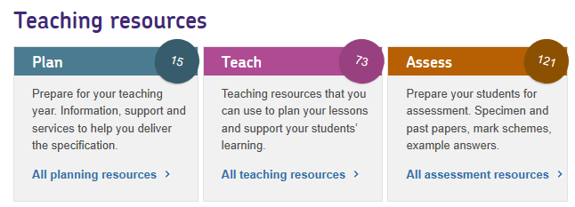
Resources
Finding help with practical work at A-level:
aqa.org.uk/resources/science/as-and-a-level/teach/practicals
On the ‘Teach’ link of each GCSE Science:
Notes:
A-level support:
Handbooks – including maths, uncertainty etc
Practical set-up guides
Examples of good practice
Technician adviser
GCSE:
Technician adviser
Handbooks – example methods and student worksheets
Webcast and slides about integrating practical as a core part of teaching science

Slide 38
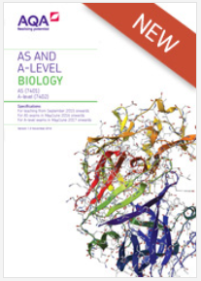
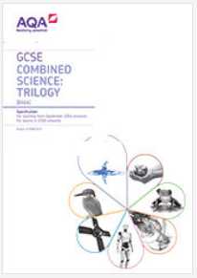
Resources
The specifications are the definitive source of information.
These include several sections, not just the
subject content:
working scientifically
subject content
mathematical requirements
practical assessment
appendices.
Notes:
A repeat of the earlier slide really, but it’s important people look at it!

Slide 39
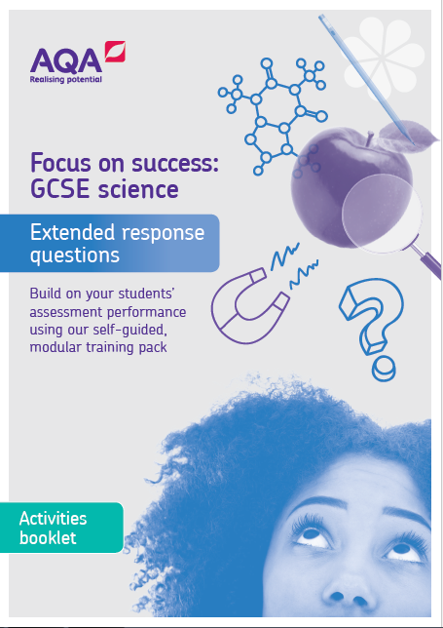
New GCSE science resources
Five self-guided modular training packs being released over the next year
Helping teachers to better understand the assessment requirements
Pack 1: Extended response questions – help your students master the extended response
Pack 2: AO2 – prepare students to manage scientific knowledge in an unfamiliar context
Pack 3: Practical questions coming Spring 2020
Pack 4: AO3 coming Spring 2020
Pack 5: Maths in science coming Summer 2020

Slide 40
Any questions?

Slide 41
How did we do?
Please rate this session on the Sched Conference app.
Using the postcards provided, please write:
one thing you enjoyed about our session or will take away for your teaching
one thing you feel could be improved.
Please hand your postcard in as you leave.

Slide 42
Get in touch
For qualification information, resources and support, please visit: aqa.org.uk/science
Enquiries:
Tel: 01483 477 756
Email:
gcsescience@aqa.org.uk
alevelscience@aqa.org.uk

Slide 43
Thank you

