Slide 1
Jennifer Obaditch
ASE Conference 2022

Slide 2
Science - based Extended Project Qualifications (EPQs)
What we’ll cover today:
the benefits of EPQ and Project Qualifications − in school, at university and entering the workplace
what’s in an EPQ? Examples from science students and STEM EPQs
Project Qualifications as a bridge to successful transition
spotlight on University of Leeds outreach
support for EPQ
Q&A.

Slide 3
The benefits

Slide 4
Benefits of the EPQ
For students
It allows young people to follow their passions and to stand out from the crowd.
It is flexible and allows students to follow the course independently, but with supervision.
The taught element benefits all students and develops essential HE skills.
It supports successful transition to HE.
For schools
It can fit into the existing curriculum model.
The deadlines can be flexible and set to meet the needs of your school.
There are lots of resources and support from universities.
University advocacy.

Slide 5
Be seen by universities
\
\
\
Increase chance of achieving A-level A*–B by up to 29%
Worth half an A-level in terms of UCAS points
Learn how to work independently
\
\
\
Receive lower offers from many universities
Discuss in UCAS statements and interviews
Learn how to research, write and reference

Slide 6
Setting up for success
Less likely to leave university after the first year
University of Southampton and Thompson, 2018

Slide 7
Setting up for success
More likely to obtain 1st or 2:1
^{Thompson and Jones}
⁽²⁰¹⁶⁾
University of Southampton and Thompson, 2018

Slide 8
Be seen in the workplace

Slide 9
Be seen in the workplace
\
\
\
Gain
CV-worthy skills
Learn interview skills
Improve planning skills
\
\
\
Learn how to reflect on work and suggest improvements
Improve time management
Build abilities in conducting research

Slide 10
What’s in an EPQ?

Slide 11
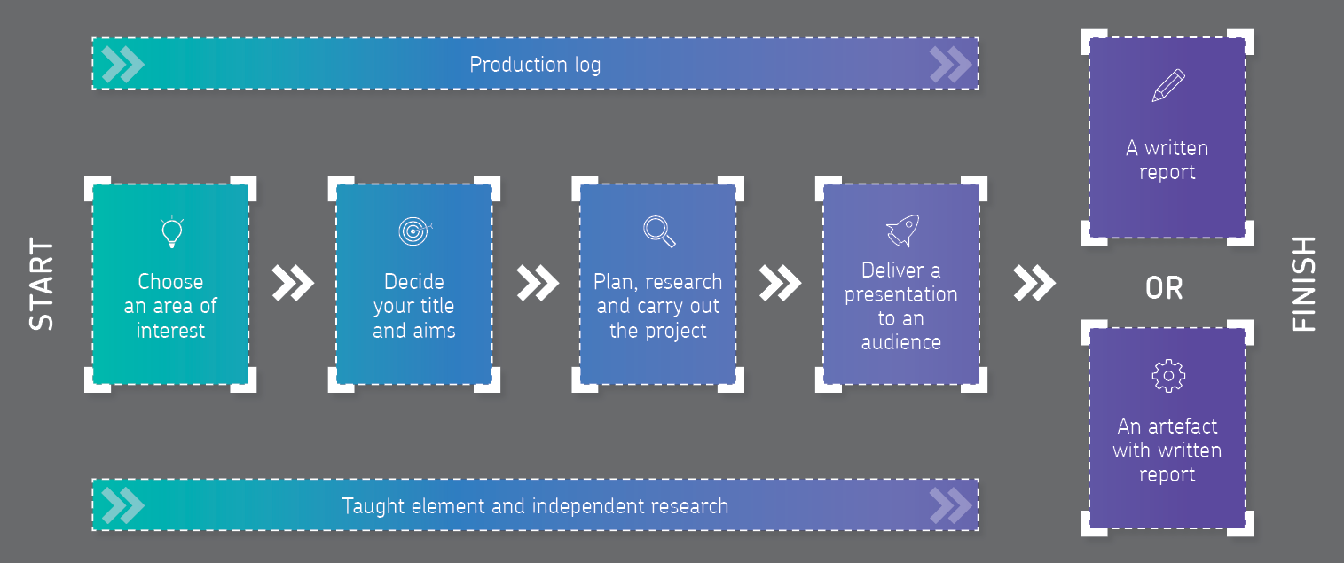
Where the journey starts: What’s in an EPQ?

Slide 12
Presenting the outcome
\
\
\
^{5000 words}
^{A formal academic report}
^{Research based}
^{Fully referenced}
Minimum 1,000 word report and something the student creates, for example:
an engineered piece of work; a robot or a model aeroplane etc
a play, written, produced, or directed
an original musical composition
a computer programme or website.
^{A shared vision?} Students can work in a group and create together, developing their individual EPQ along the way.
^{Written report}
^{Artefact with written report}
^{Group projects}

Slide 13
30 hours supervised learning…
30 hours of learning – the taught element.
These may not be typical lessons and could be:
learning from visiting speakers
visiting university libraries
completing online courses.
Students learn skills such as:
how to develop titles, questions and proposals
project management skills, including time management, planning techniques, and setting aims and objectives
research methods, including research ethics, analysis and evaluation, risk assessment and data collection techniques
report writing and presentation skills.

Slide 14
… at least 90 hours to be independent
Independent research is the foundation of the EPQ.
Students will:
carry out detailed research that informs the project product outcome and format
use a wide range of relevant resources
perform critical analysis and evaluation of resources
use a mix of sources to realise the project product outcome.

Slide 15
Discover your true passions
Some examples of past projects:
\
\
\
\
\
To what extent is open source superior to proprietary software with respect to security?
What was the most significant reason for Jet Airways’ decline?
^{To what} ^{extent do genetic} factors contribute to a propensity towards addiction in humans?
^{How dimples} ^{affect the aerodynamic} ^{drag of a} ^{golf ball.}
Designing a solar powered ultraviolet water purification system for the developing world
\
\
\
\
\
^{Could} hydro-electric power be created outside our ^{front door?}
^{How sustainable} ^{is the financial inequality} ^{between teams} ^{in the English Premier League?}
To what extent can neuroaesthetic research be used to produce scientifically ‘attractive’ paintings?
Can emergency whistles be optimised for design and ^{use in rural environments?}
^{Construction} and testing of a small-scale hybrid rocket motor.
Notes:
This isn’t your ordinary A-level. You really can do an EPQ in anything. What are you passionate about? What annoys you? What have you always wanted to know more about?
Take a look at some of these examples of past EPQs.

Slide 16
Expanding scientific understanding and methodology
Students may have a fairly narrow view of what scientific investigation involves, centring around the ‘scientific method’ of developing and testing a hypothesis by manipulation of variables.
EPQ gives students the opportunity to:
explore the wide variety of different methods scientists use when conducting investigations
do more open-ended investigations
explore interests beyond the required practicals
use and further develop the investigative and analytical skills introduced at GCSE and A-level.

Slide 17
Project qualifications as a bridge to success

Slide 18
Bridging to the next stage with EPQ
The EPQ is seen as a desirable choice by many universities as a bridge to higher education study.
The skills developed support transition to undergraduate courses.
As part of a Level 3 programme, students will build independent study and research skills.
Students will be able to provide evidence of essential research and academic skills and is considered by tutors as part of alternative offers.
Universities are researching the impact of EPQ on student progress and performance in undergraduate courses.

Slide 19
Support and resources

Slide 20
University advocacy and support
Universities provide resources, workshops, visits and library access for EPQ students.
For example:
MOOCs from Bath and Southampton
library access, visits and workshops, eg Warwick, Leeds, Southampton, Sheffield
guides to each stage of an EPQ research project, eg Birmingham, Oxford, Cardiff
specific websites to support EPQ, eg Newcastle.
Find out more by visiting our community links page.
AQA | Project qualifications | Level 3 Extended Project Qualification | Teaching resources

Slide 21
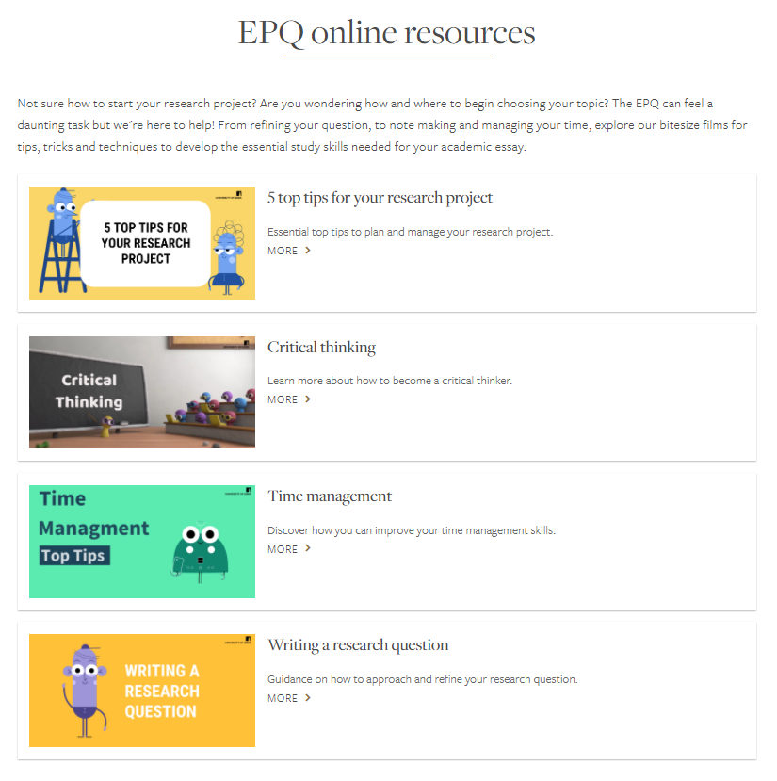
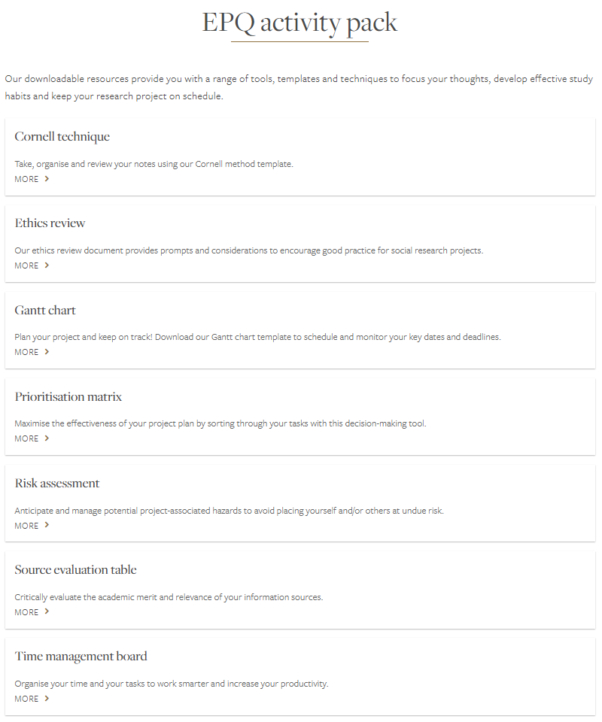
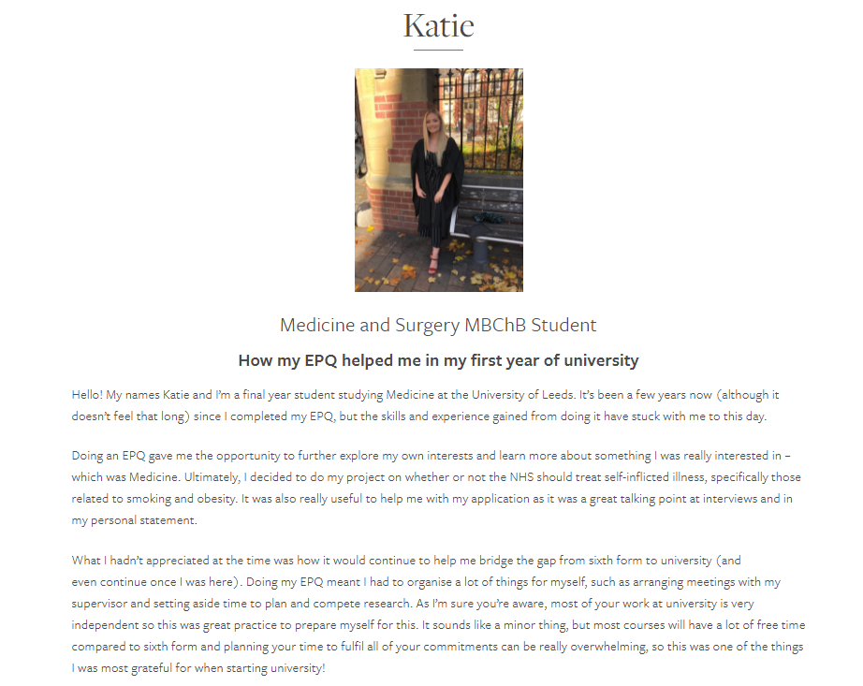
Spotlight on the University of Leeds
leeds.ac.uk/download/downloads/id/1367/research_and_study_skills_programme_202021.pdf
© University of Leeds

Slide 22
New support and resources
Guides to delivering the Project Qualifications
Coordinator and supervisor training courses – we’re scheduling more dates
Online on-demand training modules for supervisors
Virtual communities events for coordinators
Network meetings
Student recruitment pack
Welcome pack
Available on our website: aqa.org.uk/extended-project-qualification

Slide 23
Resources and support
NEA Adviser – contact via your exams officer or email projects@aqa.org.uk
Centre Services materials:
standardisation materials
previous course materials
peports on the series from the Principal moderator.
Guides to delivering Project Qualifications
Endorsed textbook by Christine Andrews with free scheme of work and resources
University support – see our community links

Slide 24
Resources and support
Projects team – general support – projects@aqa.org.uk
Curriculum team – visits, email and telephone – expert support
Free online standardisation meetings
AQA training events: Supervisor, Coordinator
In-school events – single school or multiple schools, whole or half days

Slide 25
Q&A

