Slide 1
AS/A-LEVEL BIOLOGY 3.1.8 Inorganic ions presentation
To be used alongside AQA AS/A-level Biology inorganic ions teaching notes
Version 1.0

Slide 2
Atoms
All matter is made up of atoms
Each atom is made of three types of particle:
neutrons, with no charge
protons, with a positive charge
electrons with a negative charge
The neutrons and protons form the nucleus
The electrons orbit around the nucleus
In an atom, the number of protons is the same as the number of electrons (so no overall charge)
Version 1.0

Slide 3
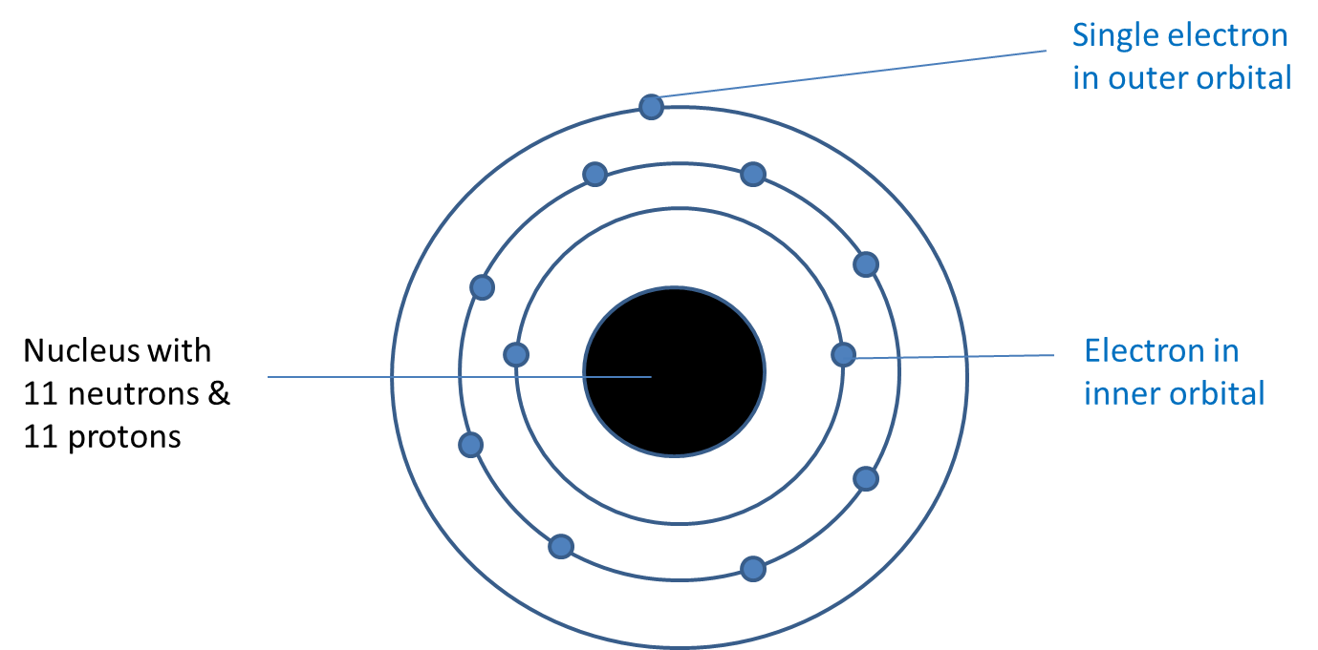
A sodium atom

Slide 4
Stability of atoms
Each atom has one or more orbitals of electrons
Atoms are more stable if their outer orbital is full
Stability is achieved by either gaining or losing electrons from the outer orbital
Version 1.0

Slide 5
A sodium ion is formed when a sodium atom loses the electron from its outer orbital

Slide 6
Ions are formed when an atom gains, or loses, electrons
If an atom loses one or more electrons, it becomes a positively charged ion
If an atom gains one or more electrons, it becomes a negatively charged ion
If placed in an electric field, ions will migrate to the electrode with the opposite charge
Negatively charged ions migrate to the positive electrode (anode), so are called anions
Positively charged ions migrate to the negatively charged electrode (cathode), so are called cations

Slide 7
Representing ions
A sodium ion still has 11 protons but having lost one electron it only has 10 electrons, ie it has a positive charge
Na (atom) – 1 electron = Na⁺ (sodium ion)
Some atoms gain electrons
If a chlorine atom gains one electron it becomes a negatively charged chloride ion
Cl (atom) + 1 electron = Cl– (chloride ion)

Slide 8
Some ions are complex
They contain more than one atom, eg,
nitrate (NO₃–)
phosphate (PO₄^{3–})

Slide 9
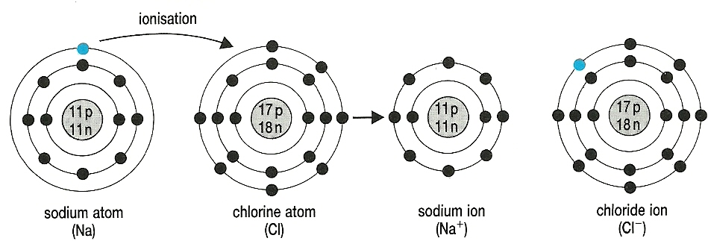
A cation and anion can share electrons
When they do, their opposite charges attract each other forming an ionic bond

Slide 10
Acknowledgements
Diagram on slide 9 © Rowland, M., 1992, Biology, Thomas Nelson & Sons Ltd

