Slide 1
AS/A-LEVEL BIOLOGY 3.3.3 Protein digestion and absorption presentation
To be used alongside AQA AS/A-level Biology protein digestion and absorption teaching notes
Version 1.0

Slide 2
Protein digestion
Like all digestion, this involves hydrolysis
Three types of enzyme involved
Endopeptidases: hydrolyse peptide bonds between specific amino acids in the middle of a polypeptide
Exopeptidases: hydrolyse peptide bonds between specific amino acids at the ends of a polypeptide
Dipeptidases: hydrolyse the peptide bond in a dipeptide
Version 1.0

Slide 3
Exopeptidases and endopeptidases
Exopeptidase breaks bonds at ends of polypeptide to produce dipeptides or individual amino acids
Endopeptidase breaks bonds in middle of polypeptide to produce shorter polypeptides

Slide 4
Pause for thought
The first stage of protein digestion occurs in the stomach.
An endopeptidase (pepsin) is the only protein-digesting enzyme in the stomach.
Only later, in the small intestine, is the food mixed with exopeptidases.
Suggest the advantage of this sequence.

Slide 5
Dipeptidases
Dipeptidases are located in the surface membranes of cells lining the small intestine
They hydrolyse dipeptides into amino acids
As a result, the final products of protein digestion are amino acids, which are absorbed by cells lining the ileum of the small intestine

Slide 6
Summary of protein digestion

Slide 7
Amino acid absorption
Uptake from the ileum is by facilitated diffusion through specific carrier molecules in the surface membranes of epithelial cells
With each amino acid, one Na⁺ ion is also taken up, an example of co-transport
A diffusion gradient for Na⁺ is maintained by their active transport through the base of the epithelial cells
Amino acids pass through the base of the epithelial cells by facilitated diffusion

Slide 8
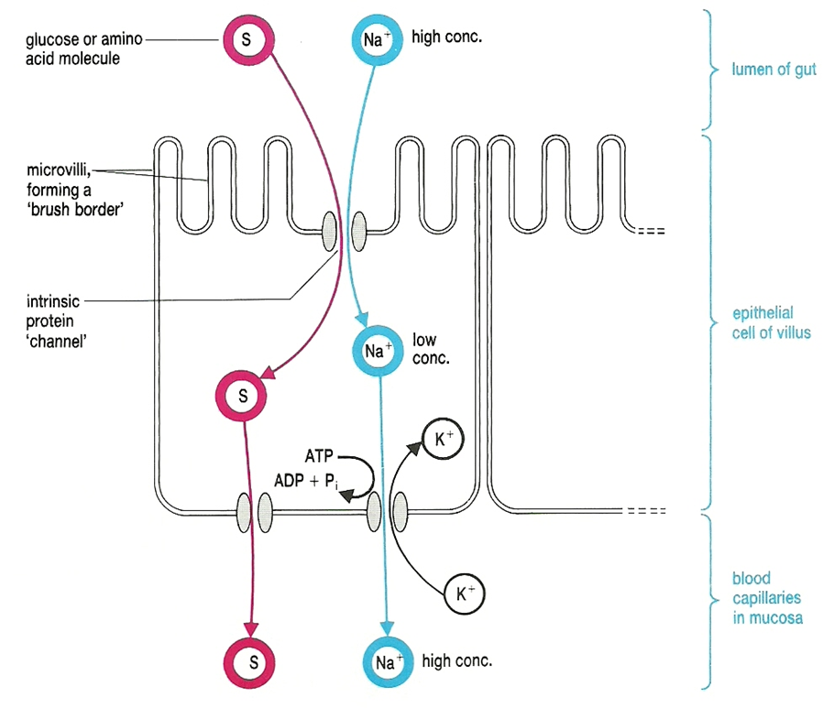
Uptake by co-transport

Slide 9
Acknowledgements
Diagram in slide 8 © Rowland, M., 1992, Biology, Thomas Nelson & Sons Ltd

