Slide 1
AS/A-LEVEL BIOLOGY 3.3.4.2 Transport of organic compounds in plants - translocation
To be used alongside AQA AS/A-level Biology transport of organic compounds teaching notes
Version 1.0

Slide 2
Overview
During photosynthesis, organic compounds are synthesised in a plant’s leaves
The leaves act as a source
Most of these organic compounds are moved to parts of the plant that are actively growing, to storage organs or to seeds
These regions act as sinks
Transport is from source to sink
Transport occurs in the phloem tissue
Version 1.0

Slide 3
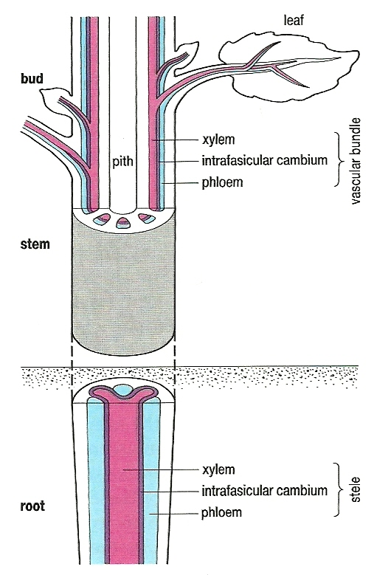
Location of phloem
Note the close association between phloem and xylem in all parts of plant

Slide 4
Evidence that transport of organic compounds occurs in the phloem
¹⁴C used to label organic compounds – subsequent autoradiography shows labelled compounds are in the phloem
The bark of a tree contains the active phloem – remove a ring of bark and downward movement of organic compounds stops where bark removed
Sap-sucking insect – piercing mouthpart found to be in phloem and sap removed via piercing mouthpart found to contain organic compounds
Version 1.0

Slide 5
Structure of phloem
Two types of cell
Sieve tube elements
Stacked one on top of another
No nucleus, thin layer of cytoplasm around large central ‘vacuole’, few organelles, P-protein in cytoplasm
Large pores in end walls (sieve plates) with cytoplasm passing from element to element
Smaller pores in side walls with strands of cytoplasm (plasmodesmata) running through to adjacent:
Companion cells
Smaller cells with nucleus, cytoplasm and organelles
Each controls activity of adjacent sieve tube element

Slide 6
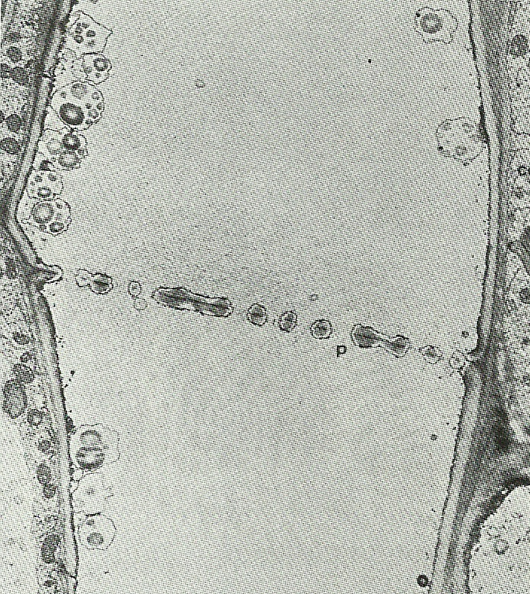
Two sieve tube elements
This slide was taken using an optical microscope
It shows a sieve plate between two adjacent sieve tube elements
Notice:
the pores (p) in the sieve plate
very little cytoplasm in the sieve tube elements

Slide 7
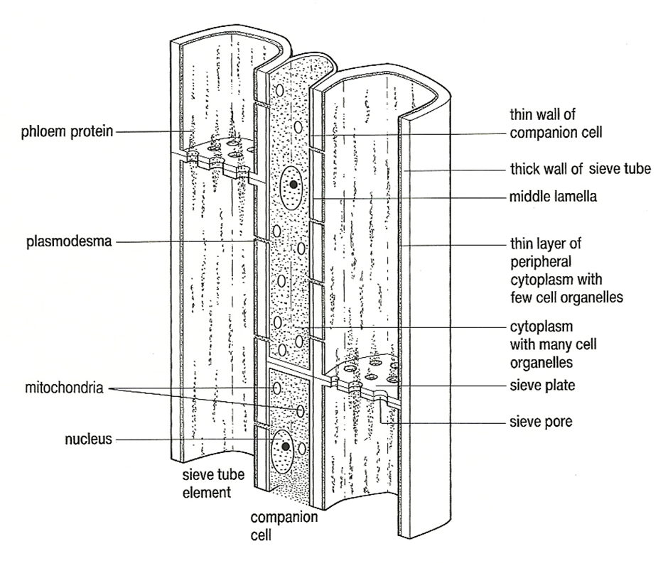
Sieve tube elements and a companion cell

Slide 8
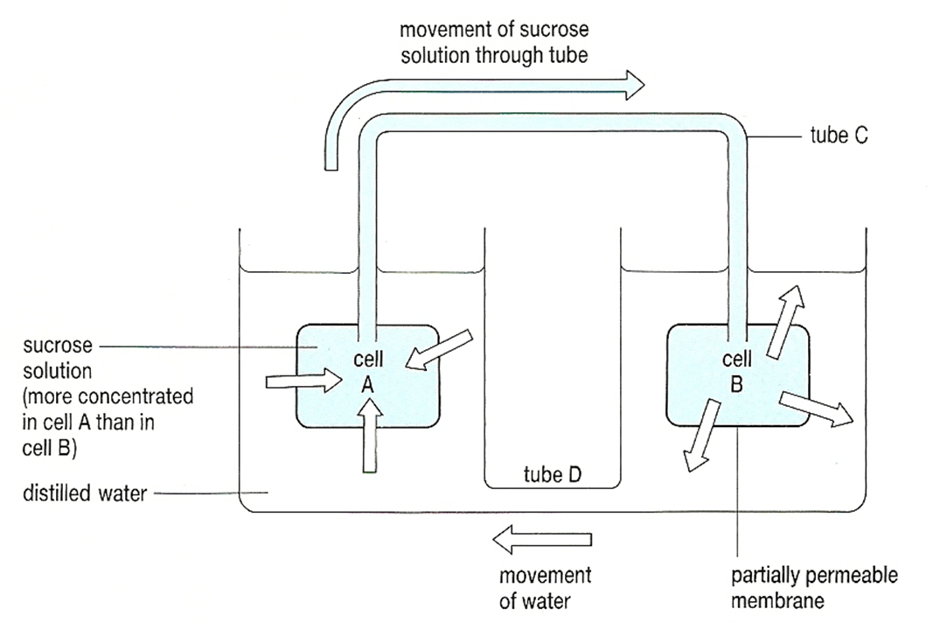
A model of mass flow

Slide 9
Transport in the phloem (1)
Loading from source
In the leaves, solutes are passed from photosynthesising cells into the companion cells of the phloem
The companion cells then load the solutes into the sieve tube elements via plasmodesmata
ATP hydrolysis is involved in this transfer

Slide 10
Transport in the phloem (2)
Pressure flow from source to sink
Entry of solutes into sieve tube elements lowers their water potential (makes the water potential more negative)
As a result, water enters the sieve tube elements from the surrounding xylem vessels
This increases the pressure within the sieve tube elements, pushing their contents through the pores in the sieve plates

Slide 11
Transport in phloem (3)
Unloading to a sink
As solutes are pushed down a pressure gradient, they are surrounded by cells with a lower solute concentration
Solutes leave the phloem into these cells, lowering their water potential
Water leaves the phloem by osmosis, returned to the surrounding xylem and is re-circulated
Cells in the sink use, or store, the solutes

Slide 12
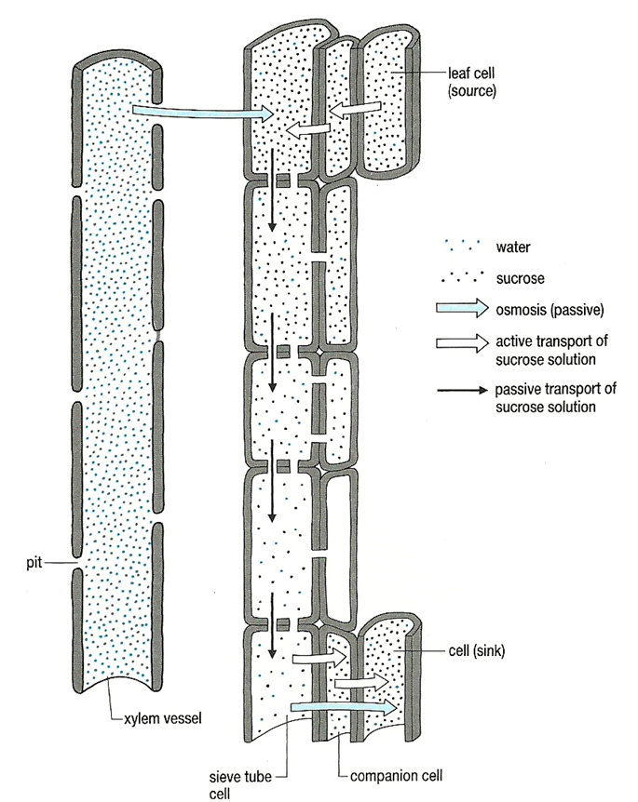
Mass flow hypothesis

Slide 13
Contents of phloem / mg cm⁻³
Non-reducing sugars / ∼ 80–120
Very little reducing sugar transported
Amino acids / ∼ 5
Proteins / ∼ 2
Organic acids / ∼ 3
Inorganic ions / 5

Slide 14
Acknowledgements
Diagrams in slides 3, 7, 8 and 12 © Rowland, M., 1992, Biology, Thomas Nelson & Sons Ltd
Image on slide 6 © Moore, R., Clark, W.D., Stern, K.R. and Vodopich, D., 1995, Botany, McGraw-Hill Education

