Slide 1
AS/A-LEVEL BIOLOGY
3.1.7 Water
To be used alongside AQA AS/A-level Biology Water teaching notes
Version 1.0

Slide 2
Water in biology
It is the most common compound
Why is water so important?
The table shows the approximate composition of two organisms
Water is a metabolite in many reactions, including:
  hydrolysis reactions
  condensation reactions
A cell’s metabolic reactions occur in aqueous solution
But most of its properties result from the ability of water molecules to ‘stick together’
Substance | % body mass
 | Human | E. coli
Water | 70.0 | 70.0
Lipid | 15.0 | 2.0
Protein | 12.0 | 15.8
Nucleic acids | 1.0 | 7.8
Carbohydrate | 0.5 | 3.0
Inorganic ions | 1.5 | 1.4
Version 1.0

Slide 3
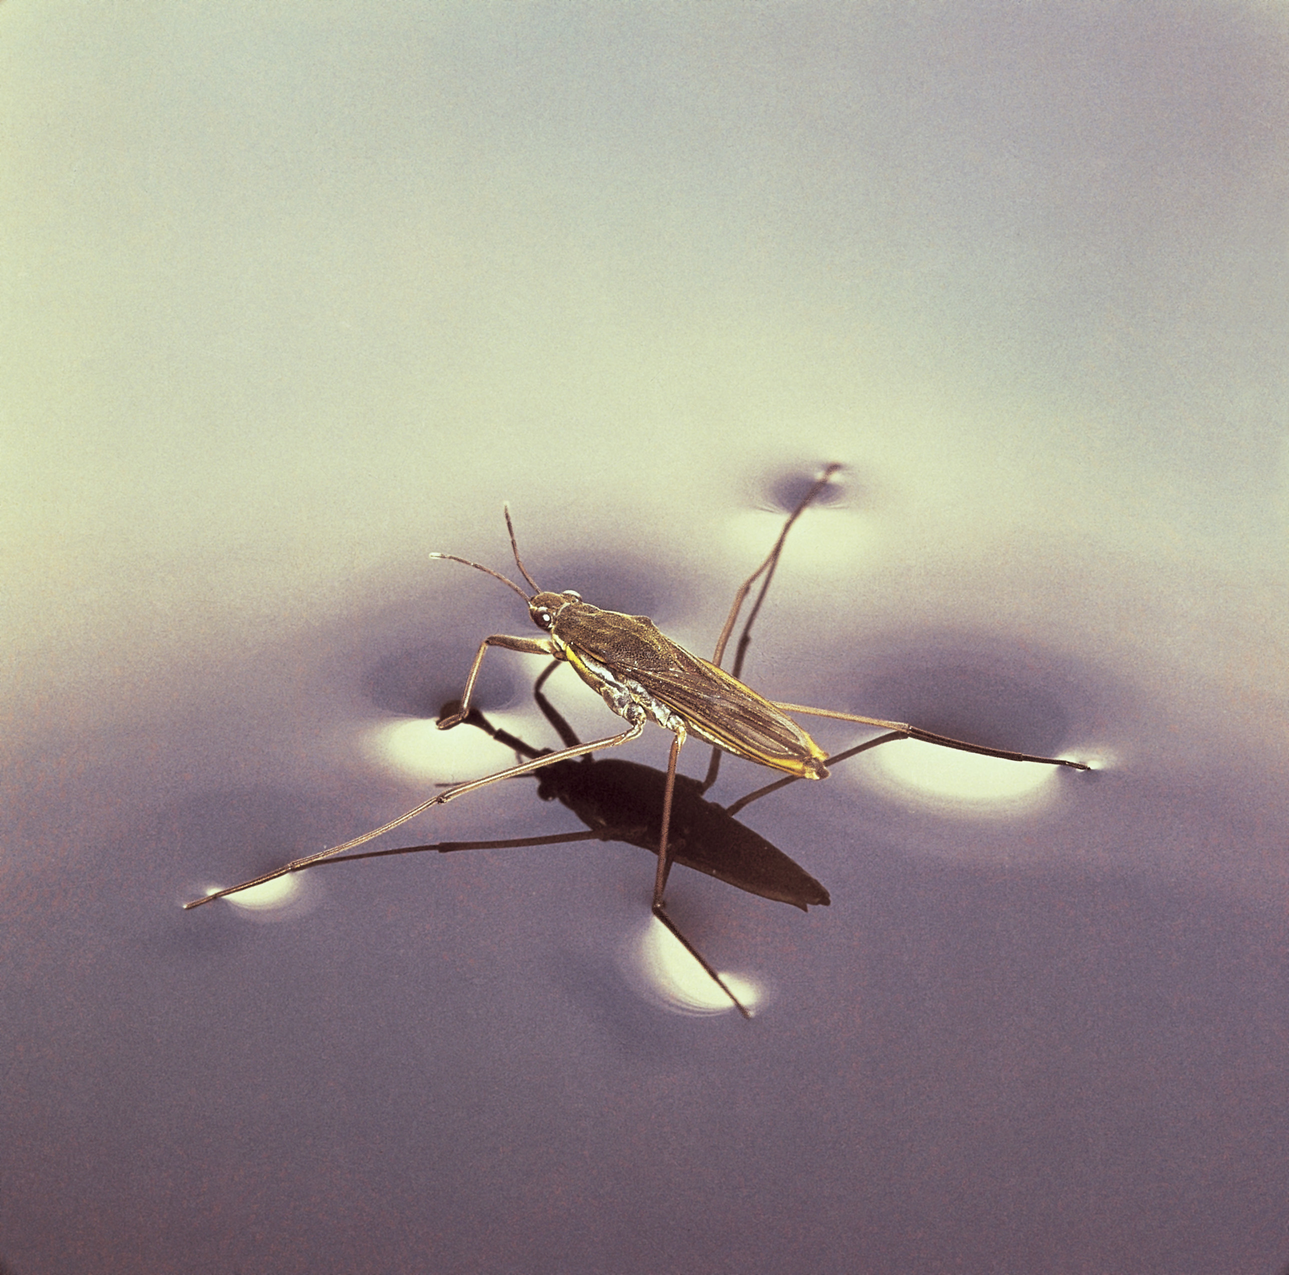
This pond skater can walk on water
What property of water allows it to do so?

Slide 4
Water molecules are polar
Look at the water molecule on the left of the diagram
Each hydrogen atom shares its electron with the atom of oxygen
Because the oxygen atom has more protons than the hydrogen atoms, it pulls more strongly on these electrons
So the oxygen end of the molecule has a slight negative charge (δ⁻) and the hydrogen ends have a slight positive charge (δ⁺): the molecule is polar
Note how a hydrogen bond forms
Version 1.0

Slide 5
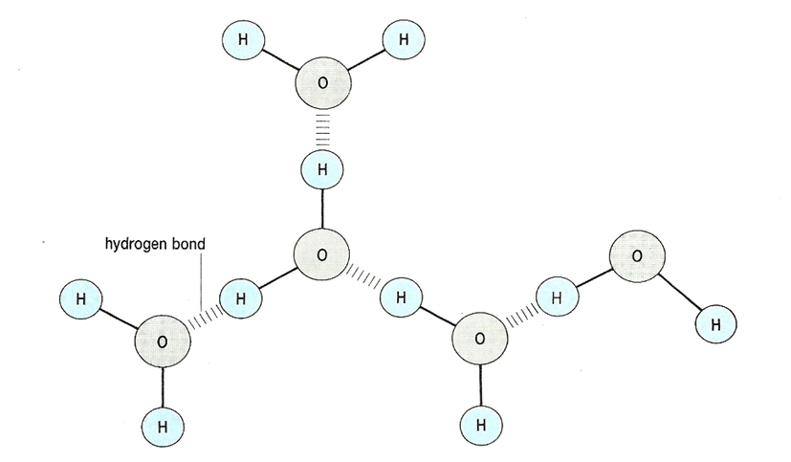
Hydrogen bonds
When water molecules get close together, the oppositely charged parts of the molecules attract each other, forming hydrogen bonds. We call this cohesion. At room temperature, water forms a lattice, as shown.

Slide 6
Cohesion between water molecules
At an air-water surface, the cohesion between water molecules produces surface tension. This surface tension can make a solid-like surface, explaining how the pond skater can walk on water
Within a column of water, cohesion also explains why the column does not break when water molecules are pulled up a narrow tube (eg in a straw when you drink or in the xylem during transpiration)

Slide 7
Water as a solvent (1)
Because it has polar molecules, water is attracted to any substance that is also polar
Substances that can become part of water’s hydrogen-bonded structure will dissolve in water and are called hydrophilic
Substances that cannot become part of water’s hydrogen-bonded structure will not dissolve in water and are called hydrophobic
Of the biologically important molecules in your specification, only triglycerides and large polymers do not dissolve in water

Slide 8
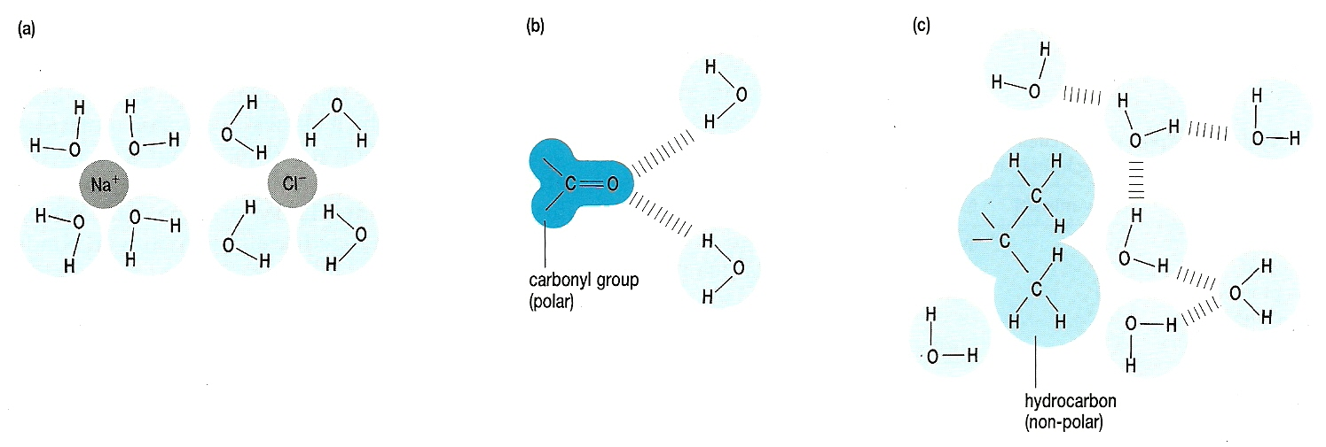
Water as a solvent (2)
Ions (a) and polar molecules (b) will dissolve in water but non-polar molecules (c) will not

Slide 9
Cohesion of water molecules explains why:
water absorbs/loses a relatively large amount of heat before its temperature changes
  This is called the specific heat capacity of water and has a value of 4.184 kJ kg^{–1} K^{–1}
water absorbs a large amount of heat before it turns into water vapour
  This is called the latent heat of vaporisation of water and has a value of 2.26 MJ kg^{–1} K^{–1}

Slide 10
Acknowledgements
Photograph on slide 3 © Hermann Eisenbeiss, Science Photo Library Z285/0206
Diagrams on slides 5 and 8 © Rowland, M., 1992, Biology, Thomas Nelson & Sons Ltd

