Slide 1
A-level Biology 3.6.4.3 Control of blood water potential
To be used alongside AQA A-level Biology Control of blood water potential teaching notes
Version 1.0
Notes:
There are two aspects to this topic:
the role of the hypothalamus, posterior pituitary and ADH in osmoregulation
the structure and function of the nephron.
Depending on the interests of your students, you could choose to treat these as two separate topics, linking osmoregulation to the overall topic of homeostasis and dealing with the nephron at another time.

Slide 2
What might happen if...
The water potential of the blood became too low (more negative)?
The water potential of the blood became too high (less negative)?
Version 1.0
Notes:
Use this slide to:
Remind students of the correct way to refer to water potential. Examiners accept descriptions such as ‘the water potential becomes more/less negative’ and many students find this easier to understand than ‘high’ having a value of zero and ‘low’ having a negative value.
Think about the damage that might occur as a result of osmosis (eg lysis of cells if the blood water potential is higher than that of cells and cell shrinkage/slowing of hydrolysis reactions if the blood water potential is lower than that of cells).

Slide 3
Gains and losses of water in mammals
Water gains:
food
drink.
Mammal
Water losses:
evaporation
faeces
urine.
Version 1.0
Notes:
You could ask students:
To name two ways in which we lose water by evaporation (eg evaporation of sweat from the skin and evaporation of water from the alveoli).
Which of these gains or losses we can control by changing our behaviour (eg drink more when thirsty, move from a hot environment when we are sweating).

Slide 4
Diuresis - terminology
Excessive water loss in the urine is known as diuresis.
An antidote to diuresis is called an antidiuretic.
Mammals produce a hormone called antidiuretic hormone (ADH) that reduces water loss in the urine.
ADH is produced in the hypothalamus then secreted to and stored in the posterior pituitary gland.
When the water potential of the blood decreases (becomes more negative), osmoreceptors in the hypothalamus detect this and send impulses to the posterior pituitary stimulating it to release ADH.
Version 1.0
Notes:
By introducing the term ‘diuresis’, students are encouraged to understand why ADH is so called and this could help them to recall its function. Some students might know someone who is taking a prescribed antidiuretic.
This slide introduces the role of the hypothalamus in producing ADH and the role of the posterior pituitary gland in storing and releasing ADH. The specification clearly states posterior pituitary, so examiners could expect students to use this level of specificity in their answers.
It is worth stressing here that a decrease in the blood’s water potential (water potential becomes more negative) results in stimulation of the posterior pituitary to release ADH, which reduces water loss (diuresis).

Slide 5
Formation of urine: an overview
In a way similar to the formation of tissue fluid, small molecules are forced out of capillary networks within the kidneys into microscopic kidney tubules.
Useful substances are reabsorbed back into the blood from these kidney tubules.
ADH regulates the reabsorption of water from the kidney tubules back into the blood.
Version 1.0
Notes:
This slide encourages students to gain an overview of basic principles.
Students learnt about the formation of tissue fluid in Year 1 of this course (specification section 3.3.4.1). Once ultrafiltration in the glomerulus has been covered, a comparison of the two processes could form the basis of a good class discussion.
More detail of the structure and function of kidney tubules comes later in this presentation.

Slide 6
Control of water loss in the urine
Hypothalamus
contains osmoreceptors
produces ADH, which it secretes into the posterior pituitary body.
Posterior pituitary body
releases ADH into the blood when stimulated to do so by osmoreceptors in the hypothalamus.
ADH
stimulates reabsorption of water by collecting ducts in the kidney.
Version 1.0
Notes:
We will look at the structure of the kidney in later slides.
The important points being consolidated here are the roles of the hypothalamus, posterior pituitary and ADH.

Slide 7
Overview of osmoregulation
more water reabsorbed
reabsorption of water in kidney
less water reabsorbed
no release released
release of ADH by posterior pituitary
Water potential falls
Water potential rises
no stimulation stimulates
osmoreceptors in hypothalamus
increases decreases
(less negative) (more negative)
‘normal’ blood water potential
represents negative feedback
Version 1.0
Notes:
This diagram summarises the information in the previous slide and might be more helpful to visual learners.
This type of negative feedback loop will recur in specification sections 3.6.4.1 and 3.6.4.2.
So far, students have learnt about the roles of the hypothalamus, posterior pituitary and ADH. The following slides look at the structure and function of nephrons. You could choose to leave this to a later session.

Slide 8
The role of the kidney
The functional units within the kidneys are microscopic tubules, called nephrons.
Each nephron starts as a blind ended Bowman’s capsule supplied by a knot of capillaries, called a glomerulus. The nephron then becomes, in turn;
a coiled region called the proximal convoluted tubule
a hairpin bend called the loop of Henle
a second coiled region called the distal convoluted tubule
before joining a collecting duct.
Version 1.0
Notes:
This slide introduces the components of nephrons named in the four bullet points in specification section 3.6.4.3.
Here the capsule is referred to as the Bowman’s capsule. Terms such as ‘renal capsule’ or ‘capsule of the nephron’ would be acceptable in an examination answer.

Slide 9
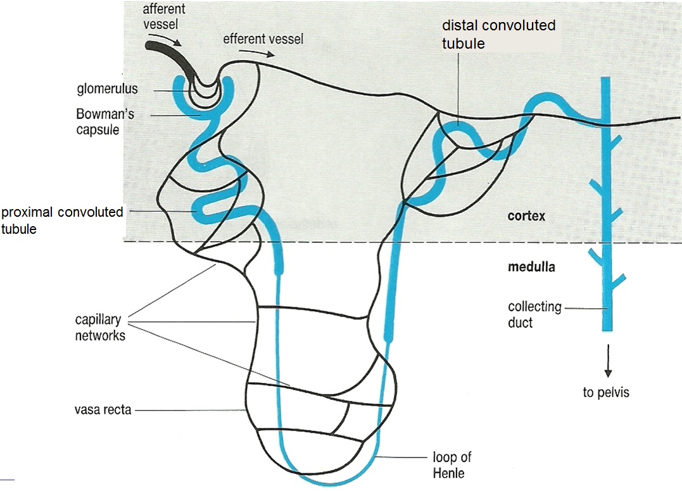
A single nephron
Version 1.0
Notes:
It is worth pointing out here the importance of the capillaries. Students usually refer to the glomerulus but fail to show understanding of the importance of the capillary networks around the rest of the tubule in the reabsorption of ‘useful’ ions, molecules and water.

Slide 10
VS kidney showing a single nephron
Version 1.0
Notes:
This slide simply shows the position of an individual nephron within a kidney.
The capsules, glomeruli, proximal tubules and distal tubules are mainly in the outer cortex; the loops of Henle and collecting ducts are in the inner cortex.
The position of the collecting duct and its pathway to the pelvis is also shown.
The results of filtered blood (ie the urine) pass from each nephron into the pelvis and from there via the ureter to the bladder.

Slide 11
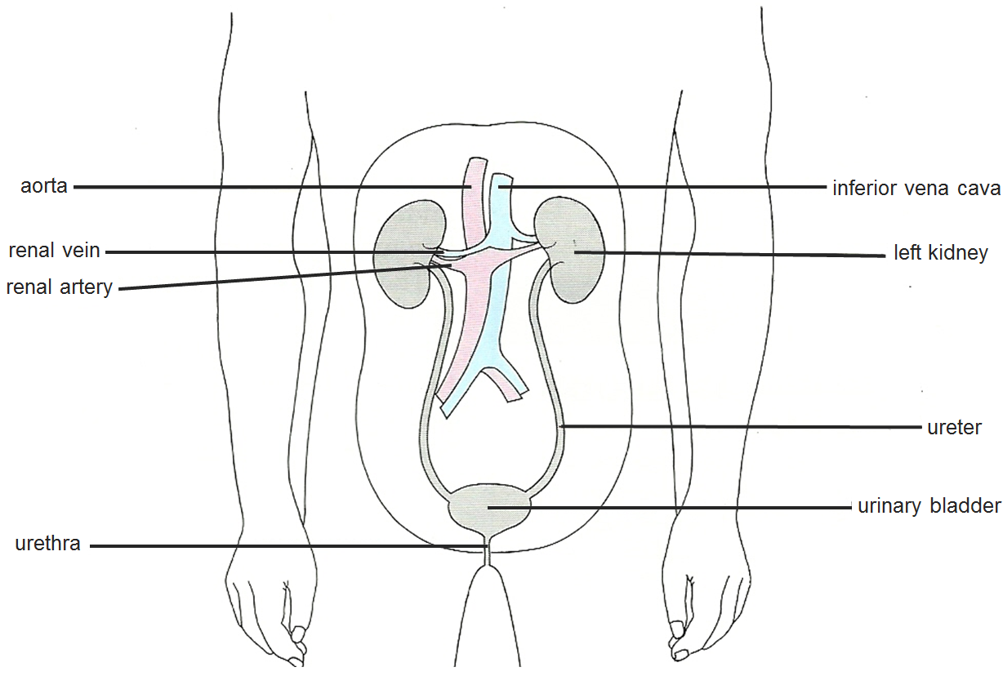
And the location of the kidneys
Version 1.0
Notes:
Like the previous slide, this slide puts the whole system into context.
If you chose to use this slide, you could point out that the renal arteries (name required in specification section 3.3.4.1) are short extensions from the aorta reinforcing the concept of high blood pressure resulting in ultrafiltration from the glomeruli.
It is worth stressing to students that the structure of the urinary system are not specification content, so examiners cannot expect students to recall this knowledge

Slide 12
Formation of glomerular filtrate
Ultrafiltration of blood
The high blood pressure in each glomerulus forces ions, water and other small molecules from the capillaries into the lumen of the surrounding Bowman’s capsule. This is the glomerular filtrate.
The blood pressure is high enough to do this partly because the capillary leaving each glomerulus (efferent) is narrower than that entering (afferent).
Filtration occurs through the microscopic pores between the cells lining each capillary and each capsule and the basement membrane between them.
Version 1.0
Notes:
Here, you could ask all students to use their recall with understanding of topics from their Year 1 studies to:
Suggest the names of small molecules that are likely to be in the ultrafiltrate.
Explain why plasma proteins and polypeptides are unlikely to be in the ultrafiltrate (a simple answer is that these molecules are too large to leave capillaries: as extension material for ‘stretch and challenge’ students, you could introduce the properties of the basement membrane as the important barrier).
Compare ultrafiltration in the nephron with tissue fluid formation (specification section 3.3.4.1), which would develop synoptic skills tested especially in Papers 2 and 3.
You could delete the terms ‘afferent’ and ‘efferent’ from this slide if you do not want to introduce these terms to your students.
You could decide to introduce the term ‘podocyte’ and the way in which podocytes are adapted for their function as extension material for ‘stretch and challenge’ students.

Slide 13
Selective reabsorption in the proximal convoluted tubule
Many of the ions, small molecules and water molecules are reabsorbed from the ultrafiltrate back into the capillaries surrounding the proximal convoluted tubule.
Glucose molecules are reabsorbed by active transport.
Water molecules are reabsorbed by osmosis.
Version 1.0
Notes:
It would be a good opportunity here to avoid teleology that would occur by suggesting that ions or molecules that ‘are needed’ are reabsorbed.
You could ask students to explain:
why water would pass into the capillaries by osmosis
the likely process by which glucose is reabsorbed.

Slide 14
Explain the advantage of the following
The wall of each proximal convoluted tubules is one cell thick.
Each cell in the wall of a proximal convoluted tubule:
has many folds (microvilli) on its surface in contact with the glomerular filtrate
has co-transport proteins in its surface membrane
has cytoplasm packed with mitochondria.
Version 1.0
Notes:
These questions relate back to Year 1 topics such as 3.2.1.1 (adaptations of eukaryotic cells) and 3.2.3 (transport across cell membranes), encouraging students to develop synoptic skills.

Slide 15
The role of the loop of Henle
The loop of Henle maintains a high concentration of sodium chloride (NaCl) in the tissues of the medulla of the kidney.
As a result, water moves by osmosis from the filtrate in the collecting ducts and is taken up by the vasa recta capillaries.
Version 1.0
Notes:
Many students find the role of the loop of Henle, including the counter-current mechanism, hard to understand/explain.
This slide provides an overview that students often fail to grasp.

Slide 16
The loop of Henle uses a counter-current mechanism
The second half of the loop (the ascending limb) actively transports sodium ions (Na⁺) and chloride ions (Cl–) from the filtrate into the medulla.
However:
its wall is impermeable to water
the first half of the loop (the descending limb) is permeable to Na⁺ and Cl– and so takes up these ions
as a result, a high concentration of Na⁺ and Cl– ions develops in the medulla as the filtrate moves down the loop of Henle.
Version 1.0
Notes:
Can students recall where they learnt about the counter-current principle before? [specification section 3.3.2, gas exchange across the gills of fish].
Can they relate it to counter-current here?

Slide 17
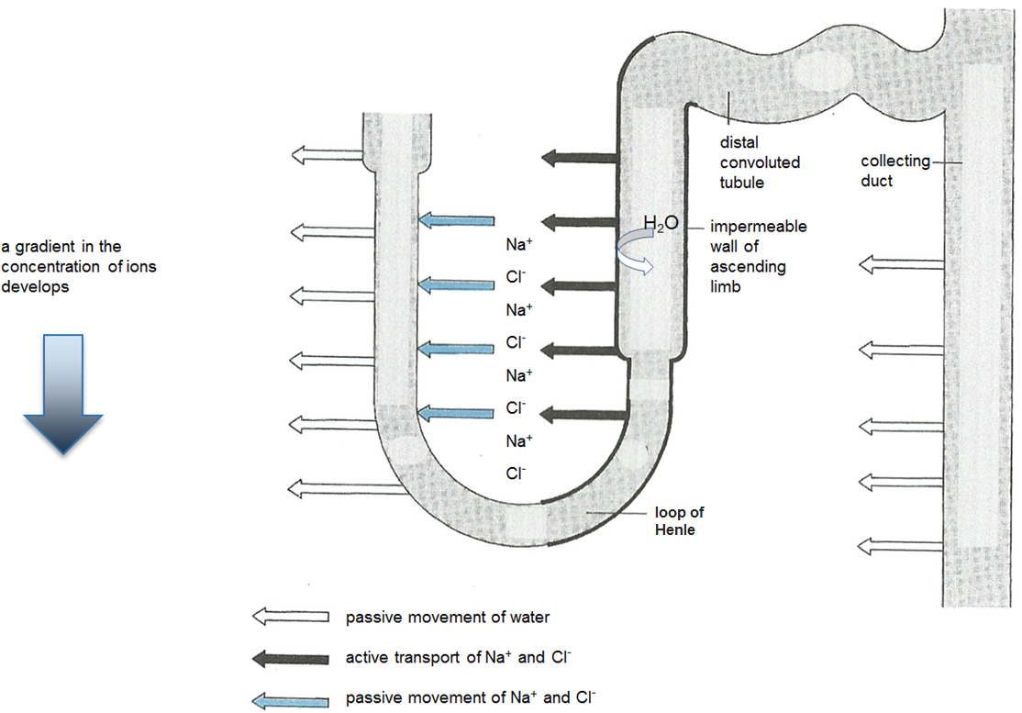
The counter-current mechanism
Version 1.0
Notes:
A diagrammatic representation for students who are visual learners.

Slide 18
The role of the collecting ducts
The permeability of the walls of the collecting ducts to water is affected by ADH.
No ADH: With ADH:
wall impermeable to water. wall permeable to water.
Version 1.0
Notes:
A model for visual learners representing the effect of antidiuretic hormone on the permeability of the walls of collecting ducts to water.

Slide 19
Reabsorption of water
In the presence of ADH, the walls of the collecting duct are permeable to water.
Water molecules move by osmosis from the filtrate in the collecting ducts into the tissue of the medulla.
The vasa recta capillaries in the medulla absorb the water back into the circulation.
The volume of the filtrate (and therefore of the urine) becomes less and its concentration increases.
Version 1.0
Notes:
It is worth stressing that the water potential gradient into the medulla is always there; it is the permeability of their walls that determines whether or not water is lost from the collecting ducts into the medulla.
Further reading:
Michael Randles (2016), The kidney filtration barrier, Biological Sciences Review, 28 (3), pp 38-43.

Slide 20
Acknowledgements
Diagrams on slides 9, 10, 11 and 17 © Rowland, M., 1992, Biology, Thomas Nelson & Sons Ltd
Version 1.0

