Slide 1
A-LEVEL BIOLOGY 3.8.2.2 RNA interference (RNAi)
To be used alongside AQA A-level Biology RNA interference (RNAi) teaching notes
Version 1.0

Slide 2
An outline of polypeptide synthesis
Transcription in the nucleus
The base sequence of a gene is copied to pre-mRNA
The pre-mRNA is ‘edited’ to remove the introns
Translation in the cytoplasm
The base sequence of mRNA is used by ribosomes to assemble the amino acid sequence of a polypeptide
The amino acids are carried to the ribosomes by tRNA
Version 1.0

Slide 3
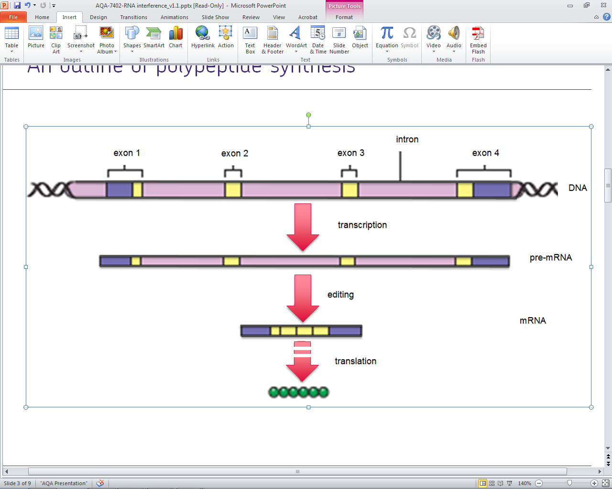
An outline of polypeptide synthesis
Version 1.0

Slide 4
RNA interference (RNAi)
Prokaryotes and eukaryotes have evolved mechanisms that either:
destroy mRNA
prevent ribosomes translating mRNA
These processes are called RNA interference (RNAi) and enable a cell to prevent the expression of a gene (‘silence’ the gene)
Version 1.0

Slide 5
RNA-induced silencing complex (RISC)
Short regulatory RNA molecules are transcribed from a cell’s DNA
There are two types of this RNA
microRNA (miRNA)
small interfering RNA (siRNA)
A single-strand of miRNA or siRNA can bind to a protein in the cytoplasm to form a complex, called an RNA-induced silencing complex (RISC)
Version 1.0

Slide 6
RISC binds to mRNA
The short miRNA or siRNA strand within a RISC binds to a target mRNA molecule
The target is any mRNA molecule that happens to contain a base sequence that is complementary to its own
Hydrogen bonds between the base pairs A-U and C-G hold the two RNA sequences together
Version 1.0

Slide 7
Once mRNA is bound to a RISC
Either
the mRNA is hydrolysed by an enzyme - RNA hydrolase
Or
ribosomes are prevented from attaching to the mRNA
Either way, the mRNA cannot be translated
Version 1.0

Slide 8
Model of a RISC

Slide 9
Acknowledgements
Slide 8: RNA-inducing silencing complex © Laguna Design/Science Photo Library.
Version 1.0

