Slide 1
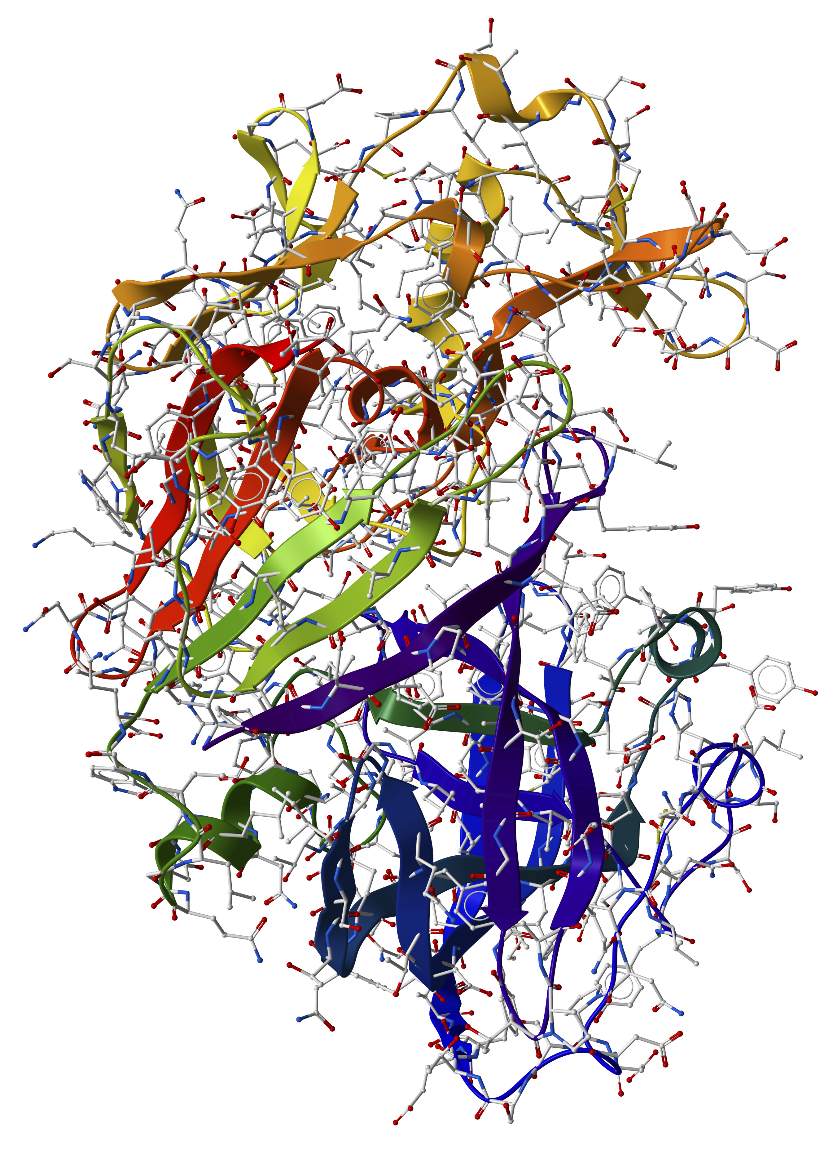
AS/A-level Biology essay training materials
April 2017

Slide 2
The essay is a synoptic exercise
As in the previous specification, BIOL5, there is a free response essay addressing a theme in a title, with a choice from two titles (Paper 3).
The essay is designed to assess whether students can bring together material from a range of topics to illustrate and explain an important concept or idea.
The essay is not just a memory test of what a student knows – it is also a test of whether they have some understanding of what they have learnt and can apply what they know.
The essay will be marked using a levels of response system. The demands for scientific content, breadth, relevance and scientific terminology are now found within each level.
2
Copyright © AQA and its licensors. All rights reserved.

Slide 3
What we expect from students in the essay
To identify an underlying theme or idea in an essay title – it will be a ‘big idea’, not a minor topic.
To select five or six different examples that they can use to illustrate the theme or idea.
To write a reasonable paragraph about each example (using appropriate A-level terminology) pointing out how it illustrates the theme or idea.
3
Copyright © AQA and its licensors. All rights reserved.

Slide 4
It is not…
‘Think of every possible thing that relates to the title and write as much as you can about it, with no thought of the main theme/idea’.
This would make it just a memory test (AO1).
‘Write at a very high level (above A-level) about one or two topics’.
This is not a synoptic approach. We do not wish to encourage learning of rote answers involving one or two important topics which might apply across many titles – eg respiration.
4
Copyright © AQA and its licensors. All rights reserved.

Slide 5
Feedback from 2016 examination
Many students wrote about relevant topics but failed to relate the content to the theme of the title.
The vast majority of students appeared to understand that this is a synoptic exercise, where they have to attempt to draw on a wide range of examples to obtain a high mark.
Examiners reported that substantive attempts at extension material were uncommon.
GCSE-level content was common; as in previous years, the use of examples that any member of the public might use did not gain any extra credit.
5
Copyright © AQA and its licensors. All rights reserved.

Slide 6
Feedback from 2016 examination
Extension material has to be at least of A-level standard and accurately described using appropriate scientific terminology.
Appropriate terminology was often poorly used or absent. For example, many students wrote about ‘signals’ and ‘messages’ rather than impulses/action potentials. The use of ‘levels’ and ‘amounts’ for concentration was also very common.
The essay is supposed to be written using appropriate terminology, at a level to be expected after two years of A-level study.
6
Copyright © AQA and its licensors. All rights reserved.

Slide 7
Feedback from 2016 examination
Remind your students that the essay has roughly equal AO1 and AO2 weighting, with AO1 being the demonstration of knowledge and understanding and AO2 being the application of that knowledge and understanding.
If a student failed to apply their knowledge and understanding in the context of the essay, then according to the descriptors, they would be limited to the top of the multistructural level (11-15 marks). The level the response then falls into (and the mark within that level) depends on how well the other aspects of the criteria have been addressed.
7
Copyright © AQA and its licensors. All rights reserved.
7

Slide 8
Marking the essay
Essay descriptors – students who give facts but don’t use these to illustrate or explain the theme/concept in the title should get a mark in the 11 to 15 range – fundamental errors also limit the mark range.
Last summer, the mean mark for the essay was 13.6 (the SD was +4.14) – students generally were poorer at the AO2 element.
One in twenty essays is double-marked; two examiners mark the same essay and the marks they award are compared – the examiners do not know which essays are double-marked.
It should be remembered that the essay is marked against descriptors – not using (numbered) marking points – so there is always some element of interpretation/judgement by an examiner.
8
Copyright © AQA and its licensors. All rights reserved.
Notes:
Attach guidance for examiners

Slide 9
Preparing students for the essay
Practice! You could start at AS, with titles that address ‘big ideas’ in sections.
When teaching, point out connections between parts of the specification, especially through the ‘big ideas’ outlined at the start of each section.
Encourage outside reading – eg Biological Science Review – which will help them to put what they learn into broader contexts. To get a top mark (24 or 25) in the essay, we will look for some evidence (at least in one topic) of reading beyond the specification.
Example – Membranes are important in many processes in cells.
What could be the theme of the essay?
What might be suitable topic areas?
9
Copyright © AQA and its licensors. All rights reserved.

Slide 10
Preparing students for the essay
Theme/idea – the role of membranes in processes – not just processes that involve membranes.
Suitable topics – eg transport across membranes, protein synthesis, immune response, exchange surfaces, photosynthesis, respiration, receptors (in various topics such as insulin action), neurones, synapses, muscle contraction.
Take one example – photosynthesis:
Weaker answers will focus on all of photosynthesis – as a process involving membranes – perhaps mention membranes in chloroplasts.
Good answers will focus on thylakoid membranes in the chloroplast and the roles of components of these membranes in holding pigments, components of the electron transfer chain, ATP synthase and the membrane as a barrier allowing maintenance of a proton gradient – and, perhaps, role of membranes in maintaining the special chemical environment inside chloroplasts.
10
Copyright © AQA and its licensors. All rights reserved.

Slide 11
Examples of what teachers can do to prepare their students
At the end of each topic, make links to other topics to encourage answers to the essay question to become more synoptic.
Regularly give students an essay title. Ask them to list the topics that could be written about for that title.
Draw mind maps with students showing the topics that could be linked to an essay title and the links between them.
At the end of teaching each topic, give a series of essay titles and ask students to write a paragraph on the topic and how it links to that title.
Students write essays and peer-assess each others’ work.
Remember, students should include 5 – 6 topics in the essay, and the essay should take about 40 minutes to write.
11
Copyright © AQA and its licensors. All rights reserved.

