Slide 1
AS and A-level English Language Preparing to Teach
Summer 2015
Follow us on Twitter @AQACPD.

Slide 2
Contents
AS Component 1 and A-level Component 1 Section A
AS Component 1 and A-level Component 2 Section A
AS Component 1 and A-level Component 2 Section B
A-level Component 1 Section B
Non-exam assessment requirements at A-level
Schemes of work and other support and resources available.
Slide 2
Copyright © AQA and its licensors. All rights reserved.
Follow us on Twitter @AQACPD.

Slide 3
Aims of the session
Walk through the differences between the AS and the A-level in terms of content and assessment.
Consider the nature of external assessments and their implications for teaching and learning.
Consider the nature of non-exam assessments and their implications for teaching and learning.
Explore ways of structuring and co-teaching the AS and A-level courses.
Provide some planning techniques and opportunities to discuss and develop plans for teaching next year.
Provide some teaching materials for use and development.
Slide 3
Copyright © AQA and its licensors. All rights reserved.
Follow us on Twitter @AQACPD.

Slide 4
Co-teaching AS and A-level
Slide 4
Copyright © AQA and its licensors. All rights reserved.

Slide 5
AS and A-level: what are you doing?
Separate classes for AS and A-level?
All students doing A-level also take AS?
Some students take the AS within an A-level group?
AS as a one year course?
AS as a two year course?
Any other patterns?
How do we plan and structure our course accordingly?
Slide 5
Copyright © AQA and its licensors. All rights reserved.
Follow us on Twitter @AQACPD.

Slide 6
The new AS specification
Slide 6
Copyright © AQA and its licensors. All rights reserved.

Slide 7
AS: specification at a glance
Component 1: Language and the individual Written Paper 1 hour 30 mins | 50% | Textual variations and representations Two texts, linked by topic or theme. A question requiring analysis of one text (25 marks) A question requiring analysis of a second text (25 marks) A question requiring comparison of the two texts (20 marks)
Component 2: Language varieties Written Paper 1 hour 30 mins | 50% | Section A – Language diversity A discursive essay on language diversity, with a choice of two questions (30 marks) Section B – Language discourses A directed writing task on attitudes to language (40 marks)
Slide 7
Copyright © AQA and its licensors. All rights reserved.

Slide 8
AS content and skills: Component 1
Students should study a range of texts:
about various subjects
from various writers and speakers
for various audiences
for various purposes
in a variety of genres
using a variety of modes (written, spoken, electronic).
Slide 8
Copyright © AQA and its licensors. All rights reserved.

Slide 9
AS content and skills: Component 1
When analysing texts, students should explore how language is:
shaped according to audience, purpose, genre and mode
shaped according to context
used to construct meanings and representations
used to enact relationships between writers, speakers and audiences or between participants within a text.
Slide 9
Copyright © AQA and its licensors. All rights reserved.

Slide 10
AS content and skills: Component 1 and 2
Methods of language analysis:
phonetics, phonology and prosodics: how speech sounds and effects are articulated and analysed
graphology: the visual aspects of textual design and appearance
lexis and semantics: the vocabulary of English, including social and historical variation
grammar, including morphology: the structural patterns and shapes of English at sentence, clause, phrase and word level
pragmatics: the contextual aspects of language use
discourse: extended stretches of communication occurring in different genres, modes and contexts.
Slide 10
Copyright © AQA and its licensors. All rights reserved.

Slide 11
The new A-level specification
Slide 11
Copyright © AQA and its licensors. All rights reserved.

Slide 12
A-level: specification at a glance
Component 1: Language, the individual and society Written Paper 2 hours 30 mins | 40% | Section A – Textual variations and representations Two texts (one contemporary and one older text) linked by topic or theme: Analysis of one text (25 marks) Analysis of second text (25 marks) Comparison of the two texts (20 marks). Section B – Children's language development Discursive essay on children’s language development, with a choice of two questions with data provided on spoken, written or multimodal language (30 marks).
Slide 12
Copyright © AQA and its licensors. All rights reserved.

Slide 13
A-level content and skills: Component 1
Students should study a range of texts:
about various subjects
from various writers and speakers
for various audiences
for various purposes
in a variety of genres
using a variety of modes (written, spoken, electronic)
from different times
from different places (global, national, regional).
Slide 13
Copyright © AQA and its licensors. All rights reserved.

Slide 14
AS and A-level exam questions
Slide 14
Copyright © AQA and its licensors. All rights reserved.

Slide 15
Question types: AS Paper 1
1. Analyse how Text A uses language to create meanings and representations.
2. Analyse how Text B uses language to create meanings and representations.
3. Compare and contrast Text A and Text B, showing ways in which they are similar and different in their language use.
Slide 15
Copyright © AQA and its licensors. All rights reserved.

Slide 16
Question types: A-level Paper 1 Section A
1. Analyse how Text A uses language to create meanings and representations.
2. Analyse how Text B uses language to create meanings and representations.
3. Explore the similarities and differences in the ways that Text A and Text B use language.
4. Compare and contrast Text A and Text B, showing ways in which they are similar and different in their language use.
Slide 16
Copyright © AQA and its licensors. All rights reserved.

Slide 17
Example responses
Slide 17
Copyright © AQA and its licensors. All rights reserved.

Slide 18
Question types: AS Paper 1 vs A-level 1 Section A
Activity:
Looking at the top band of the specimen mark schemes, what skills and approaches do students need to demonstrate?
What differences are there in the expectations of an A-level student?
Slide 18
Copyright © AQA and its licensors. All rights reserved.

Slide 19
Planning for AS Paper 1 and A-level 1 Section A
Activity:
Review texts that you currently use.
Choose texts to use in your new scheme of work to cover a range of textual variations and to help cover a range of linguistic methods.
What additional texts do you need to find?
Slide 19
Copyright © AQA and its licensors. All rights reserved.

Slide 20
The new AS specification
Slide 20
Copyright © AQA and its licensors. All rights reserved.

Slide 21
AS-level: specification at a glance
Component 1: Language and the individual Written Paper 1 hour 30 mins | 50% | Textual variations and representations Two texts, linked by topic or theme. A question requiring analysis of one text (25 marks) A question requiring analysis of a second text (25 marks) A question requiring comparison of the two texts (20 marks)
Component 2: Language varieties Written Paper 1 hour 30 mins | 50% | Section A – Language diversity A discursive essay on language diversity, with a choice of two questions (30 marks) Section B – Language discourses A directed writing task on attitudes to language (40 marks)
Slide 21
Copyright © AQA and its licensors. All rights reserved.

Slide 22
AS content and skills: Component 2
Students should study a range of examples of language in use and research data to inform their study of diversity:
texts using different sociolects (include social & occupational groups, gender)
texts using different dialects (include regional/national varieties in the British Isles)
texts that use language to represent the different groups above
(written, spoken and electronic texts about a range of subjects, for various audiences and purposes in a variety of genres)
items from collections of language data (eg dictionaries, online resources, language corpora)
research findings (eg tables, graphs, statistics).
Slide 22
Copyright © AQA and its licensors. All rights reserved.

Slide 23
AS content and skills: Component 2
When analysing texts and data, students should explore:
how language varies because of personal, social and geographical contexts
why language varies, developing critical knowledge and understanding of different views and explanations
how identity is constructed
how language is used to enact relationships
attitudes to language diversity.
Slide 23
Copyright © AQA and its licensors. All rights reserved.

Slide 24
AS content and skills: Component 2
Students will need to develop skills in:
writing discursively about language issues in an academic essay
writing about language issues in a variety of forms to communicate their ideas to a non-specialist audience.
Slide 24
Copyright © AQA and its licensors. All rights reserved.

Slide 25
AS content and skills: Component 2
Activity: Discussion
What social and occupational groups might you focus on?
What regional/national dialects and accents might you look at?
What texts do you have? What do you need to collect?
What other data would you use?
What ideas from language study do you need to cover?
What kinds of writing will students need to practise?
Slide 25
Copyright © AQA and its licensors. All rights reserved.

Slide 26
The new A-level specification
Slide 26
Copyright © AQA and its licensors. All rights reserved.

Slide 27
A-level: specification at a glance
Component 2: Language diversity and change Written Paper 2 hours 30 mins | 40% | Section A – Diversity and change One question from a choice of two: evaluative essay on language diversity or language change (30 marks). Section B – Language discourses Two texts on a topic linked to the study of diversity and change: Analysis of how the texts use language to present ideas, attitudes and opinions (40 marks) Directed writing task linked to the topic and ideas in the texts (30 marks).
Slide 27
Copyright © AQA and its licensors. All rights reserved.

Slide 28
A-level content and skills: Component 2
Students should study a range of examples of language in use and research data to inform their study of diversity:
texts using different sociolects (include social & occupational groups, gender and ethnicity)
texts using different dialects (include regional/national varieties in the British Isles and international varieties)
texts that use language to represent the different groups above
texts from different periods from 1600 to the present day
written, spoken and electronic texts about a range of subjects, for various audiences and purposes in a variety of genres
items from collections of language data (eg dictionaries, online resources, language corpora)
research findings (eg tables, graphs, statistics).
Slide 28
Copyright © AQA and its licensors. All rights reserved.

Slide 29
A-level content and skills: Component 2
When analysing texts and data, students should explore:
how language varies because of personal, social, geographical and temporal contexts
why language varies and changes, developing critical knowledge and understanding of different views and explanations
attitudes to language variation and change
the use of language according to audience, purpose, genre and mode
how language is used to enact relationships.
Slide 29
Copyright © AQA and its licensors. All rights reserved.

Slide 30
A-level content and skills: Component 2
Language discourses
Students will study a range of texts that convey attitudes to language diversity and change.
The texts studied will include those written for non-specialist audiences.
Students will explore how texts are produced to convey views and opinions about language issues.
They will explore how texts:
represent language
construct an identity for the producer
position the reader and seek to influence them
are connected to discourses about language.
Slide 30
Copyright © AQA and its licensors. All rights reserved.

Slide 31
A-level content and skills: Component 2
Students will need to develop skills in:
writing discursively about language issues in an academic essay
writing analytically about texts as parts of discourses about language
writing about language issues in a variety of forms to communicate their ideas to a non-specialist audience.
Slide 31
Copyright © AQA and its licensors. All rights reserved.

Slide 32
AS and A-level exam questions
Slide 32
Copyright © AQA and its licensors. All rights reserved.

Slide 33
Question types: AS Paper 2 Section A
Question 1
Discuss the idea that a person’s language might be affected by their occupation.
Question 2
Discuss the idea that women and men use language differently.
Slide 33
Copyright © AQA and its licensors. All rights reserved.

Slide 34
Question types: AS Paper 2 Section A
Activity
Looking at the top band of the specimen mark schemes, what skills and approaches do students need to demonstrate?
Slide 34
Copyright © AQA and its licensors. All rights reserved.

Slide 35
Question types: AS vs A-level Paper 2 Section A
A-level:
Evaluate the idea that spoken interactions between men and women are characterised by miscommunication.
AS:
Discuss the idea that women and men use language differently.
Slide 35
Copyright © AQA and its licensors. All rights reserved.

Slide 36
Question types: A-level Paper 2 Section A
Question 1:
Evaluate the idea that spoken interactions between men and women are characterised by miscommunication.
Question 2:
Evaluate the idea that the English language is changing and breaking up into many different Englishes.
Slide 36
Copyright © AQA and its licensors. All rights reserved.

Slide 37
Question types: A-level Paper 2 Section A
Activity:
Looking at the top band of the specimen mark schemes, what skills and approaches do students need to demonstrate?
Slide 37
Copyright © AQA and its licensors. All rights reserved.

Slide 38
Example responses
Slide 38
Copyright © AQA and its licensors. All rights reserved.

Slide 39
Question types: A-level Paper 2 Section A
Activity:
write a series of ideas about language that could be discussed for AS
write a series of ideas about language that could be evaluated for A-level.
Slide 39
Copyright © AQA and its licensors. All rights reserved.

Slide 40
A-level Paper 2 topics:
sociolects (to include social and occupational groups, gender and ethnicity)
dialects (to include regional, national and international varieties of English)
language that represents these groups
how language varies - personal, social, geographical and temporal contexts
why language varies and changes
critical knowledge and understanding of different views and explanations
attitudes to language variation and change
the use of language according to audience, purpose, genre and mode
how language is used to enact relationships.
Slide 40
Copyright © AQA and its licensors. All rights reserved.

Slide 41
Planning for A-level Paper 2 Section A
Activity:
Use Component 2: Topic planner to plan a topic for teaching.
Slide 41
Copyright © AQA and its licensors. All rights reserved.

Slide 42
Question types: A-level Paper 2 Section B
Language discourses – Question 3:
Analyse how language is used in Text A and Text B to present views about the nature of language change. In your answer you should:
examine any similarities and differences you find between the two texts
explore how effectively the texts present their views.
Slide 42
Copyright © AQA and its licensors. All rights reserved.

Slide 43
Question types: A-level Paper 2 Section A
Activity:
How helpful would the text ‘yes, we are judged on our accents’ be in preparing for these exam tasks?
Slide 43
Copyright © AQA and its licensors. All rights reserved.

Slide 44
A-level Paper 2 Section B: Further resources
Further resources:
Legacy ENGA3 and ENGB3 texts and data with attitudes to language found at AQA.org.uk/log-in
Dan Clayton’s blog: http://englishlangsfx.blogspot.co.uk/
Slide 44
Copyright © AQA and its licensors. All rights reserved.

Slide 45
Question types: AS vs A-level Paper 2 Section B
AS Question 3:
Text B is the start of an article in which a newspaper columnist discusses a celebrity who changed her local accent.
Write an opinion article in which you discuss the issues surrounding people changing their accents. Before writing your article you should state your intended audience.
A-level Question 4:
Write an opinion article about language change in which you assess the ideas and issues raised in Text A and Text B and argue your own views.
Slide 45
Copyright © AQA and its licensors. All rights reserved.

Slide 46
A-level Paper 2 Section B
Activity: Finding a form
theguardian.com/lifeandstyle/series/what-im-really-thinking
theguardian.com/lifeandstyle/series/aletterto
theguardian.com/media/mind-your-language
What persona could you use/person could you write to in order to explore a language issue?
Slide 46
Copyright © AQA and its licensors. All rights reserved.

Slide 47
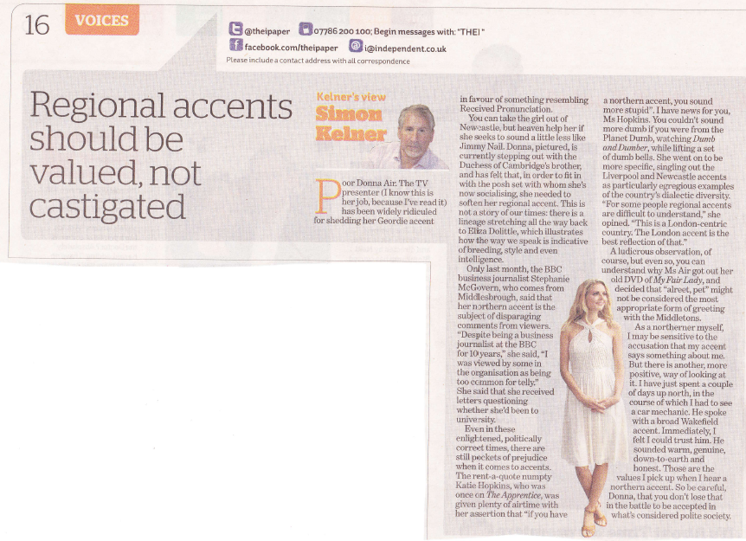
Question types: A-level Paper 2 Section B
Slide 47
Copyright © AQA and its licensors. All rights reserved.

Slide 48
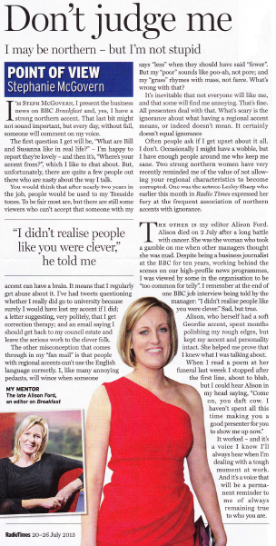
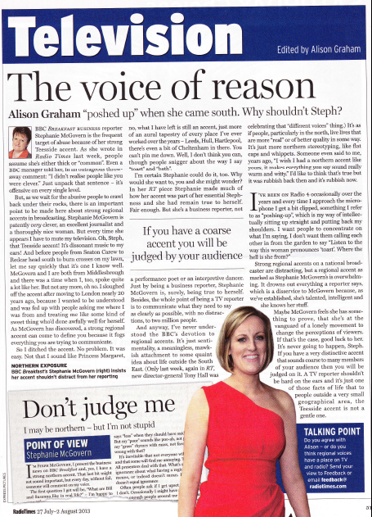
Question types: A-level Paper 2 Section B
Slide 48
Copyright © AQA and its licensors. All rights reserved.

Slide 49
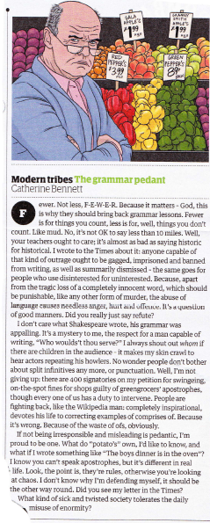
Question types: A-level Paper 2 Section B
Slide 49
Copyright © AQA and its licensors. All rights reserved.

Slide 50
Question types: A-level Paper 2 Section B
Activity: Finding a focus – Writing carousel
Write an arresting opening for an article:
In a publication for university students applying for jobs
In a local newspaper about a primary school’s language policy
And ....
Slide 50
Copyright © AQA and its licensors. All rights reserved.

Slide 51
A-level: specification at a glance
Component 1: Language, the individual and society Written Paper 2 hours 30 mins | 40% | Section A – Textual variations & representations Two texts (one contemporary and one older text) linked by topic or theme: Analysis of one text (25 marks) Analysis of second text (25 marks) Comparison of the two texts (20 marks). Section B – Children's language development Discursive essay on children’s language development, with a choice of two questions with data provided on spoken, written or multimodal language (30 marks).
Slide 51
Copyright © AQA and its licensors. All rights reserved.

Slide 52
Question types: A-level Paper 1 Section B
Question 4:
“Interaction with caregivers is the most important influence on a child’s language development.”
Referring to Data Set 1 in detail, and to relevant ideas from language study, evaluate this view of children’s language development.
Question 5:
“Accuracy is more important than creativity.”
Referring to Data Set 2 and Data Set 3 in detail, and to relevant ideas from language study, evaluate this view of children’s language development.
Slide 52
Copyright © AQA and its licensors. All rights reserved.

Slide 53
Question types: A-level Paper 1 Section B
Question:
“Interaction with caregivers is the most important influence on a child’s language development.”
Referring to Data Set 1 in detail, and to relevant ideas from language study, evaluate this view of children’s language development.
Question Structure:
“View for debate.”
Referring to Data Set in detail, and to relevant ideas from language study, evaluate this view of children’s language development.
Slide 53
Copyright © AQA and its licensors. All rights reserved.

Slide 54
A-level: non-exam assessment (NEA)
Slide 54
Copyright © AQA and its licensors. All rights reserved.

Slide 55
A-level: specification at a glance
Component 3: Language in action Non-exam assessment 3,500 words | 20% | Language investigation 2,000 words excluding data (50 marks) one piece of original writing with commentary 1,500 words total (50 marks)
Slide 55
Copyright © AQA and its licensors. All rights reserved.

Slide 56
NEA 1: Language investigation
What is it?
a student led enquiry into an aspect of language
the choice of topic is free – it does not have to arise from a taught area
the student needs to ask questions
the data will be collected by the student
the outcome will be a report
the word count is 2000 words excluding data
it is worth 10% of the total marks for the A-level.
Slide 56
Copyright © AQA and its licensors. All rights reserved.

Slide 57
NEA 1: Language investigation
The Report:
Introduction
Methodology
Analysis
Conclusion
References
Appendices.
Slide 57
Copyright © AQA and its licensors. All rights reserved.

Slide 58
NEA 1: Language investigation
The assessment:
AO1: Apply appropriate methods of language analysis, using associated terminology and coherent written expression. (15 marks)
AO2: Demonstrate critical understanding of concepts and issues relevant to language use. (15 marks)
AO3: Analyse and evaluate how contextual factors and language features are associated with the construction of meaning. (20 marks)
Slide 58
Copyright © AQA and its licensors. All rights reserved.

Slide 59
NEA 1: Language investigation
The assessment:
AO1: Apply appropriate methods of language analysis, using associated terminology and coherent written expression.
Level 5 (marks 13-15) students are likely to:
apply linguistic methods and terminology identifying patterns and complexities
select and apply appropriate methods, allowing valid conclusions to be drawn
describe language features in depth, establishing patterns of use and engaging with complexity
guide the reader
guide the reader structurally and linguistically, using controlled, accurate expression.
Slide 59
Copyright © AQA and its licensors. All rights reserved.

Slide 60
NEA 1: Language investigation
The assessment:
AO2: Demonstrate critical understanding of concepts and issues relevant to language use.
Level 5 (marks 13-15) students are likely to:
demonstrate a synthesised, conceptualised and individual overview of issues
show a conceptualised overview of theories which illuminate the discussion
use data and findings to challenge viewpoints making evaluative comment
evaluate methodology and explore alternative additional approaches
provide detailed bibliography.
Slide 60
Copyright © AQA and its licensors. All rights reserved.

Slide 61
NEA 1: Language investigation
The assessment:
AO3: Analyse and evaluate how contextual features are associated with the construction of meaning.
Level 5 (marks 17-20) students are likely to:
evaluate use of language and representations according to context
explore analysis within wider social and cultural contexts
evaluate how language is influenced by different contexts
evaluate meanings and representations
explore data in light of relevant wider social and cultural contexts
present data and findings to support reflective and cautious conclusions.
Slide 61
Copyright © AQA and its licensors. All rights reserved.

Slide 62
NEA 1: Language investigation
Discussion – issues and questions:
When should we do it?
How long should we give to it?
What preparation will students need?
What are the implications of students never having done ‘coursework’ in English?
What makes for a successful investigation?
Slide 62
Copyright © AQA and its licensors. All rights reserved.

Slide 63
NEA 2: Original writing
What is it?
A student led piece of original writing
the writing submitted will be based on one of the following:
the power of persuasion
the power of story-telling
the power of information
the student will submit a piece of writing
the student will submit a commentary examining a style model, discussing their writing process and evaluating their final piece.
Slide 63
Copyright © AQA and its licensors. All rights reserved.

Slide 64
NEA 2: Original writing
What is it?
the word count for the piece of writing is 750
the word count for the commentary is 750
original writing is worth 10% of the total marks for the A-level.
Slide 64
Copyright © AQA and its licensors. All rights reserved.

Slide 65
NEA 2: Original writing
The assessment
AO5: Demonstrate expertise and creativity in the use of English to communicate in different ways
Level | Mark | Students are likely to:
5 | 21-25 | use form creatively and innovatively use register creatively for context write accurately provide interesting and engaging content for challenging audiences use form in original and innovative ways showing ambition position audience skilfully show skilful and detailed manipulation of register at all levels guide reader through a very coherent and cohesive text
Slide 65
Copyright © AQA and its licensors. All rights reserved.

Slide 66
NEA 2: Original writing
The assessment
Commentary
Level | Mark | AOs 1-5
 |  | Students are likely to:
5 | 21-25 | evaluate the significance of connections found across texts, justifying writing choices by reference to style model and its impact on language choices AO4 evaluate use of language and representations according to the two contexts AO3 demonstrate understanding of genre as a dynamic process AO2 apply different levels of language analysis in an integrated way, recognising how they are connected across both texts AO1
Slide 66
Copyright © AQA and its licensors. All rights reserved.

Slide 67
NEA 2: Original writing
Issues and questions:
When should we do it?
How long should we give to it?
Do we do all three options in our scheme of work?
Do we teach these as discrete topics or can NEA preparation/assessment be linked to other elements of the course?
What preparation will students need?
What are the implications of students never having done ‘coursework’ in English?
What makes for a successful original writing task?
Slide 67
Copyright © AQA and its licensors. All rights reserved.

Slide 68
Supervising NEA
See the specification for details of NEA administrative information
aqa.org.uk/7702
For more information see the JCQ documentation found at
jcq.org.uk/exams-office/coursework
Slide 68
Copyright © AQA and its licensors. All rights reserved.

Slide 69
Support and resources for AS and A-level
Slide 69
Copyright © AQA and its licensors. All rights reserved.

Slide 70
AQA support and resourcing
AQA tools to help you:
aqa.org.uk/7702
ERA (Enhanced Results Analysis) found on e-AQA at aqa.org.uk/log-in
Secure Key Materials found on e-AQA at aqa.org.uk/log-in
Training courses from aqa.org.uk/cpd
Approved textbooks found at aqa.org.uk/textbooks
AQA–related resources:
Exampro
Teachit.
Slide 70
Copyright © AQA and its licensors. All rights reserved.

Slide 71
AQA-approved textbooks
We only approve student textbooks (print and digital) –
although see approved publishers’ websites for the full range of
resources to support each specification.
Textbooks must be matched to the specification to be AQA approved.
Each approval process consists of a detailed 4-stage review by
our reviewers (ie senior examiners or Chairs).
Published textbooks which do not have the AQA-approved
badge are not ‘AQA-approved’. Prior to publication publishers
will advise that these books have entered the AQA approval
process.
See the AQA website (All about us) for full details.
Slide 71

Slide 72
Contact points for more information and guidance
Customer Services advisers
General email English-gce@aqa.org.uk
Tel no 0161 953 7504
Teacher Support and CPD Managers
General email teachercpd@aqa.org.uk
Tel no 0161 957 3646
Have you completed a sign up to teach form?
aqa.org.uk/subjects/sign-up-to-teach
Slide 72
Copyright © AQA and its licensors. All rights reserved.

Slide 73
Thank you
Slide 73
Follow us on Twitter @AQACPD.

