Slide 1
GCSE English Literature
Taster Lesson: Worlds and Lives poetry cluster

Slide 2
Introductory notes for the teacher
This is a standalone lesson designed to give you and your students a taster of our newly-added poetry cluster ‘Worlds and Lives’.
This lesson focuses on one of the poems from the collection: ‘England in 1819’ by Percy Bysshe Shelley.
No prior reading/study of the poem is required to enjoy this resource.
Interactive presentation slides with teacher notes and an accompanying Resource booklet are provided.
This lesson uses an image to introduce students to the context and ideas of the poem. We have chosen part of the Peterloo Massacre engraving (published by Robert Carlile in 1819) but this could be substituted where appropriate. This approach enables students to engage with the ideas first and helps to build their confidence in forming a response, before reading the poem more closely. Students will also be encouraged to consider the relevance of the poem to current issues we face.
It’s an editable resource – the lesson content can be adapted to cover 1-2 hour lesson as required. Approximate timings and suggestions on how differentiate each task is provided in the notes beneath each slide and ideas on how the lesson could be taken further are included at the end.

Slide 3
Poetry to change the world!
Big questions for exploration:
How can poetry and art be used to help affect change in society?
What are Shelley’s ideas in his poem ‘England in 1819’?
How do issues from 1819 link to our lives now?
Notes:
Introduce the focus of today’s lesson which is framed around 3 big questions.

Slide 4
Do it Now: Vocabulary Check
1. What does the word ‘liberty’ mean?
2. Can you think of any words that have the suffix ‘–cide’? What do they mean?
3. What might the word ‘liberticide’ mean?
Notes:
‘Liberticide’ is one of the words students will encounter in the poem. It’s a useful starting point to establish students’ prior knowledge/understanding of this evocative word.
This starter could be approached in different ways according to your preference / the needs of the class.
For example students could be given a minute to write down/mind map how they would define ‘liberty’ and what they associate with its meaning(s) or students could simply share their ideas out loud. Apply the same approach to words with the suffix ‘-cide’ (or split the class in two).
Take feedback from the class.
For a more able group exploring/sharing the etymology of the word might be of interest – use Etymonline
liberticide | Search Online Etymology Dictionary (etymonline.com) Usage dates back to the 18th century (1793) and literally means ‘a destroyer of liberty’
liberty | Search Online Etymology Dictionary (etymonline.com)
Optional extension:
Once the meaning of the word ‘liberticide’ has been established, students could consider the following questions for further thought/discussion:
Can you think of any historical events that could be seen by some as liberticide?
Can you think of any recent events that could be seen by some as liberticide?

Slide 5
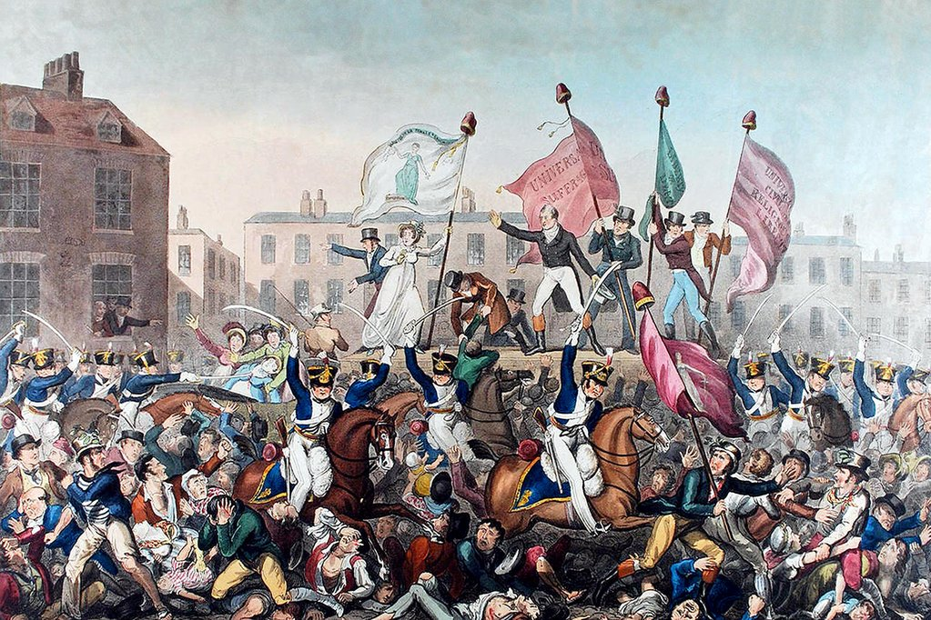
Activity 1: Reading an image
© GL Archive / Alamy Stock Photo
Notes:
Using an image is an effective way to give students a way-in to the poem. This is a depiction of The Peterloo Massacre by Robert Carlile in 1819 (though you may wish to withhold sharing that contextual information from students at first to get the most out of the exercise.)
A copy of the image is provided in the Resource booklet – see page 3
You can approach this task in a number of ways – for a scaffolded approach you could try the ‘like/dislike, puzzle/patterns, meaning’ method with your students. (A grid is provided in the Resources booklet – see page 4, or students can simply draw a grid in their workbooks)
Based on an approach pioneered by Aidan Chambers, it encourages students to develop their critical thinking about a text. Using images as a way-in to reading poems can give students confidence to trust their initial impressions and personal interpretations; there’s no fixed meaning (right/wrong); different people will ‘see’ different things and read the images differently. It helps to make students aware that it is okay to have questions about meanings and not understand immediately.
Guide students through ‘reading’ the image, following the suggested prompts below (adapt accordingly):
1st reading of the image: jot down initial impressions in the ‘like and dislike’ boxes:
What is your initial reaction to this painting? What do you notice first? What do you think is being depicted? How do you respond emotionally? Think about colours and placement; what tone / feeling is being portrayed?
Simply note down what you like and dislike about it.
2nd reading of the image: Interrogate it further:
Do you see any patterns or contrasts?
What questions do you have or what is puzzling you?
What do you notice if you look a little closer? Where does your gaze want to linger?
Focus in on a specific figure, what do you notice?
Finally – look at it as a whole for a 3rd reading:
Is the art realistic?
Do you notice any motifs or symbolism? What do you think the artist’s intended meaning / message is?
What ideas do you think are being presented?
Does it remind you of anything else you’ve seen?
How can this be linked to any texts we are studying?
Can you relate it to your own personal experience?
What’s the big idea / universal significance?
Having given students the opportunity to think about and discuss the image, ask them to consider how this image links to liberticide.

Slide 6
The Peterloo Massacre
What became known as ‘The Peterloo Massacre’ took place in St Peter’s Field, Manchester, on Monday 16th August 1819.
After the end of the Napoleonic Wars in 1815, there was a severe economic slump. Unemployment was high, and the Corn Laws meant the price of bread was excessive.
Only around 11% of adult males had the vote – very few of them in the industrial areas in the North of England.
Around 100,000 people gathered as part of a peaceful protest, in Manchester, to demand parliamentary reform. They were addressed by a well-known orator – Henry Hunt.
The army charged into the crowd, with sabres drawn, injuring and killing hundreds of people, (including women and children) before arresting Hunt.
The name the ‘Peterloo Massacre’ was first used by the Manchester Observer in an ironic reference to the bloody Battle of Waterloo which took place in 1815.
Historian Robert Poole has called the Peterloo Massacre "the bloodiest political event of the 19th century in English soil"
Notes:
Provided on the slide is some brief information/background about the Peterloo Massacre. This could be disseminated to students in a number of ways or they could be tasked with researching the subject themselves. You may also wish to adapt the amount of text and/or words according to the ability level of the group.
Ask students how the event could be seen as liberticide?
For a comprehensive background of this historical event visit the British Library’s ‘Discovering Literature: Romantics & Victorians’ collection The Peterloo Massacre | The British Library (bl.uk) There are images of other related artefacts that may be of interest.

Slide 7
Poetry to change the world?
Big Question: How can poetry and art be used to help affect change in society?
Considering the big question in light of the image and information you have seen, can you think of any art, poetry or songs that have been created in response to a major world event?
How might art, poetry and song help people to understand and react to important events and issues?
Can these things help to galvanise people into action?

Slide 8
Shelley’s Response
Poet Percy Bysshe Shelley heard about the events in Manchester while in Italy.
He responded to the news by writing the poem ‘England in 1819’
Big Question: What are Shelley’s ideas in his poem ‘England in 1819’?
Notes:
Explain that students are going to be introduced to the poem ‘England in 1819’.
You can approach the reading of the poem in your usual way or try our the guided reading strategy that follows on the next few slides.
Using the ‘reading boxes’ approach is designed to open up the poem in a series of 3 readings.
A template is provided in the Resources booklet (see page 6) to be photocopied or students can simply draw three boxes (one inside another) and, starting in the middle, label each box ‘First’, ‘Second’, ‘Third’.
The reading boxes template is a useful framework to support a layered reading of a poem. The intention is that by making explicit how repeated readings can be used to explore and analyse a poem, students can further develop skills and confidence with reading unfamiliar / ‘unseen’ poetry. It‘s just one way of structuring/scaffolding a reading process until students have internalised the process and are confident enough to follow these steps more intuitively and independently (which will happen over time and with practice).
Although questions have been included on the slides, feel free to add to or adapt for your teaching groups accordingly.

Slide 9
England in 1819
1 An old, mad, blind, despised, and dying King;
Princes, the dregs of their dull race, who flow
Through public scorn,—mud from a muddy spring;
Rulers who neither see nor feel nor know,
5 But leechlike to their fainting country cling
Till they drop, blind in blood, without a blow.
A people starved and stabbed in th’ untilled field;
An army, whom liberticide and prey
Makes as a two-edged sword to all who wield;
10 Golden and sanguine laws which tempt and slay;
Religion Christless, Godless—a book sealed;
A senate, Time’s worst statute, unrepealed—
Are graves from which a glorious Phantom may
Burst, to illumine our tempestuous day.
Notes:
Students will need their own copy of the poem (provided in the AQA poetry anthology see page 5 - available to order in print and the digital download available via Centre Services) The poem is copied on the slide here if you wish to display it on-screen and read as a class.
You can choose how to conduct the first reading of the poem - you can access an audio recording of the poem for free here
Listen to England in 1819 by Percy Bysshe Shelley by Anton Jarvis in GCSE AQA: Worlds & Lives playlist online for free on SoundCloud

Slide 10
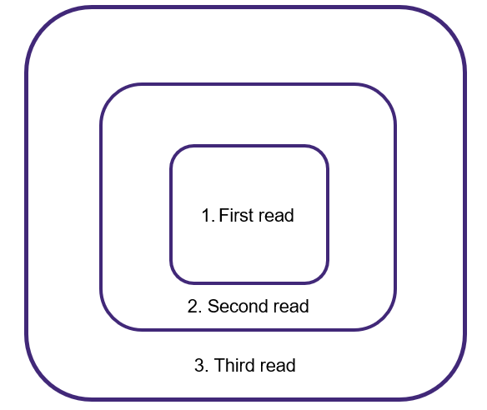
Activity 2: Reading boxes
First Reading: Initial impressions
What is your initial reaction? You only ever have the chance to read something for the first time once! Take advantage of this. What are you thinking? Jot down your initial thoughts and ideas.
What stands out to you in the poem as something you can react to? What do you like or dislike?
Take in the title – what might it be about?
Notes:
First reading: Explain to students that the first reading is all about initial impressions. There are no right or wrong responses, it’s simply what they are thinking after a first read.
Choose how you conduct the first reading of the poem – you could get students to close their eyes and listen as you read the poem aloud to the class / play the audio recording (alternatively students could read the poem in their heads).
Then give them a minute to read the title, scan over the poem on the page and take in its shape and the white spaces.
In the central box, students should capture their initial reactions, likes/dislikes, including notes on what they think the poem is literally about.

Slide 11
Activity 2: Reading boxes
Second read: Interrogate
What questions do you have or what is puzzling you?
What do you notice as you read through the poem again?
Can you see any patterns in words/phrases/images/ rhyme and rhythm?
Notes:
Second reading: Explain that the second reading is about looking closer and interrogating what has been read.
Read the poem for a second time (again you can choose whether to read the poem as a class or allow students to read through on their own at their own pace).
Encourage students to make further notes on this in the second box.
Useful questions to ask students might be:
What questions do you have or what is puzzling you?
What do you notice as you read?
What patterns or repeats do you notice? (in words/phrases/images/rhyme and rhythm)

Slide 12
Activity 2: Reading boxes
Third reading: Meanings
What is the writer saying? What is the message?
What are the big ideas in the text?
How could the poem relate to other texts you have read or the world around you?
Notes:
Third reading: Explain that the third reading is about exploring the meaning.
After a third reading of the poem, ask students to consider what they think the poet is saying and why the poem was written. (Again reassure them that there aren’t right/wrong answers – we’re just speculating based on our interpretations of what we’ve reading)
Useful questions to ask:
What is the message of the poem?
How does the text relate to other texts you have read or the world we live in?
Students jot these thoughts down in the outer box.
Students can feedback on this activity in a number of different ways – whether sharing their ideas with a partner or as a whole class.

Slide 13
England in 1819
Big Question: How do issues from 1819 link to our lives now?
How does Shelley’s poetic commentary of the Peterloo Massacre relate to modern political and social issues? Are there any similar themes and ideas?

Slide 14
Activity 3: Current issues in modern times
Can you think of any current issues affecting us at the moment? Nationally or globally?
How are people affected by this?
Is anything being done to try to counteract these issues?
What are today’s news headlines? What do they show about the state of living in today’s society?
Notes:
Depending on students’ cultural literacy, teachers may need to lead this discussion and encourage students to think beyond their own immediate life. Teachers could introduce current affairs through watching news stories, providing news articles, asking students to research themselves, or anything else that is suited to the school’s context.
For copyright reasons we cannot reproduce headlines but you can insert your own for use in the classroom.
Here are links to a couple of suggested articles from The Guardian on the current cost of living crisis with provocative headlines that teachers could use if deemed appropriate in your context:
https://www.theguardian.com/commentisfree/2022/jan/19/the-guardian-view-on-the-cost-of-living-moneys-too-tight-to-mention
https://www.theguardian.com/business/2022/dec/12/30-million-in-uk-priced-out-of-decent-standard-of-living-by-2024#:~:text=Thirty%20million%20people%20in%20the,2024%2C%20according%20to%20a%20study.

Slide 15
Activity 4: Poetry to change the world?
Big Question: How can poetry and art be used to help affect change in society?
Can your poetry help to change the world?
Choose a current issue that you feel is important and that should be tackled.
Research by reading about this issue in articles and/or editorials to find out more.
Using Shelley’s ‘England in 1819’ as a guide, write your own ‘poetry to change the world’.
Notes:
This activity could be introduced as an independent project/homework exercise or used to set-up a follow-up lesson.
Students could adopt the form and structure of Shelley’s poem (even the title: ‘England in 2023’) or be given free rein to write their own poetry on a cause/issue of personal interest. You can decide on the level of freedom you give your students – you could provide images of examples from recent history they could use as a stimulus.

Slide 16
Taking it further
You could take this lesson further by exploring other poems from the Worlds and Lives cluster that reflect the issues and ideas of their time.
Personal and political – protest poems
‘Lines written in Early Spring’ can be read as a reaction to industrialisation / urbanisation, grieving the impact on nature
‘A Century Later’ – can be read as campaigning for education rights for women
‘Thirteen’ – portrays racial profiling by the police
Global and collective issues – climate change (‘eco poetry’)
‘Except for the Lone Wave’
Notes:
There are lots of different ways in which this lesson could be taken further.
The assessment of poetry at GCSE requires students to make connections across poems and respond to unseen poems. In a follow-up lesson you could explore the genre of protest poetry further, either selecting a poem of your choice or one from the Worlds and Lives cluster. Some suggestions are provided on the slide.

Slide 17
Worlds and Lives poetry cluster
Our new cluster ‘Worlds and lives’ is an exciting, contemporary collection of poems – two thirds of which are published post-2000. Whilst very modern, the poems selected are rooted in the revolutionary spirit of the Romantics, which we hope will ignite young people’s passion for poetry.
The collection as a whole is both personal and political, providing opportunities to explore collective concerns about the world we live in as well as universal themes to which we can all relate as individuals, including our relationship with places and ideas about home, heritage, belonging and connection.
AQA | Spark something | Poetry | Worlds and lives
Notes:
You can teach Worlds and Lives from September 2023 with the first examination in summer 2025. For more information and links to further support and resources visit AQA | Spark something | Poetry | Worlds and lives

