Slide 1
English Hub School networks
GCSE English specifications
Summer 2017

Slide 2
What we will cover today
Marking processes for the new papers and how we make sure students get the right results.
How we set grade boundaries and what it means for the new specifications.
Ways of reviewing and analysing your students' results this summer.
The systems and support we have available to help you.

Slide 3
Structure of the day
You are going to discuss some statements about the examination system in place for GCSE English specifications in 2017 and work out which might be true or false.
Follow an examiner journey in order to understand better our marking processes.
Learn a bit more about how we award and ultimately grade your student scripts.
Consider the information you will get on results day and the post results services you have available to you.

Slide 4
Statements about the GCSE English 2017 summer series
Which are correct and which are false?

Slide 5
Marking
Overview and recap

Slide 6

So….how does it work?
How exams work, a guide to awarding: bit.ly/2s6hWwH

Slide 7
The exams cycle
Question papers and mark schemes are written.
Question papers are dispatched, students sit exams and teachers submit NEA.
Examiners and moderators are trained to mark at the correct standard.
Marks are collated and meetings are held to set the grade boundaries.
Results are dispatched and post-results enquiries are processed.
Receive entries and examiners/ moderators are appointed.
Question paper and marking performance is evaluated.
Marking and moderation takes place – quality and progress is regularly monitored throughout.
Process restarts for the next year, making and improvements identified.

Slide 8
AQA’s e-Marking strategy
What are the advantages of using electronic marking?
Electronic marking introduces a number of benefits both to AQA and ultimately the candidate including:
Flexible working
Improved data capture
In-flight problem resolution
Enhanced service provision
More flexible and efficient process

Slide 9
Quality of examiners
The examiners complete a range of scripts in advance of being allowed to mark.
They have to show that the understand the standard before being allowed to start marking live scripts.
The nature of the training is through an online standardising platform.
It provides a consistency in the feedback across all the associates.

Slide 10
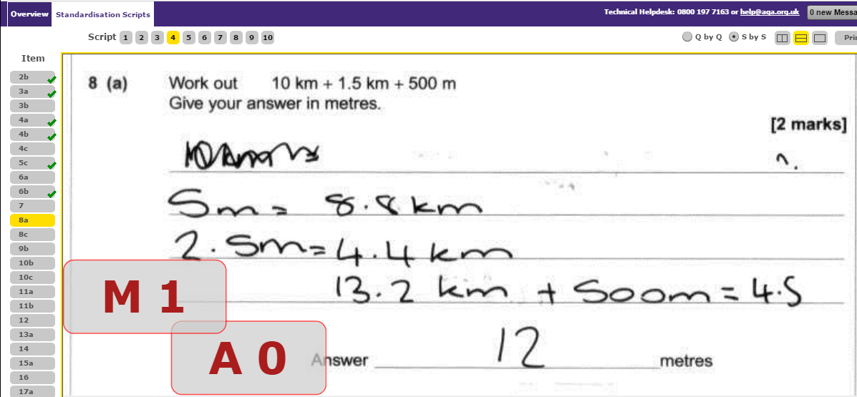
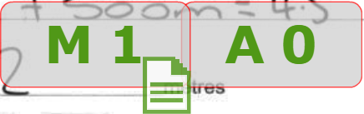
Reliability: quality of examiners

Slide 11
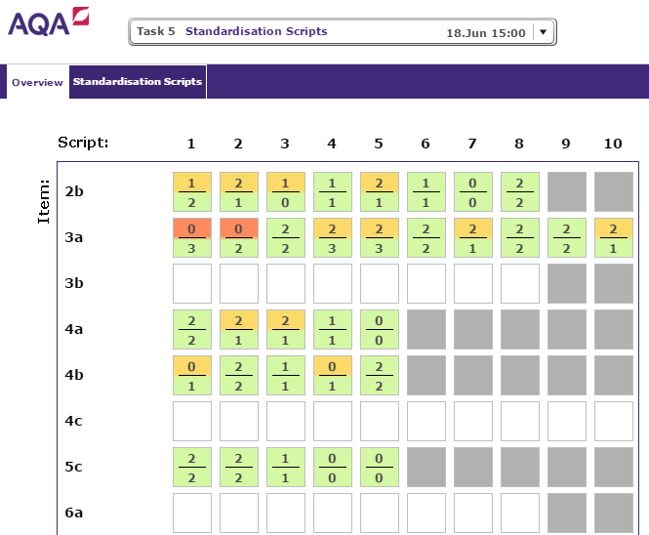
Reliability: quality of examiners
Conversation with team leader needed. Another attempt at items before marking.
Cleared to
start marking

Slide 12
Awarding
What do you need to know and how does it work?

Slide 13
Things to know about the new GCSE grades – from Ofqual
GCSEs in England are being reformed and will be graded with a new scale from 9 to 1, with 9 being the highest grade.
New GCSE content will be more challenging.
The new grades are being brought in to signal that GCSEs have been reformed and to better differentiate between students of different abilities.
Fewer grade 9s will be awarded than A*s.
In the first year each new GCSE subject is introduced, Ofqual have stated that broadly the same proportion of students will get a grade 4 or above as would have got a grade C or above in the old system.

Slide 14
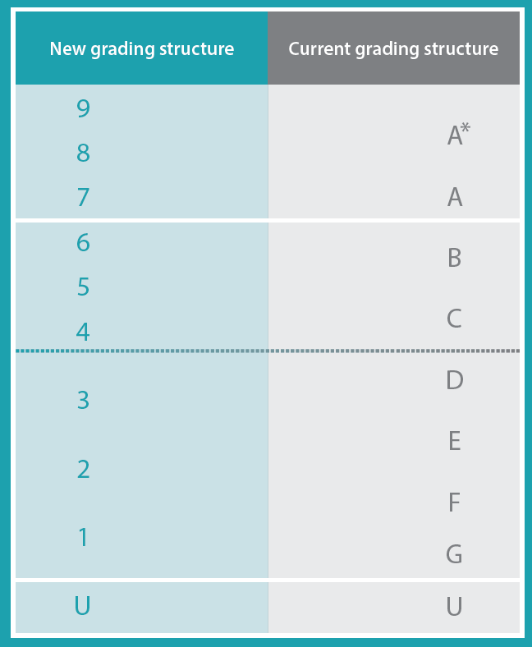
Pass mark
‘Strong pass’
‘Standard pass’

Slide 15
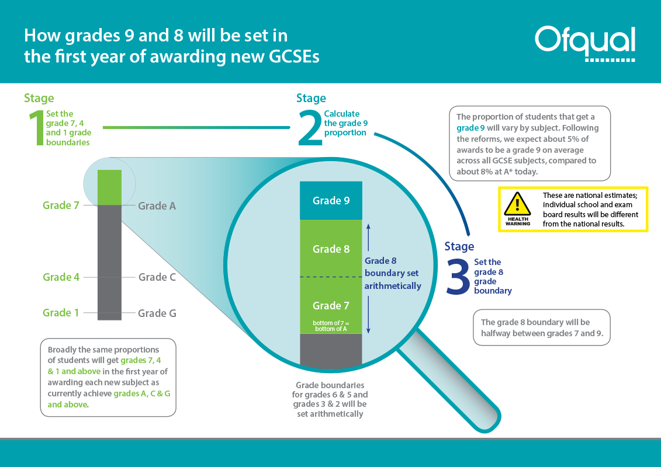

Slide 16
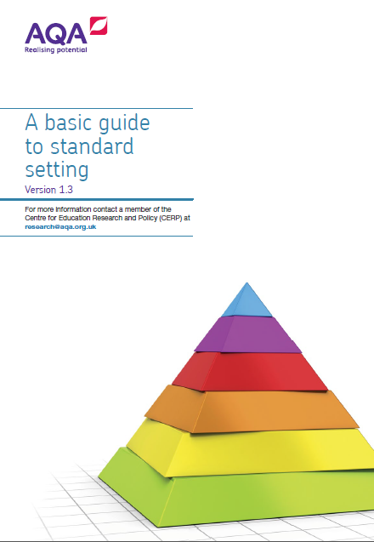
What exactly is awarding?
Awarding is the process by which the grade boundary marks are determined at subject level.
We do this in a way that ensures the standard will be comparable with previous series and with that of other awarding organisations.

Slide 17
What is the start of the awarding process?
Once we have enough marks in the system it creates a distribution of student marks.

Slide 18
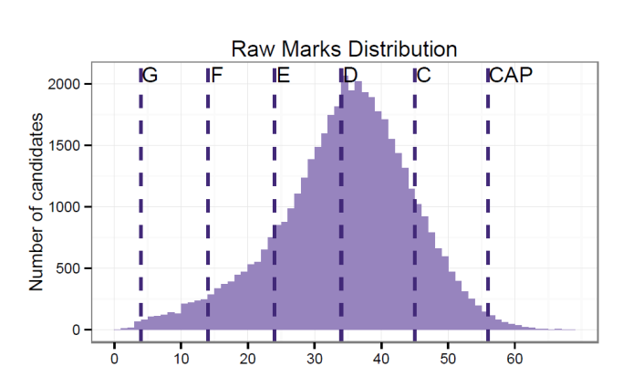
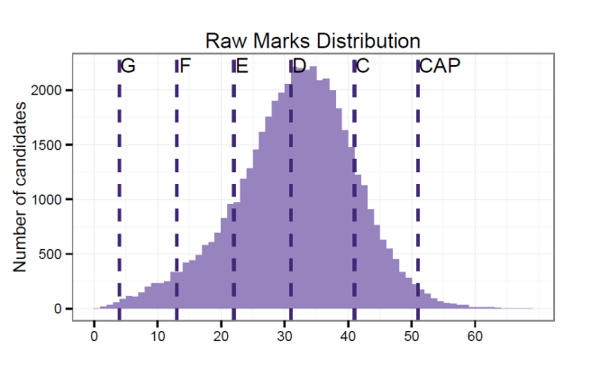
What is the start of the awarding process?
Here are some distribution curves from GCSE Mythological Studies over a 2 year period. Year 1 is on the left, year 2 on the right.
This shows that that the curve has shifted slightly to the right in year 2.
This leads to the grade boundaries moving from one year to the next.

Slide 19
Who is involved in awarding?
At the awarding meeting there will be various people with different roles
The Chair – responsible for the whole subject.
The Chief – responsible for the particular specification.
The Lead Examiners – responsible for the marking of each paper.
The Lead Assessment Writers – responsible for the writing of questions for each paper.
The Principal Moderator – responsible for any non examination components.

Slide 20
So what happens then?
The awarding meeting use a balance of judgemental and statistical evidence to make recommendations.
The committee will look at a range of scripts for each ‘judgemental grade boundary’ (7, 4 and 1 for GCSE).
The range covered is based around the judgements of the senior examiners and the use of statistical evidence.
The statistical evidence considers the ability of the entering cohort of students and also the distribution of marks.

Slide 21
How is a grade boundary decided?
The ‘statistical’ element
Our Centre for Education Research and Compliance (CERP) use a range of statistics to make predictions which suggest the most appropriate statistically recommended grade boundaries. These are based on how comparable students have performed in previous series.
The ‘judgemental’ element
Senior examiners review a sample of exam answer papers (scripts) from this year’s exam series to make judgements on where the grade boundaries should be set. These scripts will be archived and referenced in future series to ensure a comparable standard.

Slide 22
What exactly happens when setting a grade boundary?
For each paper, the sample scripts on and around the statistically recommended boundaries are the scrutinised by the senior examining team.
The awarding panel will judge whether or not scripts on the marks around the boundaries are worthy of the grade in question. Ultimately, the Chair of Examiners will recommend the boundary mark for that grade.
How does it work if the examiners disagree with the statistical recommendations?

Slide 23
Tick chart
This is a typical chart that we might see for any paper which shows what the awarders consider when making decisions.

Slide 24
The bigger process
Grades in Award
Approved by Chief Executive Officer
Inter-board comparisons
Students on results day

Slide 25
Results Day information
What support is available for us on results day?

Slide 26
Results and post-results timeline
A-level results day
GCSE results day
DEADLINE FOR REVIEWS
16
August
17
August
23
August
24
August
24
August
21
September
DEADLLINE FOR PRIORITY REVIEWS/COPY OF SCRIPT REQUESTS
Limited release of GCE results to centres
Limited release of GCSE results to centres

Slide 27
Restricted release and results days
Restricted release day (Wednesday)
A day before results day.
Available at 00:01.
e-AQA is the only place you can access our results e-documents and any late changes or amendments.
grade boundaries available (00:01 on e-AQA, 08:00 on website).
Enhanced Results Analysis (ERA).
Results day (Thursday)
Can be released to students 06:00 hours.
Students must not receive results, by post or otherwise, prior to this time.

Slide 28
What support is available for us?
Customer Services team - 0800 197 7162.
eos@aqa.org.uk
https://www.facebook.com/AQAforexamsofficers
Relationship Managers who are linked to your school.
Enhanced Results Analysis (aqa.org.uk/era).
Reports on the exam (aqa.org.uk/eaqa).
Longer term – feedback courses (aqa.org.uk/cpd).

Slide 29
Enhanced Results Analysis (ERA)
aqa.org.uk/era
User guides to allow your teachers to be make the best use of the resource.
Uses for ERA
See how students performed in specific topics .
Find information to tailor your lesson plans and focus your teaching where it’s needed most to maximise every student’s progress.
Spot year-on-year trends and measure achievement against other schools and colleges for a broader perspective.

Slide 30
Post results services
The post results services and recent Ofqual’s changes to these

Slide 31
Post-results services
Service 1: clerical check
Service 2: review of marking
Priority service 2: priority marking review
Service 3: moderation review
Access to scripts (ATS)
Priority Access to scripts (GCE only)
Cohort concern

Slide 32
Post results services – 2016 Ofqual changes
In 2016 Ofqual published ‘Decisions on marking reviews and appeals, grade boundaries and The Code of Practice’.
Post-results key points
  Require marking and moderation errors to be corrected, but not otherwise allow marks to be changed.
  Permit exam boards to accept marking review requests directly from students.
  Permit exam boards to extend the priority access to scripts service to GCSE qualifications.

Slide 33
Ofqual changes – what they mean to AQA and you?
Exam boards required to correct marking and moderation errors but not otherwise change marks.
We will only review papers to correct genuine marking errors – we can’t change reasonable marks.
  Marks may be changed when there is a marking error (can be adjusted upward or downward to correct the mark).
  Marks may be changed when the original marking cannot be supported by evidence from the mark scheme and “the original marking represents an unreasonable application of academic judgement”.

Slide 34
Ofqual changes – what they mean to AQA
Exam boards are permitted to accept requests for reviews and appeals directly from students.
We will not be accepting post-results requests directly from students in summer 2017.
We agree with the JCQ that it’s really important that students have the right support when making decisions like this, and schools have the expertise to discuss these issues with exam boards.
Allow exam boards to offer priority GCSE access to scripts to schools/colleges who want to see them before deciding whether to ask for a review.
We’re unable to offer priority GCSE access to scripts service summer 2017. We recognise the value of this service , so we’re looking into providing this service for future series.

Slide 35
Enquiries about results: student consent
Students must be made aware of the risk of mark and grade changes resulting from a marking review.
Schools/colleges should have the written consent from a student for any review of marking request (except review of moderation).
Schools/colleges should keep this consent on file for six months.

Slide 36
Extended review of marking
More Ofqual procedural changes for 2017 concerned the extended review of marking.
The service for AQA is listed as cohort concern.
Grade protection removed by Ofqual (grades can go down when scripts are reviewed).
Head of centre will have to endorse the application, ensuring students are aware of the possibility of downward mark change.
Must be a full cohort review – we can‘t limit to those students who accept the new risk.

Slide 37
Thank you

