Slide 1
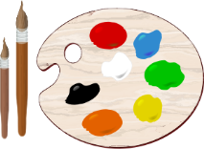
Mes options
How to develop your writing/speaking when explaining your option choices.

Slide 2
1. Use devoir and pouvoir
devoir (to have to)
Je dois
Tu dois
Il/Elle/On doit
Nous devons
Vous devez
Ils/Elles doivent
pouvoir (to be able to)
Je peux
Tu peux
Il/Elle/On peut
Nous pouvons
Vous pouvez
Ils/Elles peuvent
Notes:
Devoir and pouvoir fully conjugated in the present tense. Repeat and drill for pronunciation and memorisation. Answers appear on clicking.

Slide 3
pouvoir/devoir + infinitive
Add the correct forms of devoir/pouvoir.
Spot the infinitives.
Je _______ faire des maths et de l’anglais et tous les élèves _______ apprendre l’informatique. Nous _______ aussi étudier l’anglais.
Les élèves _______ choisir certaines matières. Nous _______ étudier le dessin ou les textiles, par exemple. Ou si on est sportif, on _______ faire de l’EPS.
dois
doivent
devons
peuvent
pouvons
peut
Notes:
Gapped sentences using devoir and pouvoir to talk about school subjects (answers will appear on clicking).

Slide 4
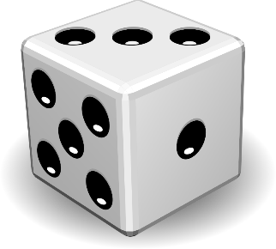
2. Use the perfect tense
avoir + past participle
J’ai
Tu as choisi (chose)
Il/Elle/On a + abandonné (gave up)
Nous avons continué (continued)
Vous avez décidé d’étudier (decided to study)
Ils/Elles ont
Notes:
Recap of the perfect tense with avoir using verbs that relate to past option choices. Students could work in pairs to roll a dice and practise saying sentences about their subjects. The number on the dice will dictate the start of each sentence according to the numbered version of avoir on the slide. For example, rolling a four will prompt a sentence starting with nous avons. Their partner should then translate the sentence into English to win their turn with the dice.

Slide 5
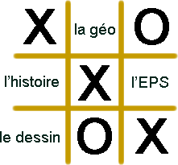
3. Give reasons for your choices
Perfect tense | Subject | Connective | Opinion
J’ai choisi J’ai abandonné J’ai continué J’ai décidé d’étudier | la physique le dessin le commerce l’histoire la géo la musique l’EPS l’allemand le français l’espagnol | parce que car | je l’adore je l’aime je le/la préfère je ne l’aime pas je le/la déteste
Notes:
Grid to support giving reasons. Students could play noughts and crosses, quickly drawing a grid and choosing any nine school subjects in French to write in the squares. To win the square, they should refer to the slide to say a full sentence about that subject in French. More able students should be challenged to extend and develop the suggested opinions.

Slide 6
4. Make comparisons
plus/moins + adjective + que (qu’)
Remember: adjectives in French might need to change their spelling to agree with what they are describing.
La géographie est plus intéressante que l’histoire.
Les langues sont moins amusantes que les sciences.
Notes:
How to compare subjects using plus/moins … que.

Slide 7
Compare these subjects
utile
adjective
facile
amusant
la physique
intéressant
la technologie
l’informatique
les maths
subject
le français
l’anglais
subject
l’EPS
le dessin
Notes:
Students use the prompts to compare subjects using the adjectives in the middle. Click on the cards to change the subjects and adjectives and generate new sentences.

Slide 8
5. Introduce your own opinions
À mon avis …
Selon moi / pour moi …
Moi, je pense que …
Moi, je crois que …
Moi, je dirais que …
In my opinion …
For me …
I think that …
I think/believe that …
I would say that …
Notes:
A reminder of how to introduce opinions. English translations will appear on clicking.

Slide 9
Recap
What were the five ingredients to include in your own work?
Use devoir and pouvoir.
Use the perfect tense.
Give reasons for your choices.
Make comparisons.
Introduce your own opinions.
Notes:
Here’s a recap of the five suggested ingredients to include in speaking and writing on this topic. When moving on to the worksheet tasks, you may wish to project the relevant slides of the PowerPoint to support the grammar exercises:
For exercise A on the worksheet, project slide 2.
For exercise B, project slide 4.
For exercise D, project slide 6.

