Slide 1






AS and A-level languages our resource package explained

Slide 2
Objectives for this presentation
To give you an overview and explanation of the AS and A-level French, German and Spanish resources currently available
To give you further information about the specific resources available when you teach our specifications
To update you on new resources which will be coming soon.

Slide 3
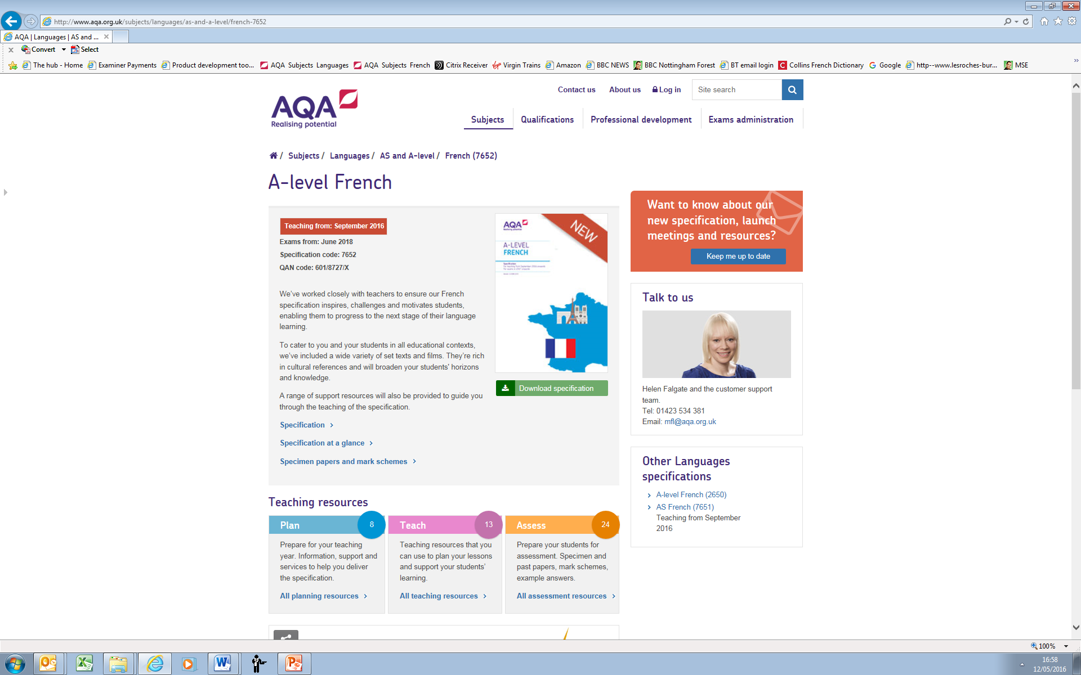
Where to find resources

Slide 4

What resources are available now?
Plan
  Co-teaching guide
  Summary of changes
  How to switch to AQA
  Webinars and launch meeting webcast
  Your questions answered
Teach
  Schemes of work
  Guides to teaching literature and film
  Guide to the A-level individual research project
  Grammar resources
Assess
  A full set of specimen papers (sound files to follow by start of Autumn term or before)
  Detailed Instructions for Speaking Tests

Slide 5
AS and A-level schemes of work
Suggested schemes of work for French, German and Spanish using slightly different but interchangeable models
Available on the ‘Teach’ pages
Fully editable so you can customise for your own students
Built-in opportunities for revision and recap
Sequencing of grammar builds on prior learning
Suggested sequencing of language content, including translation and summarising skills, as well as integrating work on set text(s) and film

Slide 6
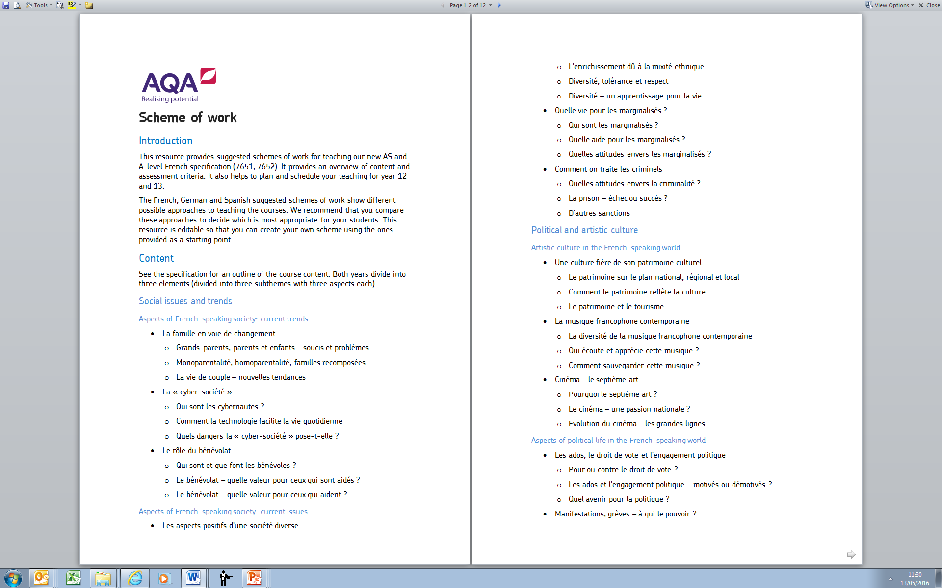
Scheme of work (1) – coverage of themes

Slide 7
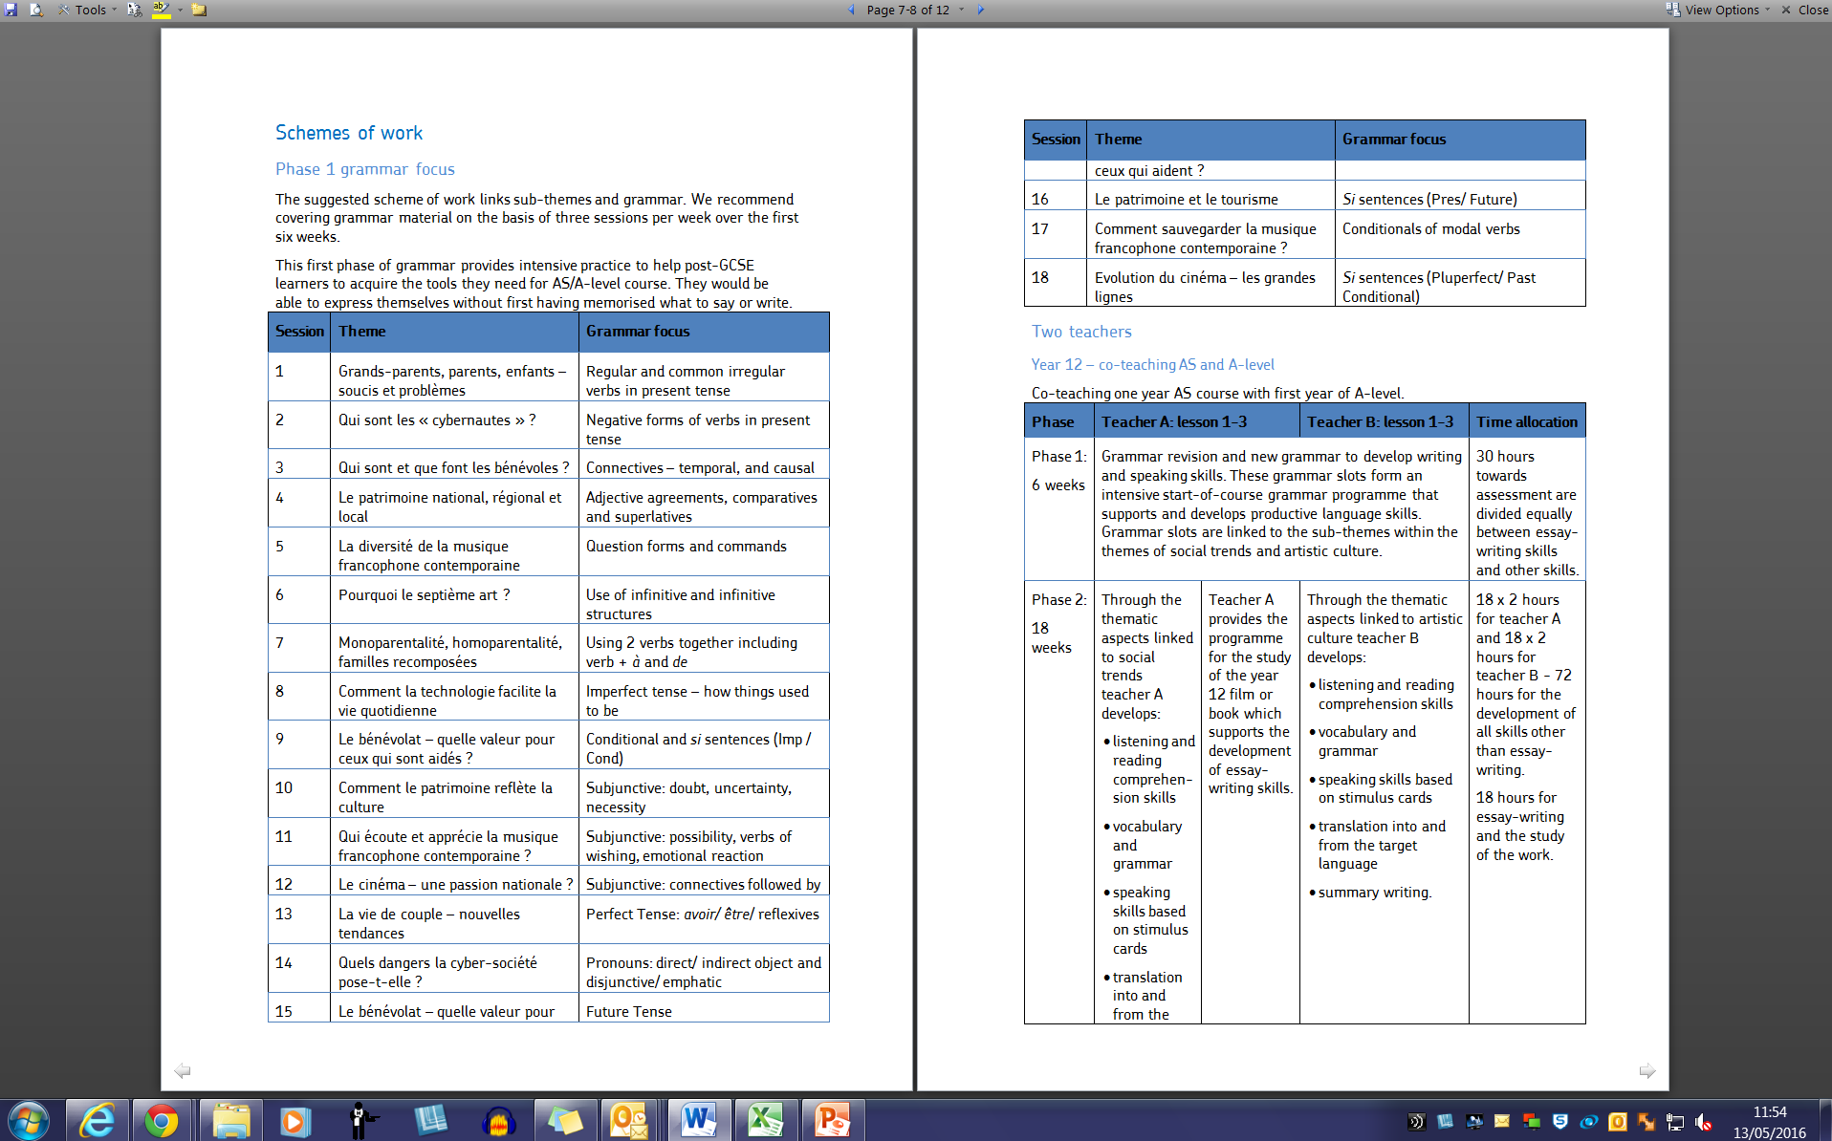
Scheme of work (2) – AS/A-level year 1 grammar coverage

Slide 8
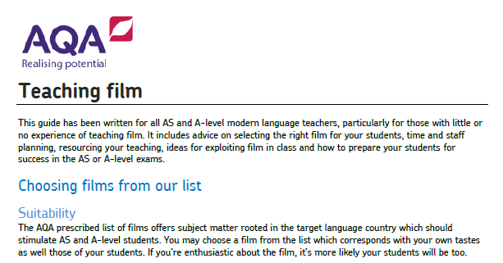
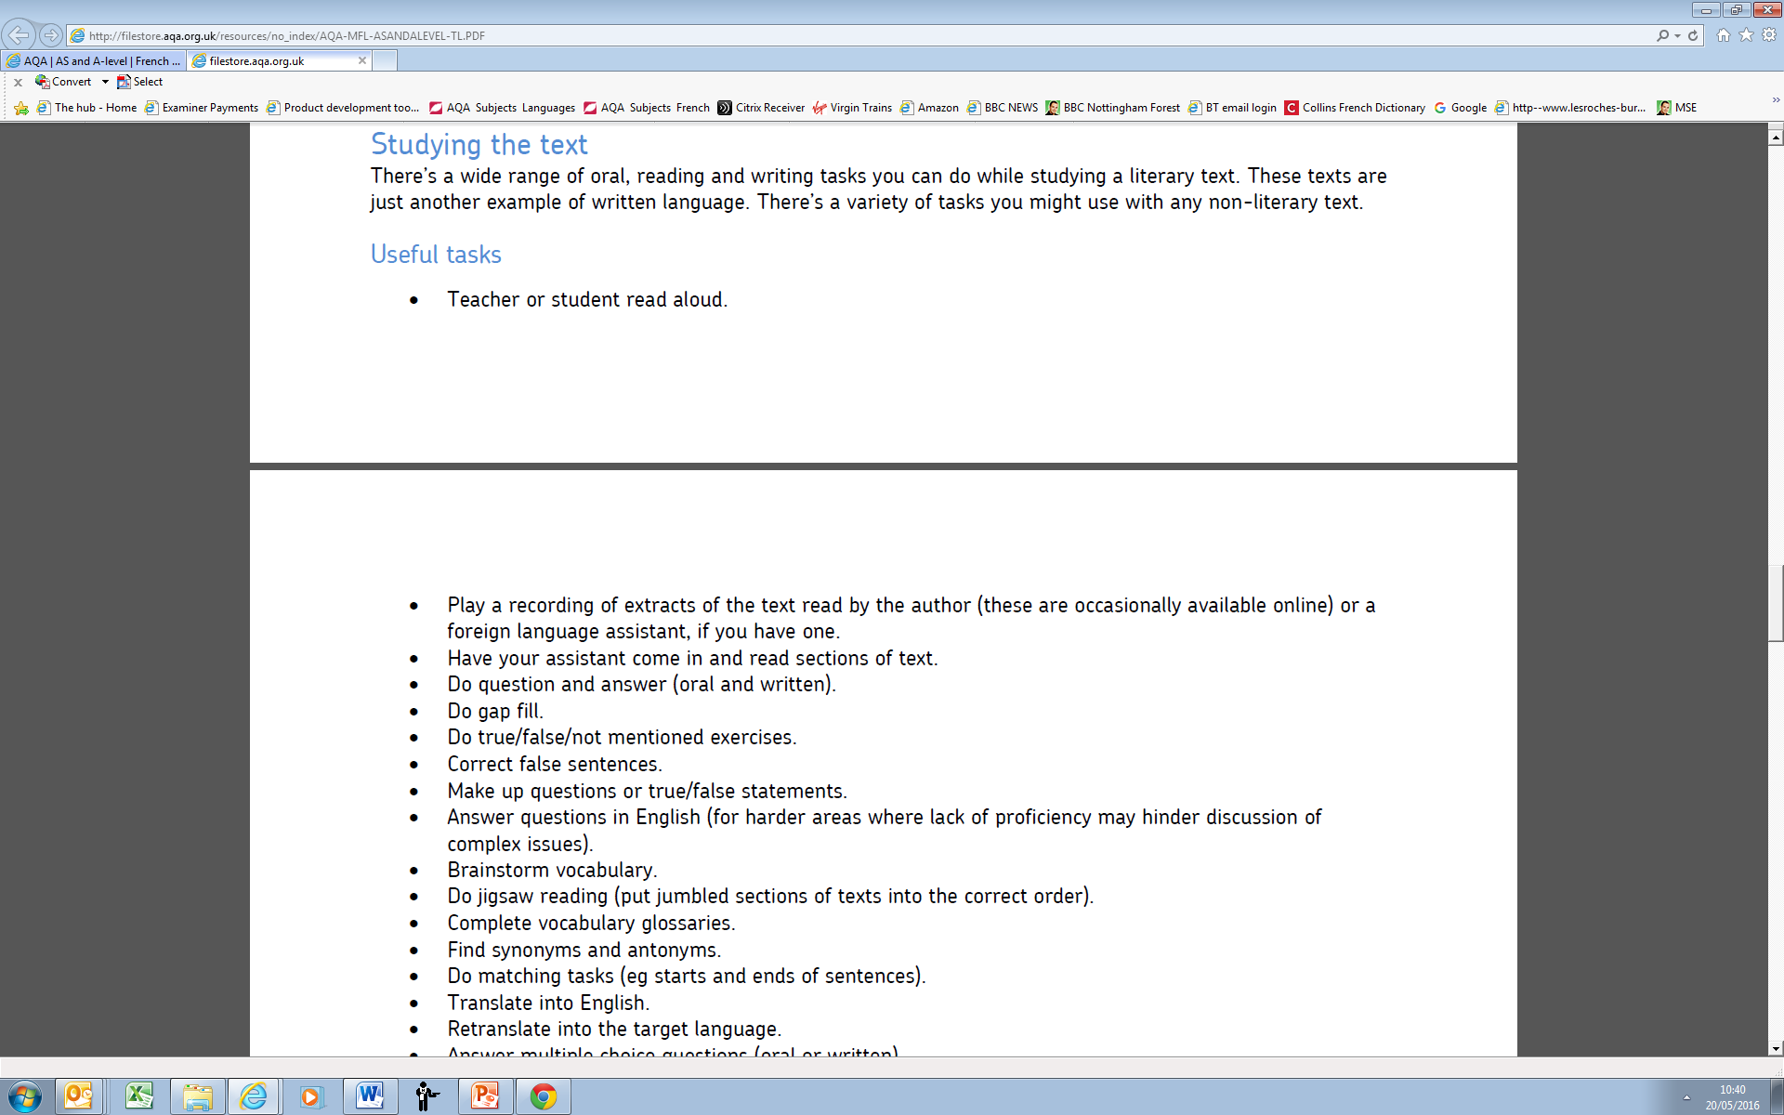
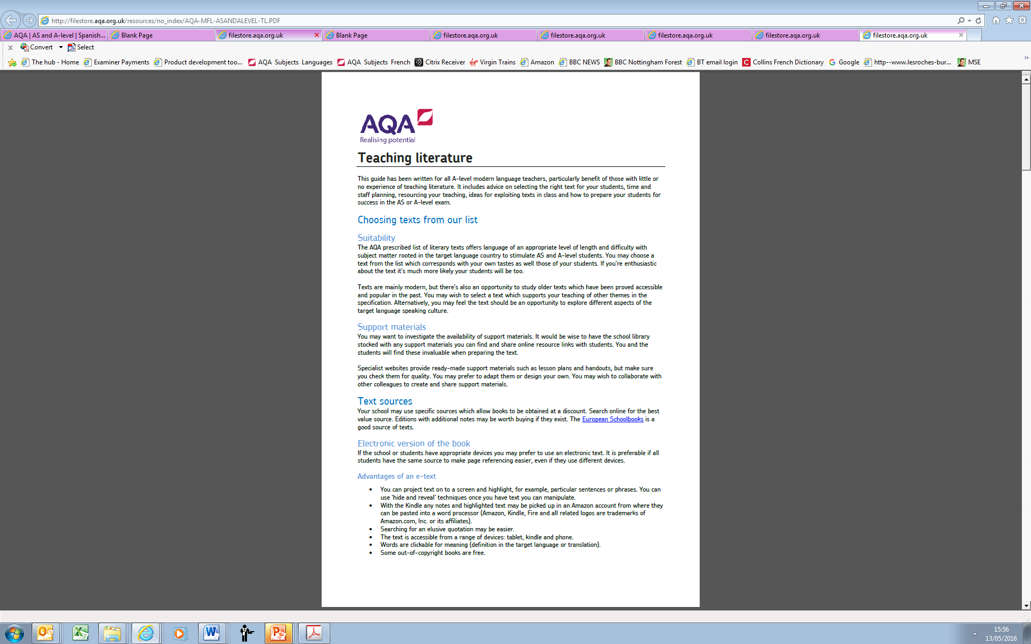
Guides on teaching film and literature

Slide 9
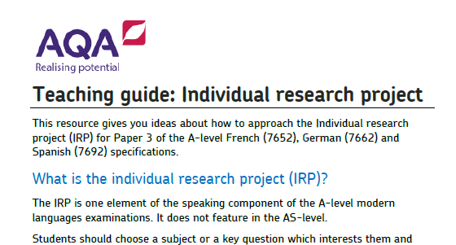
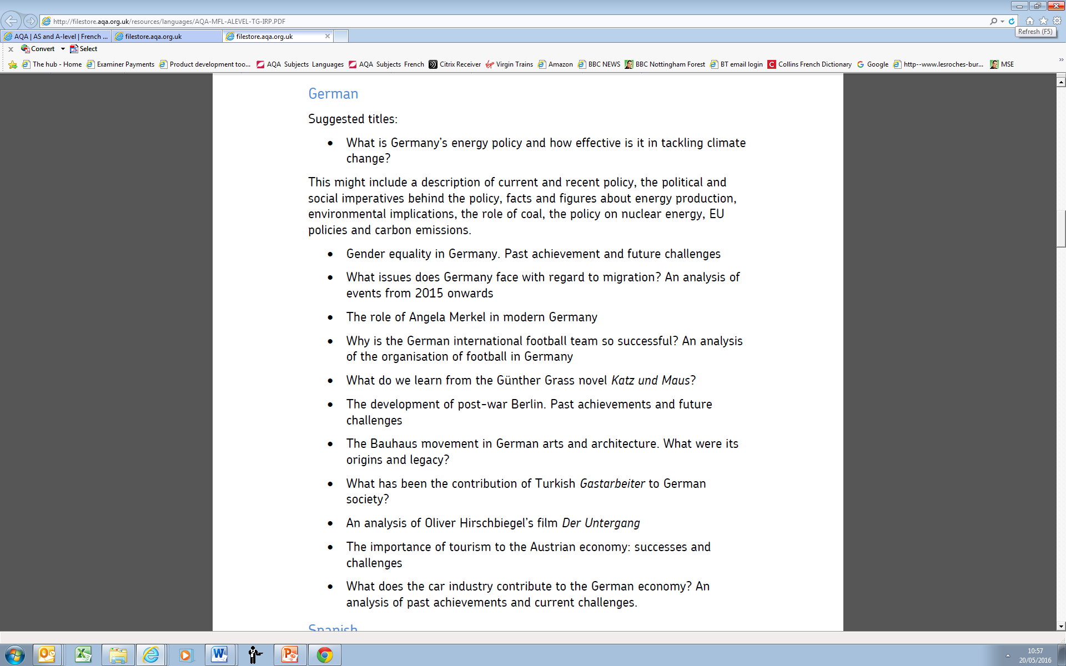
A-level speaking test – individual research project (IRP)

Slide 10

Grammar resources
Developed in conjunction with Teachit Languages
Cover a range of topics
A variety of resources including:
  PowerPoint slides
  Worksheets
  Games
  Lesson activities
  Teaching notes
Links to Teachit’s KS5 pages - browse by topic and by skill (including grammar)
http://www.teachitlanguages.co.uk/ks5-french-topics
http://www.teachitlanguages.co.uk/ks5-german-topics
http://www.teachitlanguages.co.uk/ks5-spanish-topics
Interested in sharing resources? www.teachitlanguages.co.uk/contribute
(information on royalties, free site membership and potential commissions to write materials).

Slide 11
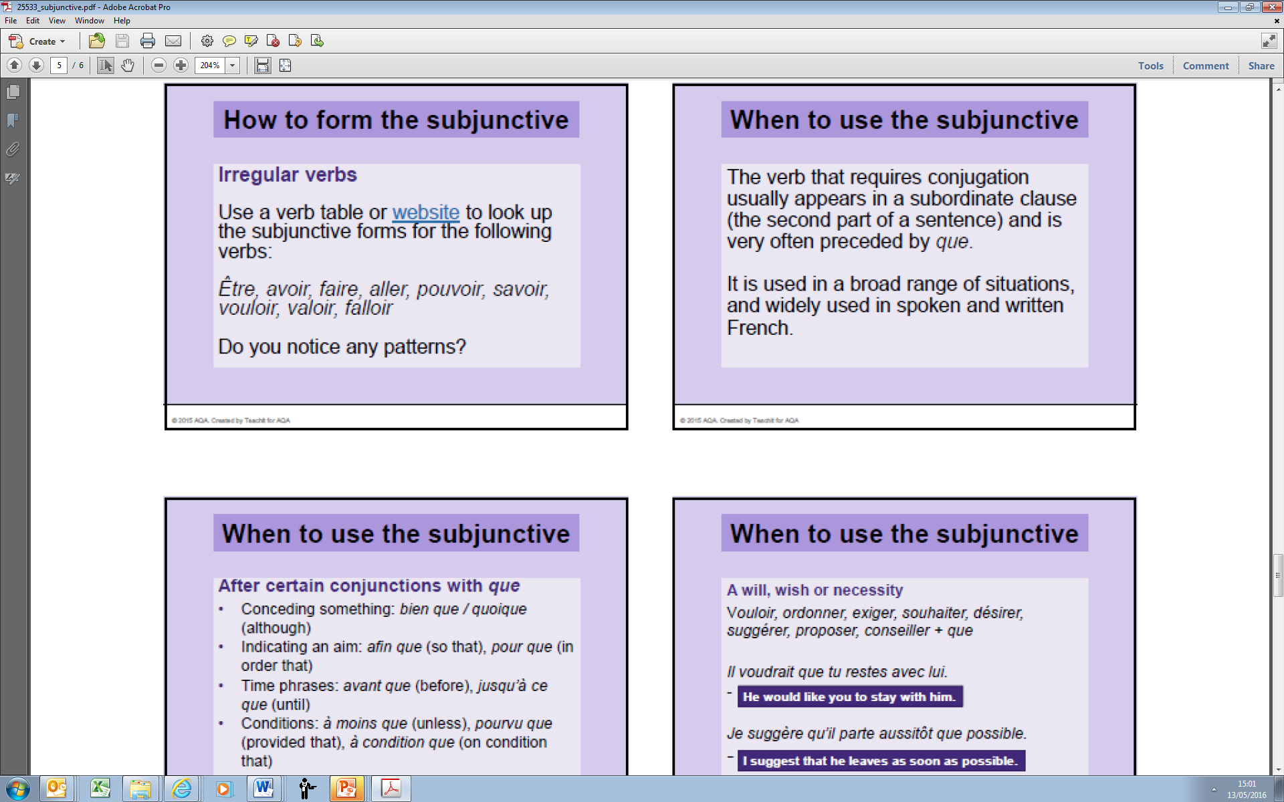
Grammar resources – French

Slide 12
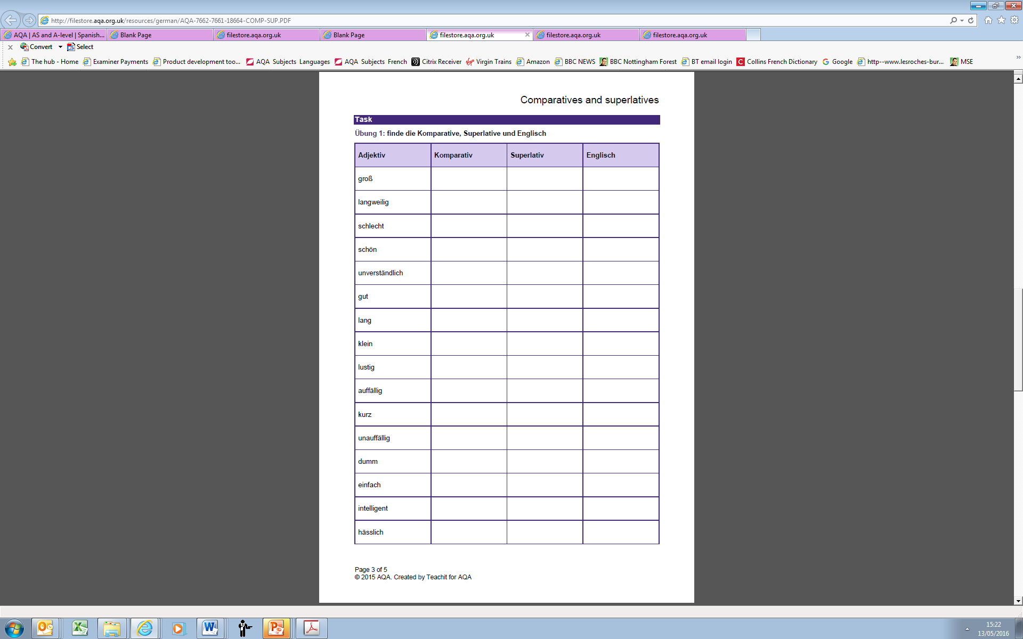
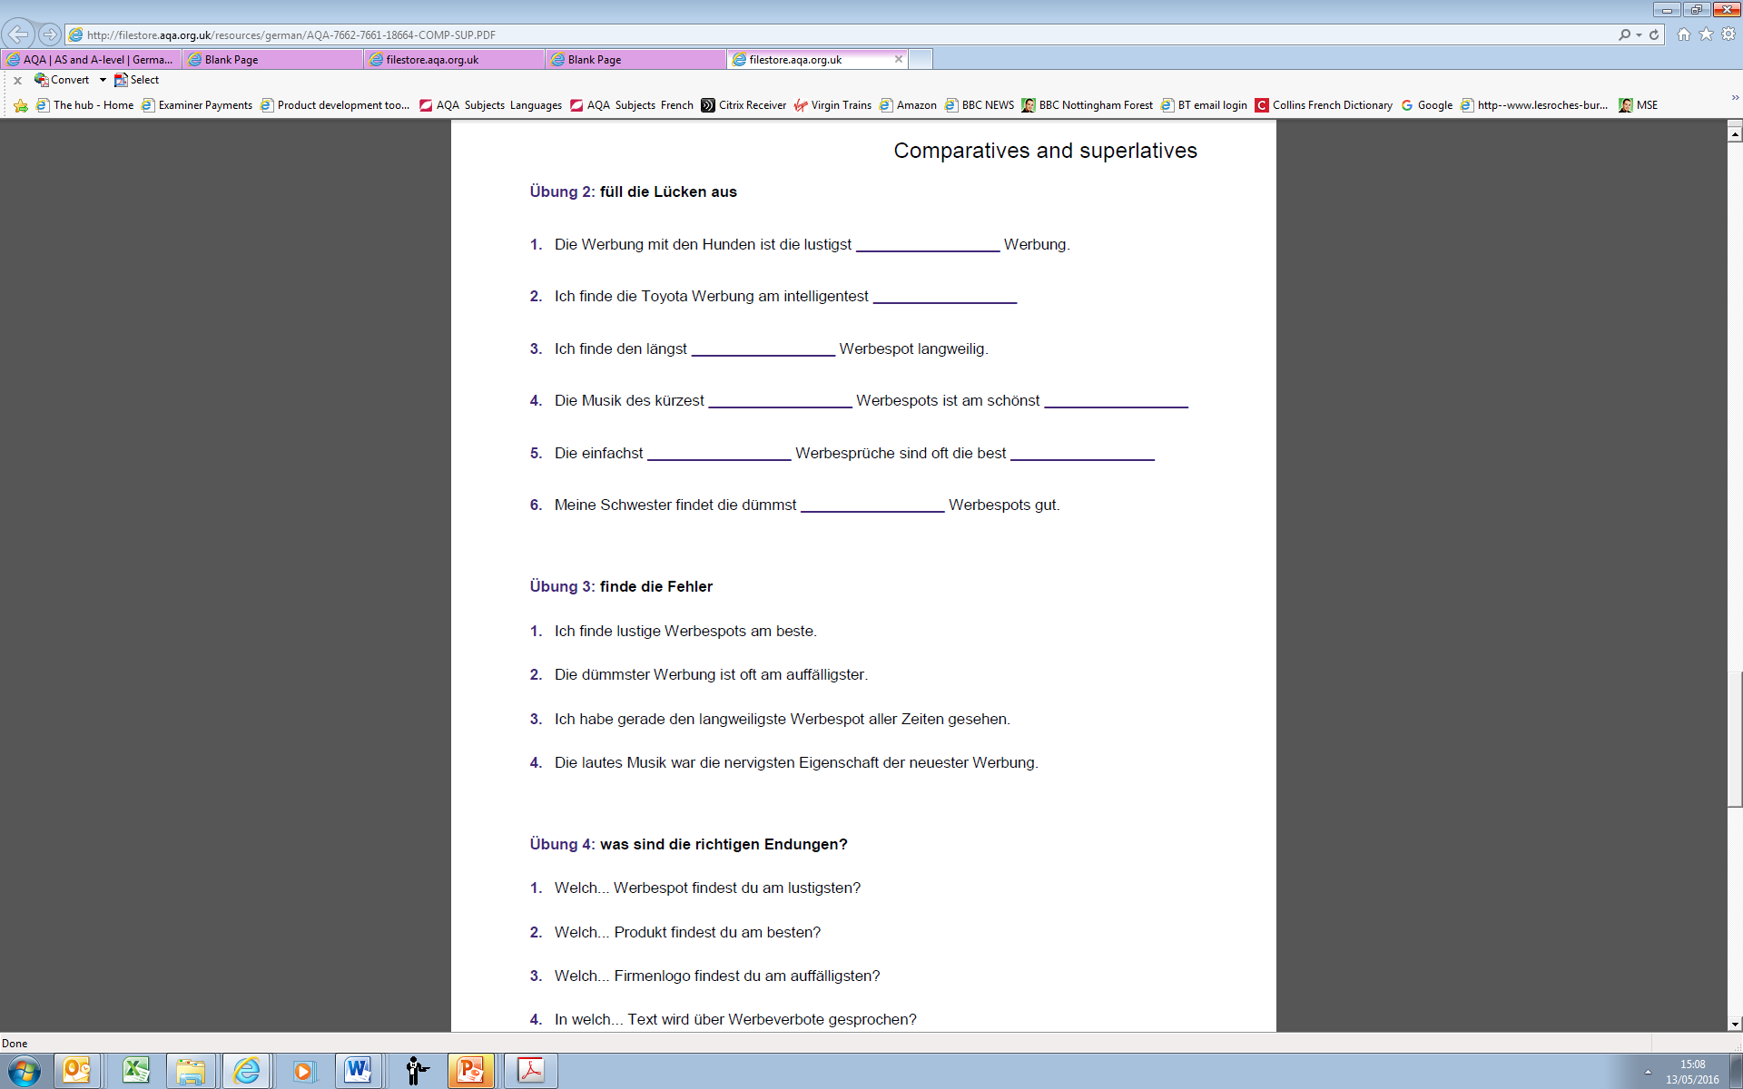
Grammar resources – German

Slide 13
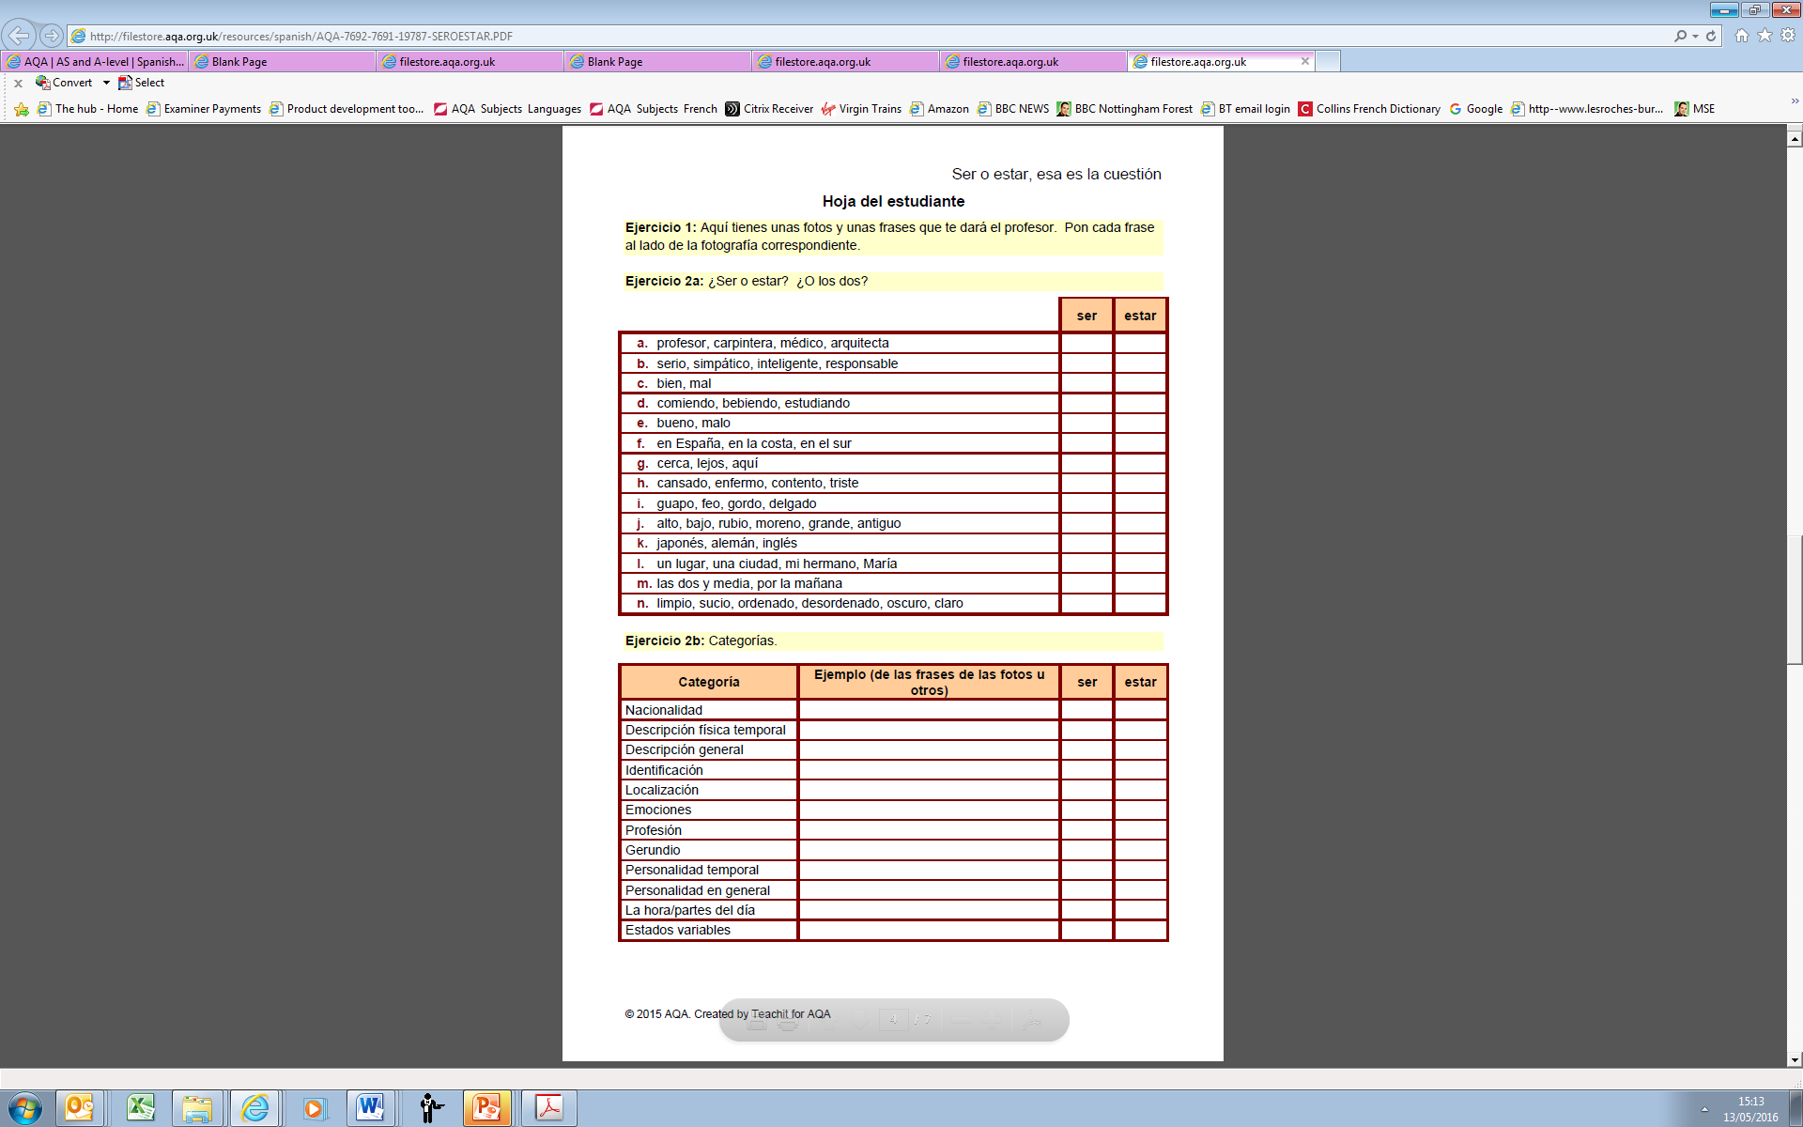
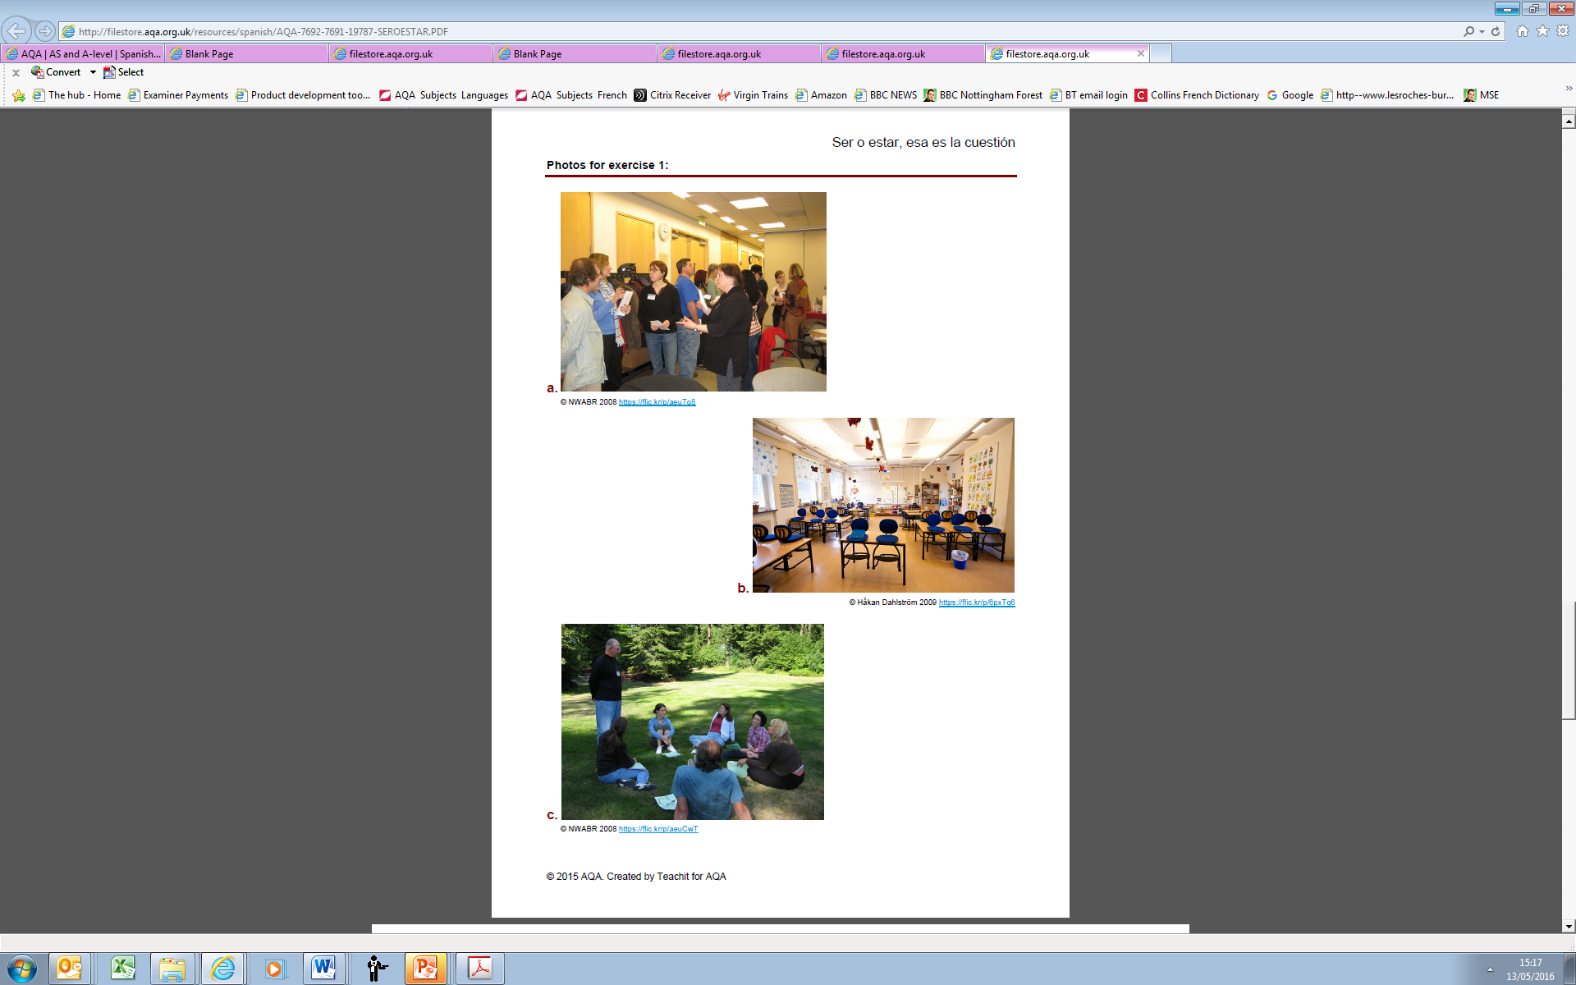
Grammar resources – Spanish

Slide 15
What other resources are coming soon?
Translation practice for AS (this term) and A-level (Autumn term 2016)
Anthology of resources on set texts and films (this term, further resources to be added Autumn 2016)
Additional exemplar marked work (Autumn 2016) for:
  Speaking tests
  Film and set text essays
  A second full set of specimen papers and mark schemes
  (September 2016), via e-AQA
Approved student textbooks (printed and digital):
  Hodder (combined AS and A-level) - May/June 2016
  - see Hodder website
  OUP (AS/A-level year 1 May/June 2016,
  A-level Spring 2017) – see OUP website
  Additional Teachit grammar resources – this term
Exampro - new specification question bank resources (Autumn term 2016)

Slide 16
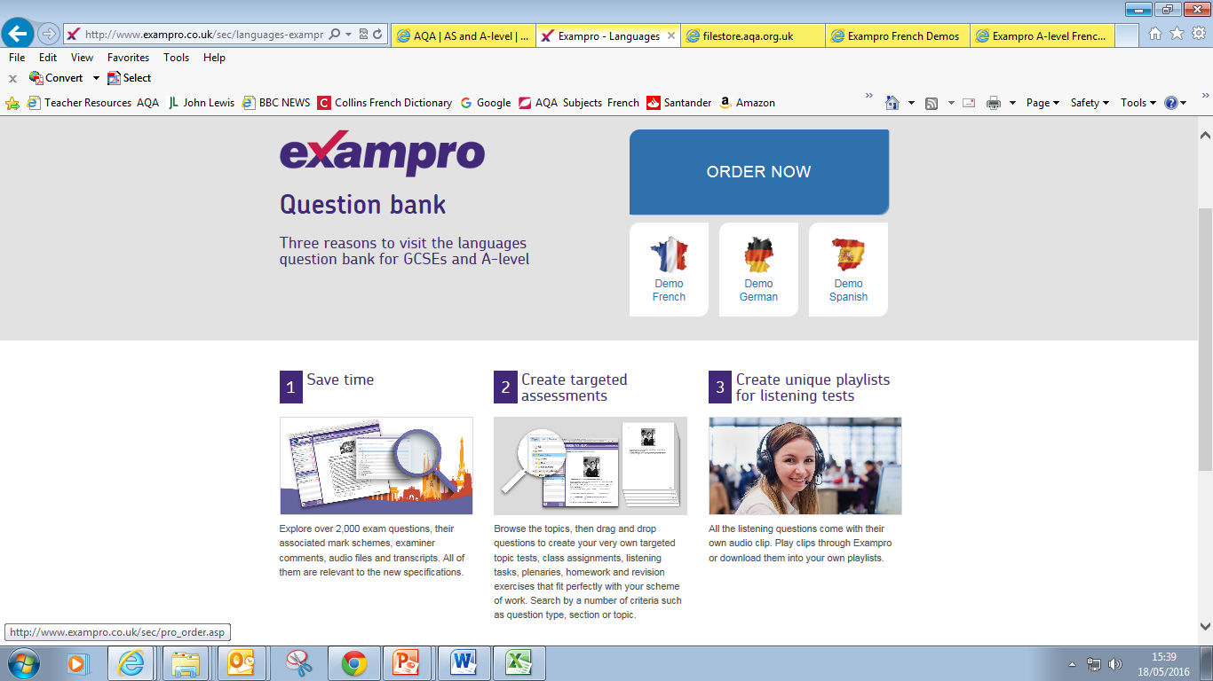
Exampro question bank
Link to Exampro

Slide 17

A range of AS/A-level events are coming up in 2016, including
Bridging the gap - stepping up to KS5
Get to grips with grammar
Success with literature

Slide 18
Teacher Support for the new specifications
Preparing to Teach event meetings – March to September 2016
Free of charge
Online or face to face options available
Language specific
How will we assess the new specification?
How do we expect students to respond to the new exams?
How can you best prepare to teach the new specifications?
How are AQA, our partner organisations and publishers planning to support you?
Preparing to Teach meetings are now available to book via our website:
AS/A-level French
AS/A-level German
AS/A-level Spanish
Preparing to Teach materials also available on e-AQA

Slide 19

Help and support
We’re here to support you throughout the exam changes and beyond.
Sign up for our email updates to get information about the changes, details of free Preparing to teach meetings and available support materials
aqa.org.uk/languagesupdates
Visit aqa.org.uk/digital/as-and-a-level-languages
Email mfl@aqa.org.uk
Call 01423 534381
We speak your language.
38 of 38 V1 April 2016

Slide 20
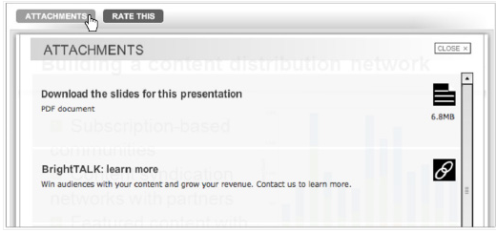

Download webinar attachments now
If you would like to download a copy
of today’s presentation, click on the
attachments tab above the screen.
You can also find webpage links to the specimen assessment materials
and our latest list of frequently asked questions here.

