Slide 1
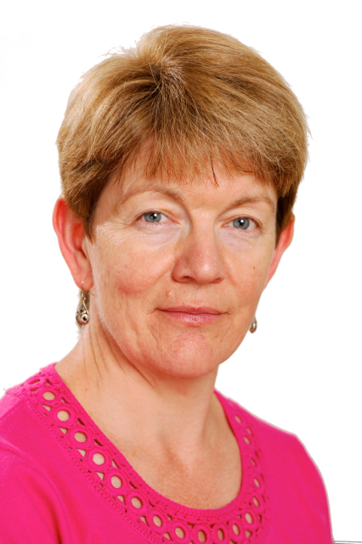
AS and A-level languages the accredited specification

Slide 2
Specification at a glance: AS
AS Paper 1
Written exam: 1 hour 45 minutes
Listening, Reading, Translation into English
90 marks
45% of AS
AS Paper 2
Written exam: 1 hour 30 minutes
Translation into target language, Essay on set text or film
50 marks
25% of AS
AS Paper 3
Oral exam: 12-14 minutes (plus 15 minutes preparation time)
Discussion of two sub-themes, based on stimulus cards
60 marks
30% of AS
2 of 38 V1 April 2016

Slide 3
Specification at a glance: A-level
A-level Paper 1
Written exam: 2 hours 30 minutes
Listening, Reading, Translation into English, Translation into target language
100 marks
50% of A-level
A-level Paper 2
Written exam: 2 hours
2 essays on set texts/films
80 marks
20% of A-level
A-level Paper 3
Oral exam 21-23 minutes (including 5 minutes preparation time)
Discussion of a sub-theme based on a stimulus card
Presentation and discussion of individual research project
60 marks
30% of A-level
3 of 38 V1 April 2016

Slide 4
AS and A-level French themes and sub-themes
Aspects of French-speaking society: current trends (AS and A-level)
The changing nature of family
The 'cyber-society'
The place of voluntary work
Artistic culture in the French-speaking world (AS and A-level)
A culture proud of its heritage
Contemporary francophone music
Cinema: the 7th art form
Aspects of French-speaking society: current issues (A-level only)
Positive features of a diverse society
Life for the marginalised
How criminals are treated
Aspects of political life in the French-speaking world (A-level only)
Teenagers, the right to vote and political commitment
Demonstrations, strikes – who holds the power?
Politics and immigration
4 of 38 V1 April 2016

Slide 5
AS and A-level French themes and sub-themes
Aspects of French-speaking society: current trends (AS and A-level)
La famille en voie de changement
Grands-parents, parents et enfants – soucis et problèmes
Monoparentalité, homoparentalité, familles recomposées
La vie de couple – nouvelles tendances
La « cyber-société »
Qui sont les cybernautes?
Comment la technologie facilite la vie quotidienne ?
Quels dangers la « cyber-société » pose-t-elle ?
Le rôle du bénévolat
Qui sont et que font les bénévolés?
Le bénévolat – quelle valeur pour ceux qui sont aidés ?
Le bénévolat – quelle valeur pour ceux qui aident ?
5 of 38 V1 April 2016

Slide 6
AS and A-level French themes and sub-themes
Artistic culture in the French-speaking world (AS and A-level)
Une culture fière de son patrimoine culturel
Le patrimoine sur le plan national, régional at local
Comment le patrimoine reflète la culture
Le patrimoine et le tourisme
La musique francophone contemporaine
La diversité de la musique francophone contemporaine
Qui écoute et apprécie cette musique ?
Comment sauvegarder cette musique ?
Cinéma – le septième art
Pourquoi le septième art?
Le cinéma – une passion nationale ?
Evolution du cinéma – les grandes lignes
6 of 38 V1 April 2016

Slide 7
A-level French themes and sub-themes
Aspects of French-speaking society – current issues (A-level only)
Les aspects positifs d’une société diverse
L’enrichissement dû à la mixité ethnique
Diversité, tolérance et respect
Diversité – une apprentissage pour la vie
Quelle vie pour les marginalisés ?
Qui sont les marginalisés ?
Quelle aide pour les marginalisés ?
Quelles attitudes envers les marginalisés ?
Comment on traite les criminels
Quelle attitude envers la criminalité ?
La prison – échec ou succès ?
D’autres sanctions
7 of 38 V1 April 2016

Slide 8
A-level French themes and sub-themes
Aspects of political life in the French-speaking world (A-level only)
Les ados, le droit de vote et l’engagement politique
Pour ou contre le droit de vote ?
Les ados et l'engagement politique – motivés ou démotivés ?
Quel avenir pour la politique ?
Manifestations, grèves – à qui le pouvoir ?
Le pouvoir des syndicats
Manifestations et grèves – sont-elles efficaces ?
Attitudes différentes envers ces tensions politiques
La politique et l'immigration
Solutions politiques à la question de l'immigration
L'immigration et les partis politiques
L'engagement politique chez les immigrés
8 of 38 V1 April 2016

Slide 9
AS and A-level German themes and sub-themes
Aspects of German-speaking society (AS and A-level)
The changing state of the family
The digital world
Youth culture: fashion and trends, music, television
Artistic culture in the German-speaking world (AS and A-level)
Festivals and traditions
Art and architecture
Cultural life in Berlin, past and present
Multiculturalism in German-speaking society (A-level only)
Immigration
Integration
Racism
Aspects of political life in the German-speaking world (A-level only)
Germany and the European Union
Politics and youth
German re-unification and its consequences
9 of 38 V1 April 2016

Slide 10
AS and A-level German themes and sub-themes
Aspects of German-speaking society (AS and A-level)
Die Familie im Wandel
_ Beziehungen innerhalb der Familie
Partnerschaft und Ehe
Verschiedene Familienformen
Die digitale Welt
Das Internet
Soziale Netzwerke
Die Digitalisierung der Gesellschaft
Jugendkultur: Mode, Musik und Fernsehen
Mode und Image
Die Bedeutung der Musik für Jugendliche
Die Rolle des Fernsehens
10 of 38 V1 April 2016

Slide 11
AS and A-level German themes and sub-themes
Artistic culture in the German-speaking world (AS and A-level)
Feste und Traditionen
Feste und Traditionen – ihre Wurzeln und Ursprünge
Feste und Traditionen – ihre soziale und wirtschaftliche Bedeutung heute
Vielfältige Feste und Traditionen in verschiedenen Regionen
Kunst und Architektur
Künstler und Architekten
Kunst und Architektur im Alltag
Kunst und Architektur – Vergangenheit, Gegenwart, Zukunft
Das Berliner Kulturleben – damals und heute
Berlin – geprägt durch seine Geschichte
Theater, Musik und Museen in Berlin
Die Vielfalt innerhalb der Bevölkerung Berlins
11 of 38 V1 April 2016

Slide 12
A-level German themes and sub-themes
Multiculturalism in German-speaking society (A-level only)
Einwanderung
Die Gründe für Migration
Vor- und Nachteile der Einwanderung
Migrationspolitik
Integration
Maßnahmen zur Integration
Hindernisse für die Integration
Die Erfahrungen verschiedener Migrantengruppen
Rassismus
Die Opfer des Rassismus
Die Ursprünge des Rassismus
Der Kampf gegen Rassismus
12 of 38 V1 April 2016

Slide 13
A-level German themes and sub-themes
Aspects of political life in the German-speaking world (A-level only)
Deutschland und die Europäische Union
Die Rolle Deutschlands in Europa
Vor- und Nachteile der EU für Deutschland
Die Auswirkungen der EU-Erweiterung auf Deutschland
Die Politik und die Jugend
Politisches Engagement Jugendlicher
Schwerpunkte der Jugendpolitik
Werte und Ideale
Die Wiedervereinigung und ihre Folgen
Friedliche Revolution in der DDR
Die Wiedervereinigung – Wunsch und Wirklichkeit
Alte und neue Bundesländer – Kultur und Identität
13 of 38 V1 April 2016

Slide 14
AS and A-level Spanish themes and sub-themes
Aspects of Hispanic society (AS and A-level)
Modern and traditional values
Cyberspace
Equal rights
Artistic culture in the Hispanic world (AS and A-level)
Modern day idols
Spanish regional identity
Cultural heritage
Multiculturalism in Hispanic society (A-level only)
Immigration
Racism
Integration
Aspects of political life in the Hispanic world (A-level only)
Today's youth, tomorrow's citizens
Monarchies and dictatorships
Popular movements
14 of 38 V1 April 2016

Slide 15
AS and A-level Spanish themes and sub-themes
Social issues and trends – aspects of Hispanic society (AS and A-level)
Los valores tradicionales y modernos
Los cambios en la familia
Actitudes hacia el matrimonio/el divorcio
La influencia de la Iglesia Católica
El ciberespacio
La influencia de Internet
Las redes sociales: beneficios y peligros
Los móviles inteligentes en nuestra sociedad
La igualdad de los sexos
La mujer en el mercado laboral
El machismo y el feminismo
Los derechos de los gays y las personas transgénero
15 of 38 V1 April 2016

Slide 16
AS and A-level Spanish themes and sub-themes
Artistic culture in the Hispanic world (AS and A-level)
La influencia de los ídolos
Cantantes y músicos
Estrellas de televisión y cine
Modelos
La identidad regional en España
Tradiciones y costumbres
La gastronomía
Las lenguas
El patrimonio cultural
Sitios turísticos y civilizaciones prehispánicas (Machu Picchu, la Alhambra)
Arte y arquitectura
El patrimonio musical y su diversidad
16 of 38 V1 April 2016

Slide 17
A-level Spanish themes and sub-themes
Multiculturalism in Hispanic society (A-level only)
La Inmigración
Los beneficios y los aspectos negativos
La inmigración en el mundo hispánico
Los indocumentados - problemas
El Racismo
Las actitudes racistas y xenófobas
Las medidas contra el racismo
La legislación anti-racista
La Convivencia
La convivencia de culturas
La educación
Las religiones
17 of 38 V1 April 2016

Slide 18
A-level Spanish themes and sub-themes
Aspects of political life in the Hispanic world (A-level only)
Jóvenes de hoy, ciudadanos de mañana
Los jóvenes y su actitud hacia la política : activismo o apatía
El paro entre los jóvenes
Su sociedad ideal
Monarquías y dictaduras
La dictadura de Franco
La evolución de la monarquía en España
Dictadores latinoamericanos
Movimientos populares
La efectividad de las manifestaciones y las huelgas
El poder de los sindicatos
Ejemplos de protestas sociales (El 15-M, las Madres de la
Plaza de Mayo)
18 of 38 V1 April 2016

Slide 19
AS/A-level Spanish – books and films
Texts
Gabriel García Márquez Crónica de una muerte anunciada
Esquivel Como agua para chocolate
Lorca La Casa de Bernarda Alba
Zafón La sombra del viento
Isabel Allende La casa de los espíritus
Sender Réquiem por un campesino español
Bécquer Rimas y leyendas
Fernando Fernán-Gómez Las bicicletas son para el verano
Luis de Castresana El otro árbol de Guernica
Gabriel García Márquez El coronel no tiene a quien le escriba
Films
Volver
El laberinto del fauno
Ocho apellidos vascos
María, llena eres de gracia
Abel
Las 13 rosas
19 of 38 V1 April 2016

Slide 20
AS Paper 1
What's assessed
Aspects of French/German-speaking/Hispanic society
Artistic culture in the French/German-speaking/Hispanic world
Grammar
How it's assessed
Written exam: 1 hour 45 minutes
90 marks
45% of AS-level
Questions
Listening and responding to spoken passages from a range of contexts and sources.
Questions in the target language to be answered with non-verbal responses or in the target language (35 marks)
Reading and responding to a variety of texts written for different purposes
Questions in the target language to be answered with non-verbal responses or in the target language (45 marks)
Translation into English; a passage of minimum 70 words (10 marks)
20 of 38 V1 April 2016

Slide 21
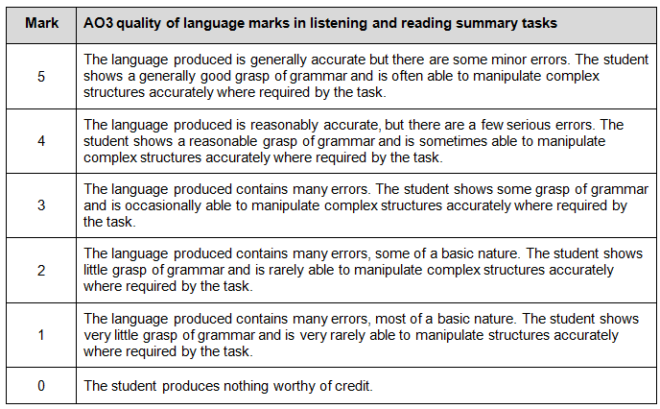
AS Paper 1 Marking Guidance
21 of 38 V1 April 2016

Slide 22
AS Paper 2
What's assessed
One book or one film from the lists in the specification
Grammar
How it's assessed
Written exam: 1 hour 30 minutes
50 marks
25% of AS level
Questions
Translation into target language; 5 sentences amounting to a minimum of 70 words (15 marks).
Either one question on a set text OR one question on a set film (35 marks)
All questions will require a critical response
No access to texts or films during the assessment
22 of 38 V1 April 2016

Slide 23
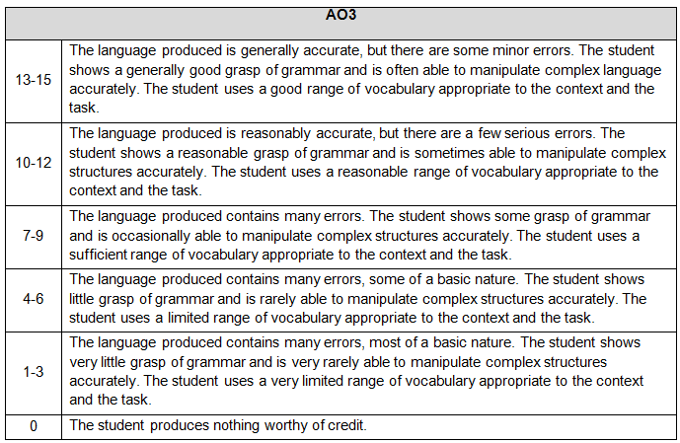
AS Paper 2 Marking Guidance
23 of 38 V1 April 2016

Slide 24
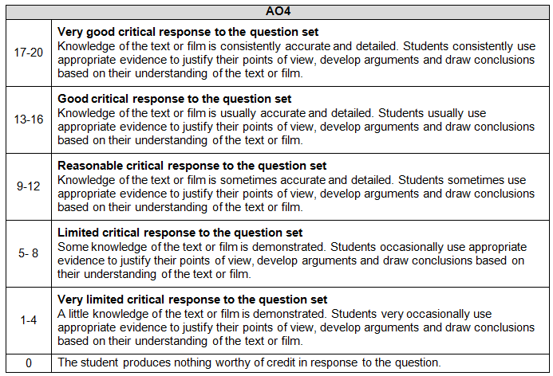
AS Paper 2 Marking Guidance (cont)
24 of 38 V1 April 2016

Slide 25
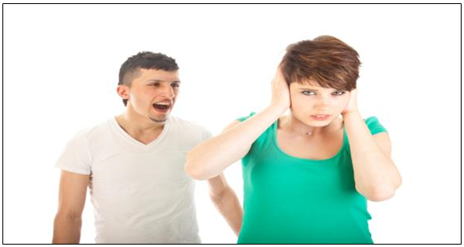
AS French Speaking
25 of 38 V1 April 2016

Slide 26
Summary of AS Speaking Assessment
26 of 38 V1 April 2016

Slide 27
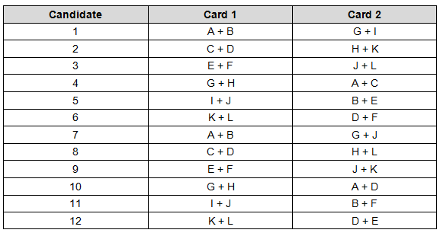
AS Sequence Table
The teacher-examiner must give the student two cards from one of the 6 AS sub-themes as shown in the sequence table below eg Card A and Card B. The teacher-examiner will also give the student two further cards, one from each of the two sub-themes from the other theme as shown in the sequence in the table below eg Card G and Card I. The student will choose one of the two cards for the first sub-theme ie either Card A or Card B and one from the other two cards ie either Card G or Card I. Schools/colleges with more than 36 students should begin the sequence again from number 1.
27 of 38 V1 April 2016

Slide 28
A-level Paper 1
What's assessed
Aspects of French-speaking society: current trends/Aspects of German-speaking society/Aspects of Hispanic society
Aspects of French-speaking society: current issues/Multiculturalism in German-speaking society/Multiculturalism in Hispanic society
Artistic culture in the French-speaking/German-speaking/Hispanic world
Aspects of political life in the French-speaking/German-speaking/Hispanic world
Grammar
How it's assessed
Written exam: 2.5 hours
100 marks in total
50% of A-level
Questions
Listening and responding to spoken passages from a range of contexts and sources
Questions in the target language to be answered with non-verbal responses or in the target language (30 marks)
Reading and responding to a variety of texts written for different purposes
Questions in the target language to be answered with non-verbal responses or in the target language (50 marks)
Translation into English; a passage of minimum 100 words (10 marks)
Translation into the target language; a passage of minimum 100 words (10 marks).
28 of 38 V1 April 2016

Slide 29
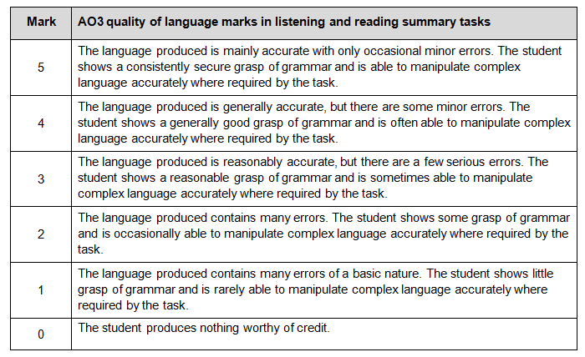
A-level Paper 1 Marking Guidance
29 of 38 V1 April 2016

Slide 30
A-level Paper 2
What's assessed
One book and one film or two books from the list set in the specification
Grammar
How it's assessed
Written exam: 2 hours
80 marks in total
20% of A-level
Questions
Either one question on a set text and one question on a set film OR two questions on set texts
All questions will require a critical appreciation
No access to texts or films during the assessment
30 of 38 V1 April 2016

Slide 31
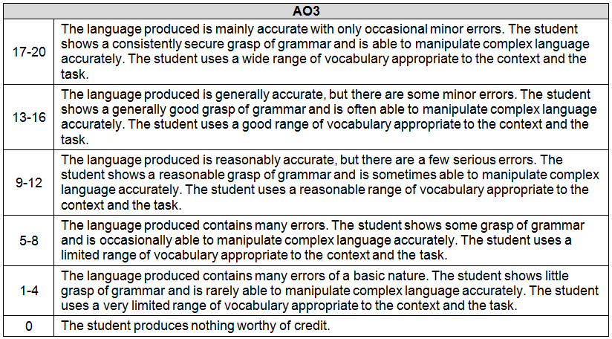
A-level Paper 2 Marking Guidance
31 of 38 V1 April 2016

Slide 32
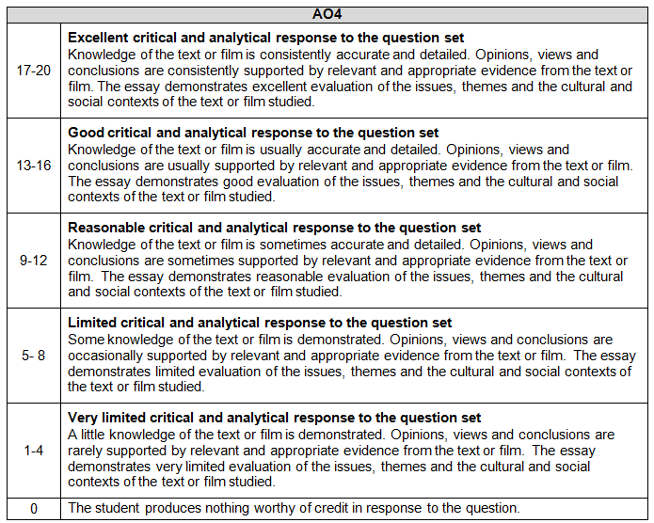
A-level Paper 2 Marking Guidance (cont)
32 of 38 V1 April 2016

Slide 33
A-level Paper 3: Speaking
What's assessed
Individual research project
One of 12 sub-themes
How it's assessed
Oral exam: 21-23 minutes (including 5 minutes preparation time)
60 marks in total
30% of A-level
Questions
Discussion of a sub-theme with the discussion based on a stimulus card. The student studies the card for 5 minutes at the start of the test (25 marks)
Presentation and discussion of individual research project (35 marks)
Students may take the assessment only once before certification
33 of 38 V1 April 2016

Slide 34
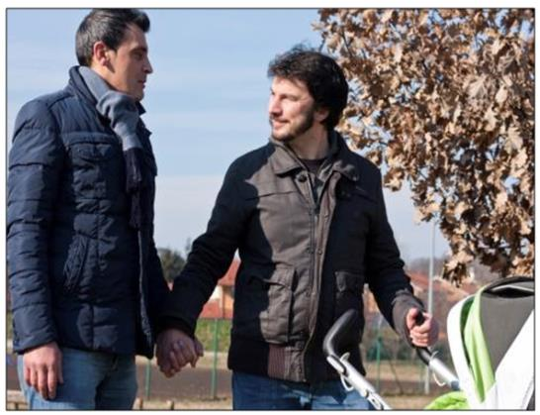
A-level French Speaking
34 of 38 V1 April 2016

Slide 35
A-level Speaking Assessment
36 of 38 V1 April 2016

Slide 36
Resources
Specimen materials - accredited set of materials on website; a further set will be released to schools on the secure AQA website only. Listening materials will be available as soon as possible.
Schemes of work - available now on the website.
Guidance for teaching literature and film - available now on the website.
Guide to Individual Research Project.
Endorsed publisher resources.
Resources on films and set texts.
Translation practice.
Marked student work with commentaries.
Grammar practice.
Teacher support and CPD courses.
37 of 38 V1 April 2016

Slide 37
Help and support
We’re here to support you throughout the exam changes and beyond.
Sign up for our email updates to get information about the changes, details of free Prepare to teach meetings and available support materials
aqa.org.uk/languagesupdates
Visit aqa.org.uk/digital/as-and-a-level-languages Email mfl@aqa.org.uk
Call 01423 534381
We speak your language.
38 of 38 V1 April 2016

Slide 38
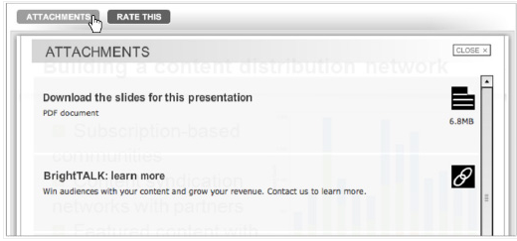
Download webinar attachments now
If you would like to download a copy
of today’s presentation, click on the
attachments tab above the screen.
You can also find webpage links to the specimen assessment materials and free Preparing to Teach meetings.

