Slide 1





GCSE languages
Our resource package explained

Slide 2
Objectives for this presentation
To give you an overview and explanation of the GCSE French, German and Spanish resources currently available
To give you further information about the specific resources available when you teach our specifications
To update you on new resources which will be coming soon.

Slide 3
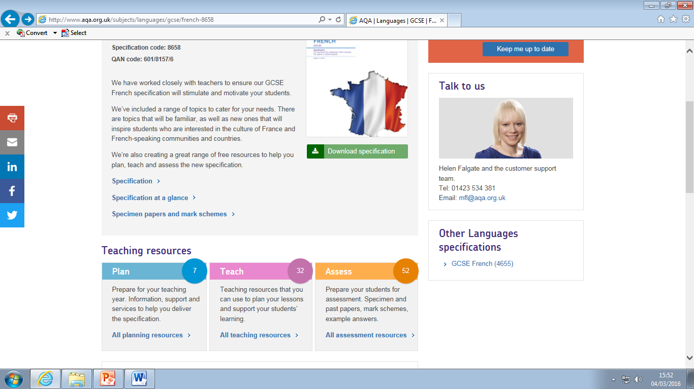
Where to find resources

Slide 4

What resources are available now?
Plan
  Summary of changes
  How to switch to AQA
  Webinars
  Your questions answered
Teach
  2-year and 3-year Schemes of work
  Lesson plans
  Grammar resources
  Reading aloud passages
Assess
  A full set of specimen papers (sound files to follow in April)

Slide 5
Schemes of work
2-year and 3-year approaches
Available on the ‘Teach’ pages
Editable
Built-in opportunities for revision and recap
Sequencing of grammar builds on prior learning

Slide 6
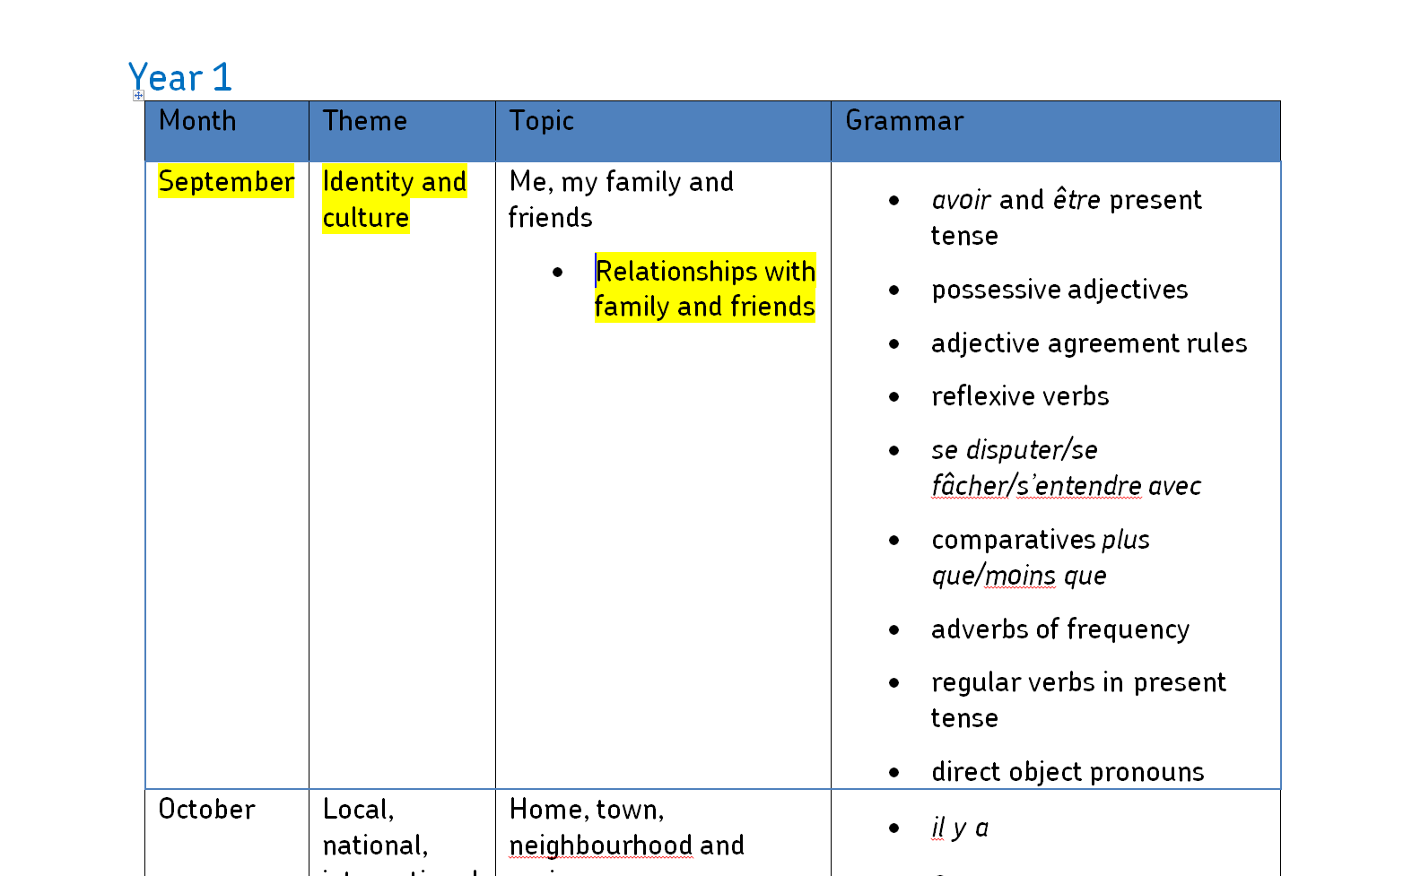
2-year Scheme of work – coverage of themes (1)

Slide 7
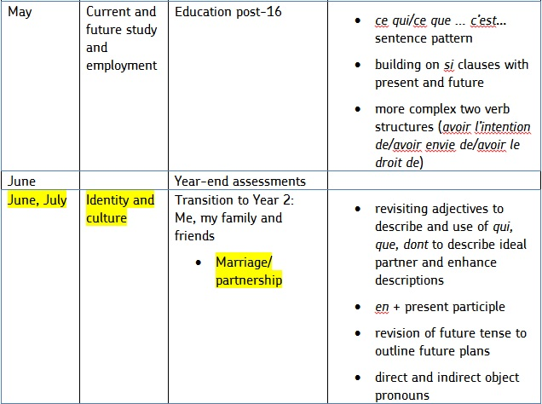
2-year Scheme of work – coverage of themes (2)

Slide 8
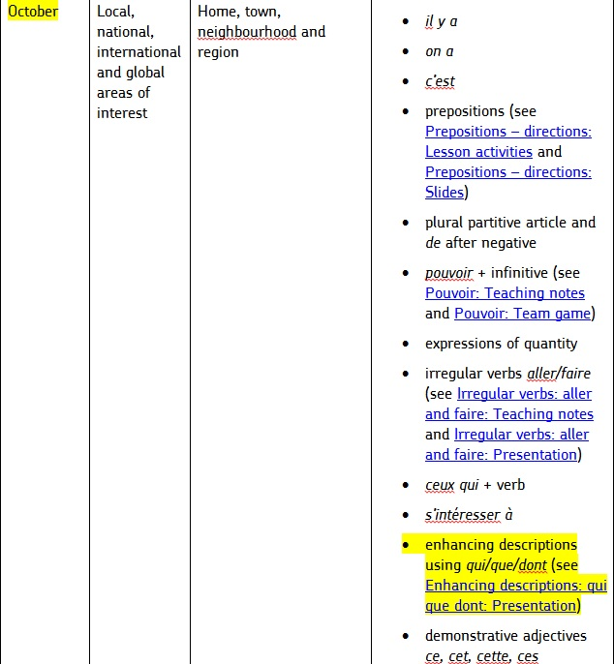
2-year Scheme of work – grammar coverage (1)

Slide 9
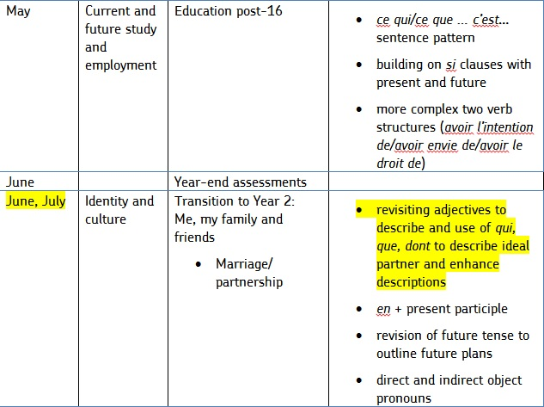
2-year Scheme of work – grammar coverage (2)

Slide 10
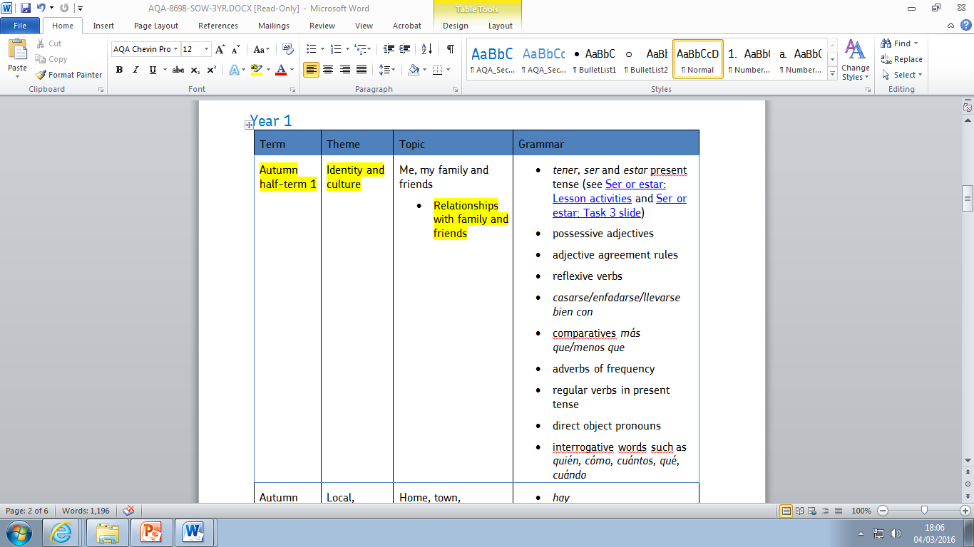
3-year Scheme of work

Slide 11
Grammar resources
Developed in conjunction with Teachit Languages
Mapped to the schemes of work
Cover a range of topics
A variety of resources including:
  PowerPoint slides
  Worksheets
  Games
  Lesson activities
  Teaching notes

Slide 12
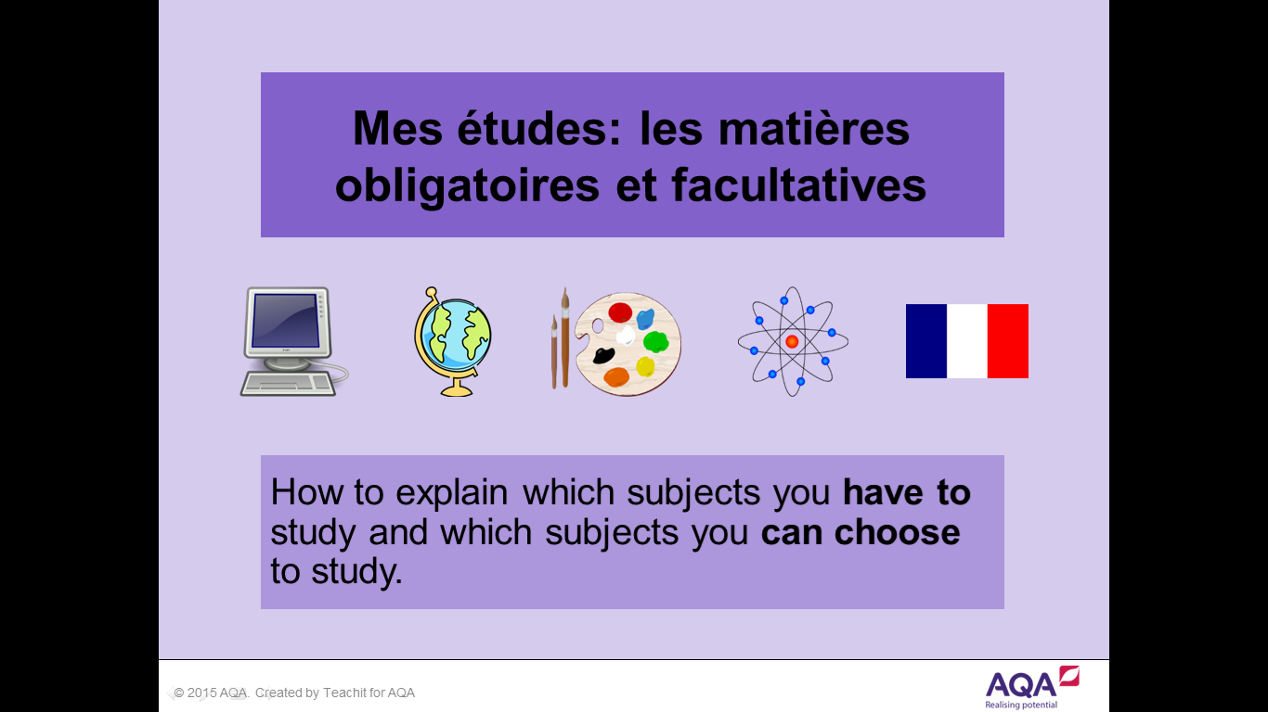
Grammar resources – French

Slide 13
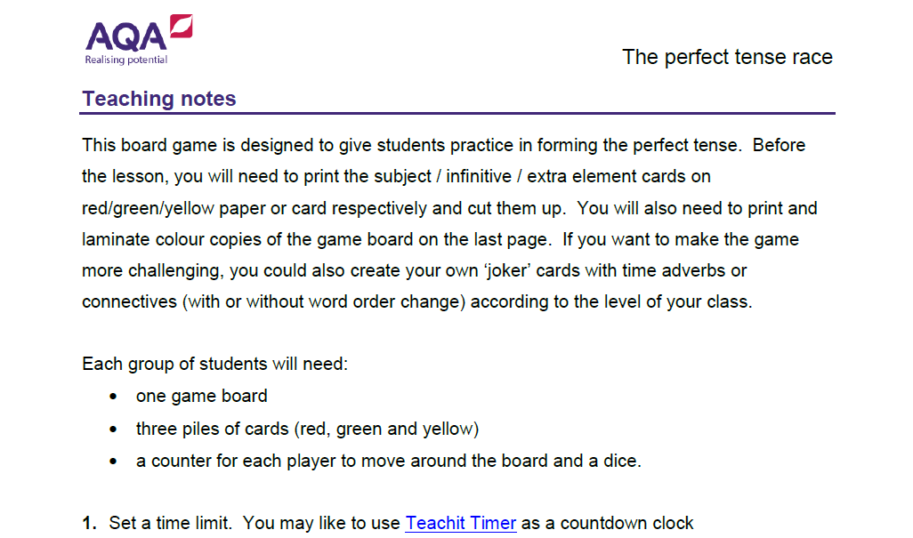
Grammar resources – German

Slide 14


Slide 15
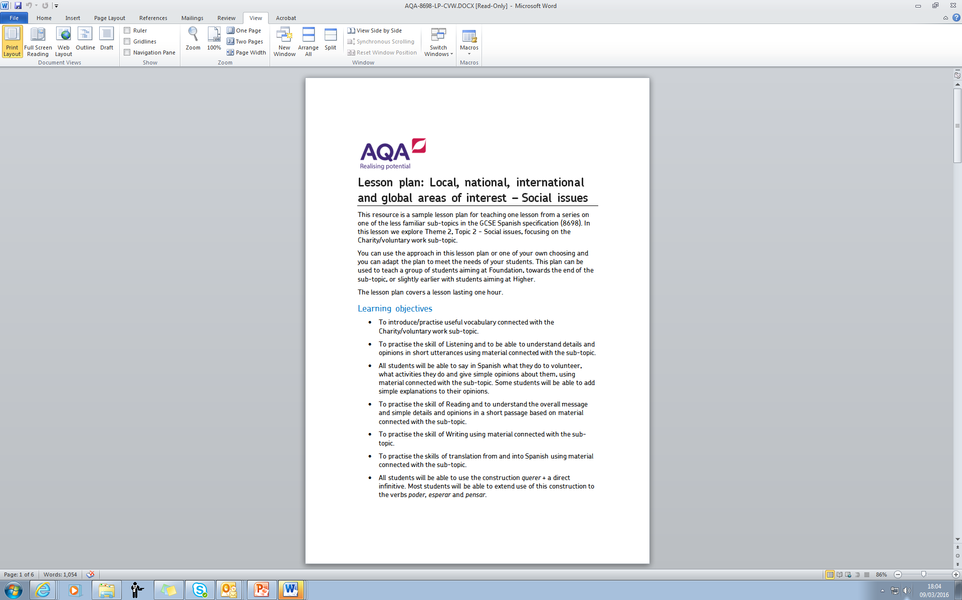
Lesson plans (1)

Slide 16
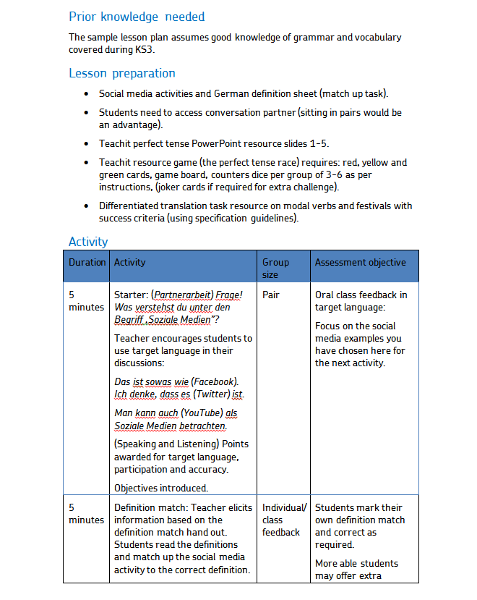
Lesson plans (2)

Slide 17
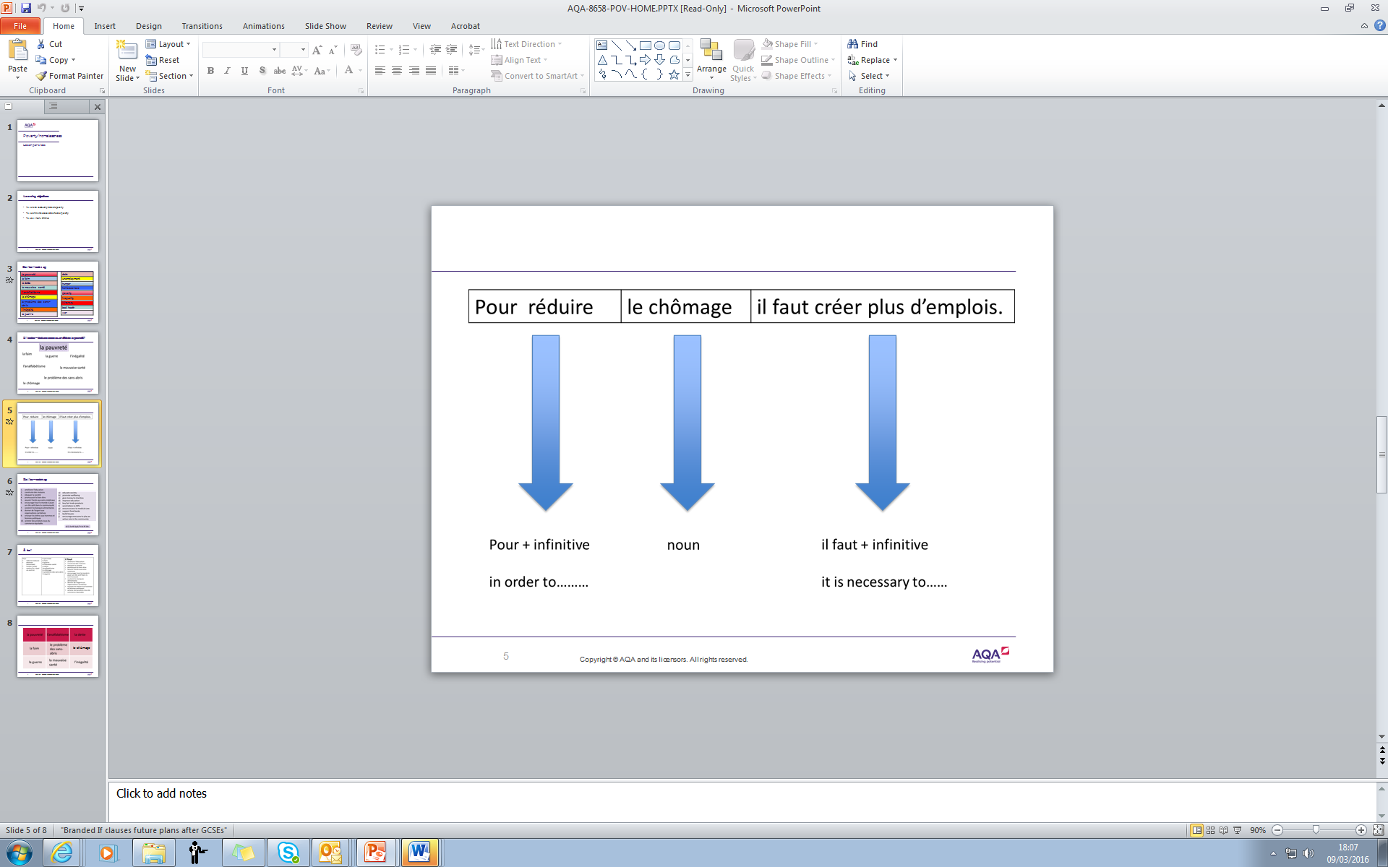
Lesson plans (3)

Slide 18
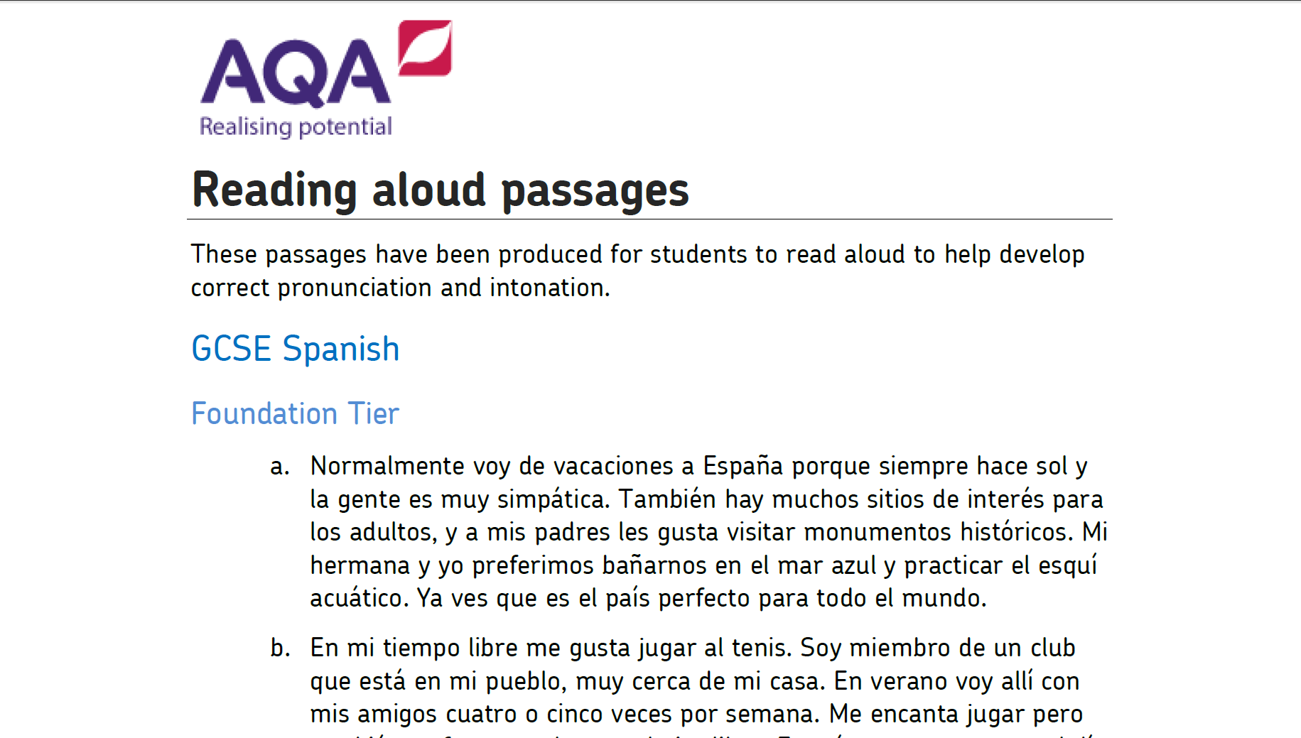
Developing pronunciation and intonation

Slide 19
What resources are coming soon?
Additional specimen papers and mark schemes (spring 2016)
Additional exemplar marked work (autumn 2016) for:
  Speaking and Writing
  Translations
  Literary texts
  Questions in the target language for Listening and Reading
Exemplar responses for role-play tasks (summer 2016)
Approved textbooks for Foundation and Higher (spring/early summer 2016)
AQA Tracker (late April 2016)
Exampro Question Bank (mid March 2016)
Exampro On-screen Assessment (late April 2016*)
*Grammar test element to follow in September 2016

Slide 20



Teach the new specification with ease
Student Books and Kerboodle Books for this course have been entered into an approval process with AQA
Smooth transition from KS3, with topic coverage to ensure seamless progression towards AS and A Level
Provides assessment and practice questions to help students prepare for the increased demands of the new linear course
Language and grammar firmly integrated throughout with clear progression
Exposure to authentic texts and literary extracts
Differentiated approach which includes one shared spread on each topic at the core level and one at a higher or lower level to facilitate co-teaching and flexibility
Plenty of spontaneous speaking and translation practice

Slide 21
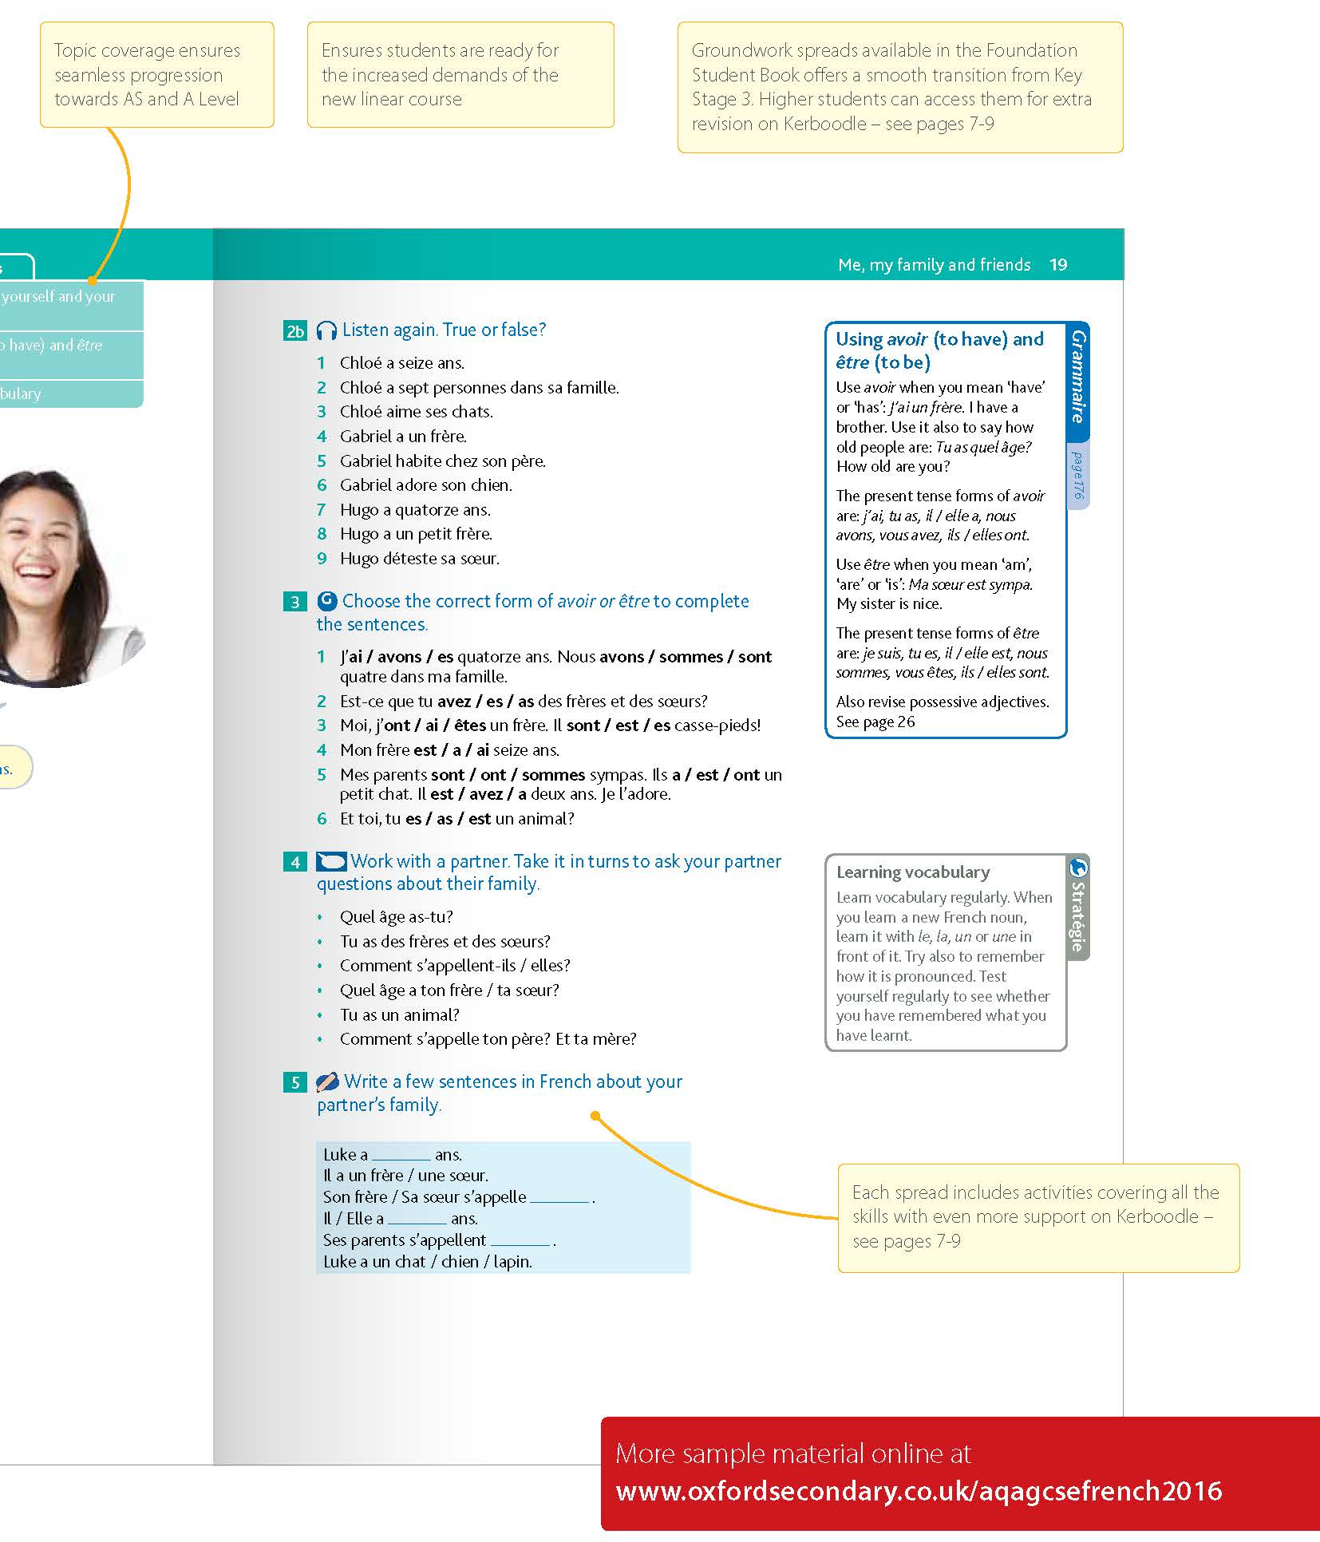
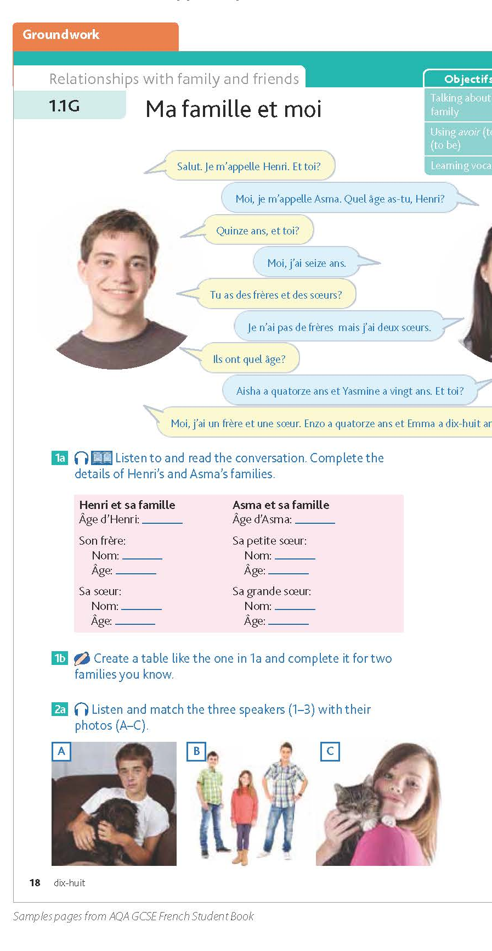
An accessible, differentiated approach

Slide 22
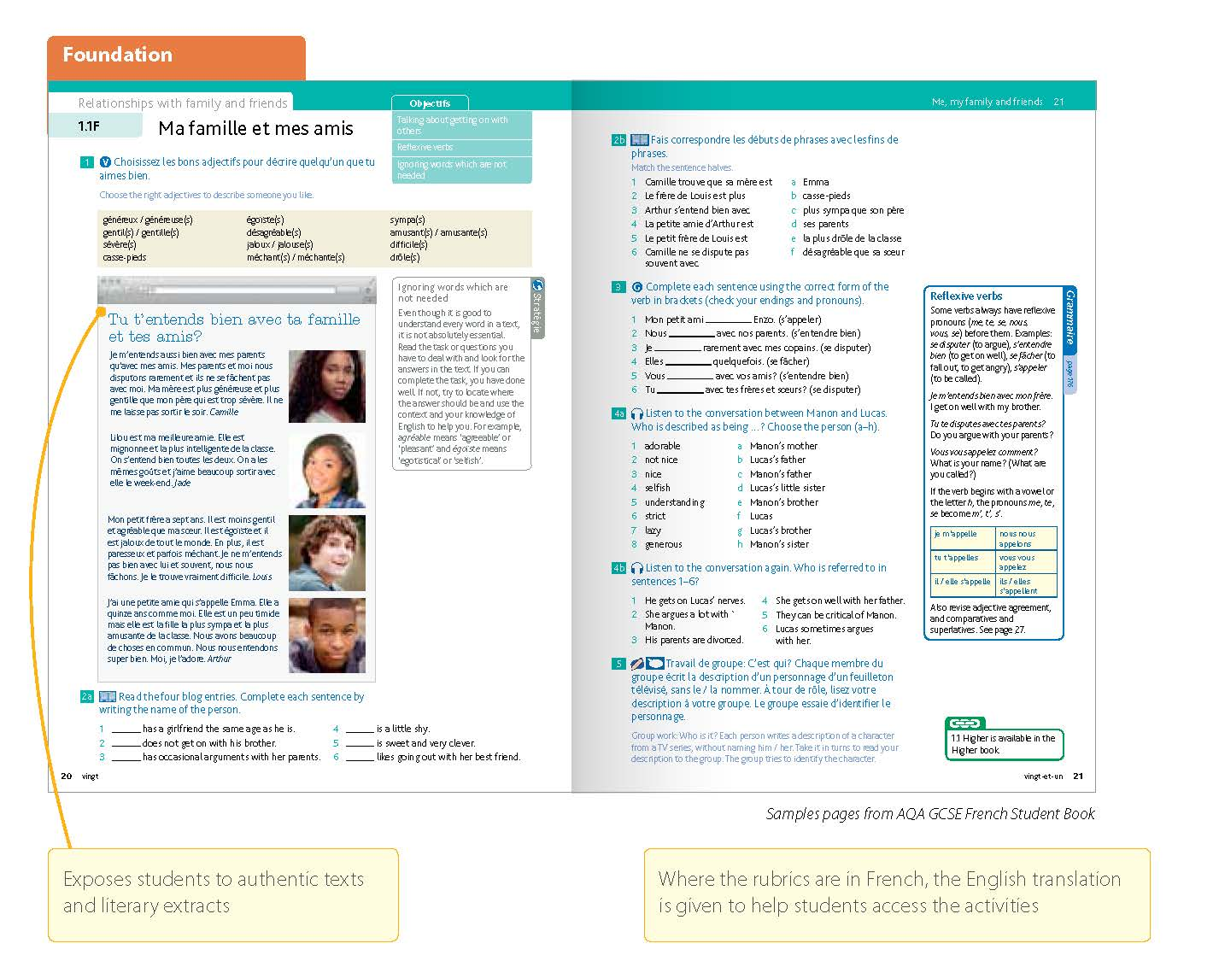
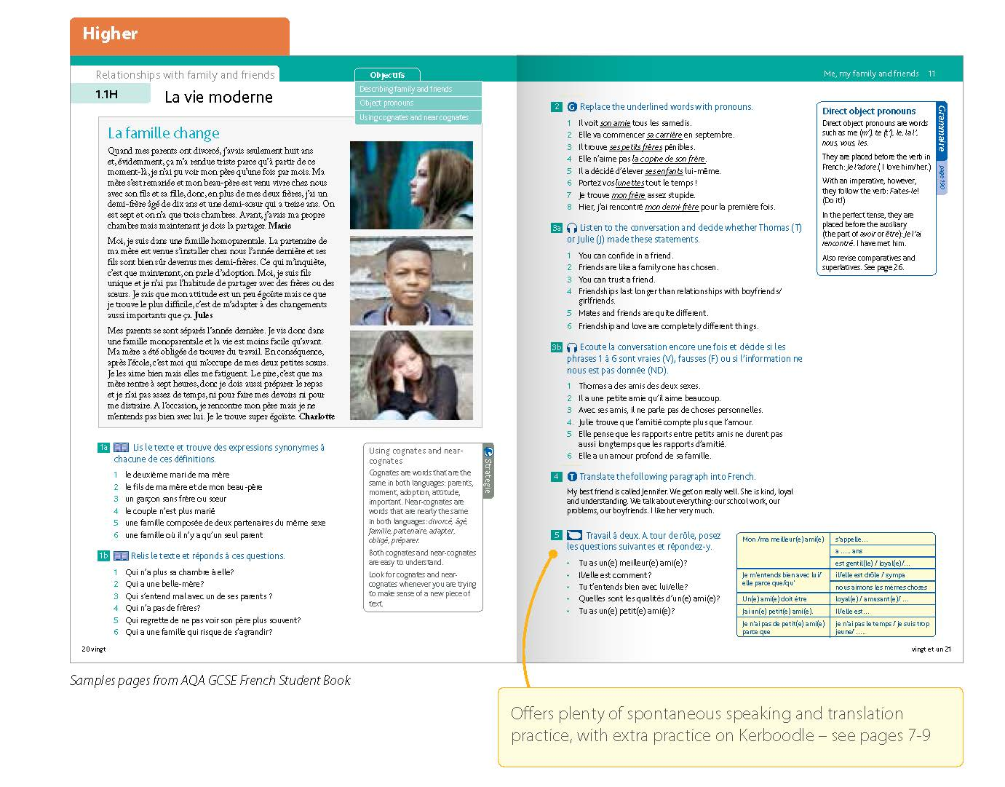
Foundation and Higher Levels

Slide 23

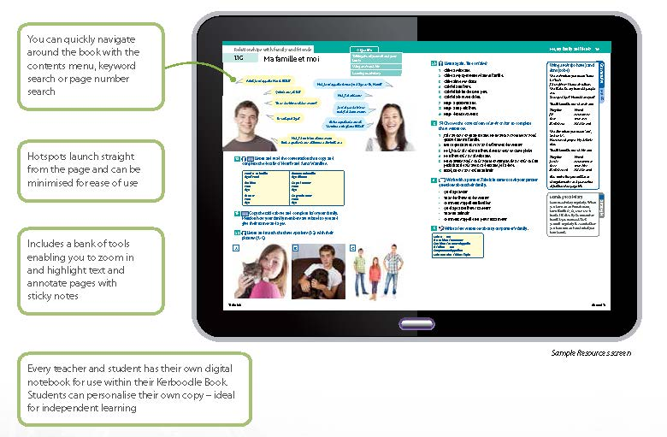
Kerboodle Book

Slide 24




Support for AQA GCSE

Slide 25
Exampro - main menu
Access to the products is from the same screen

Slide 26
Question Bank
Exampro contains over 2,000 questions, mark schemes, examiner comments, audio files, exemplars and transcripts

Slide 27
On-screen Assessment
Teachers have access to the themes, Grammar (coming soon) and scope of study
The scope of study takes you directly to the AQA tracker
Click on a theme to unlock it

Slide 28
Themes
Click on the green padlock icon to unlock the theme for students
This can be done for the entire theme or by test level under ‘Available assessments’
Teacher can quickly see analysis by group, the assessments that have been taken and the vocabulary that students got correct or incorrect
Click the ‘analysis’ button to look at individual student performance

Slide 29
Student performance
Analysis of individual performance includes how long the test took and how many attempts the student had

Slide 30
Taking a test (1)
Students can take new tests, or retake previous tests, by clicking on the ‘start’ button
They can also see how they’ve performed on individual topics

Slide 31
Taking a test (2)
The look and feel is very similar to the current Online Progress Tests
At the end of the test the data is fed through to the teacher and student screens we’ve just looked at

Slide 32
The AQA Tracker
FREE if you are teaching AQA’s new specifications
A dashboard gives you a quick update on progress across the subject
This can be customised to display all subjects
You can also filter by class or subject

Slide 33
The AQA Tracker – Tracking (1)
You can sort by using the drop downs and filter button
To change the status for an individual student click on the relevant box alongside the scope
P = plan to teach, T = taught, Orange = working towards, Green = achieved and Green Star = mastered

Slide 34
The AQA Tracker – Tracking (2)
To add exemplars or evidence for a student, click on the ‘Exemplars’ icon shown on the right
There is a ‘Notes’ section where you can add any additional information

Slide 35
The AQA Tracker – Progress
The progress screen shows how an individual student is progressing
Use the drop down options to easily find what you are looking for
You can manage how a student’s report is populated by highlighting commendations and targets
You can also add your own comments which will then appear on the student’s report

Slide 36
The AQA Tracker – Planning
See topics that have been covered by a class so you can easily identify where to focus your teaching
100% = the class are at least working towards this, P = plan to teach and T = taught
These can be changed here by the teacher

Slide 37
The AQA Tracker – Reporting
Access individual student reports or reports by group
Identify students with English as an additional language, Special educational needs or Free school meals

Slide 38
Reports
Reports are provided over two pages:
  the raw score across the scope
  a breakdown of tracker information

Slide 39

Further GCSE events coming up in 2016:
NEW: GCSE/Key Stage 3 French, German and Spanish: approaches for new GCSE success
NEW: GCSE/Key Stage 3 French, German and Spanish: success with grammar and translation
GCSE/Key Stage 3 French, German and Spanish: becoming an outstanding practitioner
Bridging the gap – stepping up to Key Stage 5

Slide 40
Teacher Support for the new specifications
Preparing to Teach event meetings – March to September 2016
Free of charge
Online or face to face options available
Language specific
How will we assess the new specification?
How do we expect students to respond to the new exams?
How can you best prepare to teach the new specifications?
How are AQA, our partner organisations and publishers planning to support you?
Prepare to Teach meetings are now available to book via our website:
for GCSE French visit: aqa.org.uk/GCSEFrenchPTT
for GCSE German visit: aqa.org.uk/GCSEGermanPTT
for GCSE Spanish visit: aqa.org.uk/GCSESpanishPTT

Slide 41

Help and support
We’re here in the Languages team to support you throughout the specification changes and beyond.
If you have any questions around our free ‘Preparing to Teach’ meetings, or extensive package of support and resources contact our dedicated team.
Visit: aqa.org.uk/subjects/languages/gcse
Email: mfl@aqa.org.uk
Call: 01423 534381
We speak your language.

Slide 42
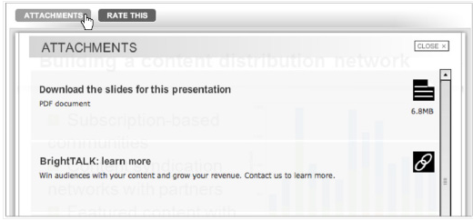
Download webinar attachments now
If you would like to download a copy
of today’s presentation, click on the
attachments tab above the screen.
You can also find an information leaflet about our resources package, a student guide to languages, and webpage links to the free Preparing to Teach meetings.
Other useful links:
aqa.org.uk/languagesupdates
exampro.co.uk/languages
oxfordsecondary.co.uk/mfl

