Slide 1
Why offer Level 2 Further Mathematics?
Ian Andrews
Copyright © 2023 AQA and its licensors. All rights reserved.

Slide 2
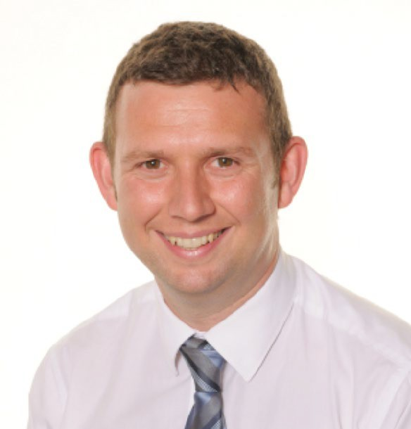
AQA Level 2 Further Maths – A fantastic additional qualification for your highest attaining students
I’ve been teaching the AQA Level 2 Further Mathematics course for over 10 years. It’s an excellent, flexible, easy to offer additional qualification for your higher attaining students.
Many of my higher attaining students found the normal maths GCSE quite straightforward. I wanted to offer these students something additional to ensure they kept interested and engaged with mathematics.
The Level 2 Further Mathematics course sits alongside the maths GCSE in a very complementary way. Most of the content is an extension of GCSE topics so it’s very easy to teach alongside, or separately depending on your situation.
In my experience, students really enjoy the additional challenge the course provides. I feel it solidifies or improves their maths GCSE grade and it’s also a great stepping stone to A-level maths.
Level 2 Further Maths is growing and in 2023, over 33,000 students took the exam. I hope this pack helps you to offer it to your students too.
Ian Andrews
Full time maths teacher and Chair of Examiners for Level 2 Further Maths
Copyright © 2023 AQA and its licensors. All rights reserved.

Slide 3
Benefits of
AQA Level 2 Further Maths

Slide 4
Why did we develop this qualification?
To motivate and challenge students who are likely to achieve grades 7, 8 and 9 at GCSE by:
encouraging greater depth, breadth and rigour
including algebra and geometry that are crucial to further study
introducing calculus and matrices
encouraging a problem solving approach
Copyright © 2023 AQA and its licensors. All rights reserved.

Slide 5
Benefits
Improves progress in GCSE maths – Level 2 Further Maths extends GCSE knowledge, especially with algebra and geometry.
Additional level 2 qualification for students.
Improved challenge and engagement for students.
Excellent preparation for A-level study.
Flexibility with little timetable impact – can be taught within normal lessons, requiring no additional staff or time, or separately in a timetabled slot or after school.
Great staff CPD – a chance to upskill staff on a new qualification and potential A-level teaching.
Complements the maths GCSE qualification no matter which exam board you’re with.
Copyright © 2023 AQA and its licensors. All rights reserved.

Slide 6
Testimonials

Slide 7
Recommended by teachers and experts
The benefits of the AQA L2 Further Maths Certificate cannot be underestimated. Every pupil I speak to that goes on to do A-level Maths tells me how helpful studying the Further Maths Certificate was in supporting their early studies for A- level. Every teacher I talk to in my team tells me how the Further Maths pupils seem more confident with the GCSE Maths content and how it is supporting those pupils to reach their full potential at GCSE.
Peter Mattock, Assistant Principal, Brockington College
There is no better course to stretch the highest attaining Year 10 and 11 students which does so in such an accessible way. Students always enjoy the course - especially learning about new topics such as matrices and differentiation - and it supports and extends their regular GCSE learning. It is also incredibly useful as a recruitment tool for A- Level maths, retaining the interest of students who possibly wouldn't have considered it before. I can't recommend the course highly enough!
Dr Tom Bennison, Head of Sixth Form, Kirk Hallam Community Academy
I love the way that AQA’s Level 2 Certificate in Further Maths goes beyond the GCSE curriculum to challenge and engage the highest attaining students. It deepens students’ understanding of algebra, geometry and number and extends their knowledge to new topics including calculus and matrices.
It’s a real pleasure to teach the course and see how much students enjoy it. It boosts students’ GCSE attainment, prepares them for A- level, and gives them the opportunity to reach their full potential. I hugely recommend this excellent course.
Jo Morgan, Director of Mathematics, Harris Academy Sutton
Having taught further maths to my class throughout Years 10 and 11, students have been highly engaged and intrigued about learning new content, and for most, this has cemented their desire to study maths at A-level.
Ofsted visited our school in March 2023 and were highly impressed with our “ambitious curriculum”; they commented that students “confidently discuss what they have learned and apply prior learning to new situations”.
We teach further maths to students in sets 1 and 2 and we find the AQA further maths worksheets and past papers prepare our students very well for the demands of the exam.
Alex Lacey, Teacher of Maths at St. Bede’s School, Redhill
Copyright 2023 © AQA and its licensors. All rights reserved.

Slide 8
What did teachers think of Level 2 Further Maths this summer?
Copyright 2023 © AQA and its licensors. All rights reserved.

Slide 9
Exam and content

Slide 10
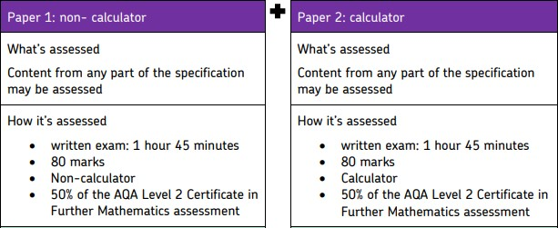
2 exam papers, no course work
Copyright © 2023 AQA and its licensors. All rights reserved.

Slide 11
Content
The specification content is set out in six distinct topic areas, although questions will be asked that range across
these topics:
Number
Algebra
Geometry
Coordinate geometry
Calculus (additional to GCSE content)
Matrix transformations (additional to GCSE content).
Copyright © 2023 AQA and its licensors. All rights reserved.

Slide 12
Resources

Slide 13
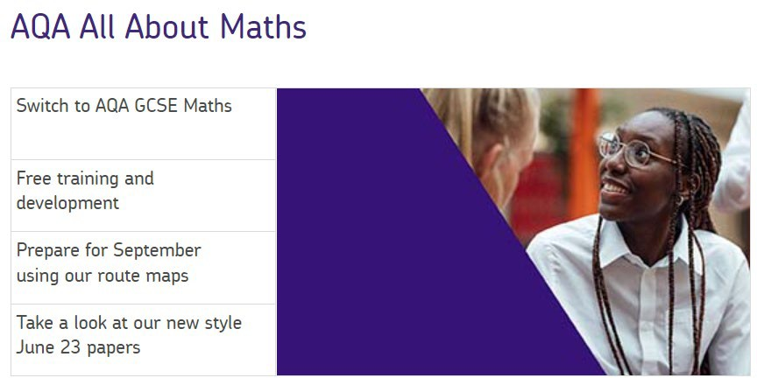
Expert resources available from AQA
Our website and All About Maths has a variety of useful resources.
Route maps – two route maps outline teaching further maths in one year or alongside the GCSE in two years.
Specification and Teaching guidance document – this is useful for checking topic specifics.
Level 2 Further Maths worksheets – a worksheet for virtually every topic. Great for using alongside teaching, extension questions, plus revision.
Past papers, practice papers, specimen papers and mark schemes – Both for this specification and the previous one. Ten years of past papers
Mock analysers from 2022 – useful tool for analysis of performance on question papers, also contains correct solutions and examiner comments so could be shared with students
Exampro – A database of Level 2 further maths questions is now available. It’s easy to filter questions and topics.
Copyright © 2023 AQA and its licensors. All rights reserved.

Slide 14
How topics fit with GCSE Maths

Slide 15
GCSE Maths and Level 2 Further Maths content
The following slides are for teachers and heads of department interested in teaching Level 2 Further Maths.
Each slide shows a top-level overview of GCSE Maths and where the Level 2 Further Maths content can fit.
The highlighted sections are where the content goes slightly beyond the GCSE content. The final topics of calculus and matrices are often taught late in year 11.
Copyright © 2023 AQA and its licensors. All rights reserved.

Slide 16
GCSE Maths and Level 2 Further Maths content
GCSE Maths topic | Additional Further Maths content
Expanding double/triple brackets | Expand using Pascal’s triangle
Solving/ factorising quadratics | Factor theorem
Indices | More complicated indices and solving
Surds | More challenging rationalising the denominator
3D Pythagoras and trig | Find the angle between line and a plane or 2 planes
Ratio | Harder problems involving ratio
Coordinate Geometry | Harder questions. Good to use y – y₁ = m(x – x₁) from A-level
Circle theorems | Harder proof questions
Completing the square | Include coefficients of x² greater than 1
Simultaneous equations | Solve equations with 3 unknowns
Inequalities | Harder inequality questions
Growth and decay | Include y = ab^{x} and y = ab^{–x}
Sequences | Harder sequence questions
Copyright © 2023 AQA and its licensors. All rights reserved.

Slide 17
GCSE maths and Level 2 Further Maths content
GCSE Maths topic | Additional Further Maths content
Equation of a circle | Include where centre is not (0, 0)
Proof and Functions | Understanding domain and range and harder functions
Trigonometry | Using trig identities such as tan𝜃𝜃 ≡ ^{sin𝜃𝜃} and cos𝜃𝜃 sin²𝜃𝜃 + cos²𝜃𝜃 ≡ 1 and solving trigonometric equations
Algebraic fractions | Simplifying and manipulating harder algebraic fractions
Rates of change – Gradients and areas under curves | Differentiation of polynomials and finding turning points and second derivatives
Vectors | 2 × 2 Matrices and transformations
Copyright © 2023 AQA and its licensors. All rights reserved.

Slide 18
Thank you

Slide 19
Get in touch
Our friendly team will be happy to support you between 8am and 5pm, Monday to Friday.
Tel: 0161 957 3852
Email: maths@aqa.org.uk Twitter: @AQA
aqa.org.uk
Copyright © 2023 AQA and its licensors. All rights reserved.

