Slide 1
AS and A-level Physical Education For first teaching in 2016
Nesta James and Rob James
Autumn 2015
Follow us on Twitter @AQACPD.

Slide 2
Programme of the day
Overview of the new AS and A-level specifications
Underlying principles and key features
Specification at a glance
Summary of content and assessment objectives
A-level Papers 1 and 2
Core content
The question papers and question types
AS Paper assessment
Core content
The question paper and question types
AS and A-level Non-exam assessment
Criteria and assessment
Support and resources
Slide 2
Copyright © AQA and its licensors. All rights reserved.
Follow us on Twitter @AQACPD.

Slide 3
Objectives
Understand the key elements of the specification structure, teaching content and assessment
Think about the implications for teaching and learning
Review the resources and support available
To give you the chance to ask questions about the specification
Slide 3
Copyright © AQA and its licensors. All rights reserved.
Follow us on Twitter @AQACPD.

Slide 4
Context
Developed by an experienced team of teachers and examiners
Designed to engage young people in this subject and provide effective assessments across the ability range
Complements other qualifications in this subject, ie GCSE PE
Submitted to Ofqual for accreditation. Approval expected by Autumn 2015
Assuming approval, the new AS and A-level specifications are for teaching from September 2016 with first assessment for AS in summer 2017 and A-level in summer 2018.
Slide 4
Copyright © AQA and its licensors. All rights reserved.
Follow us on Twitter @AQACPD.

Slide 5
Government requirements
Government requirements include:
70% theory, 30% non-exam assessment
DfE stipulated theoretical content
Reduced activity list, same across all boards
Students assessed in only one activity as either player/performer or coach
Minimum of 5% of overall assessment on quantitative skills
Visit: gov.uk/government/publications/gce-as-and-a-level-physical-education
Slide 5
Copyright © AQA and its licensors. All rights reserved.
Follow us on Twitter @AQACPD.

Slide 6
Underlying principles
Built on the foundations of our current specification
Co-teachability of AS and A-level
Relevant, familiar and accessible content
Suitable for mixed ability classes
Progression to HE or the world of work
New AQA resources to help planning, teaching and assessing
Slide 6
Copyright © AQA and its licensors. All rights reserved.
Follow us on Twitter @AQACPD.

Slide 7
AS and A-level: Assessment objectives
AO1 Demonstrate knowledge and understanding of factors that underpin performance and involvement in physical activity and sport (20-25%) AO2 Apply knowledge and understanding of factors that underpin performance and involvement in physical activity and sport (20-25%) AO3 Analyse and evaluate factors that underpin performance and involvement in physical activity and sport (20-25%) AO4 Demonstrate and apply relevant skills and techniques in physical activity and sport. Analyse and evaluate performance (30%)
Slide 7
Copyright © AQA and its licensors. All rights reserved.
Follow us on Twitter @AQACPD.

Slide 8
A-level: Specification at a glance
Component 1: Factors affecting participation in physical activity and sport Written Paper | 35% | 2 hour written paper 105 marks Combination of multiple choice, short answer and extended writing questions
Component 2: Factors affecting optimal performance in physical activity and sport Written Paper | 35% | 2 hour written paper 105 marks Combination of multiple choice, short answer and extended writing questions
Component 3: Non-exam assessment: Practical performance in physical activity and sport | 30% | 90 marks Internal assessment, external moderation
Slide 8
Copyright © AQA and its licensors. All rights reserved.
Follow us on Twitter @AQACPD.

Slide 9
AS: Specification at a glance
Component 1: Factors affecting participation in physical activity and sport Written Paper | 70% | 2 hour written paper 84 marks Combination of multiple choice, short answer and extended writing questions
Component 2: Non-exam assessment: Practical performance in physical activity and sport | 30% | 90 marks Internal assessment, external moderation
Slide 9
Copyright © AQA and its licensors. All rights reserved.
Follow us on Twitter @AQACPD.

Slide 10
Why choose the AS and A-level specifications - 1?
Familiar content designed by teachers, higher education and the Youth Sport Trust, retaining much of the current subject content
The AS and A-level are designed to be fully co-teachable within the first year of study
Assessment you can trust with clear, well-structured mark schemes and exemplar materials
The AS, A-level and GCSE have been developed in tandem creating a consistent approach to teaching and assessment throughout our suite of physical education qualifications
Slide 10
Copyright © AQA and its licensors. All rights reserved.
Follow us on Twitter @AQACPD.

Slide 11
Why choose the AS and A-level specifications - 2?
New and contemporary topics, relevant to today’s sporting world, will help students of all abilities to develop a well-rounded skill set and prepare them for progression to further studies
Content is divided clearly across the papers, helping students to see exactly which part of the specifications they are being assessed on
Our detailed specifications clearly show the skills and knowledge required in each topic
Our suite of resources will include face-to-face and online training events, schemes of work, lesson plans, exemplar student responses and exemplar practical footage
In addition to our free resources, Hodder Education has been selected to enter our approval process to create textbooks for GCSE, AS and A-level Physical Education
Slide 11
Copyright © AQA and its licensors. All rights reserved.
Follow us on Twitter @AQACPD.

Slide 12
A-level: Paper 1
Slide 12
Copyright © AQA and its licensors. All rights reserved.
Follow us on Twitter @AQACPD.

Slide 13
A-level: Structure of question Paper 1
2 hours
35% of total marks
Three sections
Combination of multiple-choice, short answer and extended writing questions
Slide 13
Copyright © AQA and its licensors. All rights reserved.
Follow us on Twitter @AQACPD.

Slide 14
A-level: Subject content for Paper 1
Applied anatomy and physiology
Skill acquisition
Sport and society
Slide 14
Copyright © AQA and its licensors. All rights reserved.
Follow us on Twitter @AQACPD.

Slide 15
A-level: Key content changes - Paper 1
Applied anatomy and physiology
health, fitness and exercise – no longer assessed
analysis of movement – no longer applied to specific sporting actions
impact of specialist training method on energy systems
Skill acquisition
theories of learning – constructivism – social development theory (Vygotsky)
information processing – Whiting’s model only
Sport and society
basic sociological terminology to help understanding of equal opportunity issues
clearly defined historical eras with a focus on three key sports; association football, lawn tennis and track and field events
development of female elite athletes in the above sports
Slide 15
Copyright © AQA and its licensors. All rights reserved.
Follow us on Twitter @AQACPD.

Slide 16
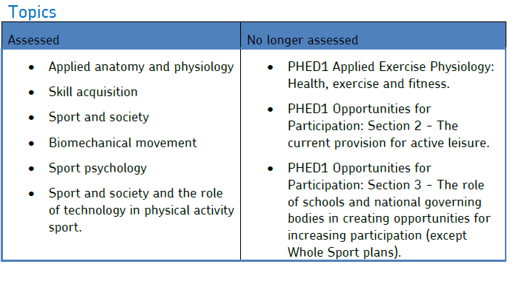
A-level: Subject content changes – resources available
Visit: aqa.org.uk/subjects/physical-education/as-and-a-level/physical-education-7581/planning-resources
Slide 16
Copyright © AQA and its licensors. All rights reserved.
Follow us on Twitter @AQACPD.

Slide 17
A-level: Paper 2
Slide 17
Copyright © AQA and its licensors. All rights reserved.
Follow us on Twitter @AQACPD.

Slide 18
A-level: Structure of Paper 2
2 hours
35% of total marks
Three sections
Combination of multiple-choice , short answer and extended writing questions
Slide 18
Copyright © AQA and its licensors. All rights reserved.
Follow us on Twitter @AQACPD.

Slide 19
A-level: Subject content for Paper 2
Exercise physiology and biomechanics
Sports psychology
Sport and society and technology in sport
Slide 19
Copyright © AQA and its licensors. All rights reserved.
Follow us on Twitter @AQACPD.

Slide 20
A-level: Key content changes - Paper 2
Exercise physiology and biomechanics
Injury prevention – assessed in more detail
fluid mechanics – new content
Sports psychology
Vealey’s model of self confidence
Sport and society and technology in sport
three main organisations; national governing bodies, national institutes of sports and UK Sport
technology
understanding of sports technology for analytics
functions of sports analytics
development of facilities and equipment and impact on participation and performance
Slide 20
Copyright © AQA and its licensors. All rights reserved.
Follow us on Twitter @AQACPD.

Slide 21
Examples of A-level questions
Slide 21
Copyright © AQA and its licensors. All rights reserved.
Follow us on Twitter @AQACPD.

Slide 22
Questions on A-level papers
Slide 22
Copyright © AQA and its licensors. All rights reserved.
Follow us on Twitter @AQACPD.

Slide 23
AS: Paper
Slide 23
Copyright © AQA and its licensors. All rights reserved.
Follow us on Twitter @AQACPD.

Slide 24
AS: Content for Paper
Section A - Applied physiology
Applied anatomy and physiology
Exercise physiology
Biomechanical movement
Section B – Skill acquisition and sports psychology
Section C – Sport and society and technology in sport
Sport and society
Sport and society and the role of technology in physical activity and sport
Slide 24
Copyright © AQA and its licensors. All rights reserved.
Follow us on Twitter @AQACPD.

Slide 25
AS: Structure of Question Paper
2 hours
70% of total marks
Three sections
Combination of multiple-choice, short answer and extended writing questions
Slide 25
Copyright © AQA and its licensors. All rights reserved.
Follow us on Twitter @AQACPD.

Slide 26
Examples of AS questions
Slide 26
Copyright © AQA and its licensors. All rights reserved.
Follow us on Twitter @AQACPD.

Slide 27
Co-teaching opportunities for AS and A-level
It is possible to teach AS and first year A-level students in the same class
Year one A-level content is the same as AS content, the differentiation is in the assessment
Students starting with the intention of taking just the AS will have the option of continuing to A-level (as at present)
AS forms a coherent and stimulating PE course in its own right providing a sound introduction to the subject
Slide 27
Copyright © AQA and its licensors. All rights reserved.
Follow us on Twitter @AQACPD.

Slide 28
Questions on AS
Slide 28
Copyright © AQA and its licensors. All rights reserved.
Follow us on Twitter @AQACPD.

Slide 29
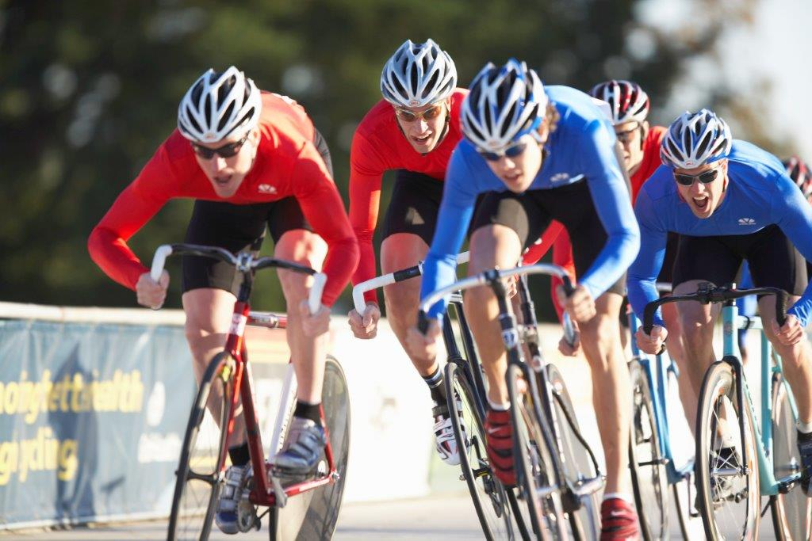
AS and A-level: Non-exam assessment (NEA)
Slide 29
Copyright © AQA and its licensors. All rights reserved.
Follow us on Twitter @AQACPD.

Slide 30
AS and A-level: Non-exam assessment criteria
30% non-exam assessment, broken down into two sections:
15% - students are assessed as a player/performer or coach in the full context of one activity from the list provided
15% - written or verbal analysis and evaluation of either their own or the performance of another
Internal assessment, external moderation
Each marked out of 45 marks – total 90 marks
Slide 30
Copyright © AQA and its licensors. All rights reserved.
Follow us on Twitter @AQACPD.

Slide 31
Performance assessment (practical performance)
15% of overall qualification
45 marks
students assessed in one activity as a either player/performer or coach
students can only be assessed in activities listed in the specification
for each activity, students will be assessed in three areas of assessment, each worth 15 marks
Slide 31
Copyright © AQA and its licensors. All rights reserved.
Follow us on Twitter @AQACPD.

Slide 32
Activity list
Amateur Boxing | Association football | Athletics | Badminton | Basketball | Camogie | Canoeing
Cricket | Cycling | Dance | Diving | Gaelic football | Golf | Gymnastics
Handball | Hockey | Equestrian | Hurling | Kayaking | Lacrosse | Netball
Rock climbing | Rowing | Rugby league | Rugby union | Sculling | Skiing | Snowboarding
Squash | Swimming | Table tennis | Tennis | Trampolining | Volleyball
Specialist Activity
Blind cricket | Boccia | Goal ball | Powerchair football | Polybat | Table cricket | Wheelchair basketball
Wheelchair football | Wheelchair rugby
Slide 32
Copyright © AQA and its licensors. All rights reserved.
Follow us on Twitter @AQACPD.

Slide 33
Areas of assessment for NEA – amateur boxing
Slide 33
Copyright © AQA and its licensors. All rights reserved.
Follow us on Twitter @AQACPD.

Slide 34
Performance analysis assessment – analysis and evaluation
15% of overall qualification
45 marks
Students will be assessed on:
analysis (20 marks)
evaluation (25 marks)
Students can analyse and evaluate their own performance or the performance of another person
Analysis and evaluation can only be carried out on an activity listed in the specification
Can be carried out in either written or verbal format – if verbal, audio-visual evidence
Slide 34
Copyright © AQA and its licensors. All rights reserved.
Follow us on Twitter @AQACPD.

Slide 35
Performance analysis assessment – analysis and evaluation continued
All causes and corrective measures used by the students must be from the theoretical content within the specification
At AS the analysis is of one weakness from Area of assessment 1
At A-level the analysis is of two weaknesses, one from Area of assessment 2 and one from Area of assessment 3
May choose one cause/corrective measure (to show depth of knowledge) or may choose to discuss more than one relevant cause/corrective measure (to show breadth and depth)
Slide 35
Copyright © AQA and its licensors. All rights reserved.
Follow us on Twitter @AQACPD.

Slide 36
Performance analysis assessment – marking criteria for analysis and evaluation of performance
Slide 36
Copyright © AQA and its licensors. All rights reserved.
Follow us on Twitter @AQACPD.

Slide 37
Questions on non-exam assessment
Slide 37
Copyright © AQA and its licensors. All rights reserved.
Follow us on Twitter @AQACPD.

Slide 38
AQA ongoing support and resources
Slide 38
Copyright © AQA and its licensors. All rights reserved.
Follow us on Twitter @AQACPD.

Slide 39
Resources - 1
Current | Spring 2016 | On-going
Specimen assessment materials (SAMs) | An additional set of SAMs | AQA website
Subject specific vocabulary | Exemplar practical footage and accompanying commentaries | e-AQA – Secure Key Materials
Command words | Exemplar analysis and evaluation work and accompanying commentaries | TOLS
Summary of changes | Training: free full day face-to-face preparing to teach events or 2 hour twilight live online events, from April 2016 | Enhanced result analysis (ERA)
Specification comparison: AQA new to competitors’ current |  | Exampro
Specification comparison: AQA new to competitors’ new
Co-teachability guidance
Slide 39
Copyright © AQA and its licensors. All rights reserved.
Follow us on Twitter @AQACPD.

Slide 40
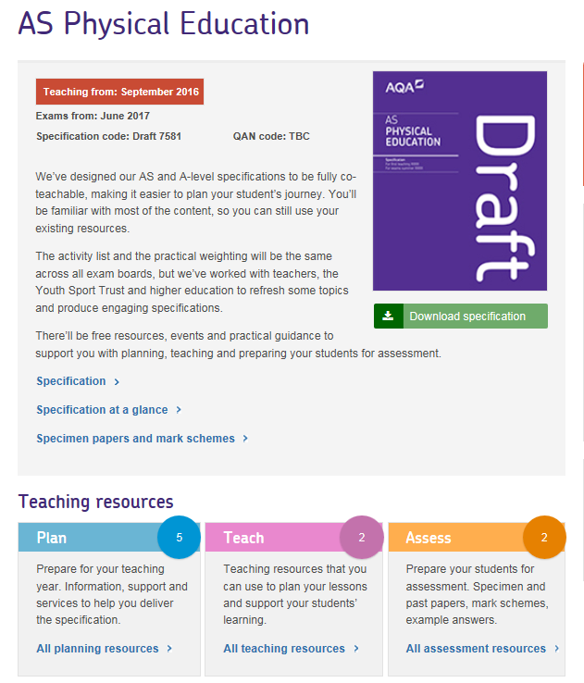
Resources 2 – Plan, Teach and Assess
Slide 40
Copyright © AQA and its licensors. All rights reserved.
Follow us on Twitter @AQACPD.

Slide 41
Exampro
Slide 41
Copyright © AQA and its licensors. All rights reserved.
Follow us on Twitter @AQACPD.

Slide 42
Timeline 1
Draft Specification and specimen Question Papers, and Mark Schemes published
Accredited Specification published
First teaching of AS/A-level in Subject
FREE Introductory events online
and face to face
FREE Preparing to Teach events
CPD events face-to-face
Teacher and learner resources published
Current specification Feedback events online
July
September
October
November to March
April to September 2016
September 2016
Slide 42
Copyright © AQA and its licensors. All rights reserved.
Follow us on Twitter @AQACPD.

Slide 43
Contact points for more information and guidance
AS and A-level PE Customer support team
E: pe@aqa.org.uk
T: 01483 477822
Teacher support manager
Eilish Gorse
CPD manager
Ros Nixon
E: teachercpd@aqa.org.uk
T: 0161 957 3646
Slide 43
Copyright © AQA and its licensors. All rights reserved.
Follow us on Twitter @AQACPD.

Slide 44
Next steps – things to consider
what is your centre policy on AS entry?
co-teachability or linear exams?
teaching and learning strategies e.g. impact of AOs on teaching strategies or what can you learn from other subjects?
staff awareness of new AS and A-level structure as separate qualifications
staff expertise in specialist areas
familiarisation with the AQA website
Training courses
Current specification – feedback events in October and November 2015
New specification – free face-to-face and online preparing to teach events in spring 2016
Slide 44
Copyright © AQA and its licensors. All rights reserved.
Follow us on Twitter @AQACPD.

Slide 45
Final questions
Slide 45
Copyright © AQA and its licensors. All rights reserved.
Follow us on Twitter @AQACPD.

Slide 46
Thank you
We are an independent education charity
and the largest provider of academic qualifications for all abilities taught in schools and colleges.
Our aim is to enable students to realise their potential
and provide teachers with the support and resources they need
so that they can focus on inspiring learning.
aqa.org.uk
Follow us on Twitter @AQACPD.

