Slide 1
Indices
Mathematics for A-level Science

Slide 2
Why are indices important?
Indices are a shorthand for multiplying a term by itself any number of times. They are also called powers or exponents.
In Physics, you will use this concept regularly. In Biology and Chemistry, you may look at this when comparing volumes of liquid, rates of reaction, or converting units.
This allows us to express $2×2×2×2= 2^{4}$
We can use indices with any term, including variables.
$$2x×2x×2x×2x×2x×2x={\left(2x\right)}^{6}$$
This makes certain calculations easier. However, with this new notation, we need to understand addition, subtraction, multiplication, and division of indices.
4 times
6 times

Slide 3
The laws of indices
Addition
$$\left(3×3×3\right)×\left(3×3×3×3\right)=3^{3}×3^{4}$$
$$3^{7}=3^{3}×3^{4}$$
$$3^{3+4}=3^{3}×3^{4}$$
Thus for any term a:
$$a^{m}×a^{n}=a^{m+n}$$
2. Subtraction
$$\frac{2×2×2×2×2}{2×2}=2^{5}÷2^{2}$$
$$\frac{2×2×2×2×2}{2×2}=2^{3}$$
$$2^{5}÷2^{2}=2^{5−2}=2^{3}$$
Thus for any term a:
$$\frac{a^{m}}{a^{n}}=a^{m−n}$$
3 threes
4 threes

Slide 4
The laws of indices
Multiplication
$(y×y)×(y×y)×(y×y)$ $×(y×y)$ $×(y×y)$
$$=y^{2}×y^{2}×y^{2}×y^{2}×y^{2}$$
$$={(y}^{2})^{5}$$
However, from the original line, we can see this is equal to $y^{10}$
So ${{(y}^{2})}^{5}=y^{10}$
For any term a:
$${(a}^{m})^{n} =a^{m×n}$$
4. Division
From the first rule, we know that $a^{\frac{1}{2}}×a^{\frac{1}{2}}=a^{1}$. We also know that $\sqrt{a}×\sqrt{a}=a$
Therefore, $a^{\frac{1}{2}}= \sqrt{a}$. There is a similar argument to show that $a^{\frac{1}{3}}= \sqrt[3]{a}$.
For any term a:
$$a^{\frac{1}{n}}= \sqrt[n]{a}$$

Slide 5
The axioms of indices
There are three more rules of indices which are important to remember and come directly from the definition of indices.
$$a^{1}=a$$
Example: $2^{1}=2$
$$a^{0}=1$$
Example: $8^{0}=1$
$$a^{−n}=\frac{1}{a^{n}}$$
Example: $2^{−3}=\frac{1}{2^{3}}=\frac{1}{8}$
It is important to note that a common misconception is that there is a law for $a^{m}+a^{n}.$ In general, there is no way to simplify this expression.

Slide 6
Examples – GCSE Mathematics question

Slide 7
Examples – GCSE Mathematics question
$${a^{20+5}=a}^{25}$$
$${a^{20−5}=a}^{15}$$
$${a^{20×5}=a}^{100}$$

Slide 8
Examples – GCSE Mathematics question

Slide 9
Examples – GCSE Mathematics question
$$9^{\frac{1}{2}}= \sqrt{9}=3$$
$${\left(−7\right)}^{0}=1$$
$${\left(\frac{1}{8}\right)}^{−\frac{1}{3}}={\left(\frac{8}{1}\right)}^{\frac{1}{3}}=\sqrt[3]{8}=2$$
Thus the correct order is:
$${\left(−7\right)}^{0} {\left(\frac{1}{8}\right)}^{−\frac{1}{3}}{ 9}^{\frac{1}{2}}$$

Slide 10
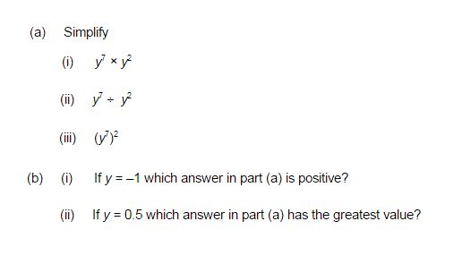
Examples – GCSE Mathematics question

Slide 11
Examples – GCSE Mathematics question
$$y^{7+2}=y^{9}$$
$$y^{7−2}=y^{5}$$
$$y^{7×2}=y^{14}$$
$${\left(−1\right)}^{9}=−1$$
$${\left(−1\right)}^{5}=−1$$
$${(−1)}^{14}=1$$
Thus the answer is iii.
Numbers less than one when multiplied by themselves become smaller. Thus the answer will be when the number is raised to the smallest index or
$${\left(0.5\right)}^{5}$$

