Slide 1
Plotting two variable equations
Mathematics for A-level Science

Slide 2
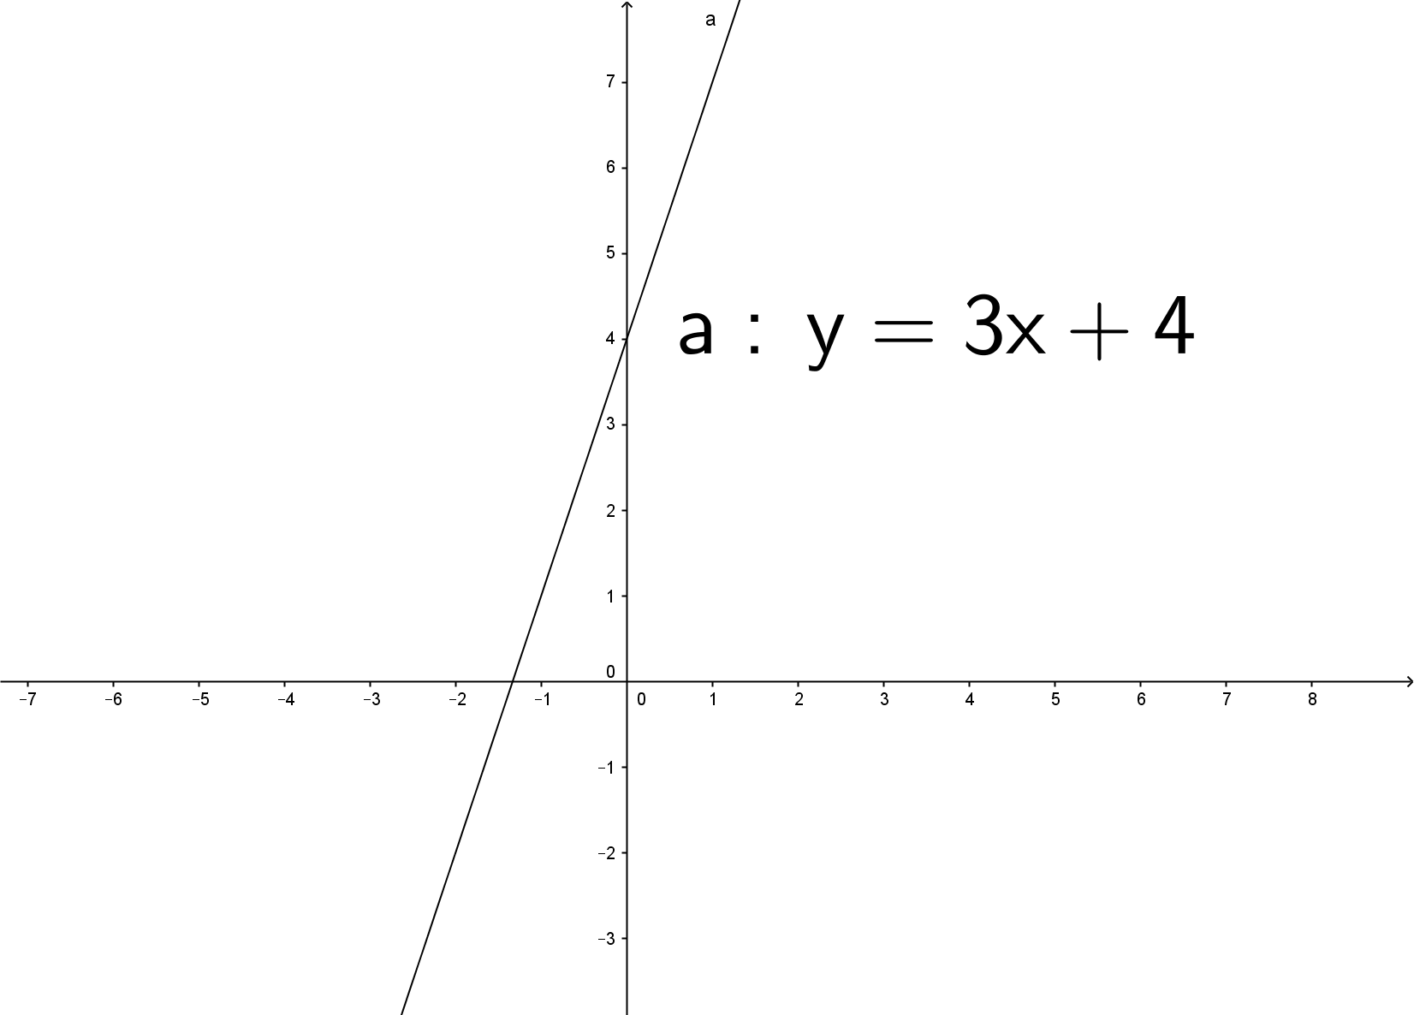
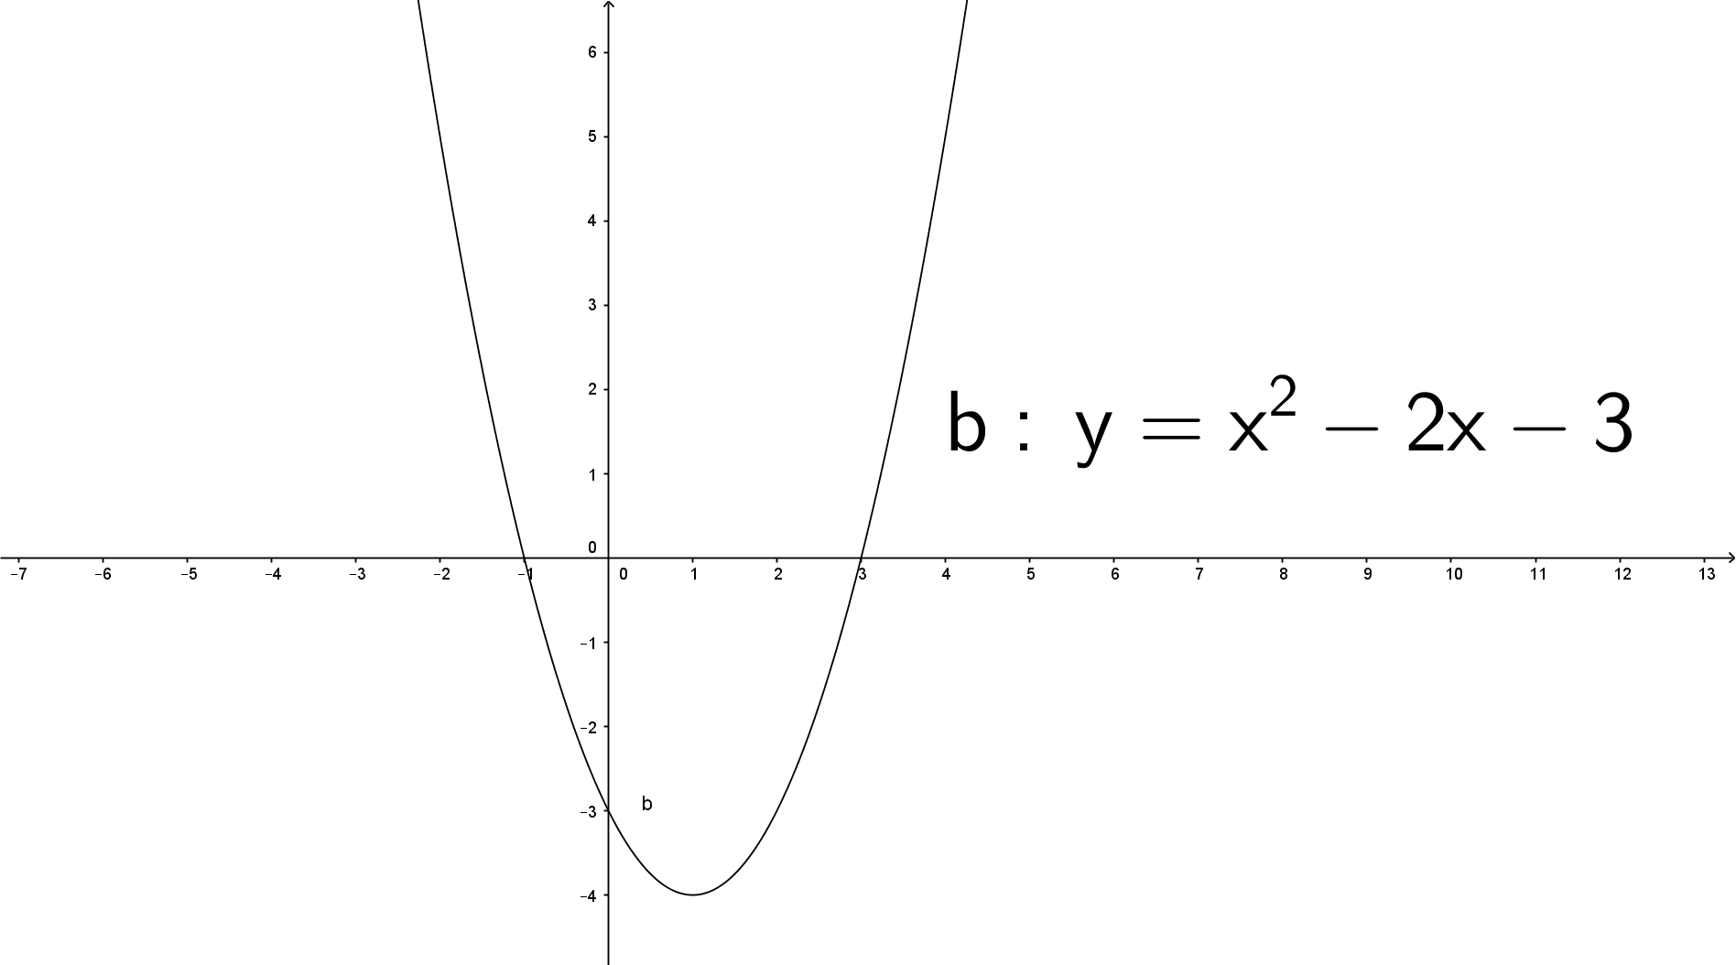
Why is plotting important?
Plotting equations gives us a sense of what a relationship looks like. We can then easily see properties of the equation as well as compare it to other equations.
a : y = 3x + 4
b : y = x² – 2x – 3

Slide 3
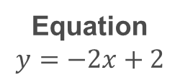


Plotting equations – A table of values
To draw a representation of an equation, we first need coordinates to plot. We can achieve this by creating a table of values. These are just the $x$ and $y$ values that are true for the given line.
To create a table of values, choose a set of $x$ values, and substitute them into the equation and evaluate to get the $y$ values.
Example
x | y
-1
0
1
2
Equation
$$y=−2x+2$$
x | y
-1 | 4
0 | 2
1 | 0
2 | -3
$$y=−2\left(−1\right)+2=4$$
$$y=−2\left(0\right)+2=2$$
$$y=−2\left(1\right)+2=0$$
$$y=−2\left(2\right)+1=−3$$

Slide 4
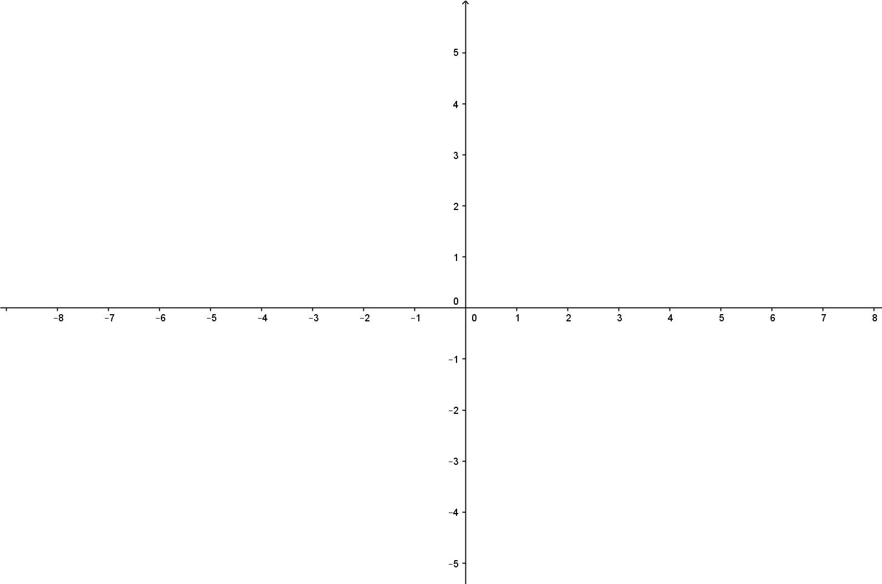
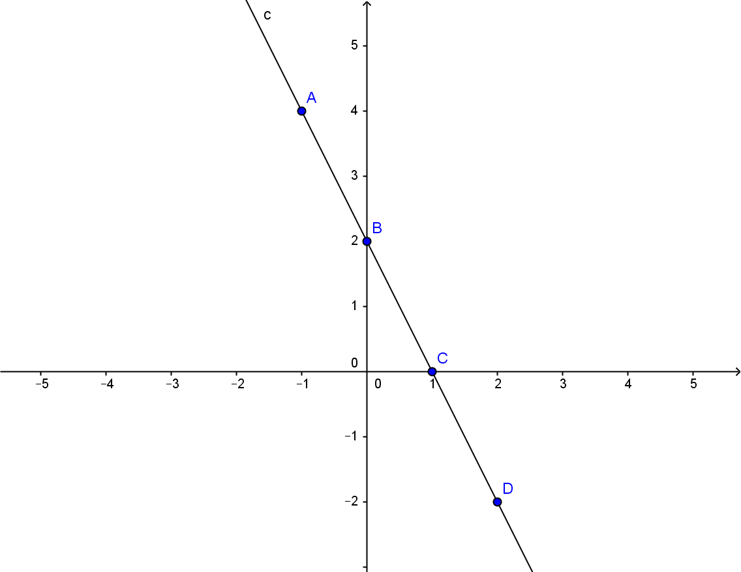
Plotting an equation from a table of values
Once you have completing your table of values, draw neatly and label a pair of axis.
Once you have done this, plot the coordinates present in your table of values onto the graph. If they form a straight line, use a ruler to connect the coordinates. Otherwise, draw a curve freehand.
x | y
-1 | 4
0 | 2
1 | 0
2 | -2

Slide 5
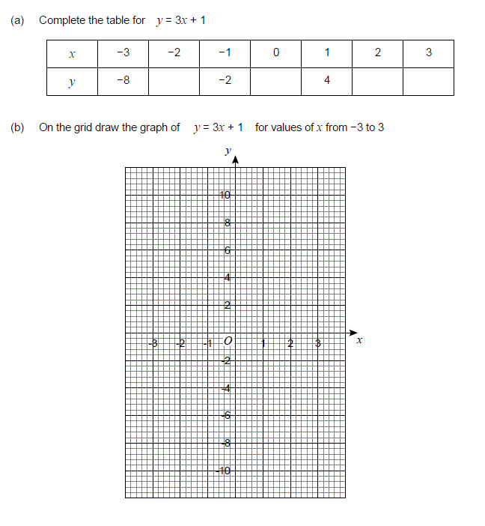
Example: GCSE Mathematics

Slide 6
Example: GCSE Mathematics
-5
1
7
10

Slide 7
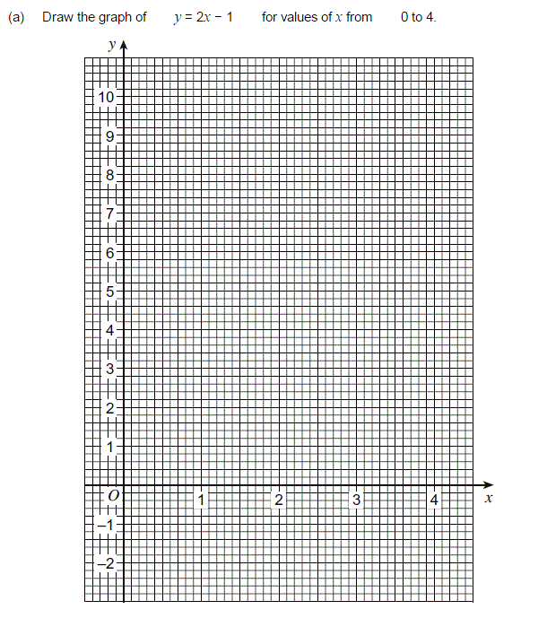
Example: GCSE Mathematics

Slide 8
Example: GCSE Mathematics

Slide 9
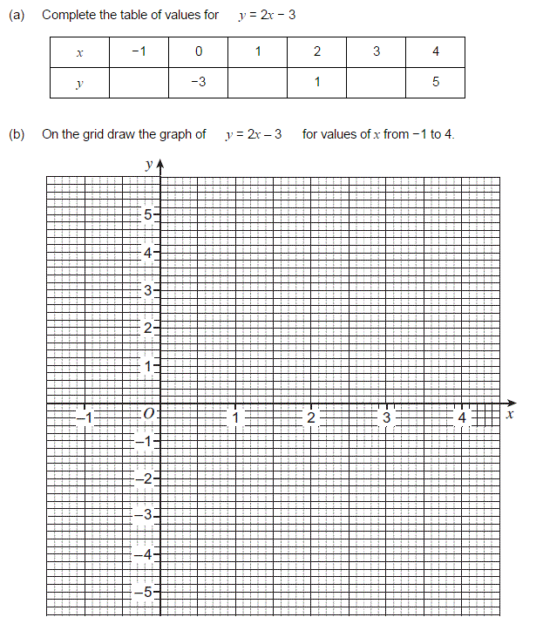
Exam paper example: GCSE Mathematics

Slide 10
Exam paper example: GCSE Mathematics
-5
-1
3

