Slide 1
Ratios
Mathematics for A-level Science

Slide 2
Why are ratios important?
Understanding ratio allows us to easily compare separate quantities. We can then examine patterns, comment on the relationship, or use ratios to help us solve equations.
For example:
- Use 3 parts red paint to 1 part white paint.
- Use 1 teabag to 250 ml of water.
- Use 1 shovel of cement to 2 shovels of sand.
The order of the ratio is very important.
The number of teabags used per ml of water would be 1:250. Saying that the answer was 250:1 would mean something very different.

Slide 3
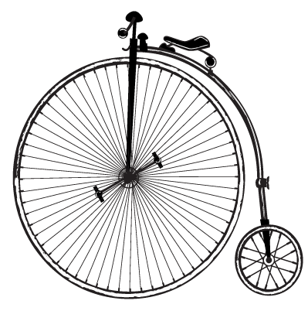
Scaling ratios
We can use ratios to scale measurements, drawings, and calculations up and down.
The height to width ratio of a picture is 3:2. For every 3 cm of height there is 2 cm of width.
We could increase the size of the picture so that it is 30 cm high. If we do this, the picture should be 20 cm wide. If we made the picture 60 cm high, it should be 40 cm wide, which is still in the ratio 3:2.
60 cm
30 cm
20 cm
40 cm

Slide 4
Writing ratios as fractions
We can write a ratio as a fraction by scaling the ratio so that it is divided by the total number of parts.
Example: To make mortar, we need 1 part cement, and 2 parts sand. The total number of parts for one batch of mortar is $1+2=3$. Thus the ratio for creating mortar is 1:2 which can also now be expressed as $\frac{1}{3}:\frac{2}{3}$
From this form, it is easy to see how much of the total mixture is sand ($\frac{2}{3})$ and how much is concrete ($\frac{1}{3}$).

Slide 5
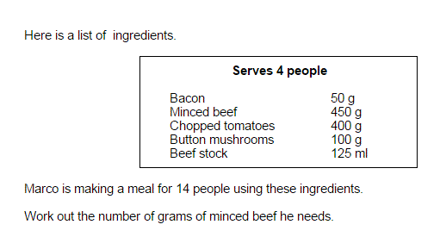
Examples – GCSE Mathematics question

Slide 6
Examples – GCSE Mathematics question
The ratio is 14:4 which is equal to 7:2
If 450 g of minced beef represents 2 parts of the total amount,
1 part is equal to 225 g, and 7 parts would be equal to $\text{7}×\text{ 225 = 1575 }\text{g}$

Slide 7
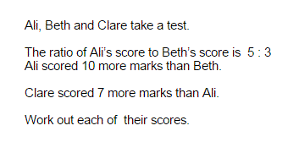
Examples – GCSE Mathematics question

Slide 8
Examples – GCSE Mathematics question
The difference between Ali and Beth is 2 parts, and this is equal to 10 marks
So each part is equal to 5 marks.
Ali then scored $\text{5 × 5 = 25}$ marks.
Beth scored $\text{3 × 5 =}$ 15 marks.
Clare scored $\text{25 + 7 = 32}$ marks.

Slide 9
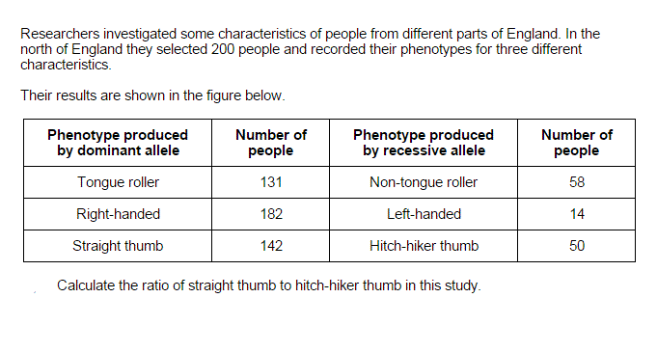
Examples – A-level Biology past paper question

Slide 10
Examples – A-level Biology past paper question
The ratio is simply 142:50. This should be simplified to 2.84:1

