Slide 1
Standard Form
Mathematics for A-level Science

Slide 2
Why is standard form important?
We use standard form to easily manage very large or very small numbers.
For example, the number 0.00000000000087 may be written as 8.7 × 10⁻¹³
In this form, 8.7 × 10⁻¹³ is the product of two numbers: 8.7 is the digit number, and 10⁻¹³ is the exponential number.
A number is in standard form when it is written as a × 10^{n}, where 1 ≤ a < 10
Here are some further examples of numbers in standard form.
Decimal | Standard Form
134 000 | 1.34 × 10⁵
0.0034 | 3.4 × 10^{–3}
82 000 000 | 8.2 × 10⁷
270 | 2.7 × 10²
0.000 000 000 026 | 2.6 × 10^{–11}

Slide 3
Converting between decimal and standard form
In standard form, the power of 10 shows the number of places the decimal point must be shifted to give the number in decimal form. A positive power will shift to the right, and a negative power will shift to the left.
In standard form, the digit number also contains the number of significant figures in the number. The exponential number positions the decimal point.
To convert to standard form, shift the decimal until there is one non-zero digit left of the decimal point, and count the number of places the decimal point has “moved” (this will be negative if your initial number was less than one). This number is the power of 10.
8.7 × 10^{–4} = 0.00087
Shift 4 left
328 000 = 3.28 × 10⁵

Slide 4
Standard form calculations on your calculator
To type a number in standard form on your calculator,
- Input the digit number followed by the multiplication sign.
- Locate the “10^{x}” symbol, and use this to insert the exponent.
- Check your equation for any needed brackets.
To check, multiply 6.1 × 10⁴ and 2 × 10³. The answer should be 1.22 × 10⁸

Slide 5
Examples
Example 1
On July 14 2015, the space probe New Horizons passed by Pluto after travelling 4.7 × 10¹² metres from Earth.
Write this number in decimal form.
Earlier, the space probe flew past Jupiter, which is 5.88 × 10⁸ metres from Earth.
b) How many times further did the space probe travel from Earth to Pluto than Earth to Jupiter?

Slide 6
Examples
Example 1
On July 14 2015, the space probe New Horizons passed by Pluto after travelling 4.7 × 10¹² metres from Earth.
Write this number in decimal form.
4 700 000 000 000 metres.
This was calculated by shifting the decimal point to the left 12 times.
Earlier, the space probe flew past Jupiter, which was 5.88 × 10⁸ metres from Earth.
b) How many times further did the space probe travel from Earth to Pluto than Earth to Jupiter?
(4.7 × 10¹²) / (5.88 × 10⁸) ≈ 8 × 10³ ≈ 8000 times farther.

Slide 7
Examples
Example 2
0.0125 moles of a particular substance were dissolved in 2.5 dm³ of water. What is the concentration of this substance? Give your answer in standard form.
Example 3
A cross section of an artery contains 9.2 × 10⁻⁹ m³ of blood.
If this blood weighs 7.1 × 10⁻³ g, calculate the density of the blood. Leave your answer in standard form.

Slide 8
Examples
Example 2
0.0125 moles of a particular substance were dissolved in 2.5 dm³ of water. What is the concentration of this substance? Give your answer in standard form.
0.0125 / 2.5 = 0.005 mol dm^{–3} = 5 × 10^{–3} mol dm^{–3}
Example 3
A cross section of an artery contains 9.2 × 10^{–9} m³ of blood.
If this blood weighs 7.1 × 10^{–3} g, calculate the density of the blood. Leave your answer in standard form.
Using the formula Density = Mass / Volume,
(9.2 × 10^{–9}) / (7.1 × 10^{–3}) ≈ 1.3 × 10^{–6} kg m^{–3}

Slide 9
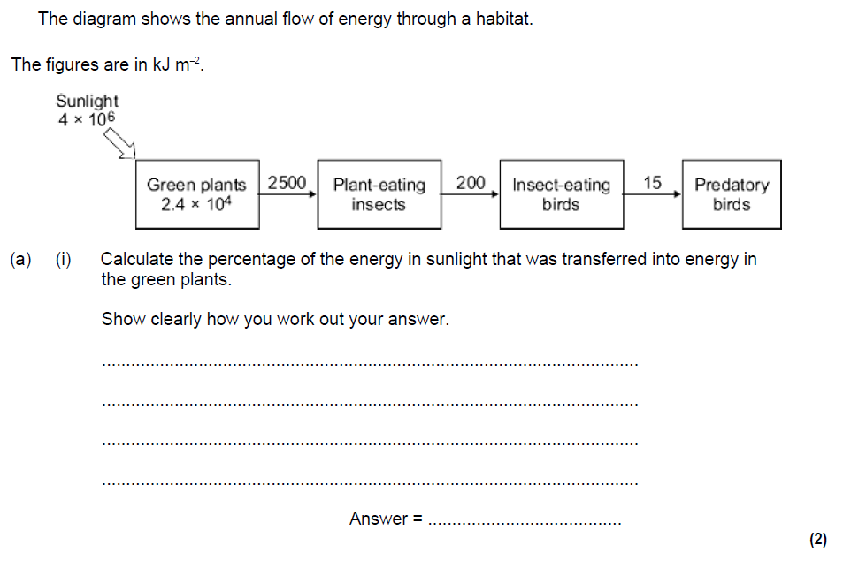
Exam paper example: GCSE Biology

Slide 10
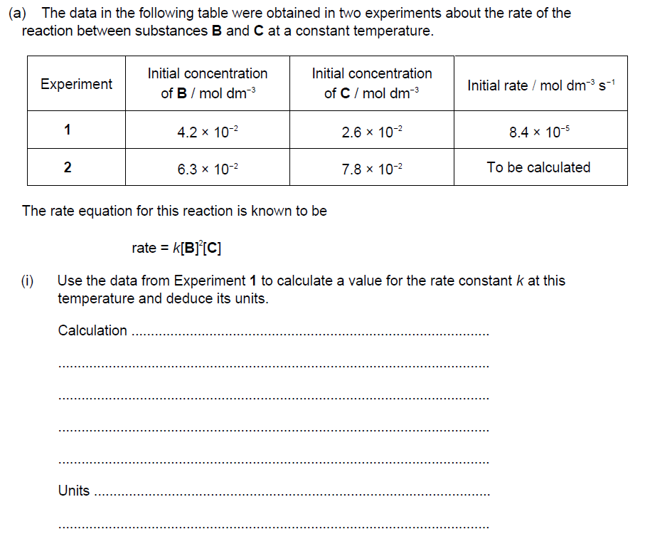
Exam paper example: A-level Chemistry

Slide 11
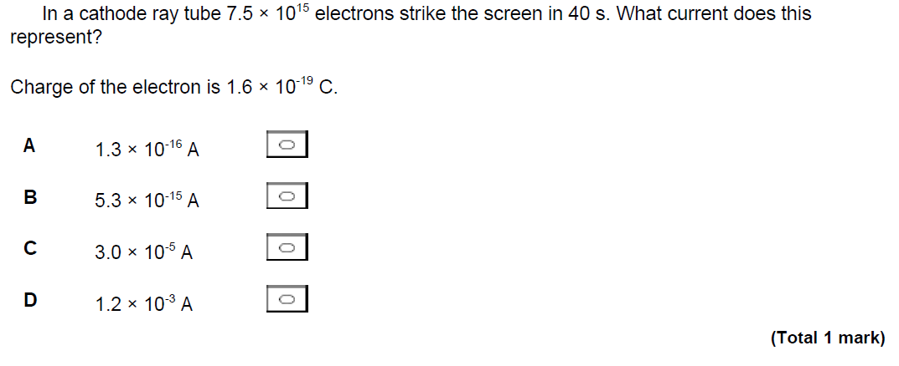
Exam paper example: A-level Physics

