Slide 1
Exampro for Science
Matthew Bennett and Jon Watts
matthew@doublestruck.co.uk
jon@doublestruck.co.uk
September 2016
exampro.co.uk/science

Slide 2
Agenda
Exampro – Specifications available
Exampro – Application changes
Exampro – Content changes
KS3 Science On-screen assessments
A-level tracker
Pricing

Slide 3
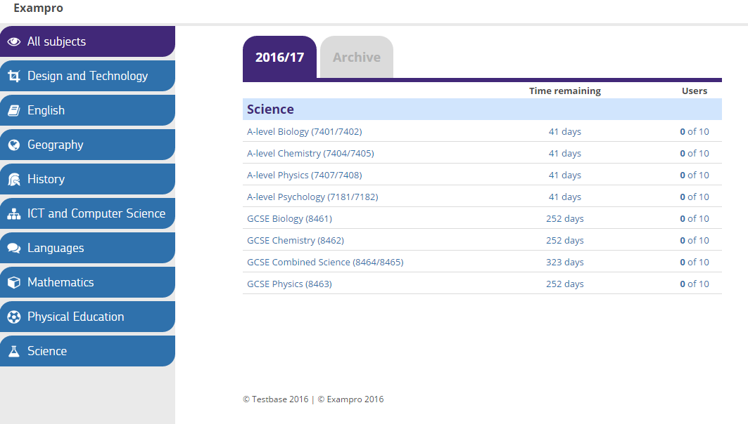
New specs…
exampro.co.uk/science

Slide 4
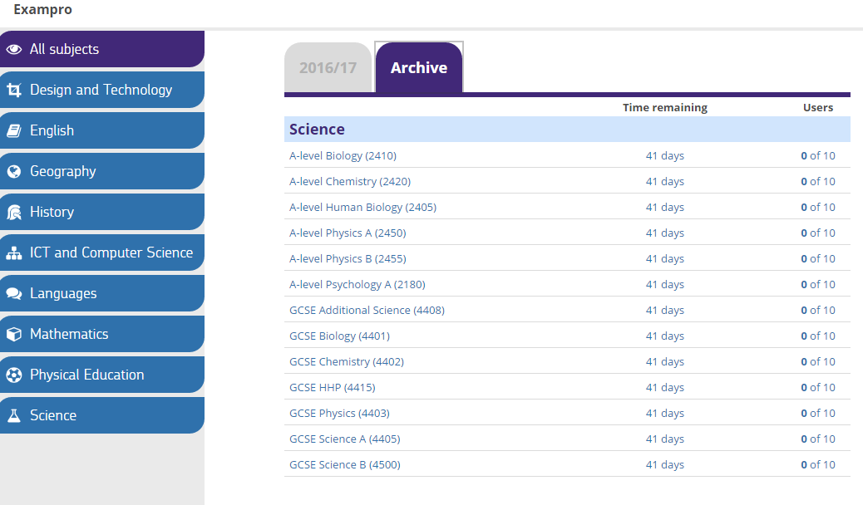
Old specs…
exampro.co.uk/science

Slide 5
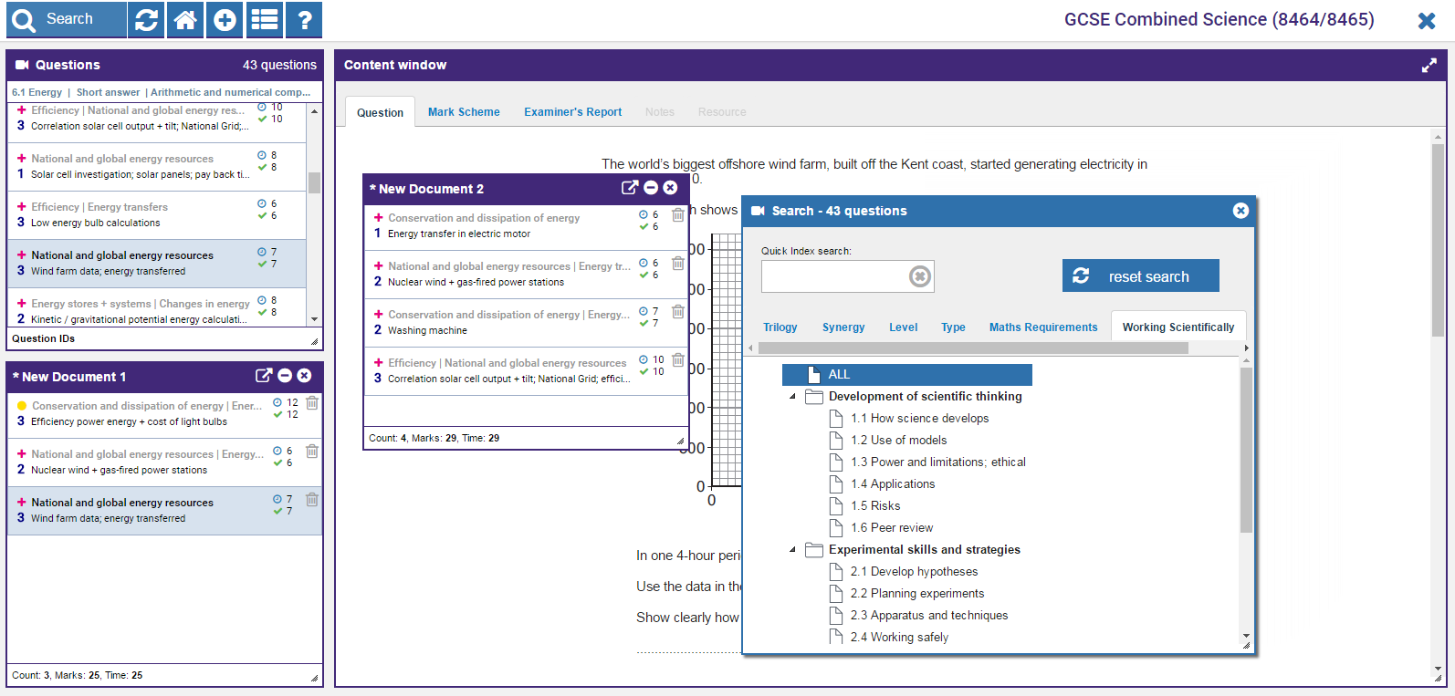
Exampro changes: Application
Non-Flash
Faster
Multiple documents
Improved search

Slide 6
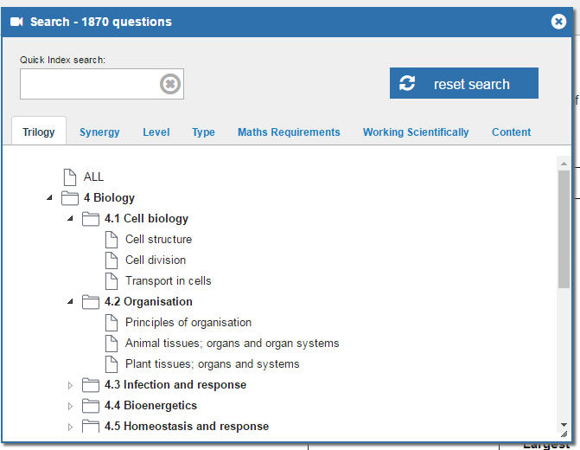
Exampro changes: Content - Combined
Both Trilogy and Synergy
Fully reviewed
Irrelevant questions removed
Physics equations removed
AO tag removed
Maths requirements and Working Scientifically added
Topic tests coming soon
exampro.co.uk/science

Slide 7
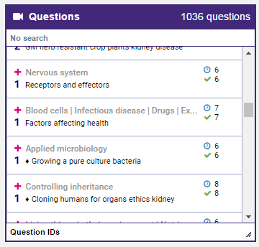
Content changes: Separates
All the improvements in Combined
Separate only content identified
Subject | Separate | Combined
Biology | 1036 | 681
Chemistry | 849 | 634
Physics | 879 | 555
exampro.co.uk/science

Slide 8
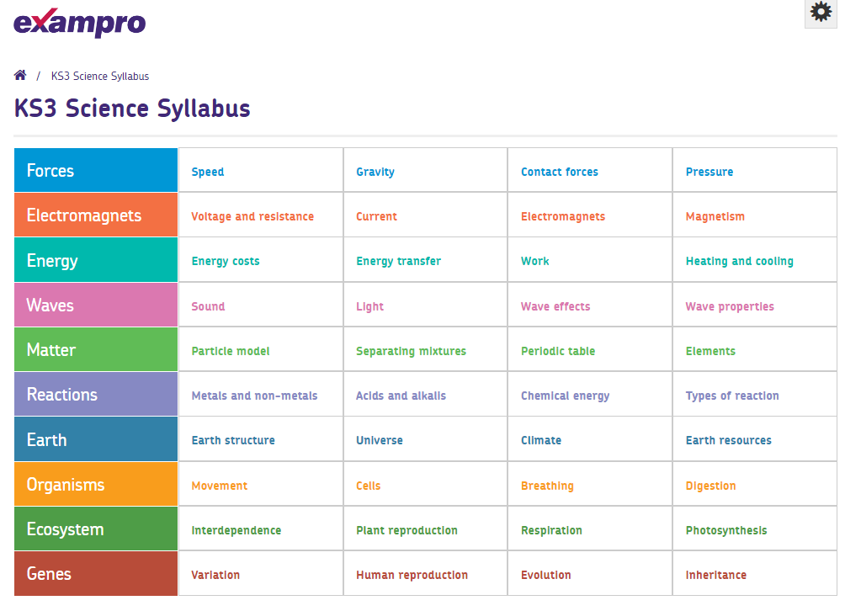
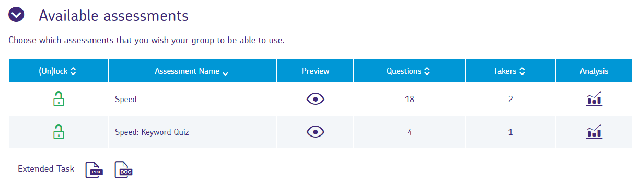
On-screen assessments
Perfectly matches the AQA KS3 Syllabus
40 topics each with:
  Key word assessment (on-screen)
  Know and Apply assessment (on-screen)
  Extend assessment (paper based)
£250/year for the whole of KS3
exampro.co.uk/science
Version 3.0

Slide 9
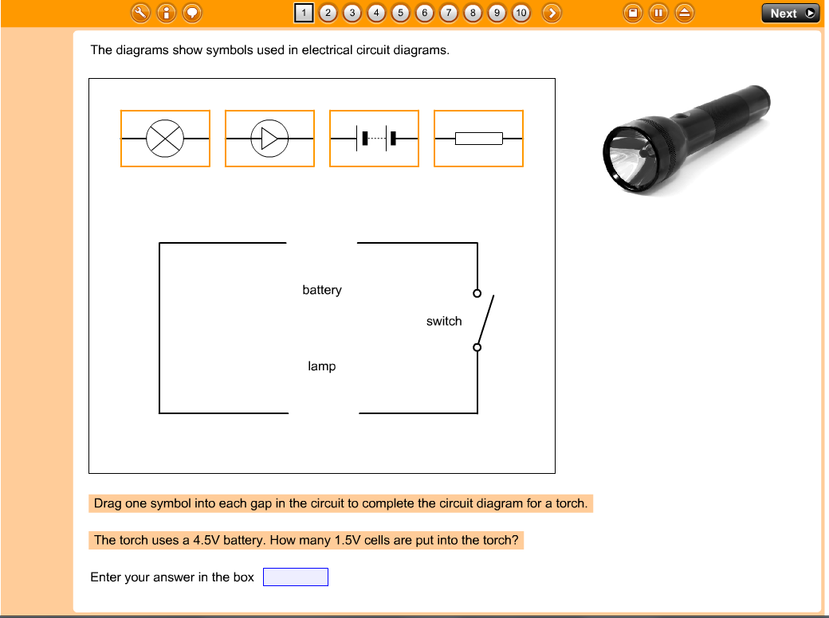
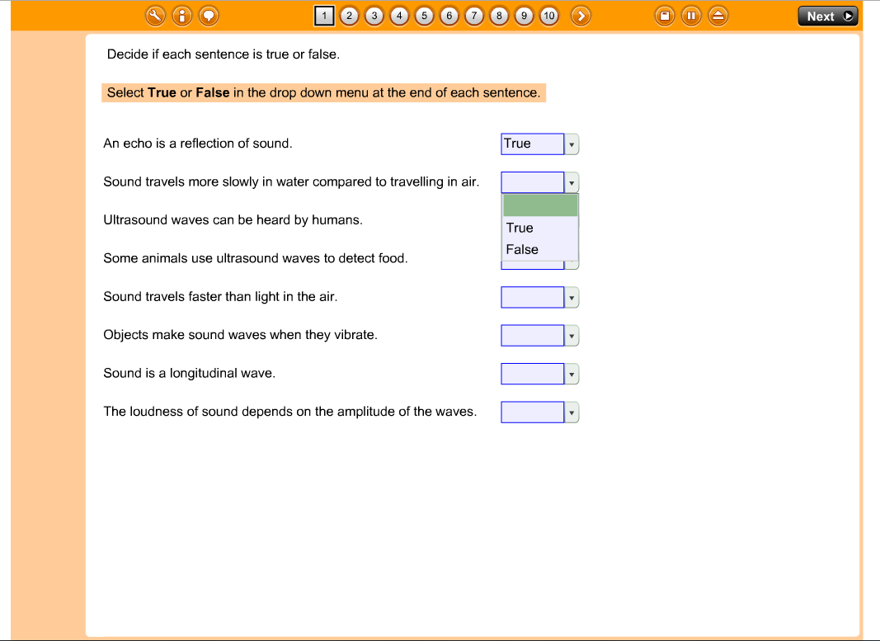
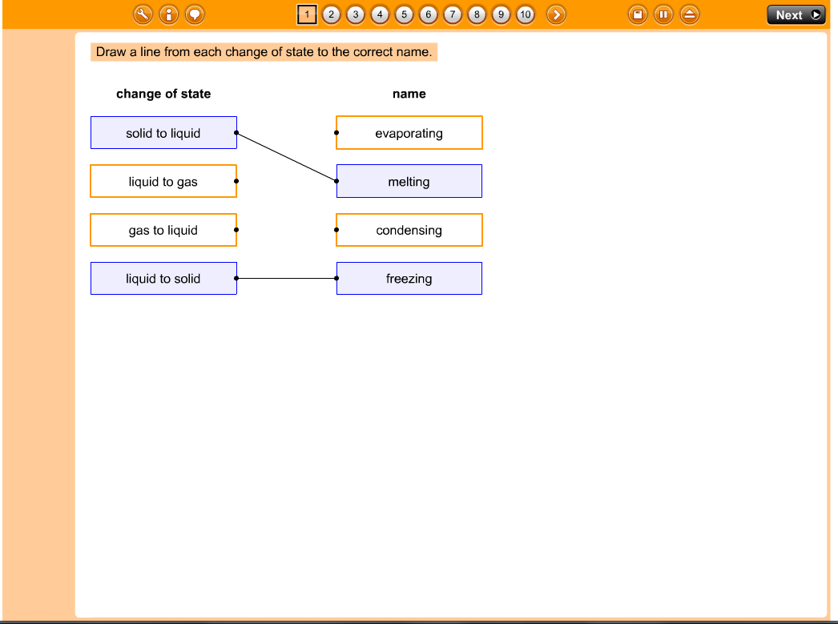
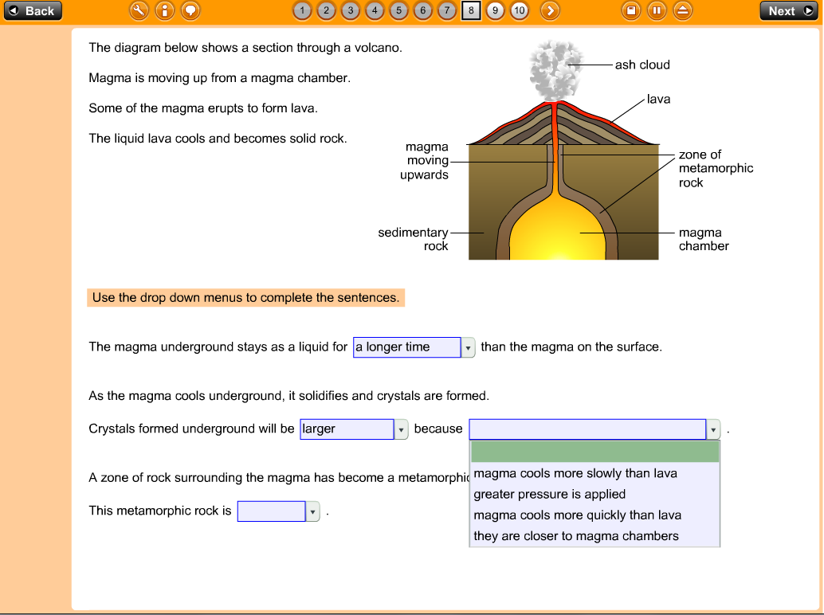
Know & Apply

Slide 10
Extend

Slide 11
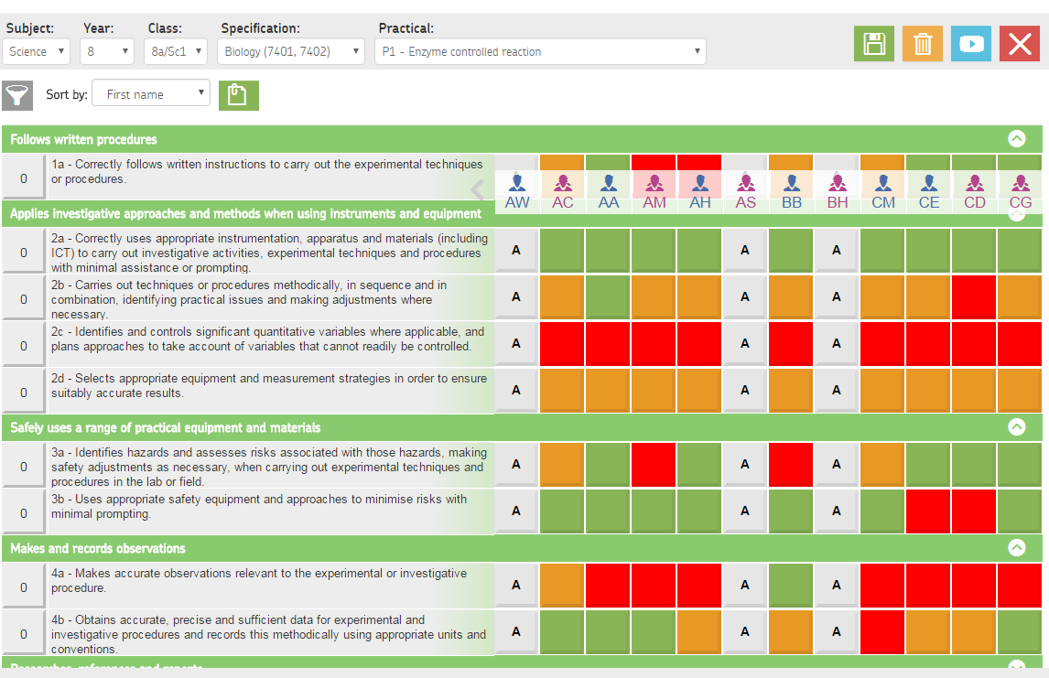
A-level tracker: track per practical with substrands

Slide 12
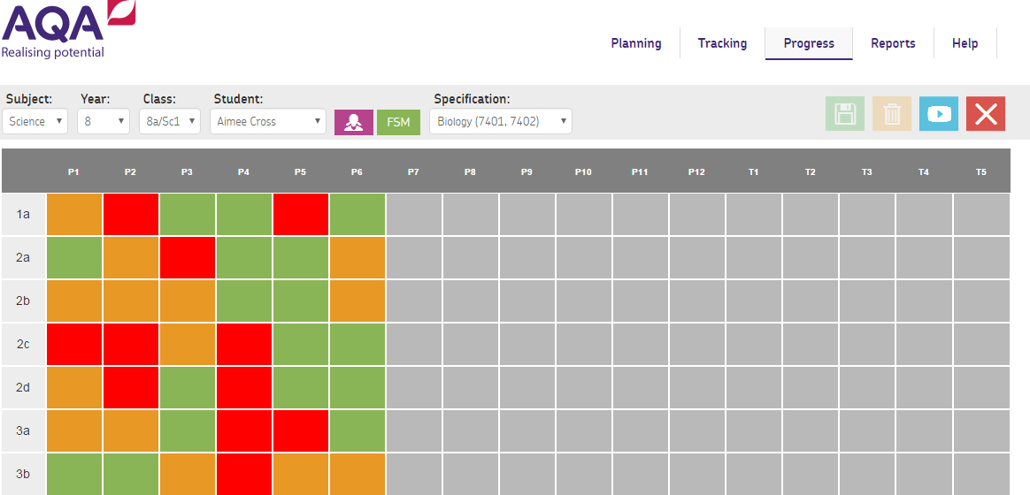
Track per student

Slide 13
Pricing
Product / subject | Cost per year
Key stage 3 On-screen assessment | £250
Testbase KS2 & 3 | £120
GCSE Separate sciences | £80
GCSE Combined science | £110
GCSE Science package | £200
Secondary science (KS3 & GCSE) | £240
A-level Sciences each | £100
A-level Science package | £250
A-level tracker | Free
exampro.co.uk/science

