Slide 1
Exampro updates October 2016
GCSE Topic tests – 2 ways of generating test
Ready made end of topic tests
Build your own
Notes:
Welcome
Introduction
Proviso that will attempt to answer all questions– anything we cant answer we will get back to you on

Slide 2
Contents
Contents | Slide
Homepage | 3
Types of formative tests | 4
Ready made end of topic tests | 5
Exporting and saving tests | 6-7
Sharing tests | 8-9
Building your own test | 10-14

Slide 3
Home page

Slide 4
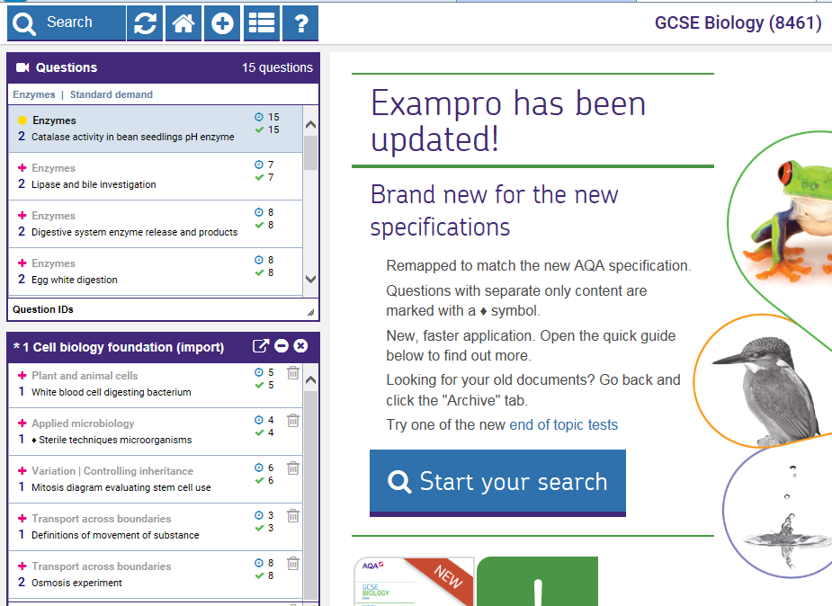
Two types of formative tests
Build your own test
Ready made end of topic tests

Slide 5
Menu of ready made end of topic tests

Slide 6
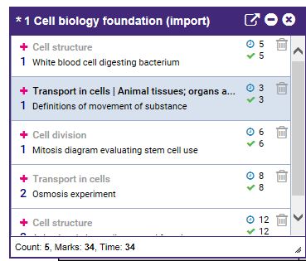
Select test, and export for printing or saving
1
Click to select what to include
2
Click icon to export

Slide 7
Select sections for printed copy
Tick required boxes and then export to save and print

Slide 8
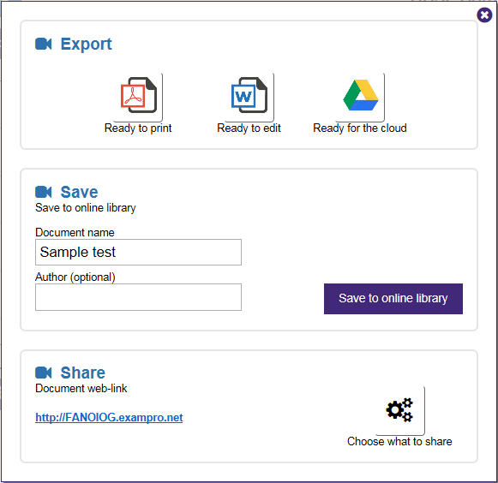
Select test, and export for sharing
1
Click icon to export
2
Enter Document name
3
Click Save to online library
4
Click Choose what to share icon

Slide 9
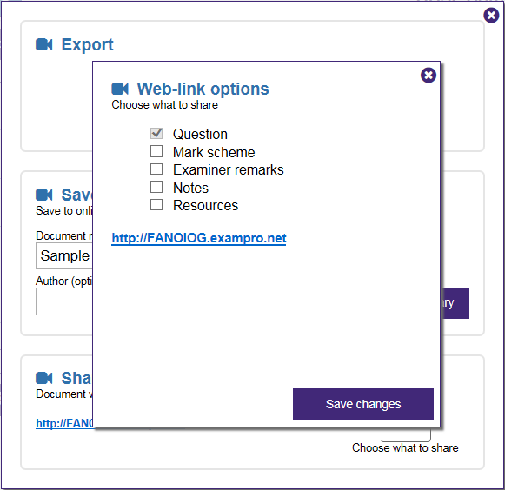
Choose what to share
5
Select what to share
6
Click Save changes
7
Link can now be copied and sent to intended parties

Slide 10
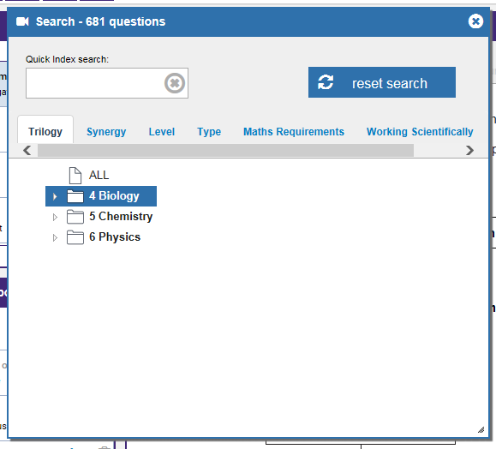
Build your own test form sorted bundles of questions – Trilogy
Click Search
Select which science

Slide 11
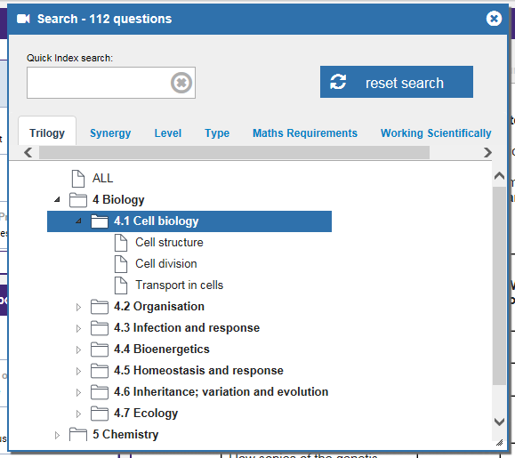
Select topic and sub topic

Slide 12
Refine search
Search questions by:
Level 1 = Low 2 = Standard 3 = High
Type of question Short answer
+ Extended writing
Maths requirements
Working scientifically

Slide 13
Drag and drop questions to New Document 1 and export

Slide 14
Extra practical questions
In order to reflect the new AOs, when constructing tests teachers should include working scientifically questions and practical questions.
There are a lot of practical questions in the AQA Certificates (iGCSE) science especially paper 2.

Slide 15
Thank you
Notes:
Try and agree a date
Ask people to fill in evaluation form and collect

