Slide 1
Averages
Mathematics for GCSE Science
This presentation covers these Maths skills:
find arithmetic means
understand the terms mean, mode and median.

Slide 2
How can we summarise data?
When carrying out an investigation, data collected must recorded so that conclusions can be made.
This data can be displayed using tables, from which graphs can be drawn.
Finding the average helps you to draw conclusions from data.
A measure of average is a number that is typical for a set of figures.
The averages most commonly used are:
MEAN
MEDIAN
MODE

Slide 3
Do you know the definitions, and which is which?
Mean
Median
Mode
Most common value
Middle value in an ordered list
Sum of all values $÷$ number of values
See BBC Bitesize for a recap of these concepts:
BBC Bitesize - Measures of average
YouTube - Mean, Median and Mode

Slide 4
Why are averages important?
If we do an experiment just once, it is probable that the result will vary from the true value.
The experiment is repeated to get a set of values – all of which may vary from the true value.
An average is then calculated so a conclusion can be made.
A typical question might be to compare two data sets using the mean, median or mode. You would be asked which data set has a higher/lower value, and asked to interpret this result in the context of the data.

Slide 5
Using the mean
Nitrate fertilisers are soluble in water and can be washed off fields and into rivers and reservoirs by rainwater. Samples were taken from 2 different rivers at 5 different points in time. The following table shows the nitrate levels at each point. Anything higher than 10 mg/l is considered unsafe.
River | Level of nitrate (mg/l)
 | Trial 1 | Trial 2 | Trial 3 | Trial 4 | Trial 5
A | 15 | 13 | 11 | 9 | 7
B | 9 | 8 | 9 | 10 | 11
What is the mean level of nitrate for each river?
Evaluate if the mean level of nitrate in each river is unsafe.

Slide 6
Answers
What is the mean level of nitrate for each river?
For river A:
15 + 13 + 11 + 9 + 7= 55
55 $÷$ 5 = 11
The mean level of nitrate for River A is 11 mg/l
For river B:
9 + 8 + 9 +10 + 11 = 37
37 $÷$ 5 = 7.4
The mean level of nitrate for River B is 7.4 mg/l
Evaluate if the mean level of nitrate in each river is unsafe.
Anything higher than 10 mg/l is considered unsafe.
The mean level of nitrate in river A is above 10 mg/l, so is unsafe.
The mean level of nitrate in river B is below 10 mg/l, so is safe.

Slide 7
Using the median
An experiment was carried out into the strength of rubber. 7 strips were stretched until they snapped. The following table shows what length each sample reached.
Calculate the median length reached by the strip.
How does this compare to the mean value?
Why are the median and mean so different?
Why wouldn’t you use the mode for this data?
Sample number | Length (mm)
1 | 21
2 | 5
3 | 22
4 | 25
5 | 27
6 | 26
7 | 28

Slide 8
Answers
Calculate the median length reached by the strip.
Put the numbers in order: 5, 21, 22, 25, 26, 27, 28
Choose the middle number.
The median length is 25mm.
How does this compare to the mean value?
5 + 21 + 22 + 25 + 26 + 27 + 28 = 154
154 $÷$ 7 = 22
The mean value is 22mm.
Why are the median and mean different?
This is because the mean is skewed by the outlier 5. The median is not affected by this.
Why wouldn’t you use the mode for this data?
No two numbers are the same, so it would not be possible to use the mode.

Slide 9
Using the mode
A study was carried out to find the average height of children in a certain class. The results are shown in the following table.
Height, h, (cm) | Number of females | Number of males | Total number of students
140 < h ≤ 144 | 4 | - | 4
144 < h ≤ 148 | 5 | - | 5
148 < h ≤ 152 | 4 | 4 | 8
152 < h ≤ 156 | 1 | 6 | 7
156 < h ≤ 160 | 2 | 3 | 5
160 < h ≤ 164 | - | 1 | 1
What is the modal height of a student in this class?
How does this compare to the modal height of a male student and a female student?
What does this tell you about using the mode?

Slide 10
Answers
What is the modal height of a student in this class?
The most common height is 148 < h ≤ 152, with 8 students falling within that interval.
How does this compare to the modal height of a male student and a female student?
The modal height of a male student is 152 < h ≤ 156
The modal height of a female student is 144 < h ≤ 148
What does this tell you about using the mode?
Using the mode does not always give a good representation of the data.

Slide 11
Advantages and disadvantages
The mean, median and mode all have advantages and disadvantages. Can you think what they are?
 | Advantages | Disadvantages
Mean
Median
Mode
Uses all the data
Usually most representative
Isn’t always a data value
May be distorted by extreme data values
Easy to find in ordered data
Not distorted by extreme data values
Isn’t always a data value
Not always a good representation of the full data set
Easy to find in tallied data
Always a data value
Doesn't always exist, or sometimes more than one
Not always a good representation of the data

Slide 12
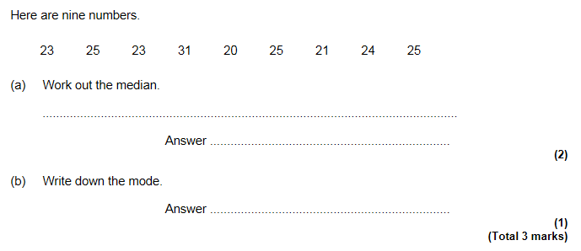
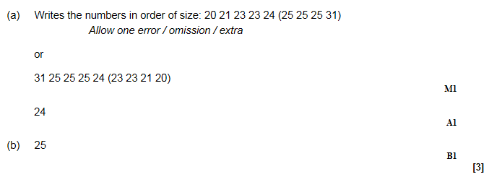
Some questions to try from Exampro
GCSE Maths F

Slide 13
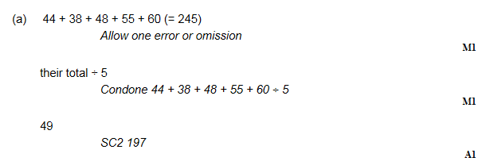
GCSE Maths F

Slide 14
GCSE Biology sample assessment materials

Slide 15
GCSE Biology sample assessment materials

Slide 16
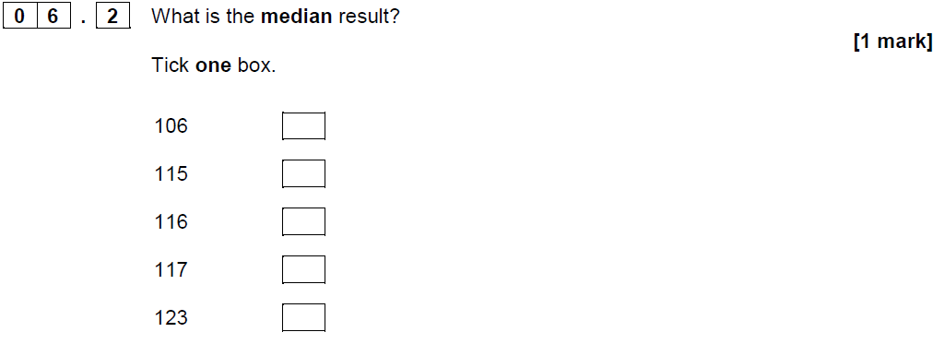
GCSE Biology sample assessment materials

