Slide 1
Graphs
Mathematics for GCSE Science

Slide 2
Objectives
Translate information between graphical and numeric form
Understand that $y=mx+c$ represents a linear relationship
Plot two variables from experimental or other data
Determine the slope and intercept of a linear graph
Draw and use the slope of a tangent to a curve as a measure of rate of change
Understand the physical significance of area between a curve and the $x$-axis and measure it by counting squares as appropriate.

Slide 3
Introduction
Science would be a lot harder without graphs.
In pairs…
Without drawing a graph, use the information in the table to decide if the pH of water affects the number of tadpoles that develop from frogspawn.
pH of water | Number of tadpoles
5.5 | 23
5.0 | 32
6.0 | 43
8.0 | 53
7.5 | 57
7.0 | 66
6.5 | 74

Slide 4
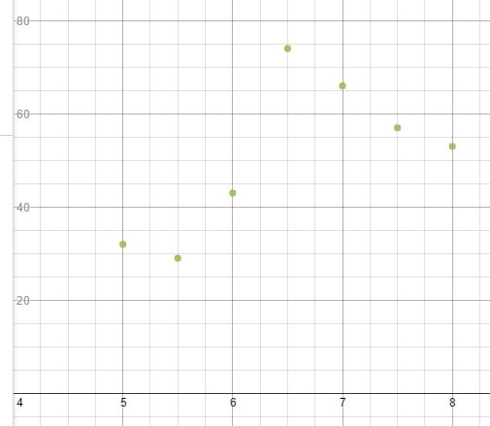
Introduction
What conclusion did you reach?
This is what a graph of the information would look like.
This suggests that tadpoles’ development was affected by the pH of water and that they were more likely to develop when the pH was around 6.5.
Number of tadpoles
pH of water

Slide 5
You have to be able to read values from a graph
The graph could come in many different formats but we’re going to mainly focus on linear graphs.
When reading a value from a graph, first make sure you have understood what the graph is about. Look at the labels on the axes and check the units that have been used.
If coordinates are required remember, the $x$ coordinate comes first and then the $y$ coordinate, ($x$,$y$).

Slide 6
What do each of these lines have in common?
Straight
Parallel
Upwards slope
Same gradient
Gradient of 2

Slide 7
What do each of these lines have in common?
Straight
Cross at one point
$y$-intercept of 2

Slide 8
What does the equation of a straight line mean?
The $x$ coordinate of a point on the line.
The $y$ coordinate of a point on the line.
$$y=mx+c$$
The $y$-intercept
of the line.
The gradient of the line.

Slide 9
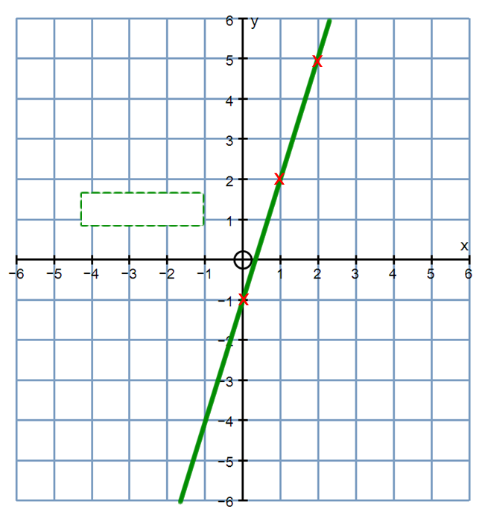
How is the gradient calculated?
3
$$3÷1=3$$
Click for equation
1
$y$=$3x−1$
$$y=3x−1$$

Slide 10
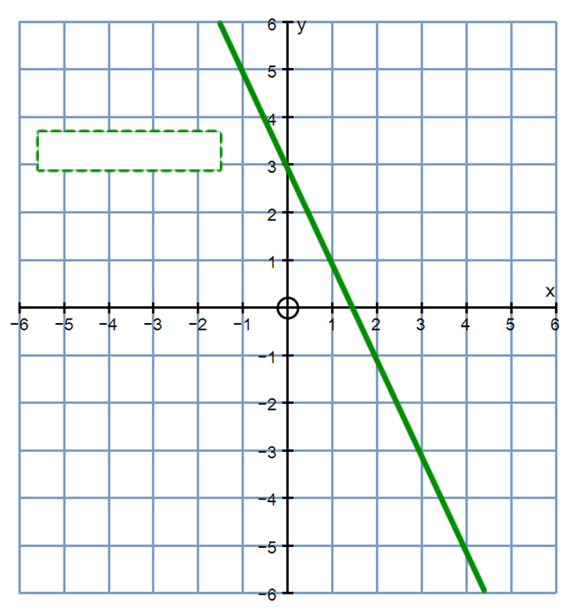
How is the gradient calculated?
$y$=$−2x+3$
$$y=−2x+3$$
Click for equation
-2
$$−2÷1=−1$$
1

Slide 11
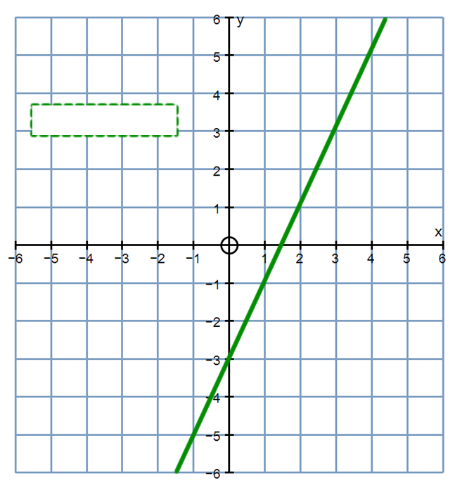
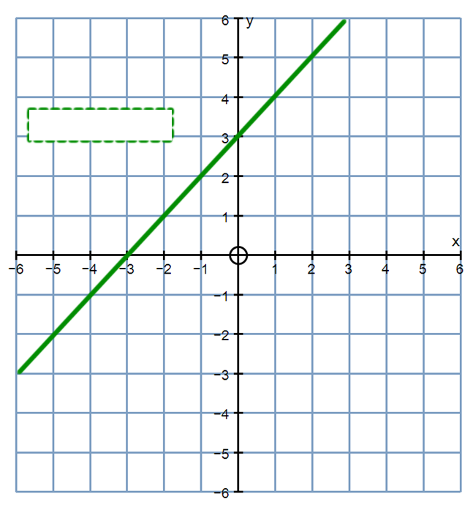
How is the y-intercept calculated?
$$y=−2x−3$$
$$y=x+3$$
-2 $÷$ 1 $=$ -2
It is the where the line crosses the y-axis.

Slide 12
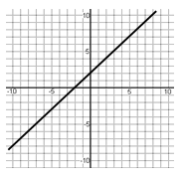
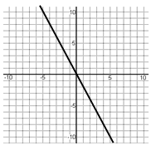
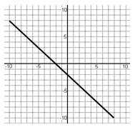
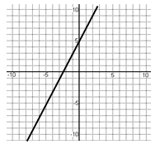
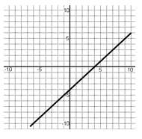
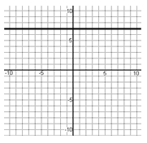
Match each line to its equation
There will be two equations left over.
$$y=x+2$$ | $$y=x−4$$ | $$y=3x$$ | $$y=−2x$$
$$y=2x+5$$ | $$y=−x+3$$ | $$y=−x−2$$ | $$y=7$$

Slide 13
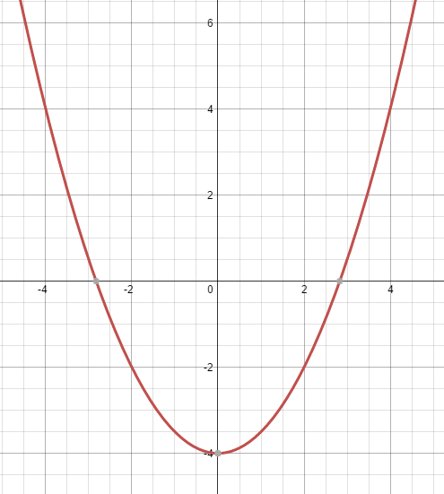
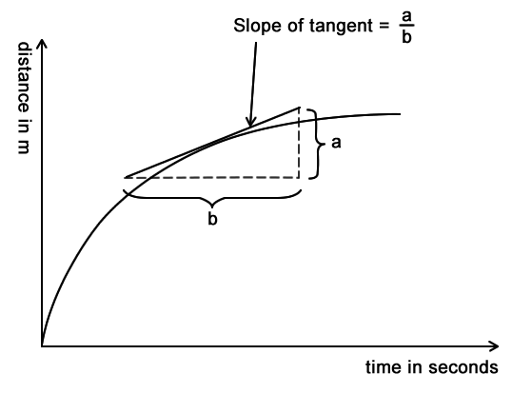
What does the tangent on a curve represent?
A curve has an infinite number of tangents.
Each one has a different gradient.
Each one represents the rate of change of the variable at that point.
Gradient

Slide 14
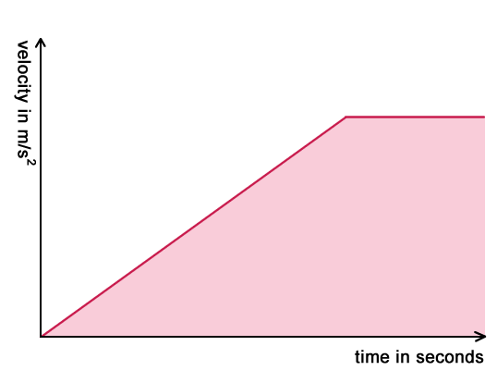
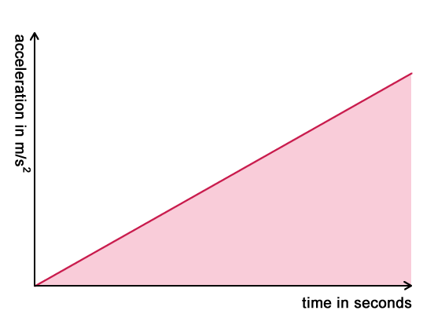
What does the area under a curve represent?
It depends on what the graph represents!
The area under a velocity/time graph gives displacement.
The area under speed/time graph gives distance.
The area under an acceleration/time graph gives velocity.

Slide 15
Some questions to try from Exampro
GCSE Maths F

Slide 16
GCSE Maths F

Slide 17
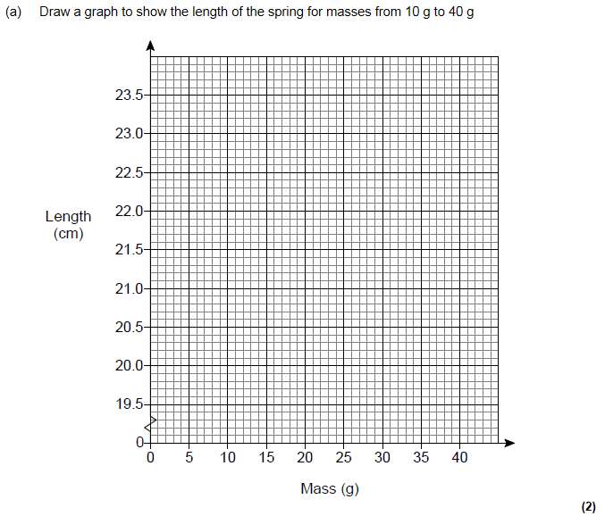
GCSE Maths F

Slide 18
GCSE Maths F

Slide 19
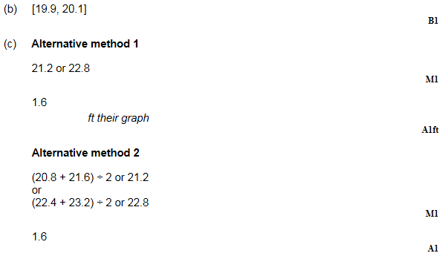
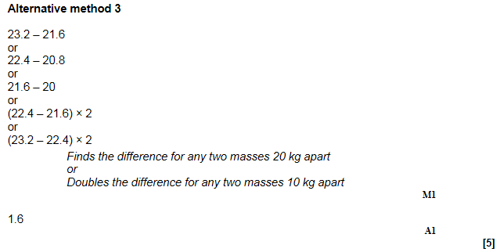

Slide 20
GCSE Biology sample assessment materials

Slide 21
GCSE Biology sample assessment materials

Slide 22
GCSE Physics sample assessment materials

Slide 23
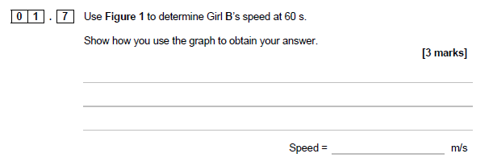
GCSE Physics sample assessment materials

Slide 24
GCSE Physics sample assessment materials

Slide 25
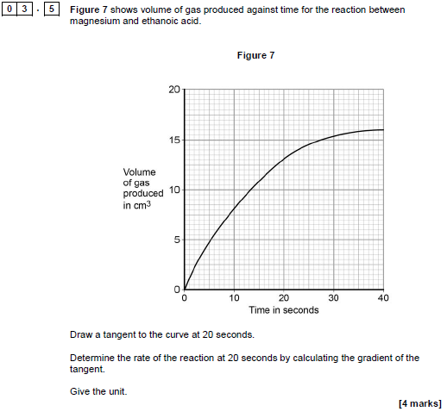
GCSE Chemistry sample assessment materials

Slide 26
GCSE Chemistry sample assessment materials

