Slide 1
September 2021

Slide 2
Discover your true passions
Some examples of past projects:
\
\
\
\
\
^{To research,} plan and produce (own needlework) an eighteenth century ball gown.
^{Can true} ^{happiness} ^{be found in a} ^{single moment?}
^{To what} ^{extent do genetic} factors contribute to a propensity towards addiction in humans?
^{How dimples} ^{affect the aerodynamic} ^{drag of a} ^{golf ball.}
^{Should you} be concerned about mass surveillance?
\
\
\
\
\
^{Could} hydro-electric power be created outside our ^{front door?}
^{How sustainable} ^{is the financial inequality} ^{between teams} ^{in the English Premier League?}
^{How can we} ^{help those suffering} ^{from elderly loneliness?}
Can emergency whistles be optimised for design and ^{use in rural environments?}
^{Construction} and testing of a small-scale hybrid rocket motor.
Notes:
This isn’t your ordinary A-level. You really can do an EPQ in anything. What are you passionate about? What annoys you? What have you always wanted to know more about?
Take a look at some of these examples of past EPQs.

Slide 3
Be seen by universities

Slide 4
Be seen by universities
\
\
\
Increase chance of achieving A-level A*-B by up to 29%
Worth half an A-level in terms of UCAS points
Learn how to work independently on your own topic
\
\
\
Receive lower offers from some universities
Discuss in university interviews
Learn how to research and reference
Notes:
Do you want to stand out from the crowd when applying to University? Studies have shown that you’re a-level results can improve by up to 29% when studying for an EPQ at the same time.
Gain an extra half an A-level in UCAS points if you choose EPQ as your fourth option.
Make a strong first impression in your university interviews with your EPQ as a discussion point.
Impress your professors and get ahead of the class by learning how to reference before you’ve even attended your first seminar.
(Increase chance of achieving A-level grades A*-B by up to 29% - B Jones 2015 aqa.org.uk/about-us/our-research/research-library/paper?path=does-extended-project-qualification-enhance-students-gce-level-performance )

Slide 5
Set yourself apart from the rest

Slide 6
Set yourself apart from the rest
Less likely to leave university after the first year
University of Southampton and Thompson, 2018
Notes:
Studies have shown that you’re more likely to progress to second year with an EPQ under your belt. This graph shows students from Southampton university and the difference in those that stayed in with an EPQ, to those that didn’t

Slide 7
Set yourself apart from the rest
More likely to obtain 1st or 2:1
^{Thompson and Jones}
⁽²⁰¹⁶⁾
University of Southampton and Thompson, 2018
Notes:
Studies also show that students who completed an EPQ went on to get better results in their degrees.

Slide 8
Be seen in the workplace

Slide 9
Be seen in the workplace
\
\
\
Gain
CV-worthy skills
Learn how to interview
Improve your planning skills
\
\
\
Learn how to reflect on work and suggest improvements
Improve your time management
Build your abilities in conducting research
Notes:
Even if Higher Education isn’t your end goal, or you’re looking beyond Higher Education, completing an EPQ will set you up with some key skills for the workplace, including interviewing, conducting research, time management and planning.

Slide 10
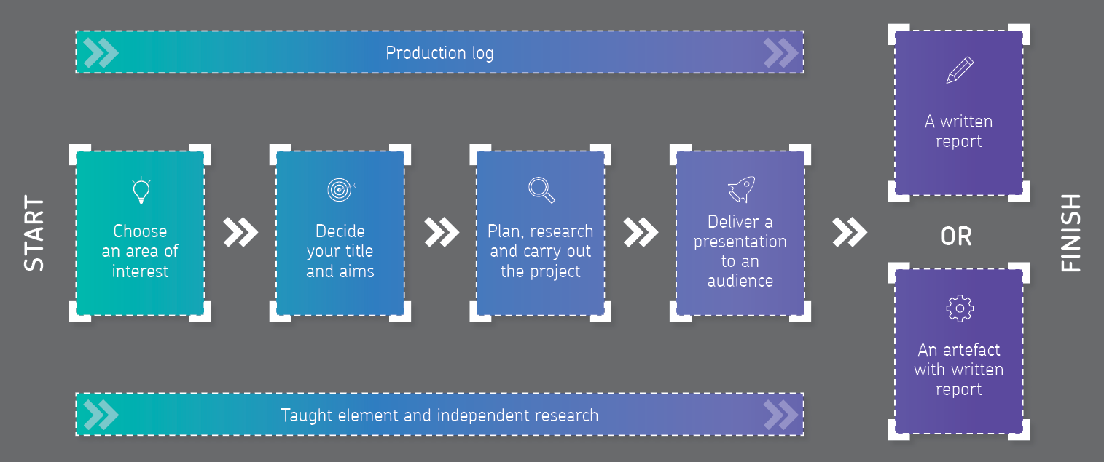
Where your journey starts: what’s in an EPQ?
Notes:
So what makes an EPQ?
An EPQ can take two formats: written or practical.
Your final piece will be either a written report, or you might take a more practical route, creating a piece called an artefact alongside a report.
The process is simple: choose your interest, decide your title and aims, create your project, then present it to an audience.
This is all underpinned by lots of independent research and completing a production log, to track your progress throughout the project.

Slide 11
Presenting your passion
\
\
\
^{5000 words}
^{a formal academic report}
^{research based}
^{fully referenced.}
Minimum 1,000 word report and something you’d like to create, for example:
an engineered piece of work; a robot or a model aeroplane etc
a play that you’ve written and produced, and directed
an original musical composition
a computer programme or website.
^{Got a shared vision?} ^{Work in a group and} ^{create together, developing} your individual EPQ along the way.
^{Written report}
^{Artefact with written report}
^{Group projects}
“You’re really only limited by your imagination.”
Jen Obaditch, AQA Head of Curriculum and former teacher

Slide 12
30 hours supervised learning…

Slide 13
30 hours supervised learning…
Your EPQ coordinator will guide you through 30 hours of learning.
These may not be typical lessons and you could be:
learning from visiting speakers
visiting university libraries
completing online courses.
You’ll learn skills such as:
how to develop titles, questions and proposals
project management skills, including time management, planning techniques, and setting aims and objectives
research methods, including research ethics, analysis and evaluation, risk assessment and data collection techniques
report writing and presentation skills.

Slide 14
… at least 90 hours to be independent

Slide 15
… at least 90 hours to be independent
Independent research is the foundation of the EPQ.
You’ll:
carry out detailed research that informs the project product outcome and format
use a wide range of relevant resources
perform critical analysis and evaluation of resources
use a mix of sources to realise the project product outcome.

Slide 16
Log your progress and accomplishments

Slide 17
Log your progress and accomplishments
The production log is an ongoing record of your project’s progress. It’s a tool to track and manage the EPQ process. You will have ownership of it and it’ll be completed by you and your supervisor and coordinator.
The production log records:
the initial ideas, project proposal recommendation and approval
meetings you have with your supervisor
project planning, progress and decision making
development of your project from the initial ideas to summary and refection
your live presentation and Q and A
marking by your supervisor.

Slide 18
How EPQ works alongside your A-levels
Insert your method of delivery here
Notes:
Use this slide to add your school or college’s method of delivery.

Slide 19
Don’t just take our word for it!
It’s really opened up so many different things for me, changed my whole lifestyle and it’s really helped me at uni.
Kizzy, former student
I would have loved to have had the opportunity to learn referencing before going to university. It was always the thing that I really, really struggled with and was one of the reasons why I couldn’t quite understand why I wasn’t getting the marks that I wanted and I think EPQ students overcome that barrier almost straight away.
Dr Emma Thompson – 'Learn with US' transition leader at University of Southampton
What we see as teachers in the classroom is, the student developing some really wonderful skills, in terms of really growing as a human being, and growing as a young adult.
Jen Obaditch, AQA Head of Curriculum
If you want to get a head start on university-style work, the EPQ is great for introducing concepts like independent learning, research and time management.
Lucy, former student

Slide 20
Want to know more?
Insert your supervisor or coordinator’s contact information here
Notes:
Use this slide to add your coordinator and supervisor details.

